Slide 1
OSCE
JCM
2nd Jun 2021
Union Hospital

Slide 2
Case 1
32/M, good past health
c/o fever with cough for 3 days, vague chest discomfort.
He had bodycheck 1 year ago and the ECG was told normal.

Slide 3
1) Please describe the ECG finding
-Coved ST segment elevation and inverted T wave in V1/V2
2)What is the name of the ECG sign?
-Brugada sign
3)Apart from fever, name three other factors that can lead to this ECG change?
Ischaemia
Drugs
Sodium channel blockers eg: Flecainide, Propafenone
Calcium channel blockers
Alpha agonists
Beta Blockers
Nitrates
Cholinergic stimulation
Cocaine
Alcohol
Hypokalaemia
Hypothermia
Post DC cardioversion

Slide 4
4)What is the definitive treatment for this condition ?
-Automatic implantable cardioverter-defibrillator(AICD)
5)Apart from the ECG sign, name any three factors that need to be present before you decide for the treatment in 4)?
Documented ventricular fibrillation (VF) or polymorphic ventricular tachycardia (VT).
Family history of sudden cardiac death at <45 years old .
Coved-type ECGs in family members.
Inducibility of VT with programmed electrical stimulation .
Syncope.
Nocturnal agonal respiration.

Slide 5
Case 2
42/M
c/o dyspnea after waking up from sleep
Went out for dinner with friend last night
and drank 1 bottle of whisky
BP: 135/80, p: 85/min
SpO2: 96% in RA
Temp: 36.5
ECG: NSR, 90/min

Slide 6
1) Describe the CXR findings:
Pneuomediastinum(extraluminal gas along the left paracardiac border and parapharyngeal space), subcutaneous emphysema at right chest wall/shoulder
2)How would you classify the condition in 1)? and give one predisposing factor for each type
Spontaneous- any event that increase intrathoracic pressure e.g. coughing, vomiting, forceful defecation, severe asthmatic attack, recreational drug use
Secondary – any penetrating, blunt trauma, iatrogenic such as endoscopy, intubation

Slide 7
The patient was admitted for further management. On arrival at ward, he became increasingly distressed
BP: 100/70, P: 100/min, SpO2: 94%, temp: 37.5
)What are the possible complications? Name 2
Mediastinitis as in Boerhaave syndrome
Tension pneumomediastinum
Associated pneumothorax
4)Name two further investigations you would like to confirm your answer to 3)
-repeat CXR/USG
-CT thorax
-contrast esophagraphy with water soluble contrast
*Barium may cause mediastinitis
*upper endoscopy may miss a small perforation

Slide 8
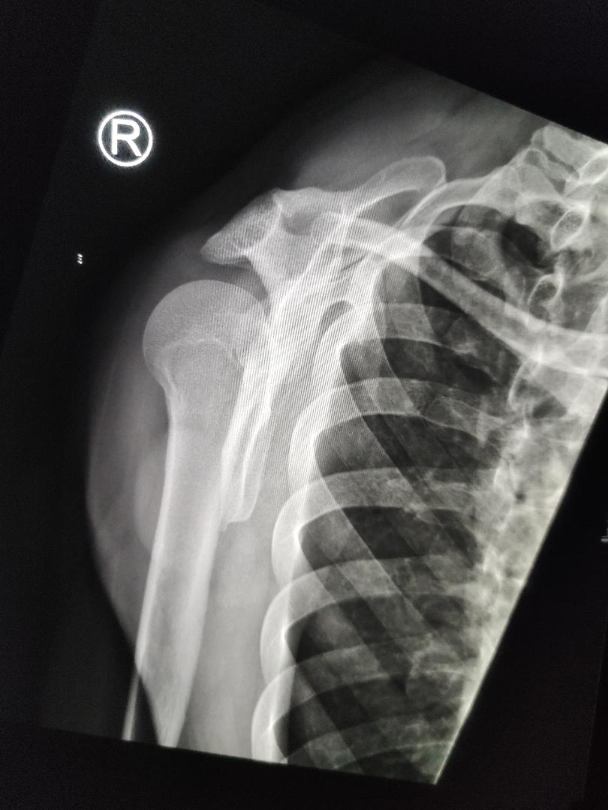
Case 3
20 year old man drunk last night and wake up from sleep
c/o right shoulder pain, excruciating pain when moving his right shoulder

Slide 9
1)What is the diagnosis?
Posterior dislocation of shoulder
2)Name four signs on the x-ray to support your diagnosis
AP view:
-internal rotation of humerus/ light bulb sign(+/-)
-rim sign: widened glenohumeral joint >6 mm
-trough line sign: dense vertical line in the medial humeral head due to impaction of the humeral head
-loss of normal half-moon overlap sign: the glenoid fossa appears vacant due to the lateral displacement of the humeral head
Y scapular view:
-slight posterior displacement of humeral head from the glenoid fossa

Slide 10
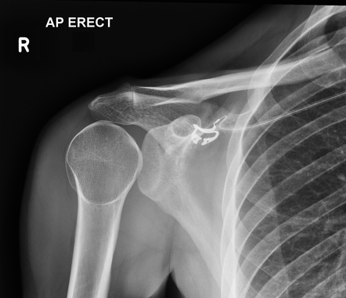
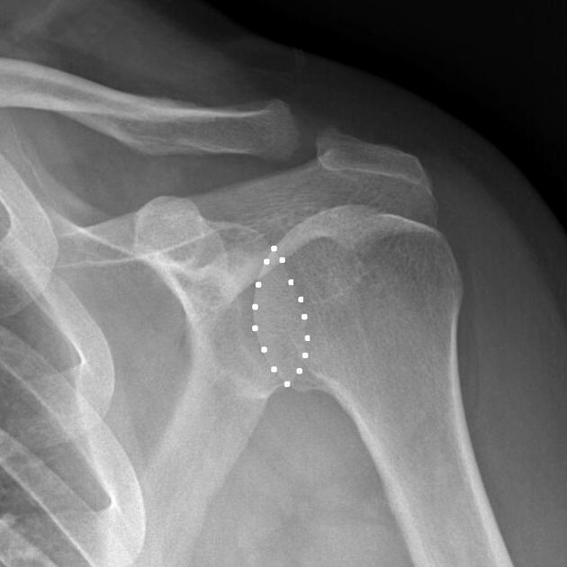
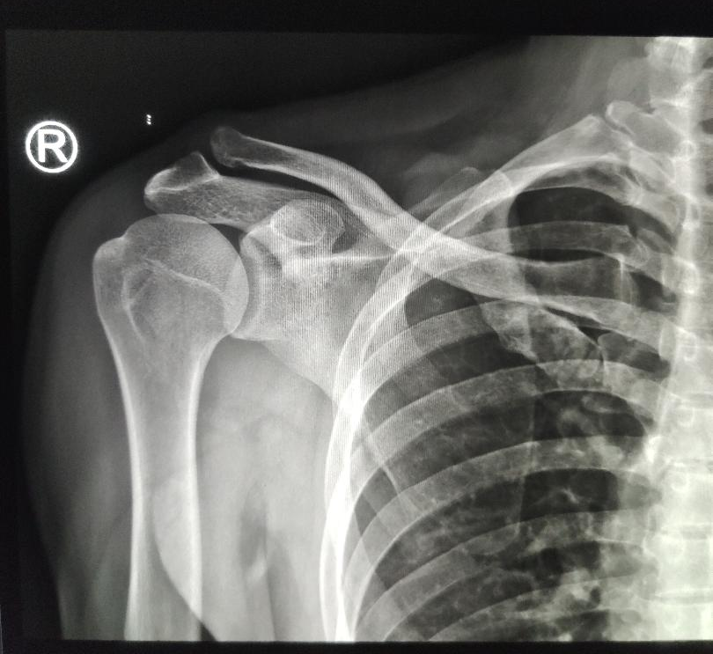
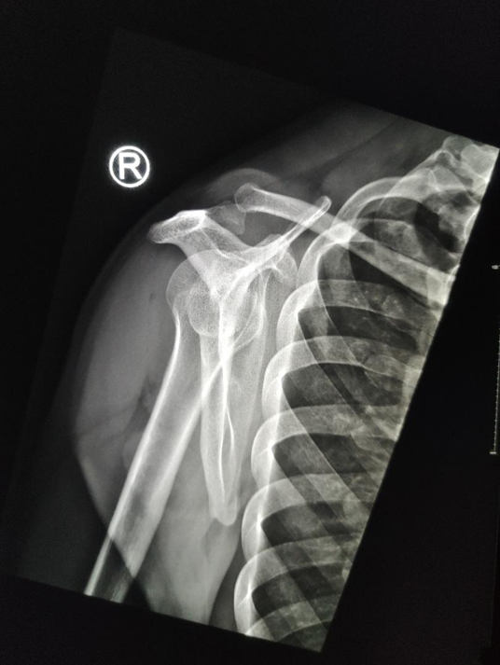
Light bulb sign
loss of normal half-moon overlap sign
Noraml AP & Y- scapular view

Slide 11
Trough line sign

Slide 12
3)Your senior does not concur with your findings, name two ways you can confirm your diagnosis at A&E ?
-Point of care USG
-Other X-ray views: Axillary view, Velpeau view, Modified trauma axial view, Wallace view
4)What are the complications associated with this condition? Name three
Stiffness/adhesive capsulitis
Recurrent dislocation (up to 50%)
Degenerative joint disease
Nerve injury(axillary, suprascapular)

Slide 13
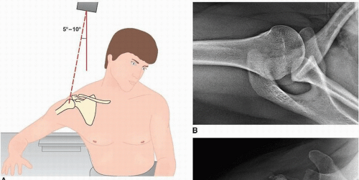
Axillary View
Velpeau view

Slide 14
Modified trauma axial view

Slide 15
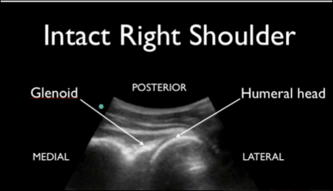
The shoulder joint should be immediately adjacent to the glenoid.
With an anterior dislocation, the humeral head will be deep on the screen, while with a posterior dislocation, the humeral head will be more superficial on the screen (closer to the probe).

Slide 17
Case 4
60/F, head injury at 8am
S/F with head contusion, c/o persistent headache
GCS 15/15

Slide 18
1)Describe the CT findings.
Thin rim of hyperdensity lesion at right parieto-occipital region, no midline shift
2)What is your differential diagnosis and list 3 points to differentiate the diagnosis
Subdural haematoma, epidural haematoma
Shape: crescentic vs biconvex
Suture crossing: subdural but not epidural can cross suture
Fracture association: usually in epidural haematoma

Slide 19
3)What are the factors to be considered when deciding the need for operation?
Thickness of clot (>10mm)
Midline shift(>5mm)
Change in GCS (>=2 points from time of injury to hospital admission )
Pupillary reaction (asymmetrical or fixed & dilated pupils)
Age(elderly has poorer prognosis)

Slide 20
The CT film was interpreted by the attending EM physician as normal and discharged. Patient was found confusion the next day, GCS 12/15, BP: 190/60, HR: 50/min, Hstx: 5.6mmol/l. You reviewed the film and suspected there was raised intracranial pressure from the pathology. However the CT room is currently occupied with another patient.
4)Name one bedside investigation you can do to confirm your diagnosis.
-transorbital/ocular Ultrasound
5)Describe what abnormalities you expect to see.
-Increased optic nerve sheath diameter
-Elevation of optic disc
-discrete, anechoic fluid collection within optic nerve sheath

Slide 21
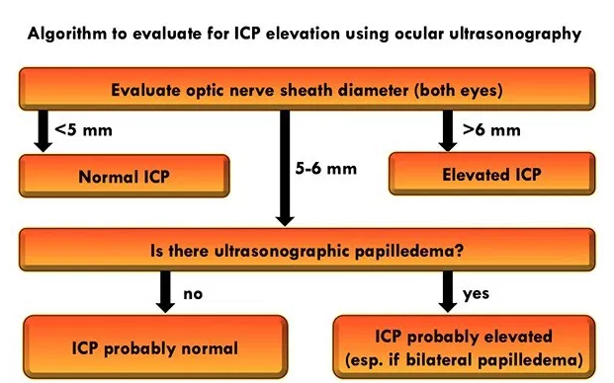

Slide 22
Case 5
3/F,
c/o sudden onset of sob while running at the playground

Slide 23
1)Please comment on the x-ray
hyperinflated left lung(hyperlucency of left lung, depressed left hemidiaphragm)
2)How can you specify in your chest x-ray order form in order to better delineate the pathology?
Inspiration/expiration (demonstrate the secondary signs of the ball-valve phenomenon)
Bilateral Lateral decubitus film(affected lung will appear to be hyperinflated on both radiographs; in the obstructive foreign body there will be air-trapping and therefore hyperlucency of the dependent lung)
3)Name two possible diagnoses
-Foreign body aspiration left lung/bronchus
-neoplasm
-mucus plug
-Granulomatous disease eg sarcoidosis

Slide 27
4)What further investigation can you do?
-multidetector CT thorax
-Bronchoscopy
5)What are the possible complications?
-atelectasis
-pneuomonia, lung abscess
-Bronchiectasis
-pneumothorax, pneumomediastinum
-bronchial stenosis

Slide 28
~End~

