Slide 1
JCM OSCE
Dr Cheung Calvin Ka Wai
Resident Trainee
Department of Accident and Emergency, Ruttonjee Hospital

Slide 2
Case 1
A 73yo woman presents to the emergency department with neck pain, palpitations, dyspnea and hoarseness of voice for 2 days.
History of multinodular goitre on Carbimazole
A chest X-ray was done

Slide 3
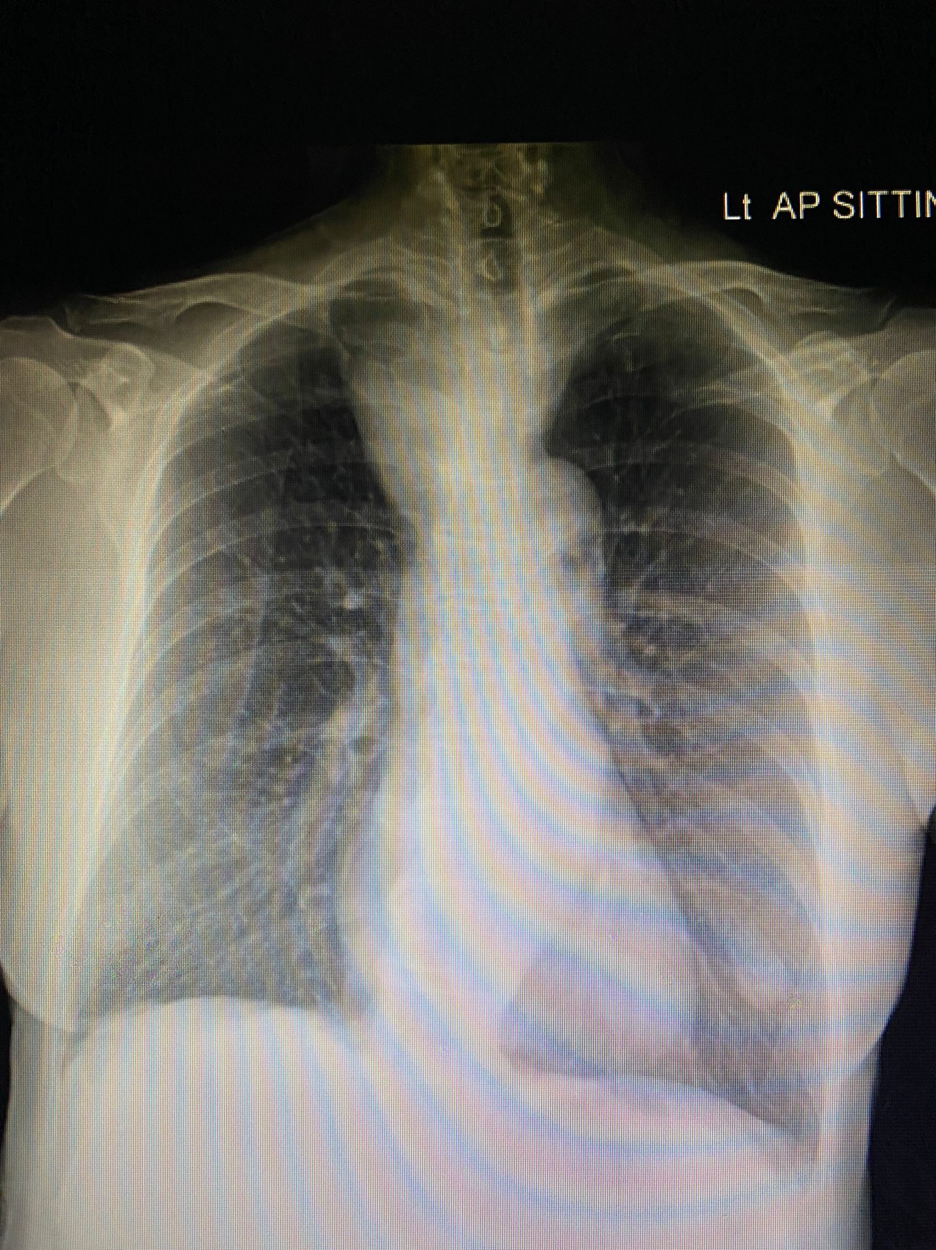
Describe the CXR (2 marks)

Slide 4
Right mediastinal oval shaped soft tissue mass
Trachea compressed and deviated to the left
Name 1 eponymous physical exam maneuver (1 mark) and the positive clinical findings for a syndrome this patient may present with. (2 marks)

Slide 5
Pemberton’s sign
Superior vena cava syndrome
Facial plethora, cyanosis and respiratory distress 1 minute after raising both arms to the ears
Name the most likely diagnosis (1 mark)

Slide 6
Right thyroid mass with retrosternal extension causing extrinsic airway compression
A lateral CXR was done

Slide 7
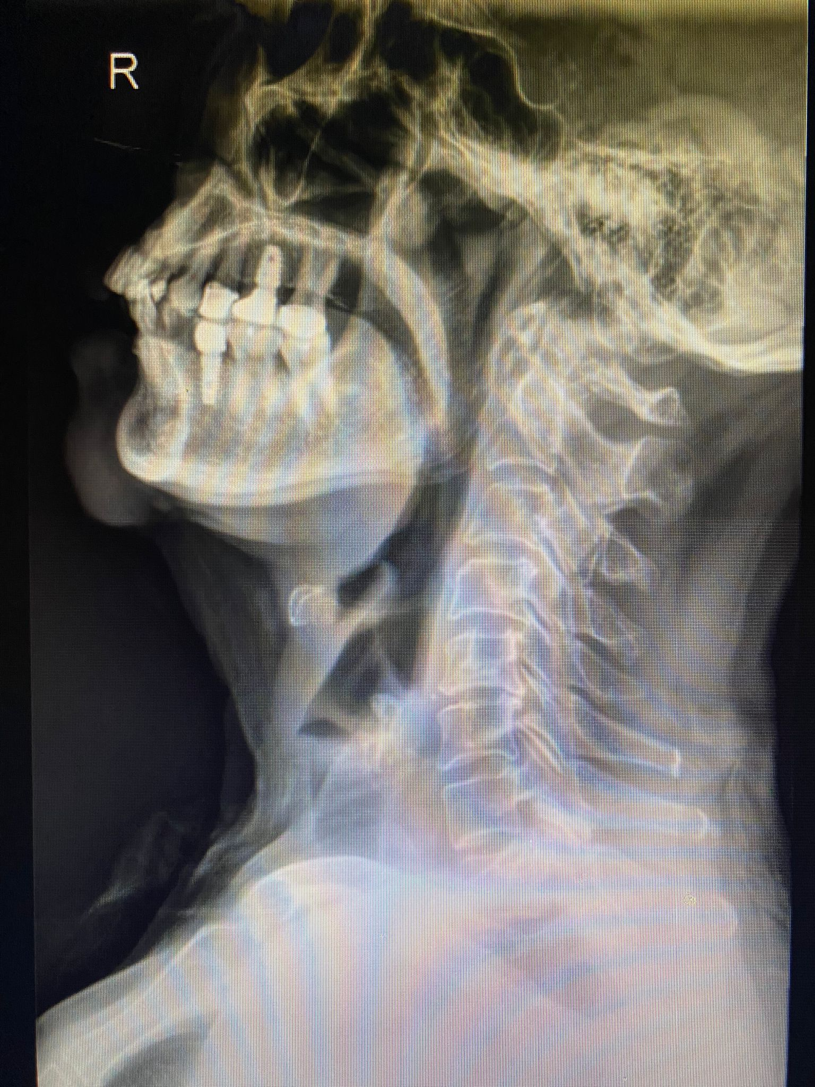
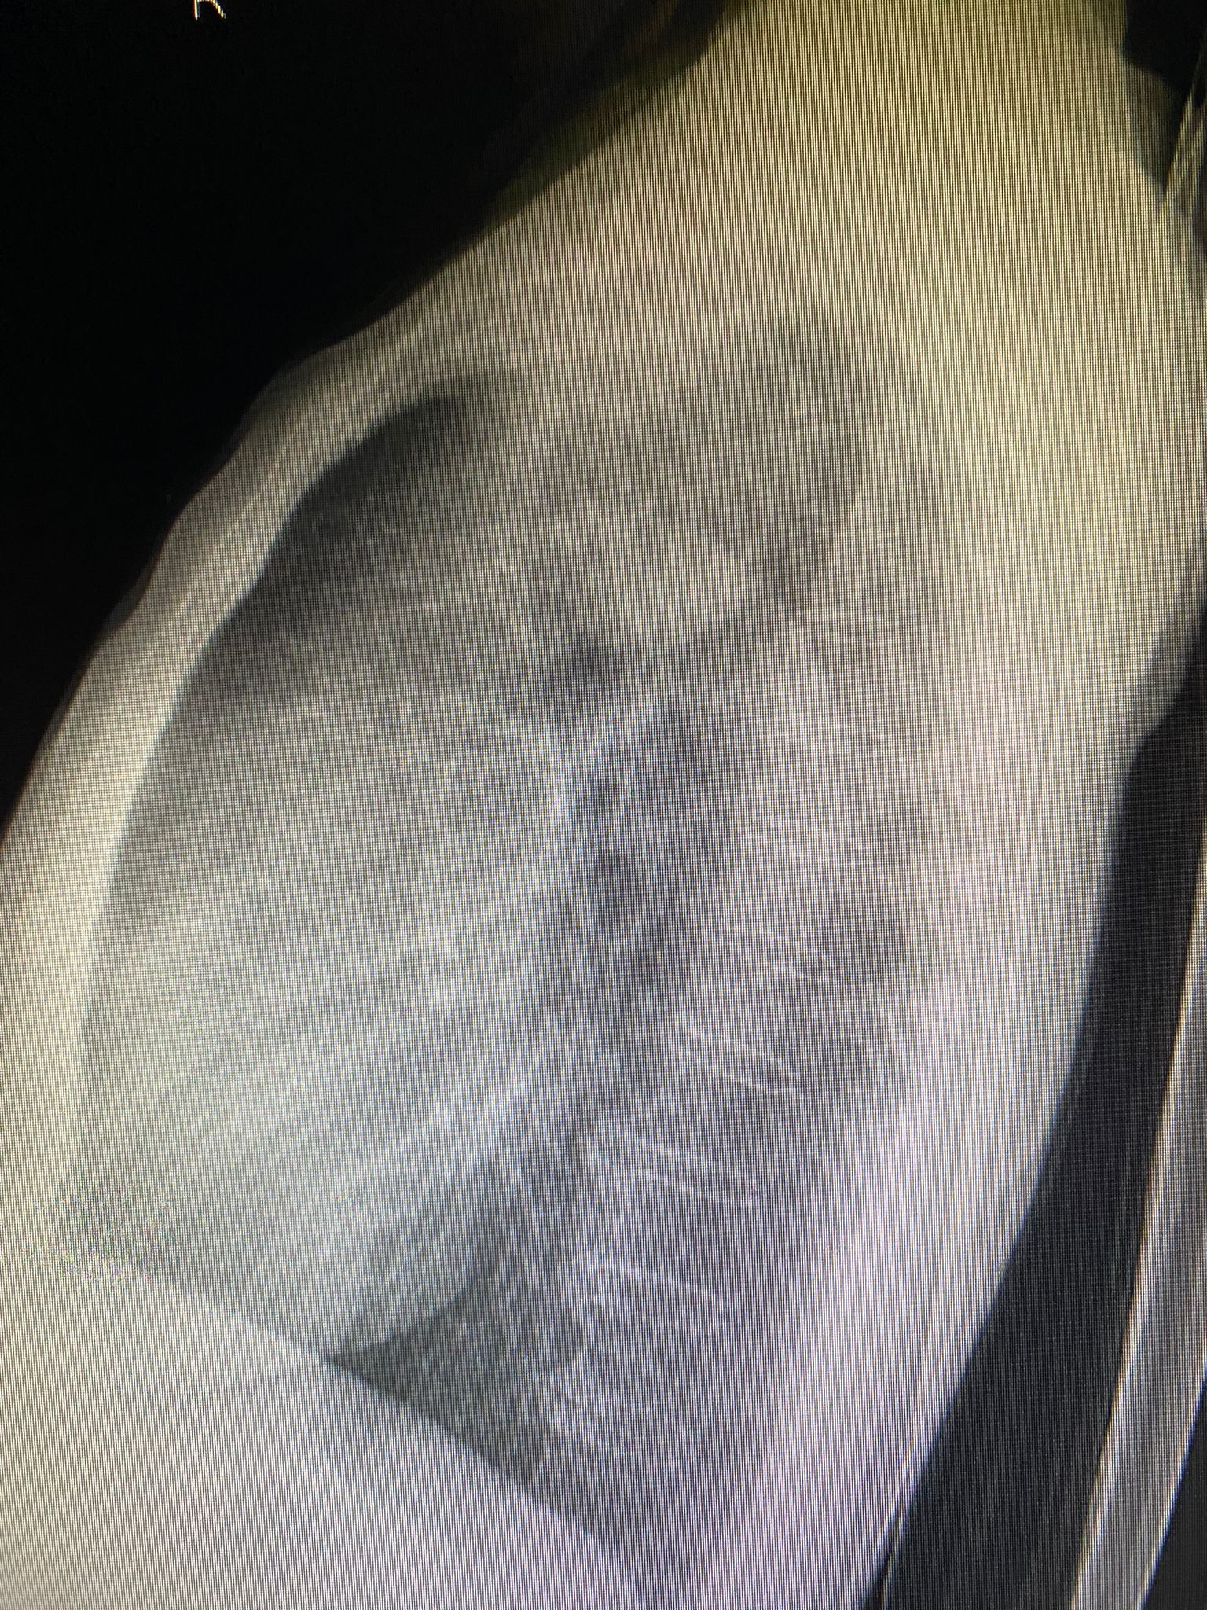
The case MO is preparing for rapid sequence intubation. What should be considered before intubating the patient? (4 marks)

Slide 8
Anticipate a difficult airway
Experienced specialist i.e. fellow, anesthetist, ENT / general surgeon on standby
Consider awake fiberoptic intubation or intubation with video laryngoscopy
Smaller sized endotracheal tube should be ready
Back up plan in mind e.g. surgical airway, retrograde intubation

Slide 9
Case 2
A 67yo woman presents to the emergency department with dyspnea, dizziness, nausea and drowsiness for 1 day after taking some unknown drugs.
SpO2 90% on 6L O2

Slide 10
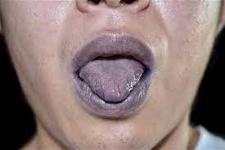
Name the PE finding (1 mark)

Slide 11
Central cyanosis
When ABG was being taken, the case MO found something unusual. Describe your finding. (1 mark)

Slide 12
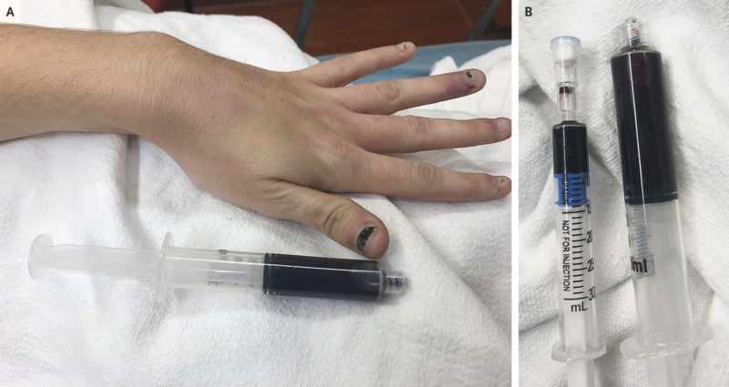

Slide 13
Chocolate brown blood
Name the clinical diagnosis in this lady. (2 marks)

Slide 14
Methemoglobinemia
ABG
MetHB level: 20.4%
CoHb level: 0.8%
Name 4 classes of drugs which can cause methemoglobinemia (4 marks)

Slide 15
Antibiotics e.g. trimethoprim, sulfonamides, dapsone
Local anaesthetics e.g. lignocaine, benzocaine
Massive overdose of Zopiclone
Nitrates, nitrites
Non drug causes
Vegetables e.g. carrots, beetroot, leafy greens
Aniline dyes
Suggest an antidote that can be given in the A&E. (1 mark)
What other treatment options can be considered? (1 mark)

Slide 16
IV Methylene blue 1mg/kg over 5min
Vitamin C if Methylene blue contraindicated e.g. known hypersensitivity / allergy
Supplemental O2
Hyperbaric oxygen therapy

Slide 17
Case 3
A 55yo man fell and landed on his right shoulder when a bus he was on suddenly braked
Attends AED complaining of right shoulder pain
Describe the X-rays. Give 1 positive and 1 negative radiological finding. (2 mark)

Slide 18
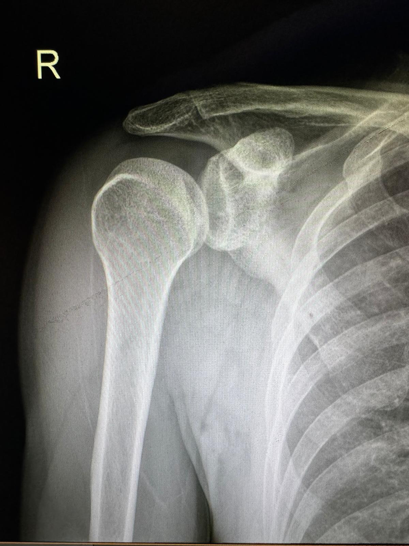
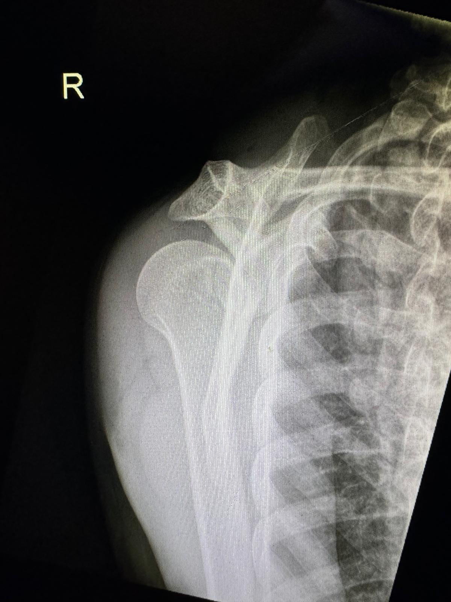

Slide 19
Lightbulb sign on AP film
No fracture
Posterior dislocation of the R shoulder
Name 2 expected findings on physical examination of this patient (2 marks)

Slide 20
Inspection / palpation
prominent posterior shoulder and coracoid process
Movement
Limited external rotation
Name 2 common non-traumatic causes for this injury. (1 mark)

Slide 21
Electrocution
Epileptic seizures
What is the immediate management in the AED setting (2 marks)

Slide 22
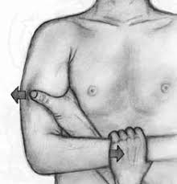
Attempt closed reduction in the AED +/- under procedural sedation
Immobilization by shoulder immobilizer / sling
Analgesia
DePalma method
Adduction + internal rotation
Followed by caudal traction
Push the humerus medial to lateral while maintain caudal traction
Name 3 possible complications of this condition (3 marks)

Slide 23
Acute re-dislocation
Recurrent posterior shoulder instability
Joint stiffness
Osteonecrosis of humeral head
Nerve injury: axillary nerve, suprascapular nerve

Slide 24
Case 4
A 70yo man presents to the A&E complaining of a left sole ulcer for 1 month
After some some soil and rocks got into his shoe and caused an abrasion
Self managed all along
Noted increased erythema, pain and discharge for 3 days
Also developed fever today

Slide 25
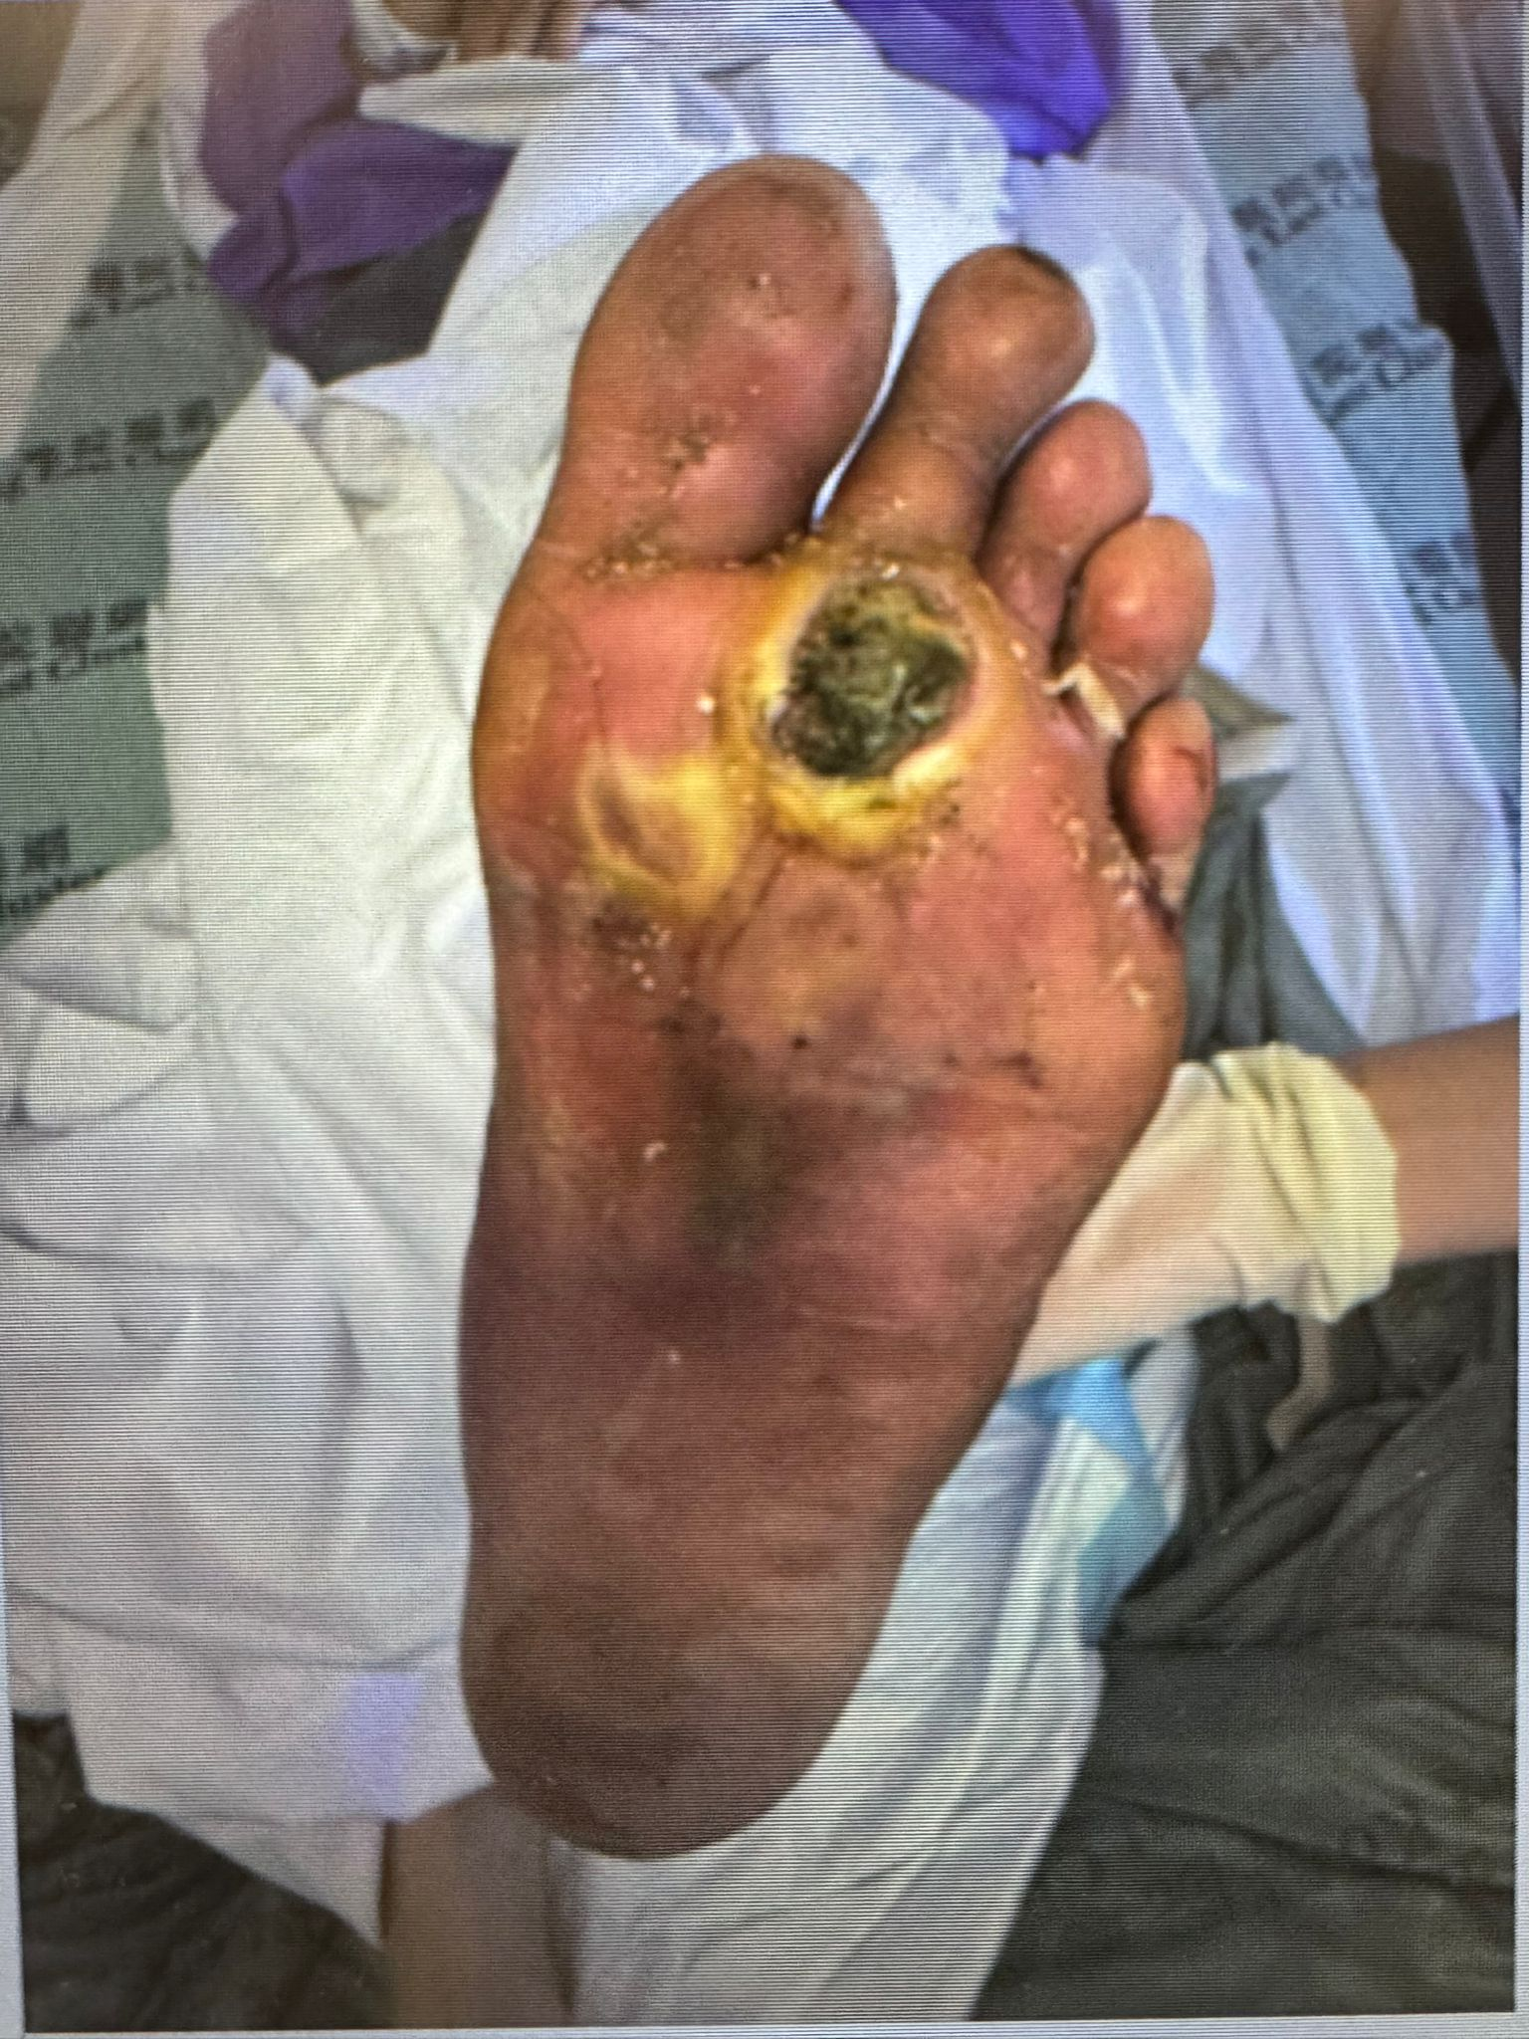
Name 4 things to look for on focused physical examination. (2 marks)

Slide 26
Presence of crepitus
Extent of erythema / lymphangitis
Any active discharge / bleeding
Neurovascular status: sensory deficit, distal pulses, capillary refill
Presence of foreign bodies
Regional lymphadenopathy
Suggest 2 differential diagnosis for this man. (1 mark)

Slide 27
Necrotising fasciitis
Gas gangrene / gas myonecrosis
Subcutaneous abscess
Describe the X-ray of his left foot (2 marks)

Slide 28
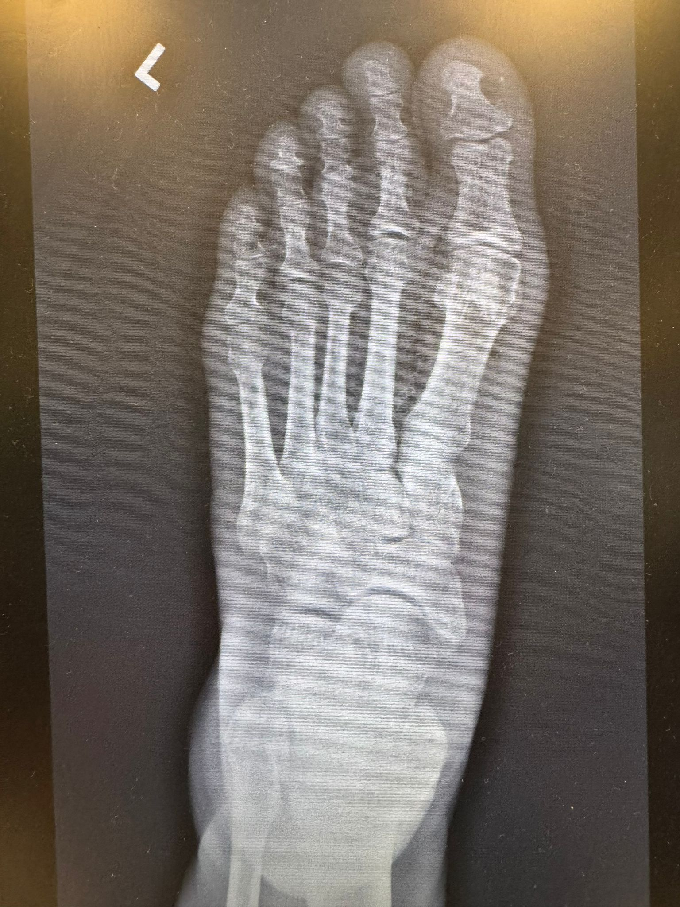
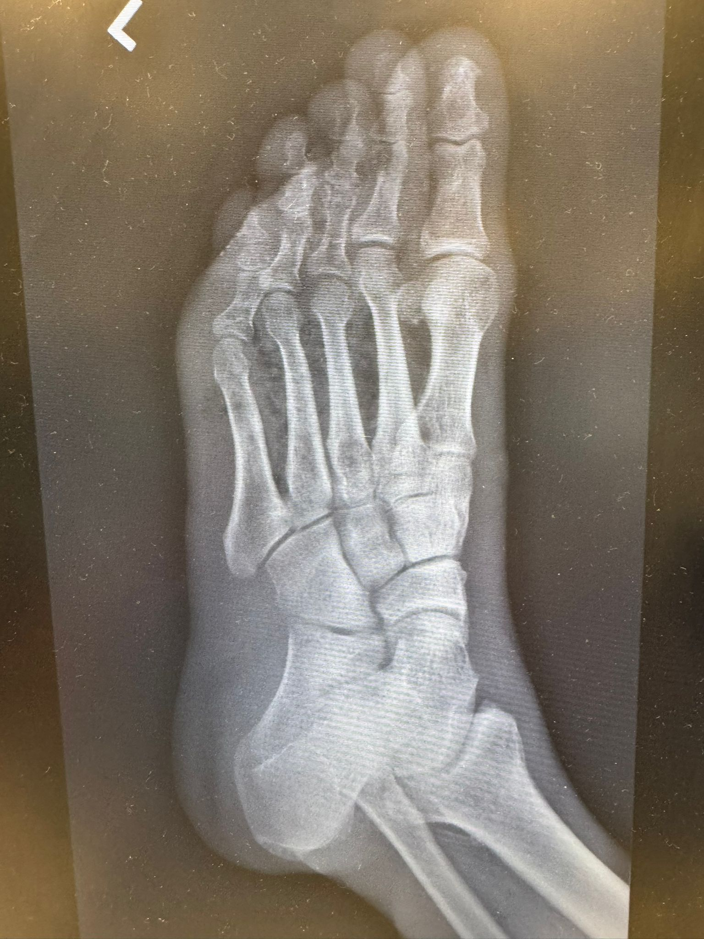

Slide 29
Gas pockets seen in soft tissue of left foot
Mainly over forefoot and midfoot
No osteomyelitic changes
No fracture
What is the most likely diagnosis for this man? (1 mark)

Slide 30
Gas gangrene / gas myonecrosis
Name 2 pathogens that may cause this condition. (2 marks)

Slide 31
Clostridium perfringens
Clostridium novyi
Clostridium septicum
List the management plan for this man. (2 marks)

Slide 32
Admission to orthopedics
Broad-spectrum IV antibiotics
Early aggressive surgical debridement after admission
Pain control

Slide 33
Case 5
A 40yo woman presents to the emergency department with suboccipital headache and bilateral neck pain (left worse than right), sore throat and globus sensation.
Pain is worsened by head rotation to either side

Slide 34
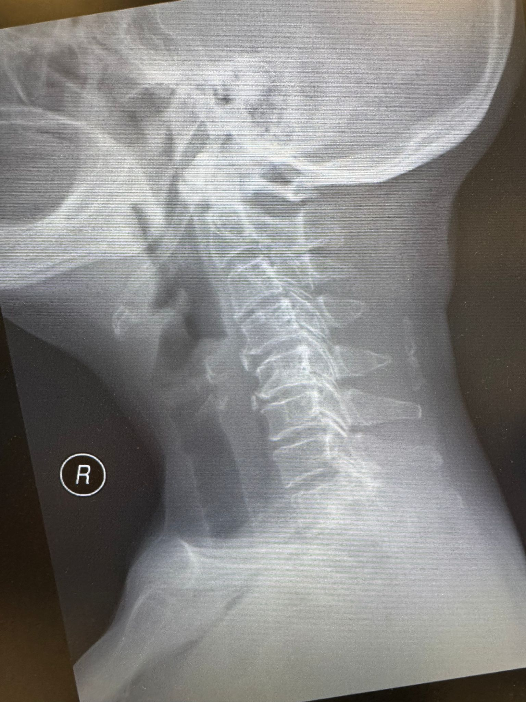
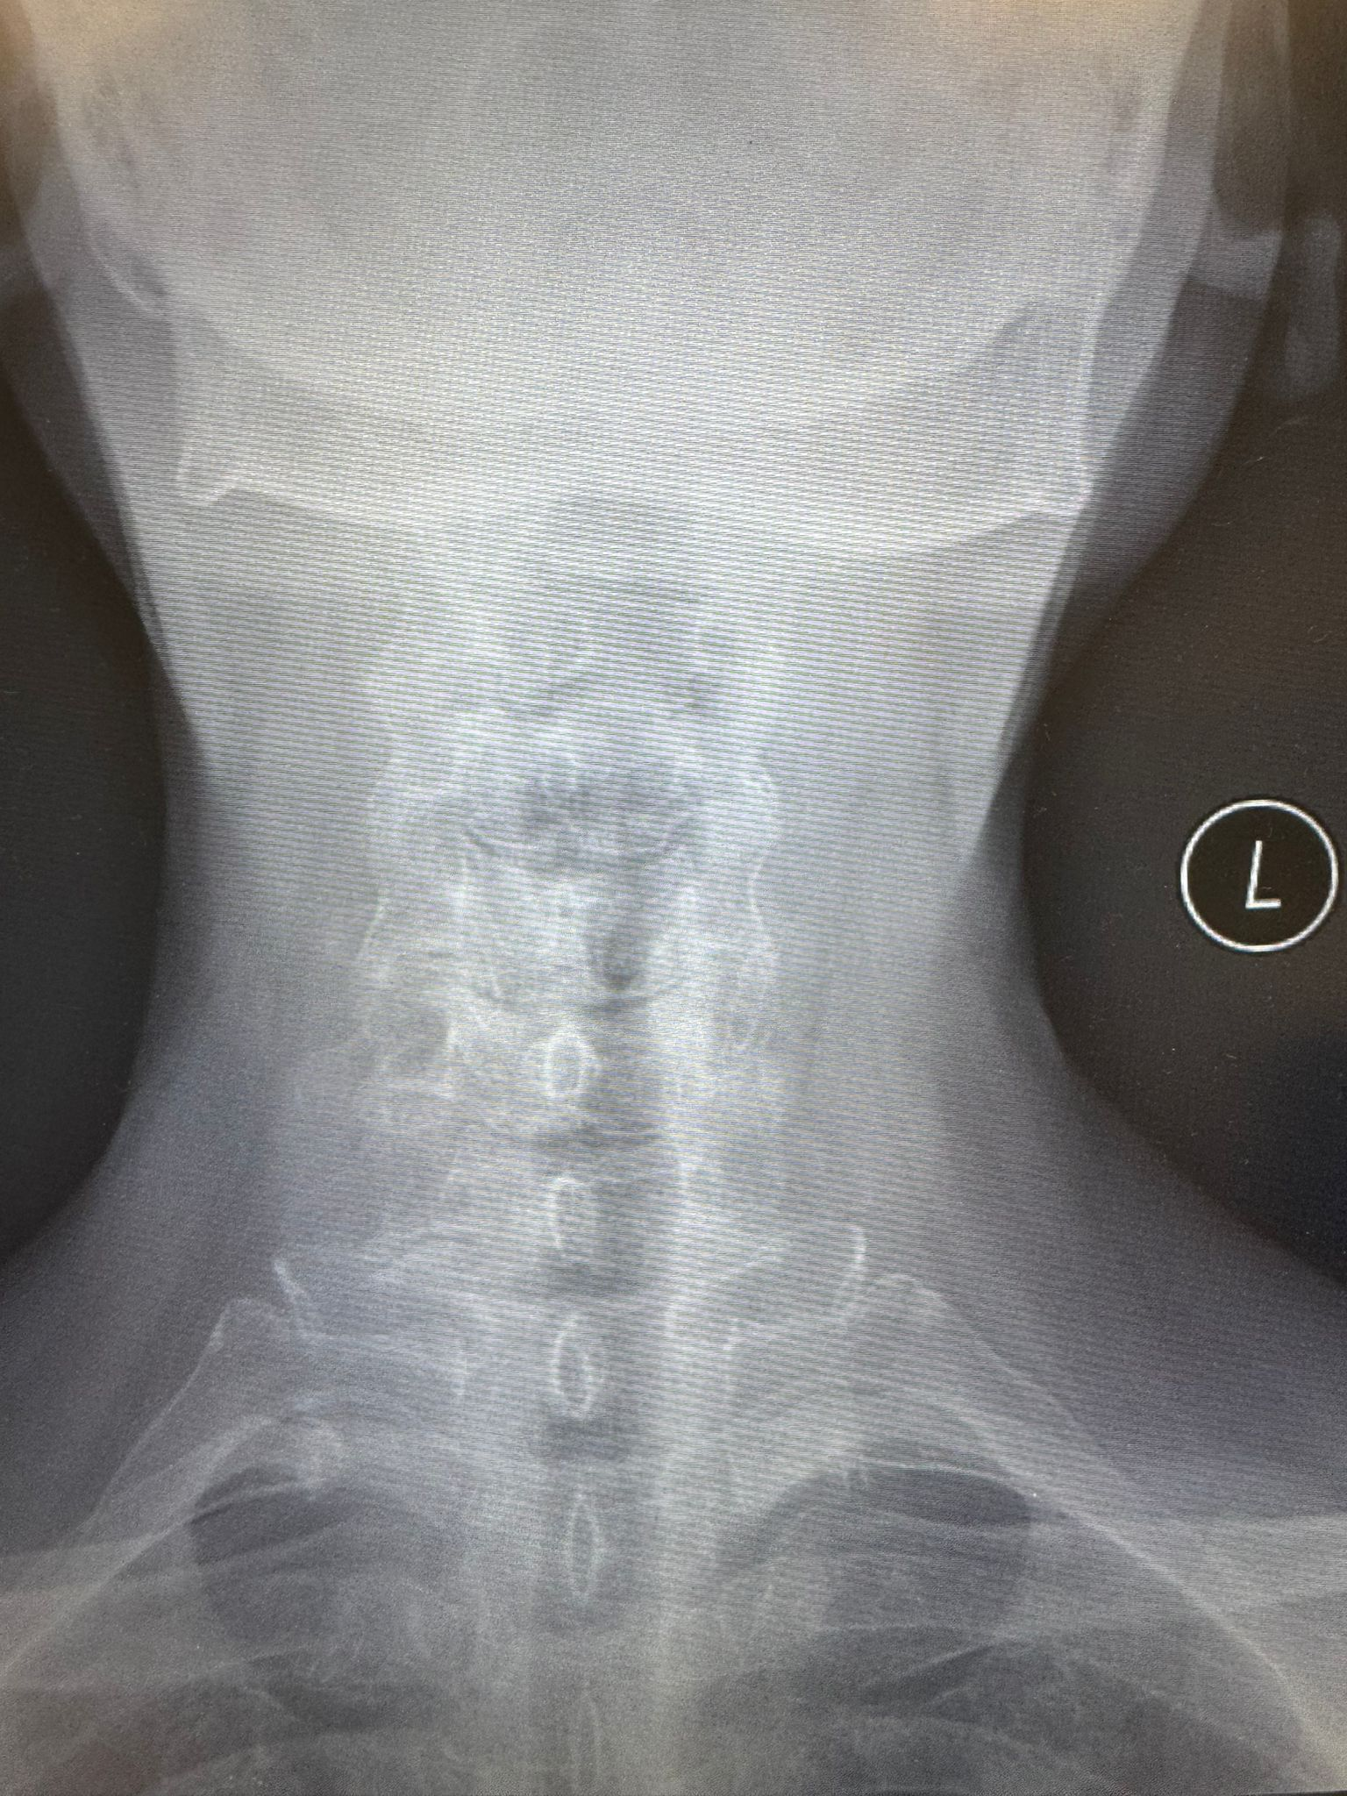
Give 1 positive and 1 negative X-ray findings to narrow down your differential diagnosis. (2 marks)

Slide 35
Positive finding: ossification of stylohyoid ligament
Negative finding: no soft tissue swelling / thumb sign, no fracture
Mild degenerative changes with narrowing of intervertebral disc spaces and osteophytes
Alignment unremarkable
What is the eponymous name of her condition? (1 mark)

Slide 36
Eagle syndrome
Name 4 potential complications of this condition. (4 marks)

Slide 37
Glossopharyngeal neuropathy
Impingement onto the carotid artery
Carotid dissection
Ischemic stroke
Sympathetic plexus irritation
Impingement onto the internal jugular vein (styloidogenic jugular venous compression syndrome)
Venous outflow obstruction
Give 2 treatment options for this patient? (2 marks)

Slide 38
Conservative: NSAIDs, steroid injection, physiotherapy
Surgical: styloidectomy / excision of the mineralized ligament

Slide 39
Case 6
A 18yo girl fell during high jump practice at school
Landed on outstretched left hand
Isolated injury

Slide 40
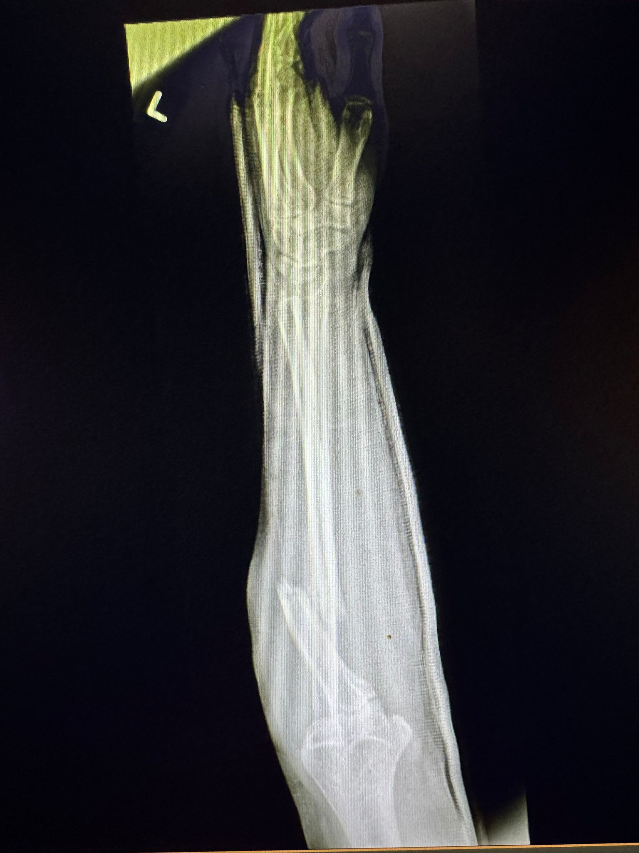
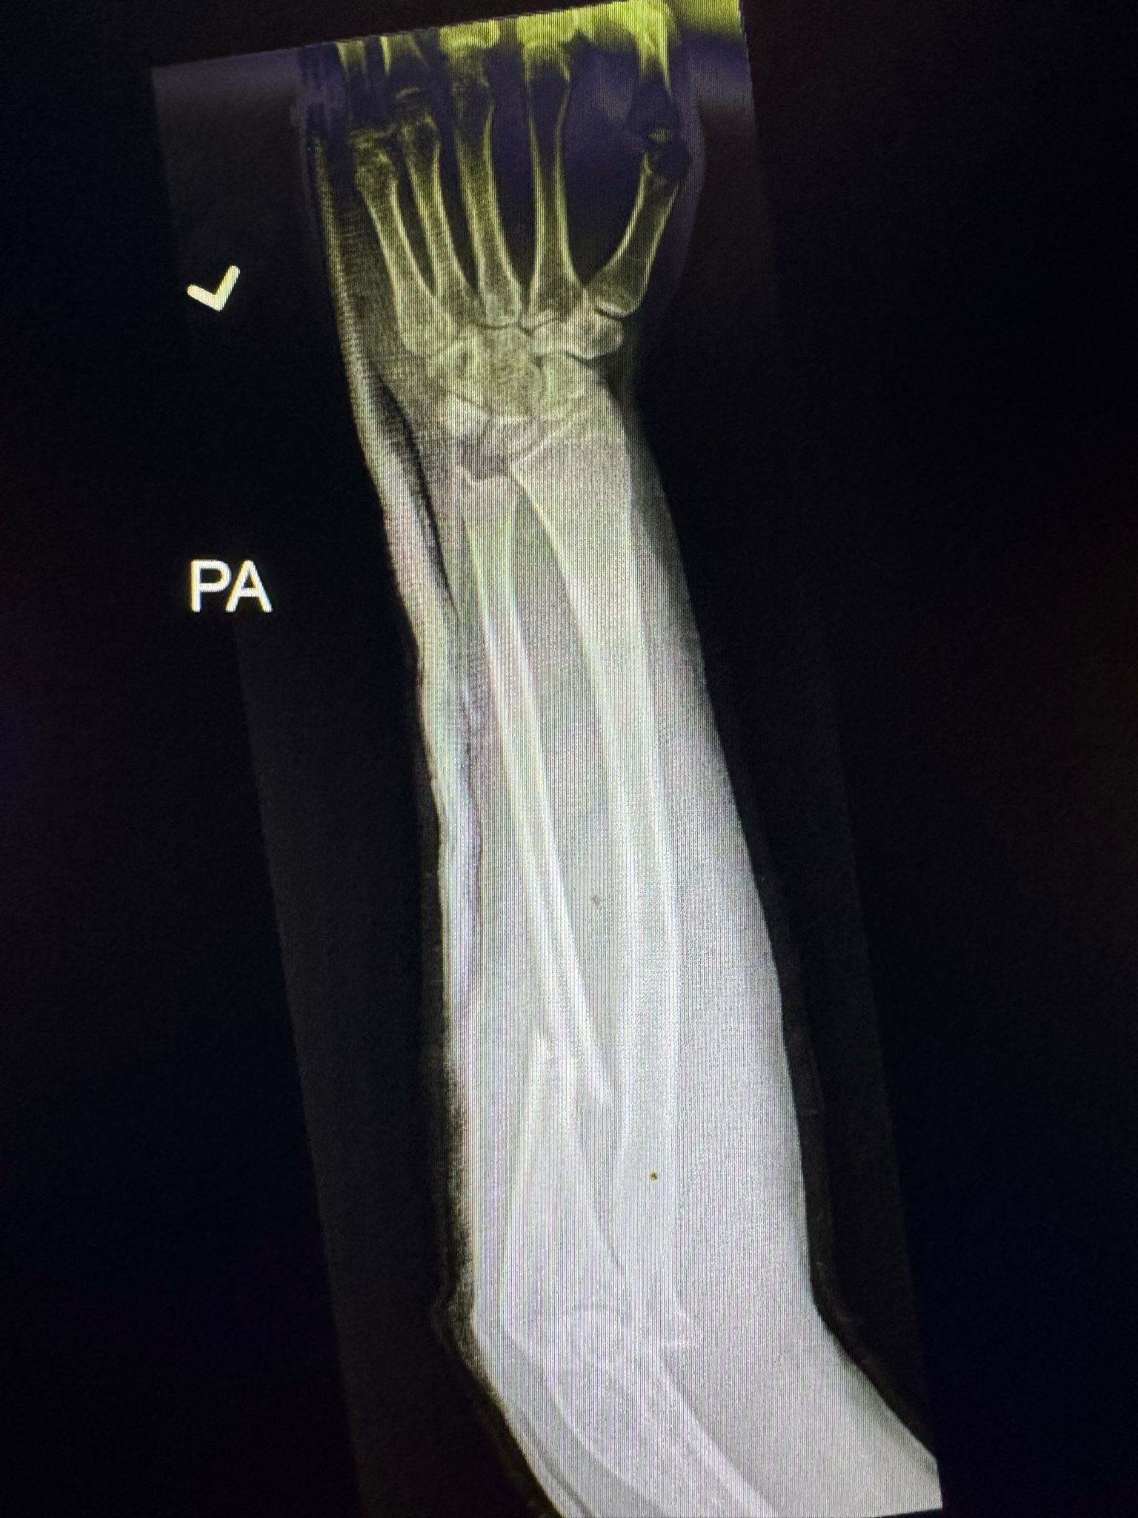
Describe the X-rays (2 marks)

Slide 41
Monteggia fracture-dislocation
Proximal 1/3 ulna shaft fracture
Dislocation of radial head
How are Monteggia fracture-dislocations classified? (2 marks)

Slide 42
Bado classification
I: anterior dislocation of the radial head
II: posterior dislocation of the radial head
III: lateral dislocation of the radial head
IV: anterior radial head dislocation, proximal third ulnar and radial shaft fractures
Name the definitive management for this patient (1 mark)

Slide 43
Open reduction, internal fixation
Name 3 possible complications of Monteggia fracture-dislocations (3 marks)

Slide 44
Posterior interosseous nerve (PIN) neuropathy
Nonunion / malunion with radial head dislocation
Elbow stiffness
Elbow osteoarthritis
What are the expected physical examination findings if she does indeed have PIN neuropathy? (2 marks)

Slide 45
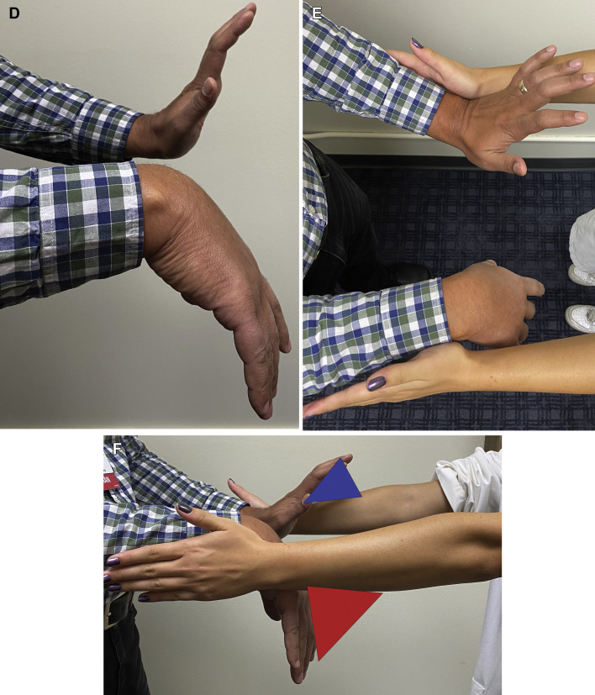
Hand radially deviated
Wrist in extension
Finger drop
Weakness of thumb extension
Weakness of MCP extension

Slide 46
Thank you!

