Slide 1
JCM OSCE 6/2025

Slide 2
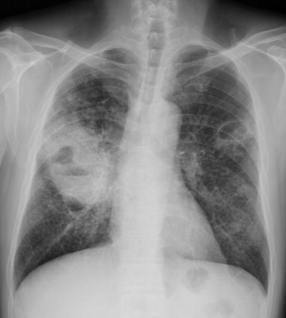
Case 1
A healthy man, aged 30 years, stayed in Thailand for 1 month and recently came back to Hong Kong.
He complained of persistent low grade fever, a productive cough for 1 week and three-week history of malaise.

Slide 3
Questions
Interpret the CXR
Blood culture shows Aerobic, gram-negative (“safety pin” appearance) motile saprophytic bacillus. What organism can it be and is endemic in South East Asia?
What urological manifestation does it associate?
What are the choice of antibiotics?

Slide 4
Case 2
Questions
What are the red flags of headache?
What specific physical signs will you look for?
What are the differential diagnoses?
She developed loss of consciousness with 4 limbs twitching and uprolling eyeball around 5 minutes while waiting in A&E. What is the most likely diagnosis?
What are the management?
31/F, GPH, ℅ headache x 3/7, insomnia, vomited undigested food x 3 times yesterday
Discharged from O&G yesterday after delivery
Now Postpartum Day 4
Vitals:
BP 165/86 P66 temp 37.3C SpO2 99% RA

Slide 5
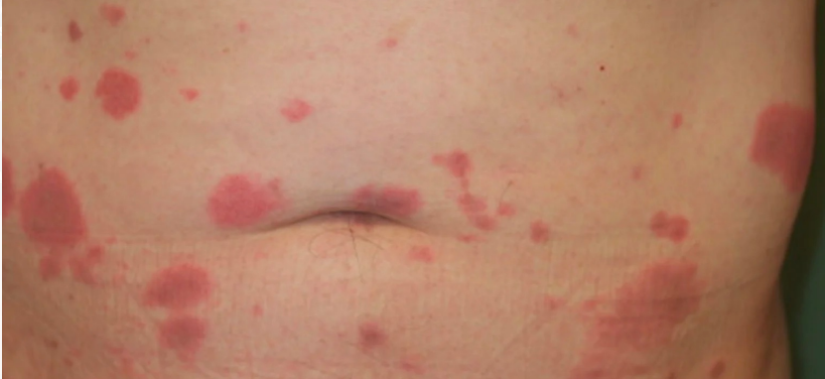
Case 3
A 50/F, history of Crohn’s disease, newly started on azathioprine.
℅ acute onset of painful, edematous, and erythematous plaques over abdomen, neck.
Questions
What diagnosis do you suspect?
How to confirm the diagnosis?
How will you manage this patient in A&E?
What hematological disorder is most frequently associated?
What is the first line treatment?

Slide 6
Case 4
Questions:
What immediate management will you do?
What are the differential diagnoses other than heat stroke? Name 4
A colleague suggest using succinylcholine as muscle relaxant. Do you agree?
What is the temperature target and cooling rate in heat stroke?
Should we use antipyretics such as paracetamol for temperature control in exertional heat stroke?
64/F, GPH, Street cleaner
Brought to A&E in 8/2024, found unresponsive on street
Vitals:
Temp 42 ℃ (tympanic)
GCS E1V1M1 on arrival
BP 92/49, P 154 sinus tachycardia
SpO2 86% via non-rebreathing mask

Slide 7
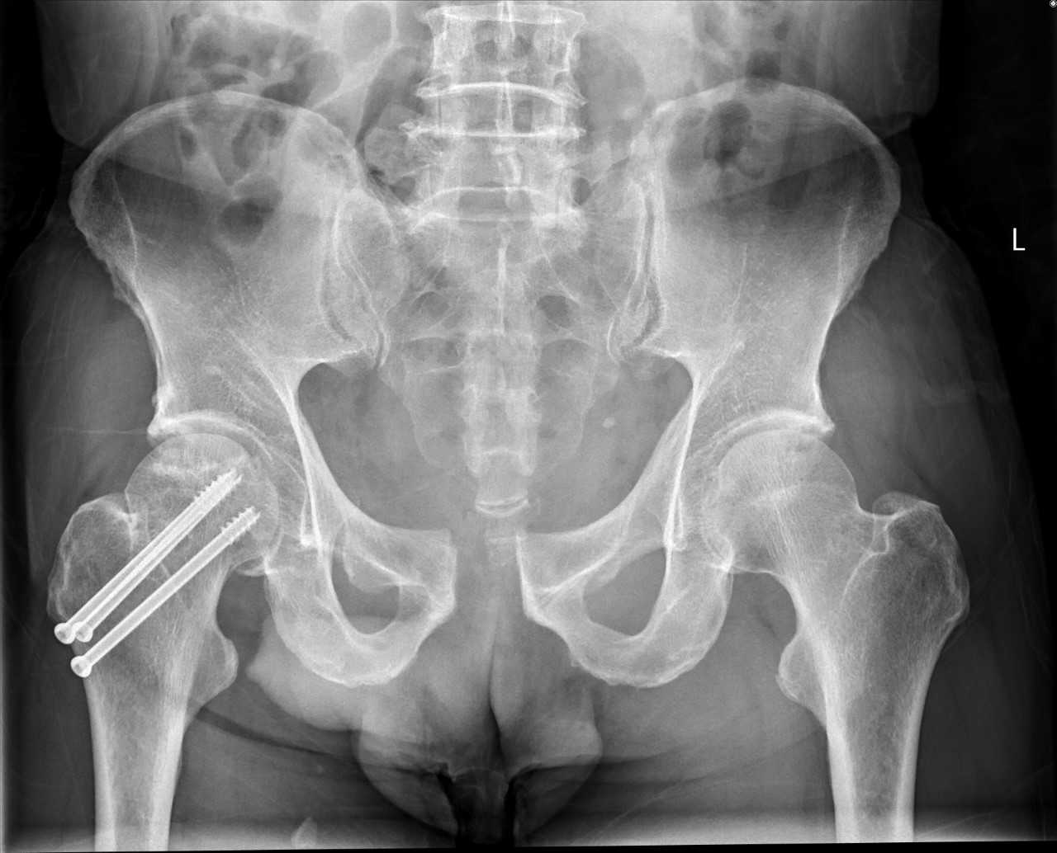
Case 5
A 70-year-old man c/o bilateral groin pain after riding a horse, with no prior history of falling.
Vitals:
GCS E4V5M6
BP 120/74 P110, SpO2 98% RA Temp 36
Xray of pelvis was performed

Slide 8
Questions
Interpret the xray
What is your next immediate step of management?
What are the classification scheme?
Give 3 complications associated with this injury.
What are the further management?

