Slide 1
HKCEM JCM OSCE
United Christian Hospital
2 July 2025

Slide 2
Case 1
M/3
Known Autism
Dry cough 2/12
Seen by GP, told reactive airway and Ventolin was given
Attended AED for no improvement
Vital signs
BP 107/73 p 143/min
SpO2 97% room air
Temp 36.8°C

Slide 3
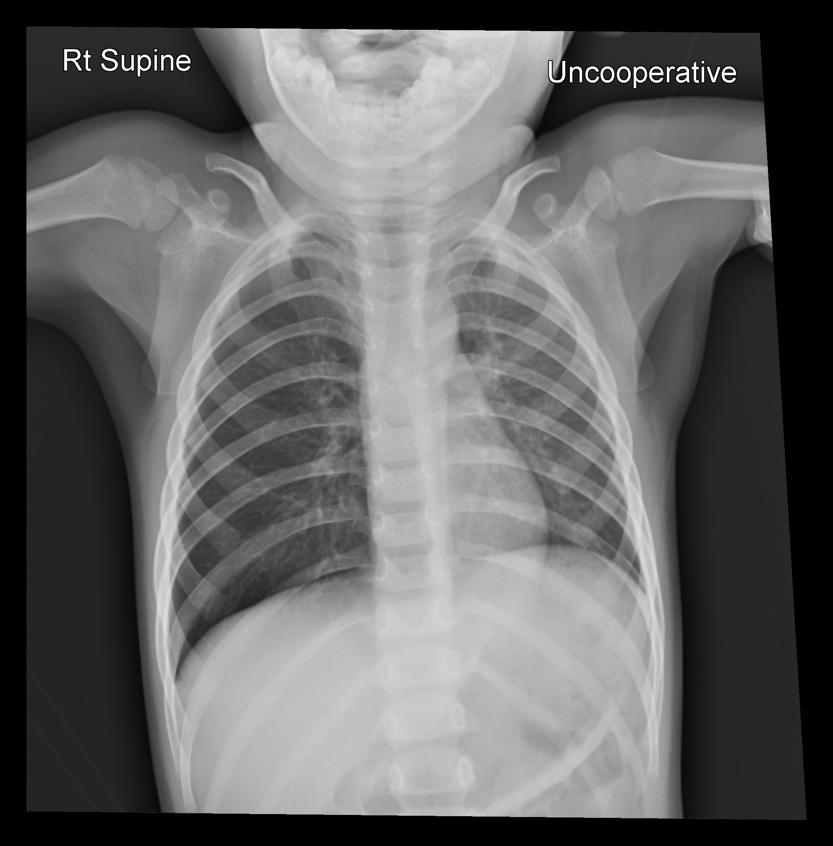

Slide 4
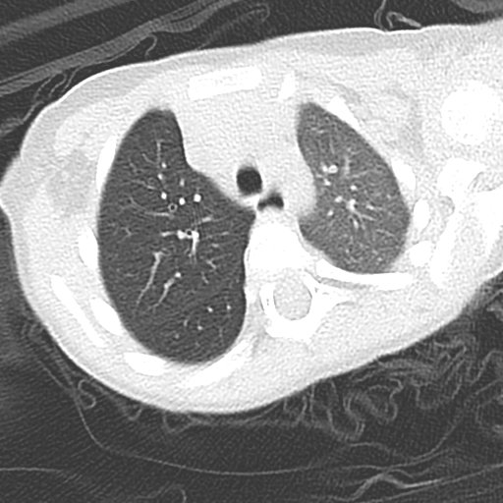
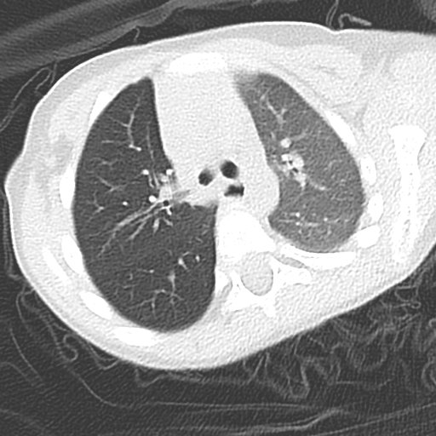
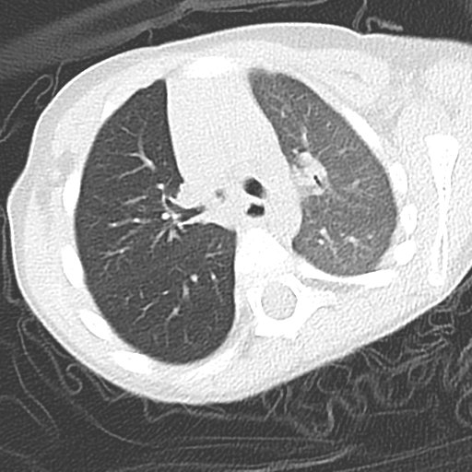

Slide 5
Case 1
What are the abnormal CXR findings? (2 points)
What are the abnormal CT findings? (2 points)
What is the definitive management? (1 point)

Slide 6
Case 2
F/89
Known chronic rheumatic heart disease
Complains of SOB for three days
Vital signs
BP 124/64, pulse 88/min
SpO2 98% on 2L O2
Afebrile

Slide 7
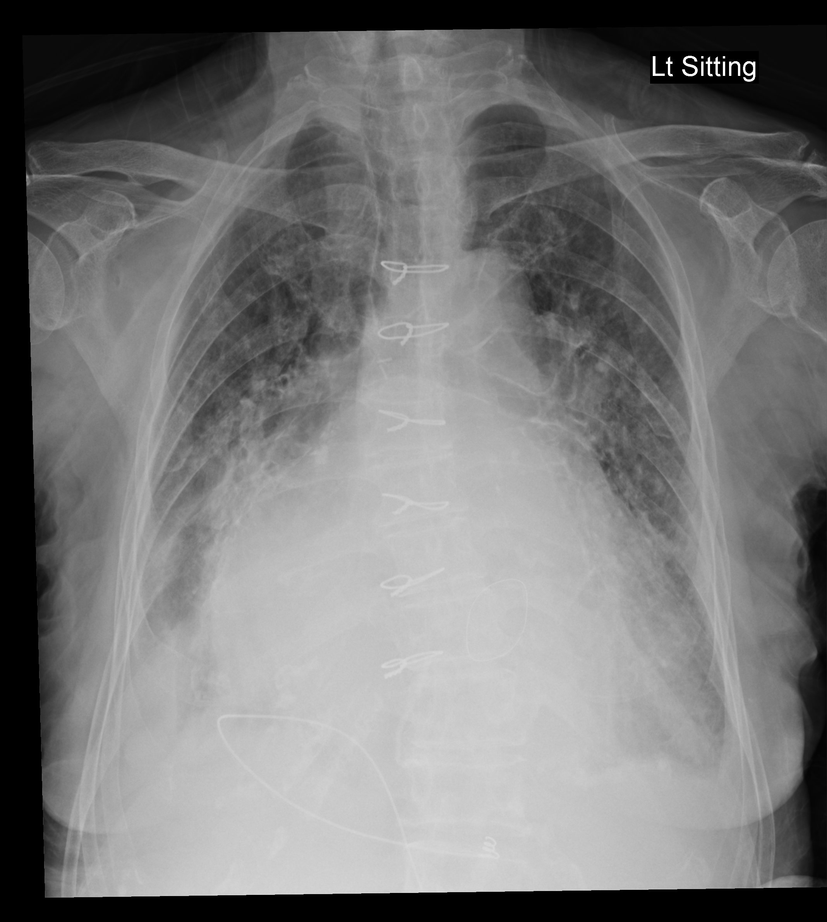

Slide 8
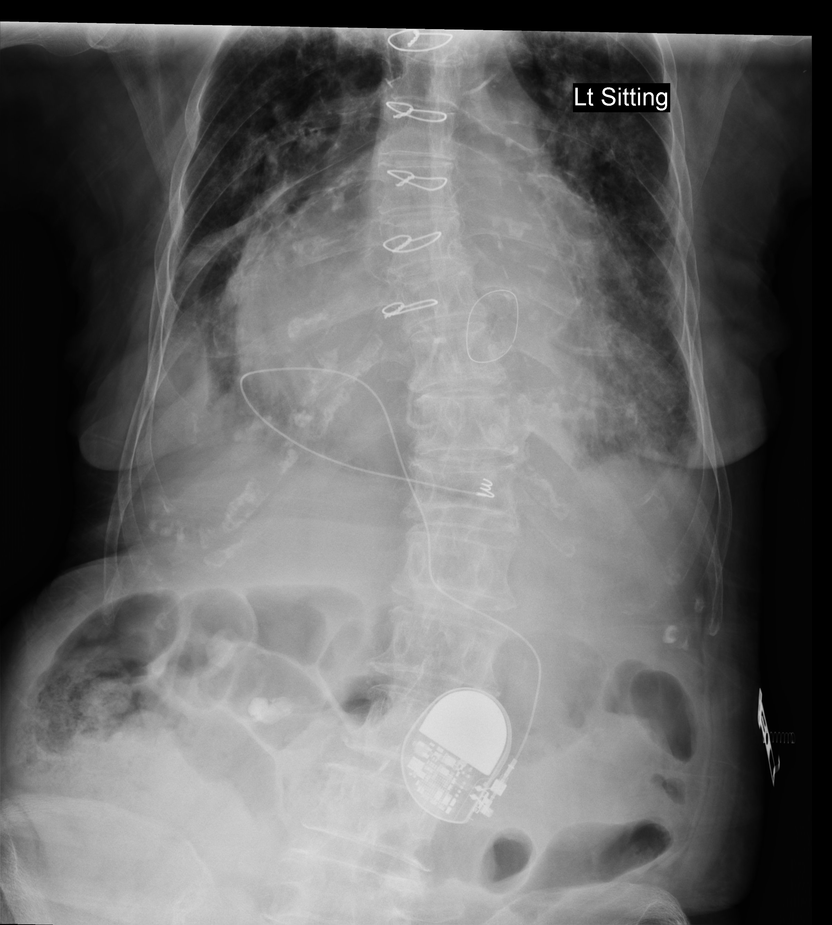

Slide 9
Case 2
What is the device shown from the X-ray? (1 point)
Name two reasons for not using a transvenous device. (2 points)
Name two disadvantages of the device compared with a transvenous device. (2 points)

Slide 10
Case 3
M/32
Known substance abuser, vaping habit
Found confused and generalized weakness
Vital sings
GSC 12 E3V4M5
BP 110/60, pulse 120/min
SpO2 100%
Afebrile
H’stix 5.1 mmol/L

Slide 11
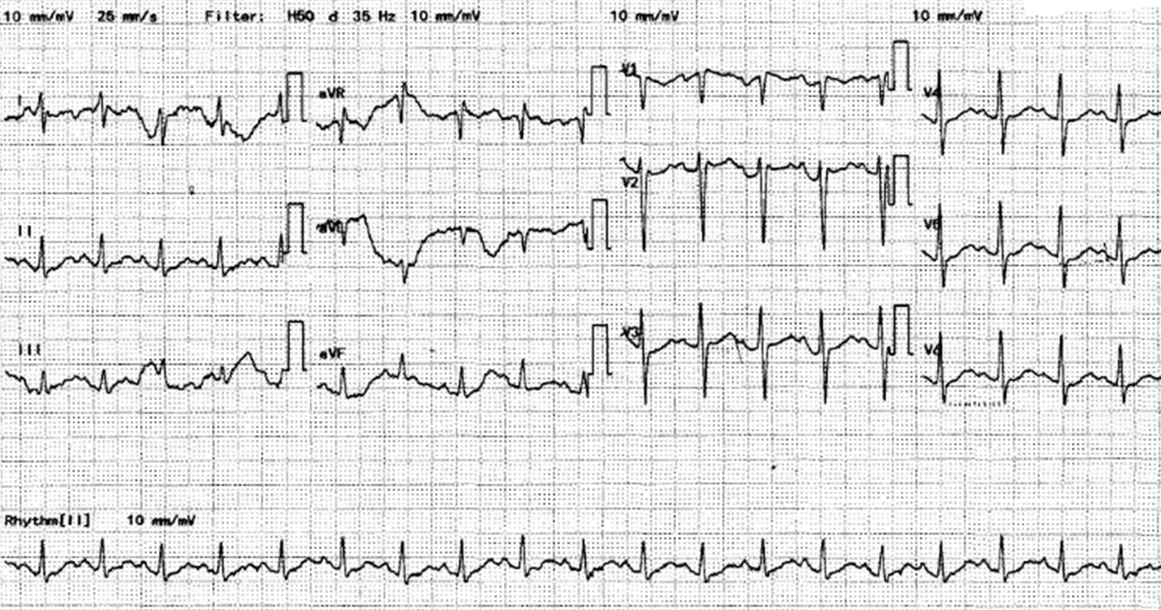

Slide 12
Case 3
What are the abnormal ECG findings? (2 points)
What is the likely cause of the ECG findings and the underlying causative agent? (2 points)
What is another metabolic complication which can be caused by that agent? (1 point)

Slide 13
Case 4
M/63
Fell from a motorbike (static) with right hand landed
Tenderness over right palm

Slide 14
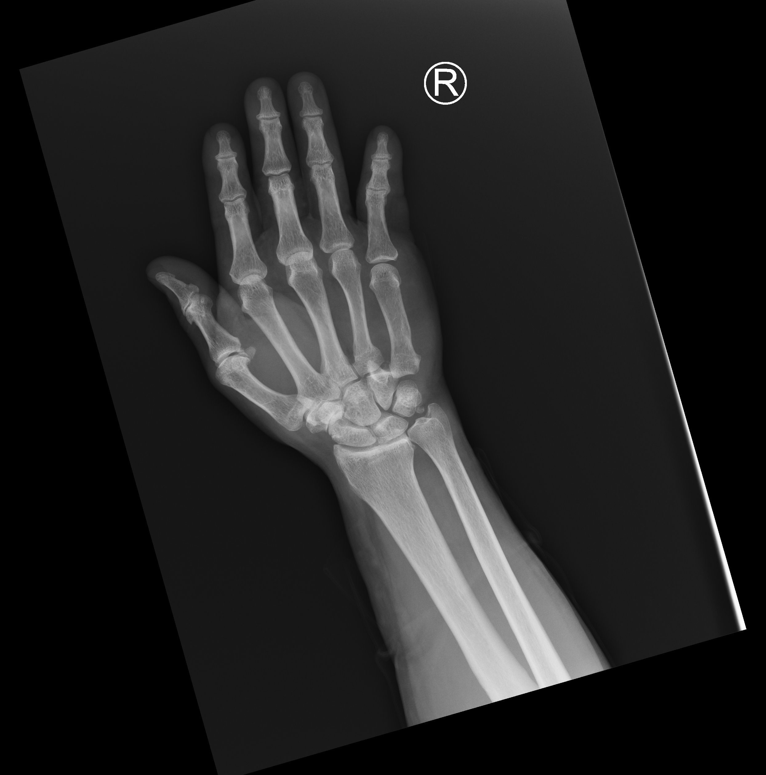

Slide 15
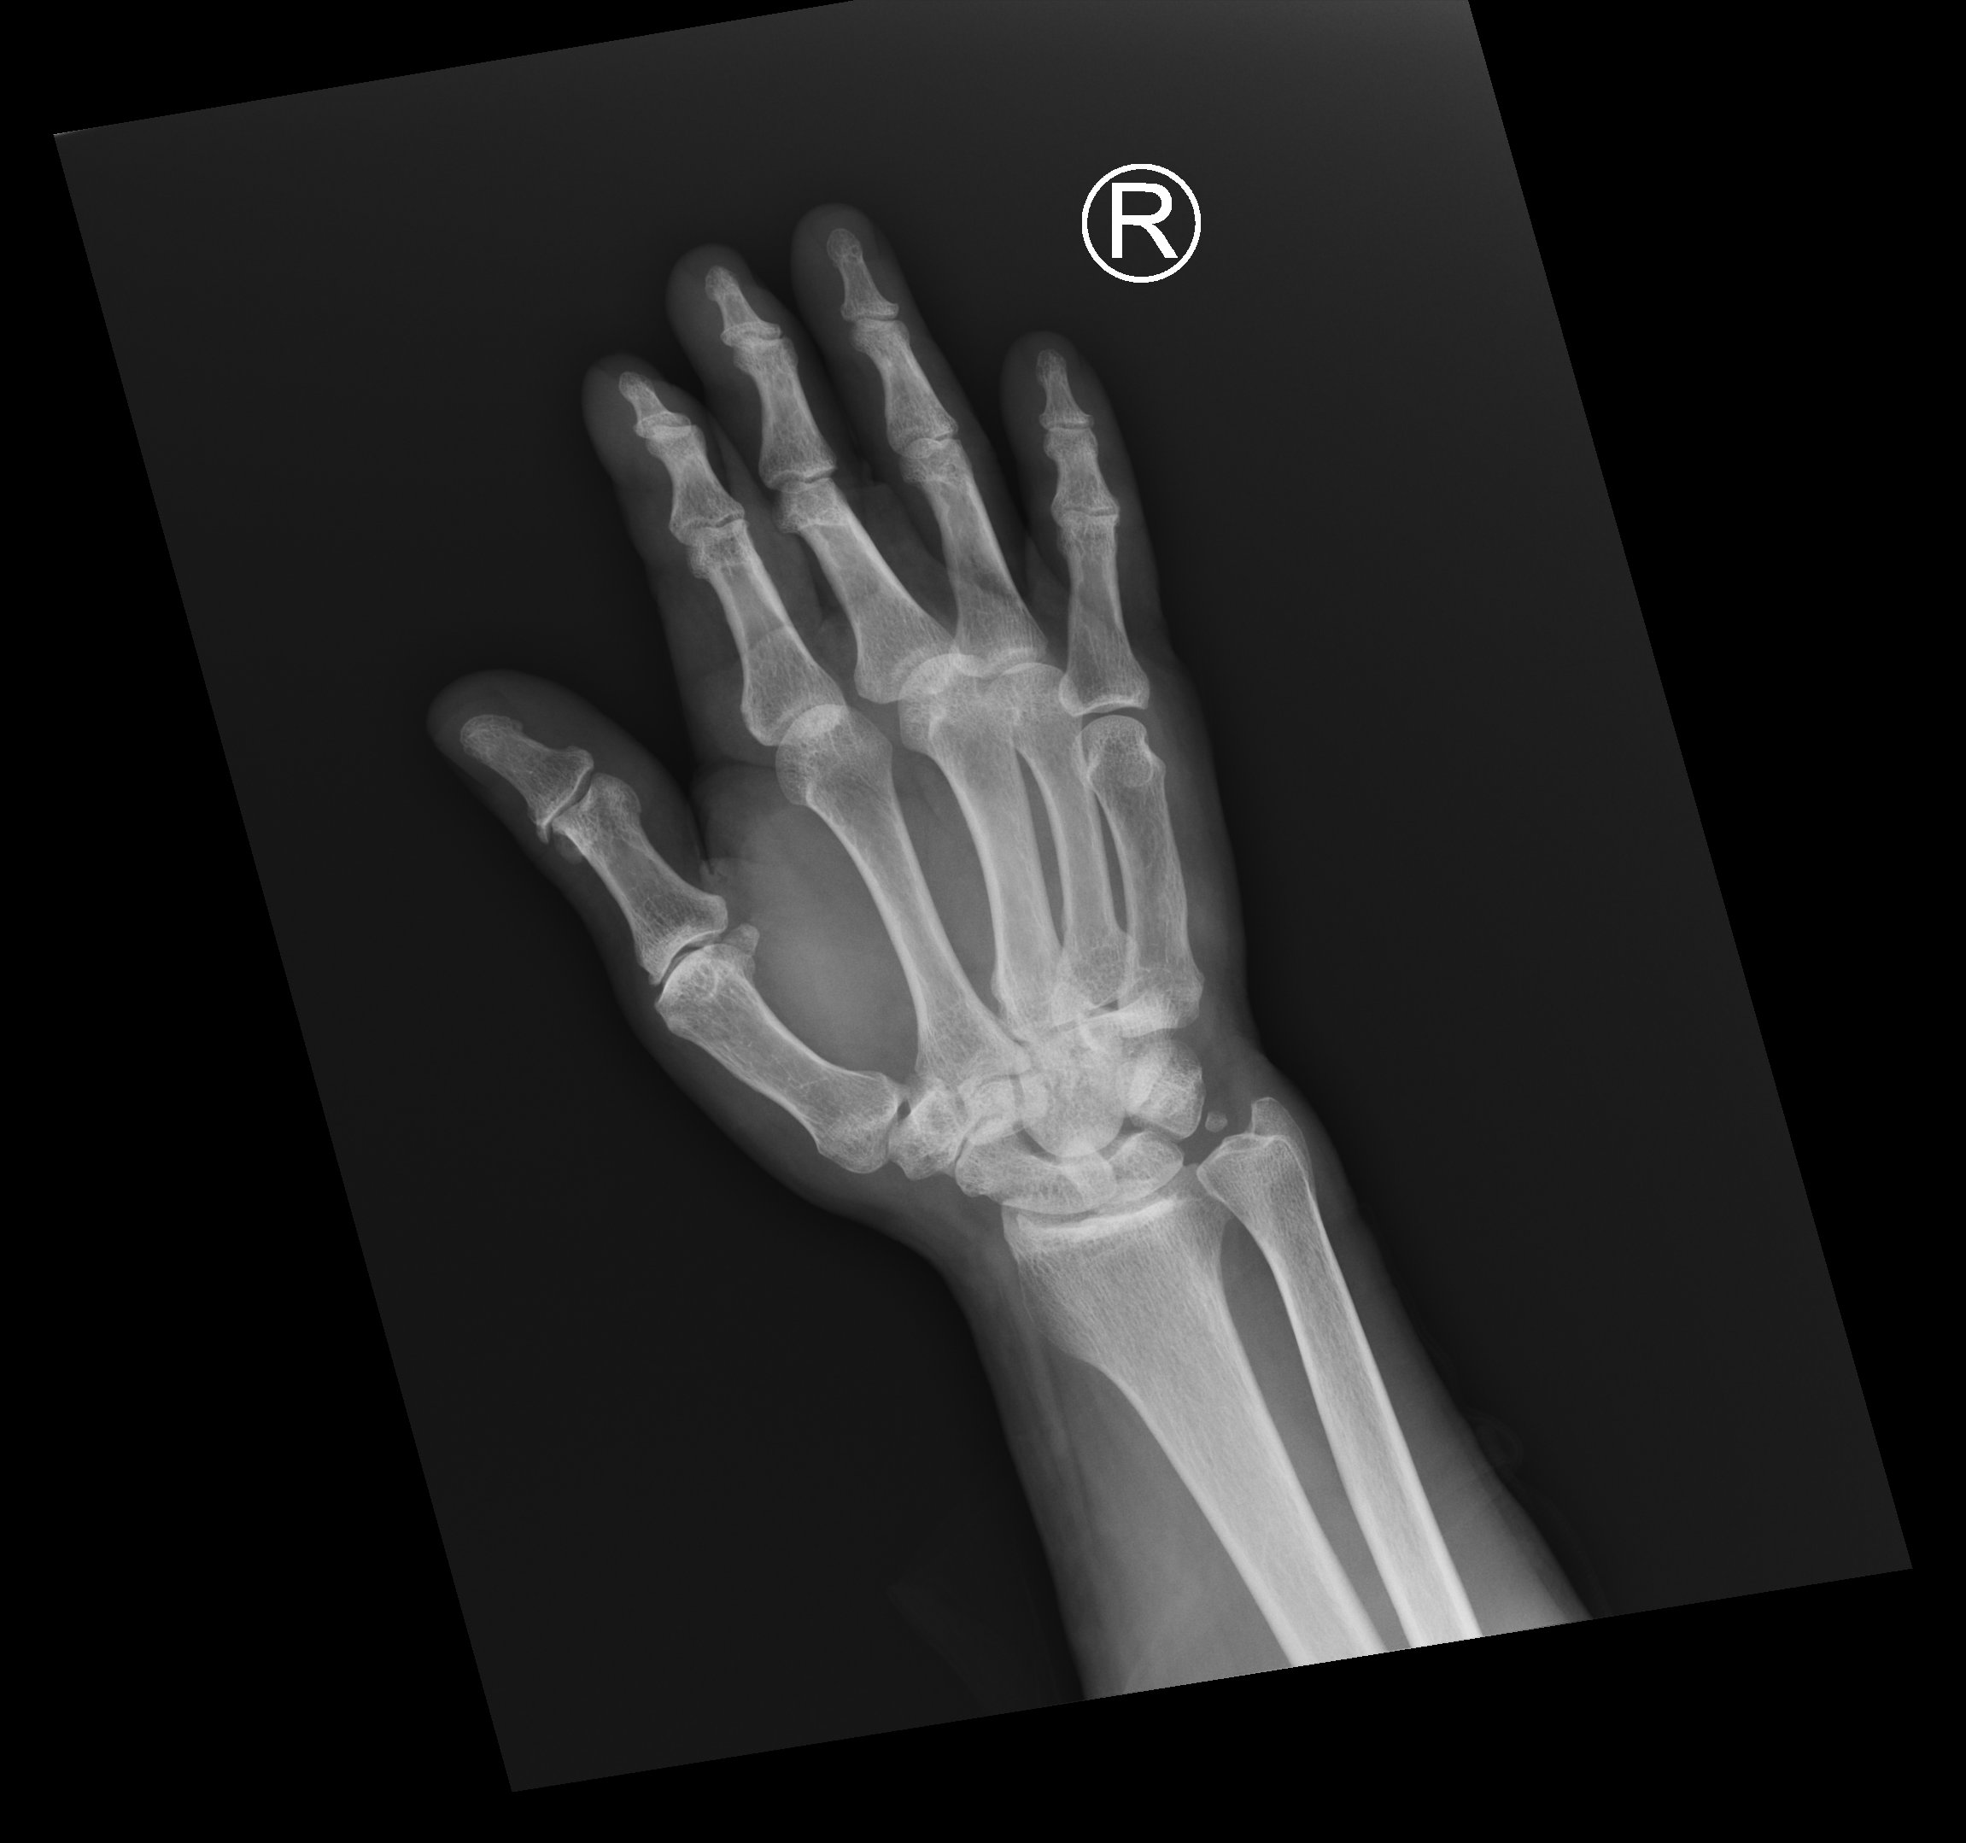

Slide 16
Case 4
What is the diagnosis? (2 points)
What is the usual mechanism of injury? (1 point)
What is the definitive treatment? (2 points)

Slide 17
Case 5
F/92
Known suspected CA rectum
Found decreased GC
Vital signs
BP 120/71, pulse 119/min
SpO2 99%
Temp 38.6°C
H’stix 5.2mmol/L
Abdomen non-tender

Slide 18
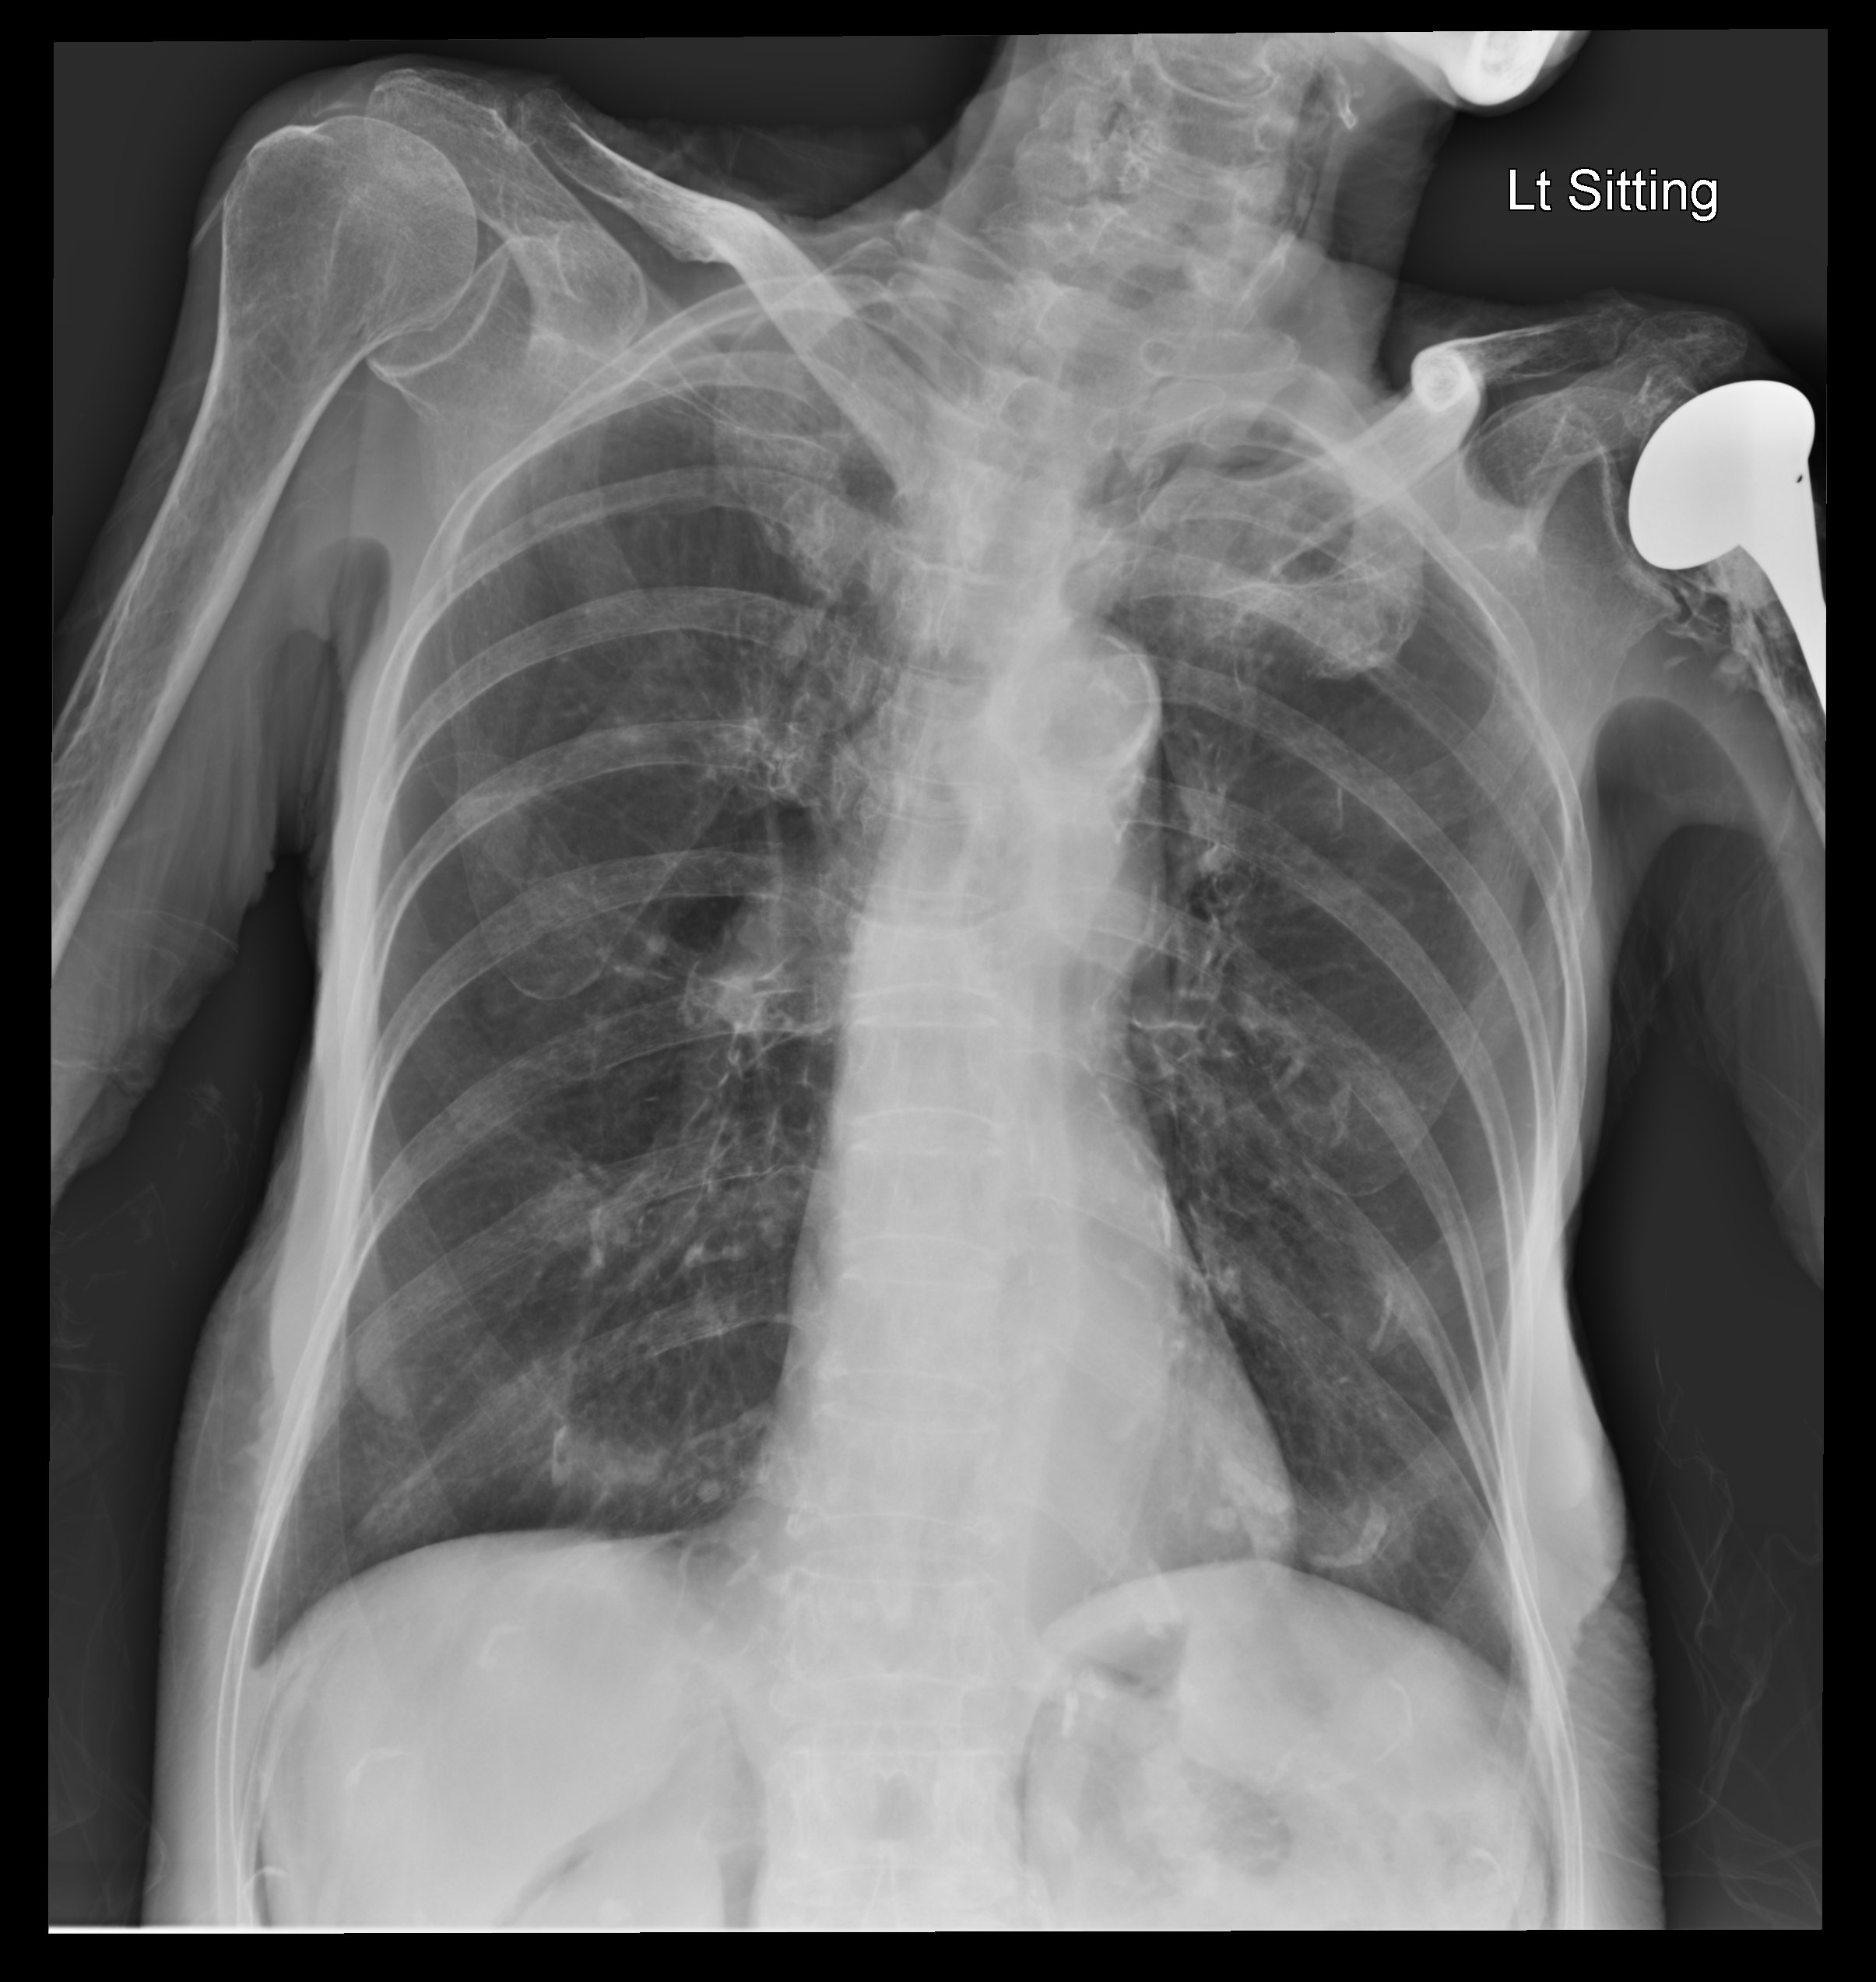

Slide 19
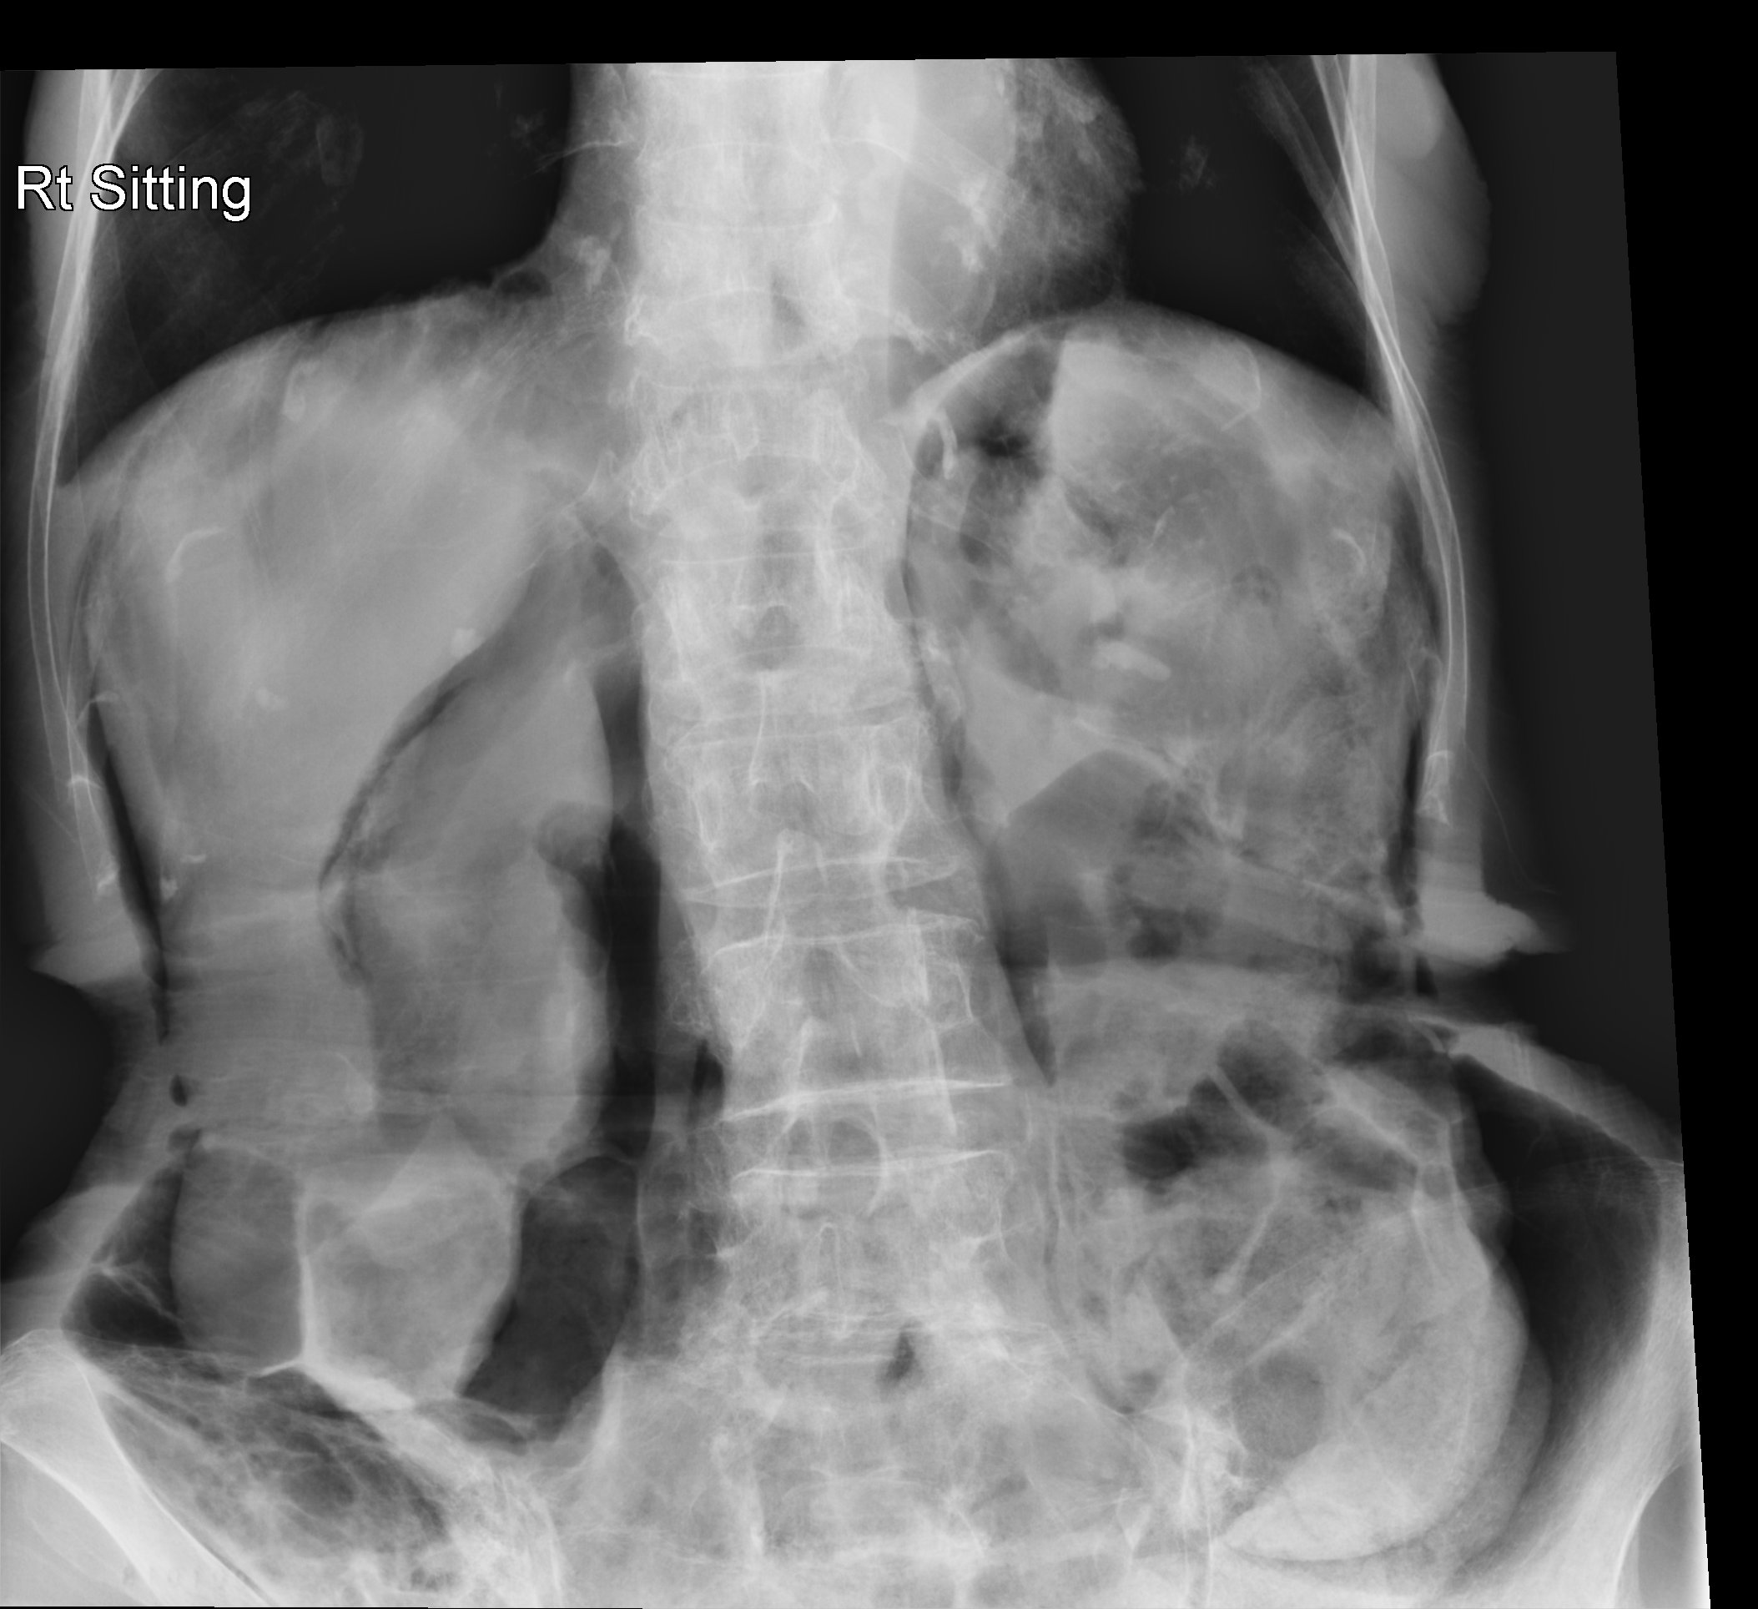

Slide 20
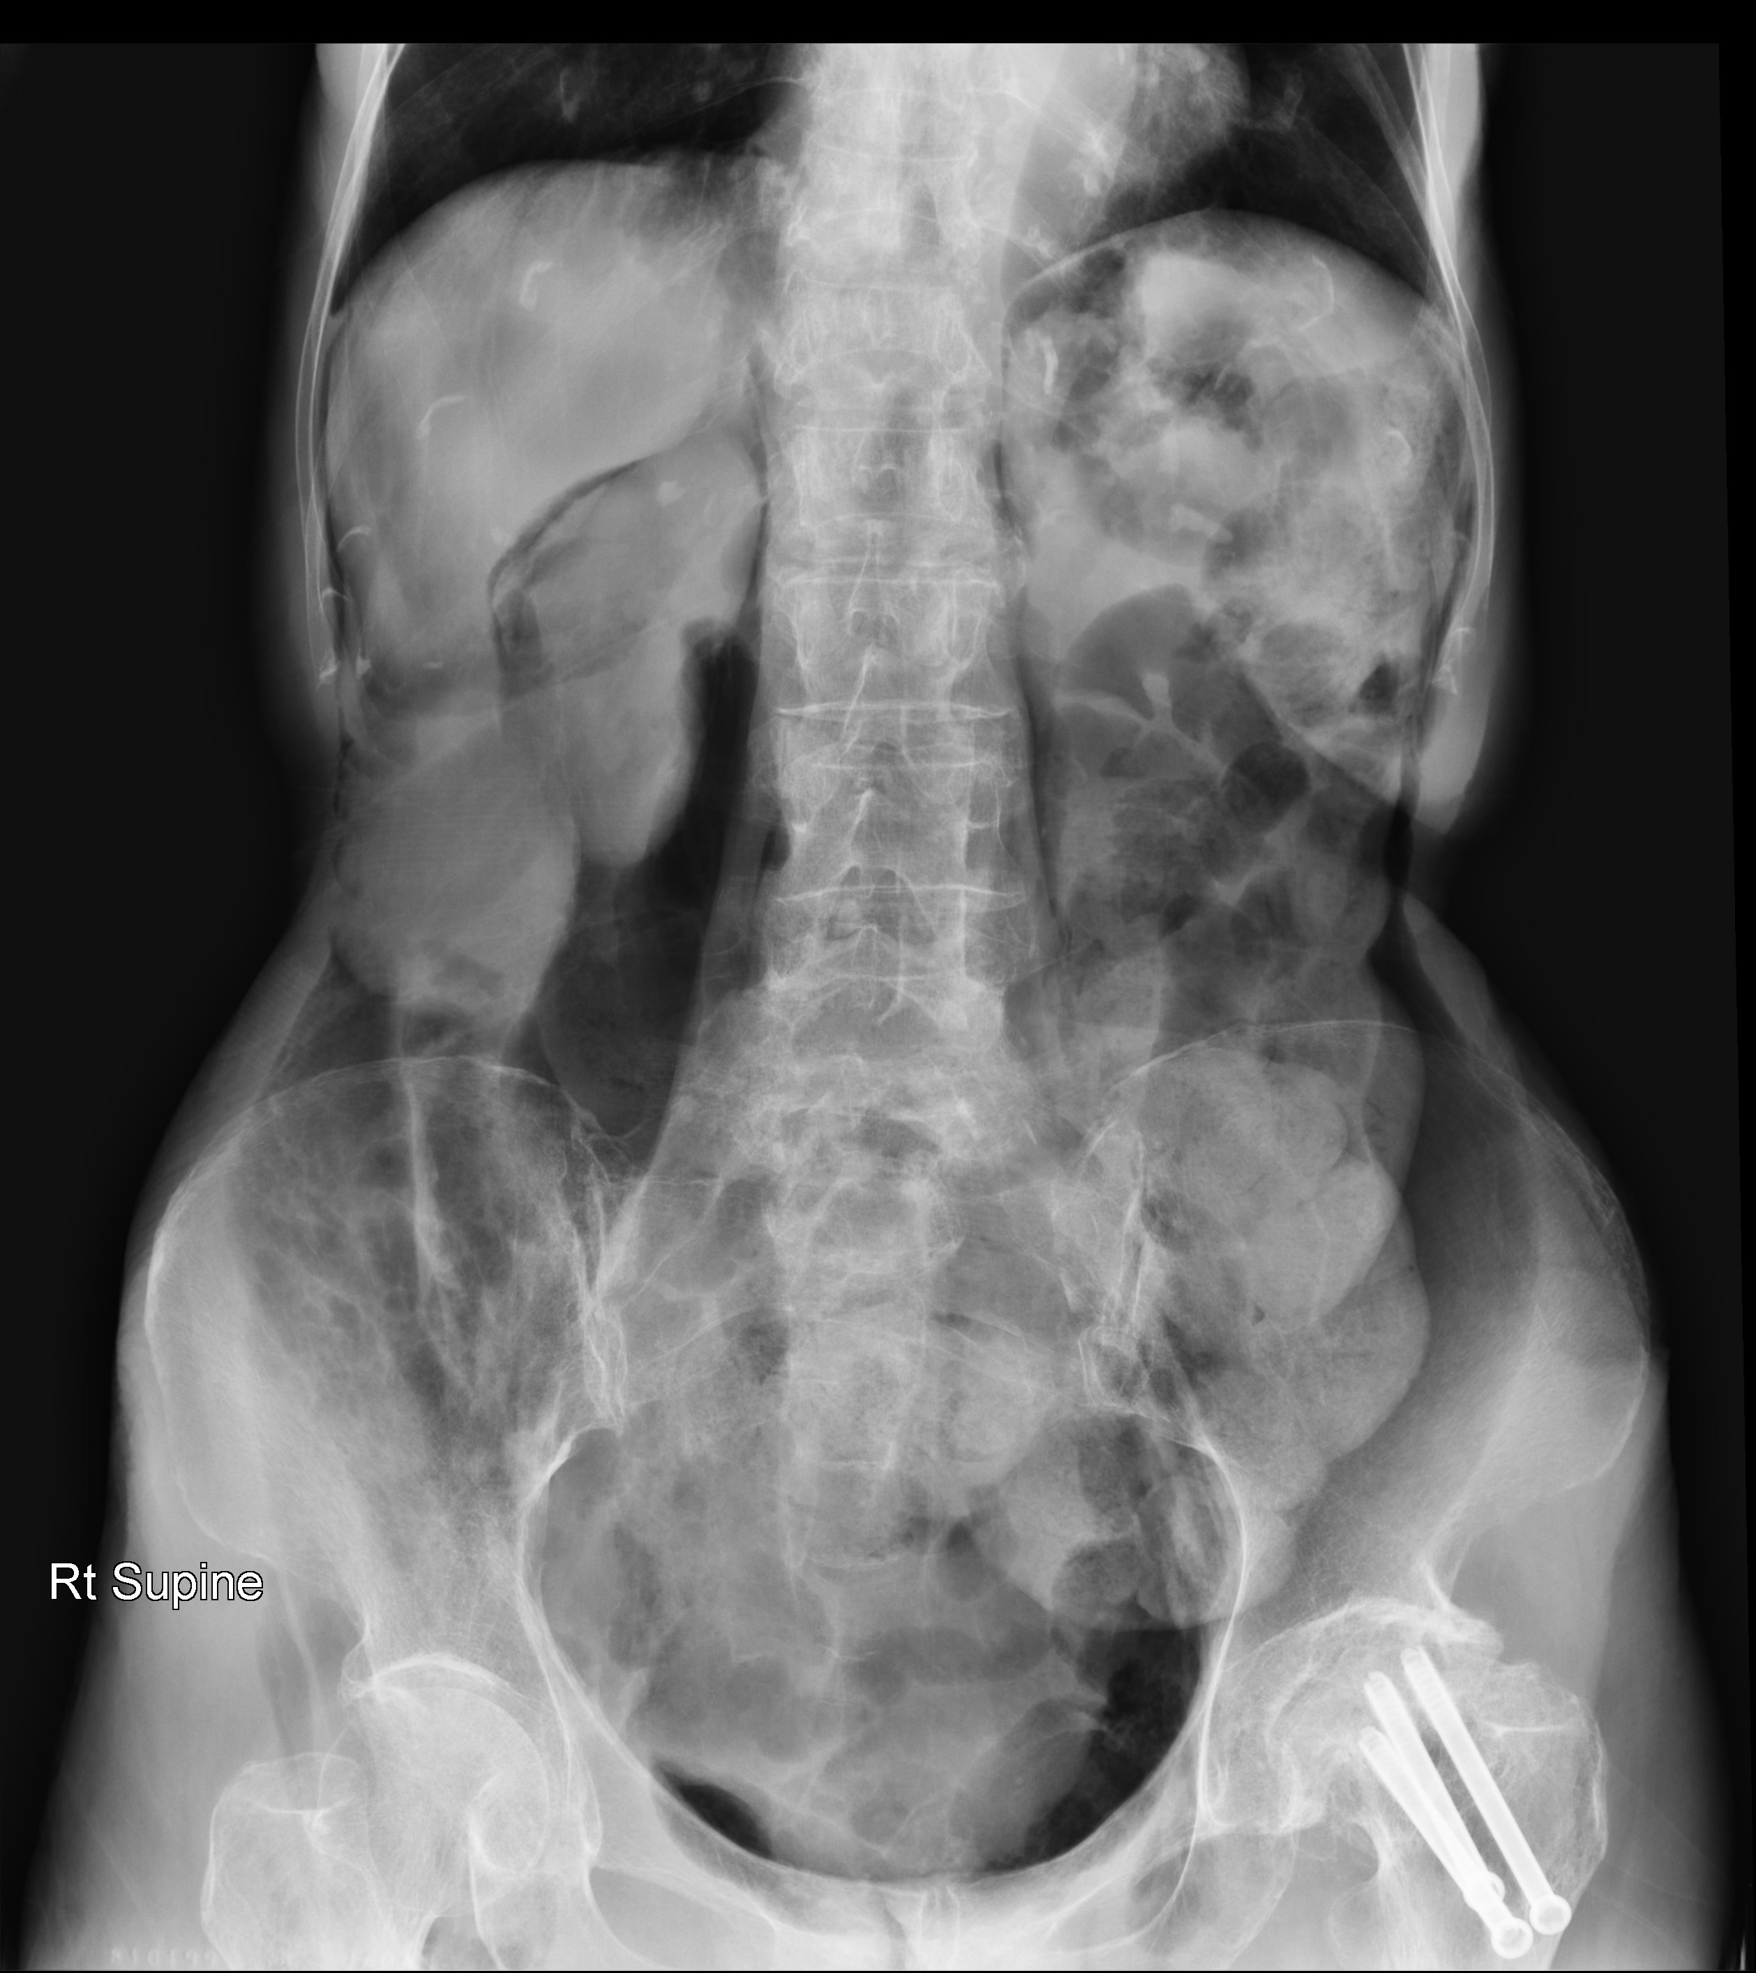

Slide 21
Case 5
What is the diagnosis? (2 points)
What are the X-ray findings support your diagnosis? (3 points)

Slide 22
Case 6
M/70
Smoker
Cough for months
SOB few days
Vital signs
BP 198/100, pulse 126/min
SpO2 97% on 2L O2
afebrile

Slide 23
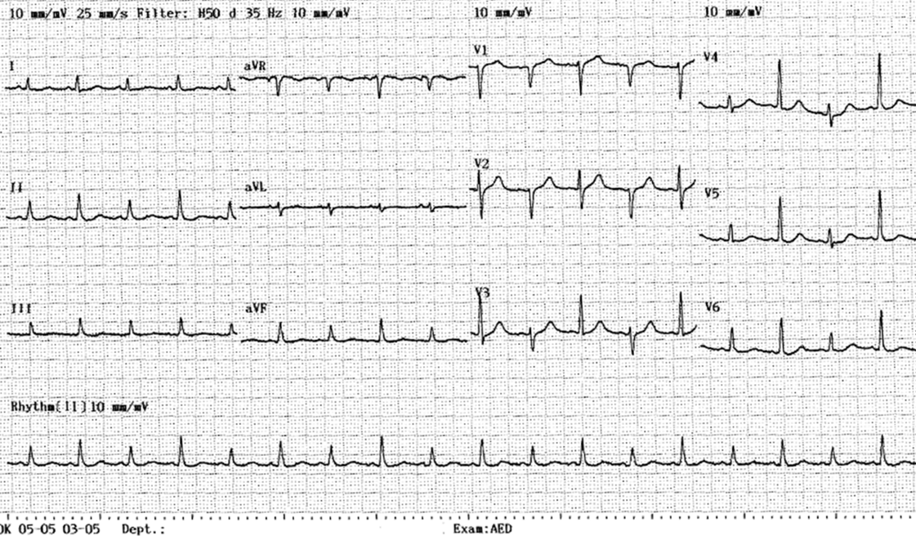

Slide 24
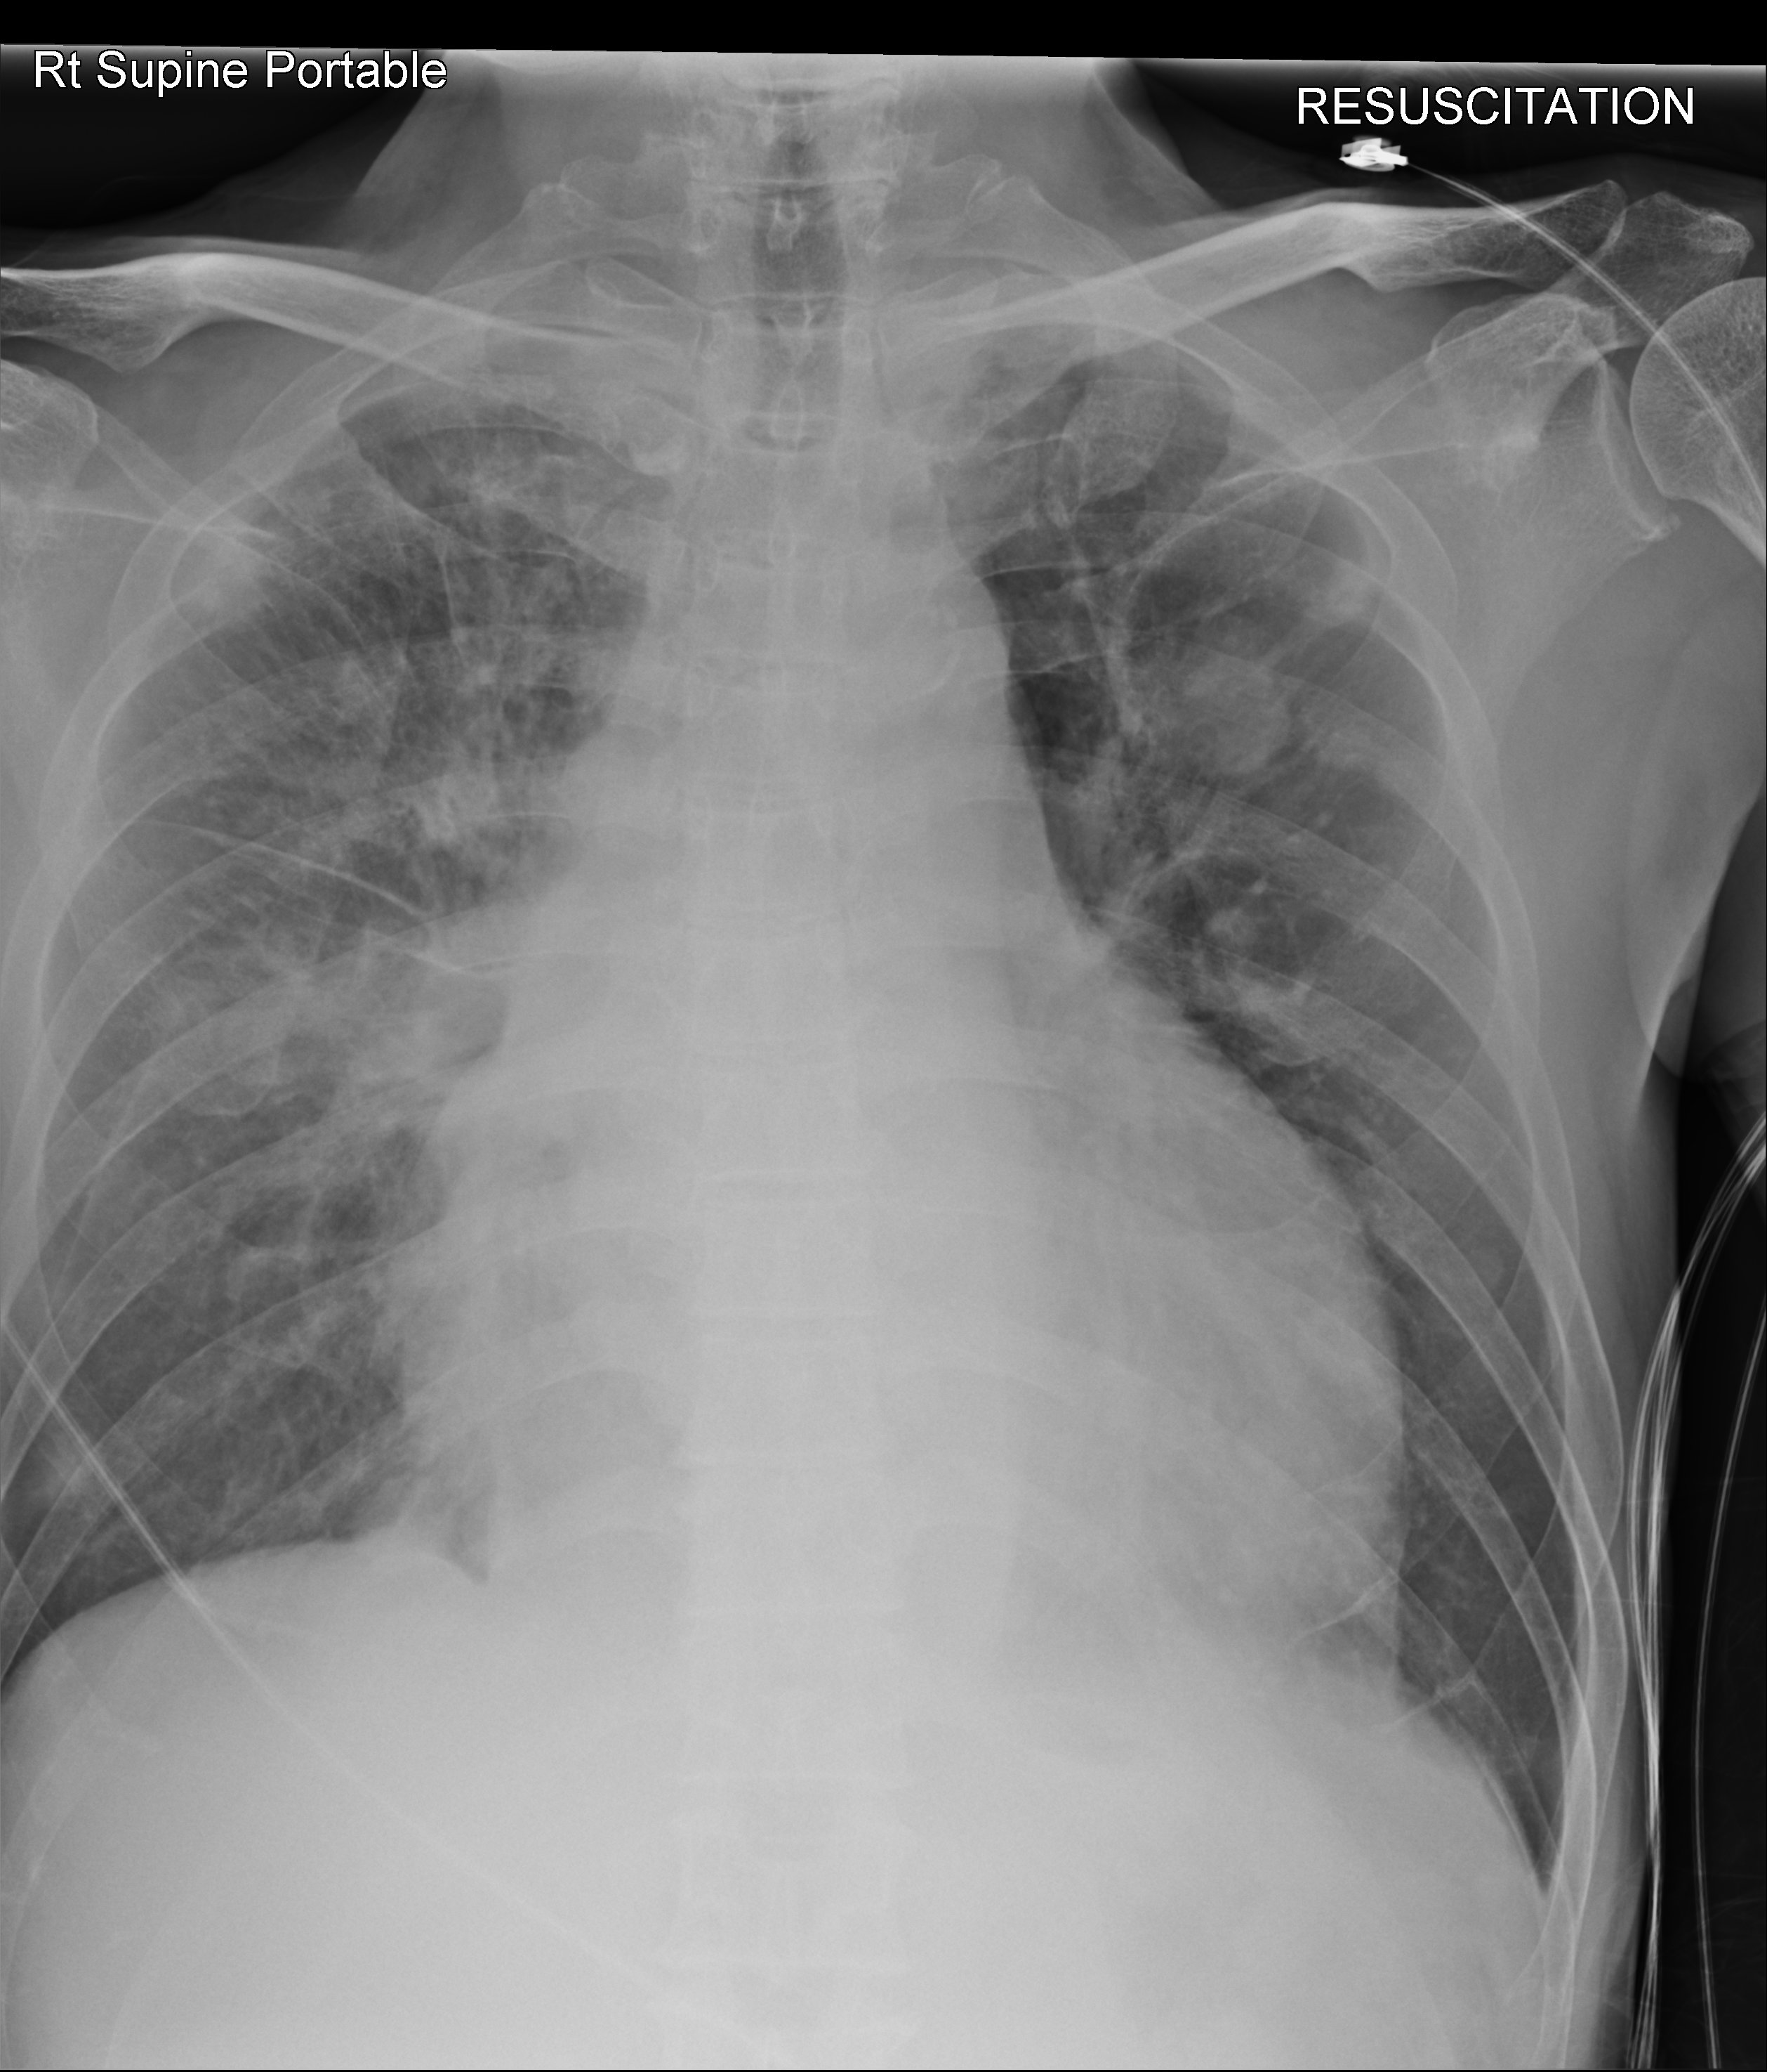
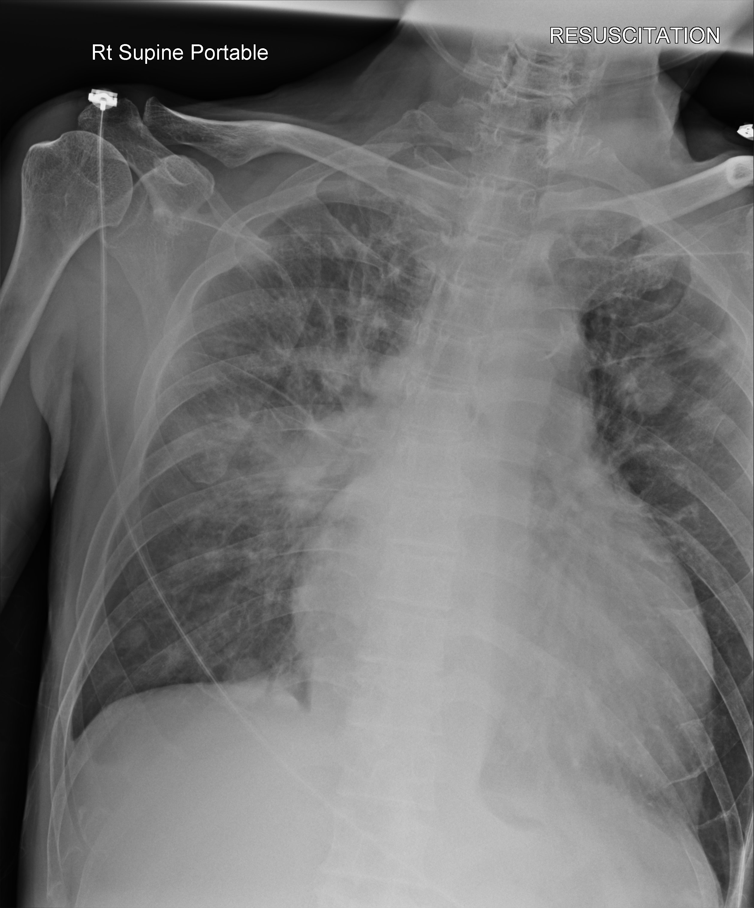

Slide 25
Case 6
What are the abnormal ECG findings? (2 points)
State three abnormal CXR findings. (3 points)
What is the likely diagnosis? (2 points)

