Slide 1
Case 1
80/M
PMH: HT, DM, hyperlipidemia
HPI:
Sudden onset of symptoms 3 hours ago
Left sided weakness and left UMN facial weakness
O/E:
Limb power 4/5 on the left side with mild ataxia
Dysarthria but comprehension and expression intact
Rest of neurological examination normal
NIHSS 5
BP 160/80

Slide 2
MCQ 1
What should be done next?
CT brain
Capillary glucose
Alert stroke team
Direct digital subtraction angiography
A, B and C.

Slide 3
MCQ 1
What should be done next?
CT brain
Capillary glucose
Alert stroke team
Direct digital subtraction angiography
A, B and C.

Slide 4
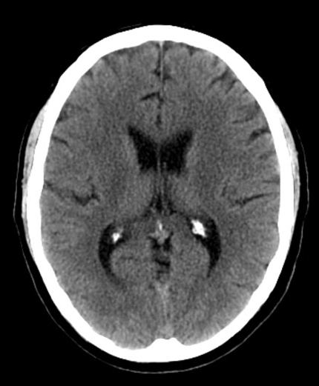
MCQ 2
CT brain is shown on the left, capillary blood glucose was 5mmol/L. What should be the next immediate action?
Arrange CT angiography
Alert neurointervenion team
Prepare patient for intravenous thrombolytic therapy
Intravenous 0.9% NaCl
Consult physiotherapist for stroke rehabilitation

Slide 5
MCQ 2
CT brain is shown on the left, capillary blood glucose was 5mmol/L. What should be the next immediate action?
Arrange CT angiography
Alert neurointervenion team
Prepare patient for intravenous thrombolytic therapy
Intravenous 0.9% NaCl
Consult physiotherapist for stroke rehabilitation

Slide 6
Case 2
88/F
PMH: HT, Coronary artery disease, hyperlipidemia
HPI:
Sudden onset of symptoms upon waking up
R sided weakness and R UMN facial weakness
Last-seen-well 8 hours ago before sleep
O/E:
Limb power 4/5 on the R side with mild ataxia
Dysarthria but comprehension and expression intact
Rest of neurological examination normal
NIHSS 7
BP 169/70

Slide 7
MCQ 1
Suppose your research institute has CT, MRI and DSA suite available for use. What should be done next?
Plain CT brain
CT angiography with perfusion series
MRI brain
Direct digital subtraction angiography
B or C.

Slide 8
MCQ 1
Suppose your research institute has CT, MRI and DSA suite available for use. What should be done next?
Plain CT brain
CT angiography with perfusion series
MRI brain
Direct digital subtraction angiography
B or C.

Slide 9
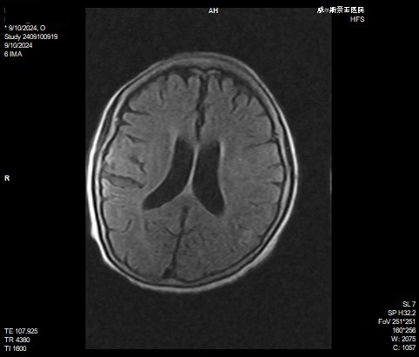
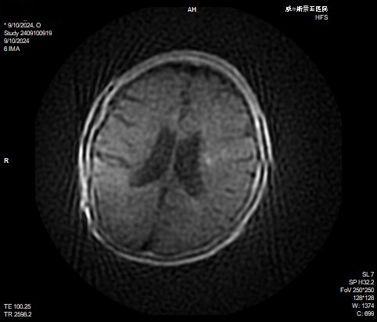
MCQ 2
FLAIR
DWI
MRI brain is shown on the left, capillary blood glucose was 5mmol/L. What should be the next immediate action?
Arrange CT angiography
Alert neurointervenion team
Prepare patient for intravenous thrombolytic therapy
Intravenous 0.9% NaCl
Consult physiotherapist for stroke rehabilitation

Slide 10
Case 3
70/F
PMH: Untreated hypertension
HPI:
Sudden onset of symptoms upon waking up
Left sided weakness and left UMN facial weakness
Last-seen-well 10 hours ago before sleep
O/E:
Limb power 4/5 on the left side with mild ataxia
Dysarthria but comprehension and expression intact
Rest of neurological examination normal
NIHSS 6
BP 169/70

Slide 11
MCQ 1
Suppose your institute has CT, MRI and DSA suite available for use. What should be done next?
Plain CT brain
CT angiography with perfusion series
MRI brain
Direct digital subtraction angiography
B or C.

Slide 12
MCQ 1
Suppose your research institute has CT, MRI and DSA suite available for use. What should be done next?
Plain CT brain
CT angiography with perfusion series
MRI brain
Direct digital subtraction angiography
B or C.

Slide 13
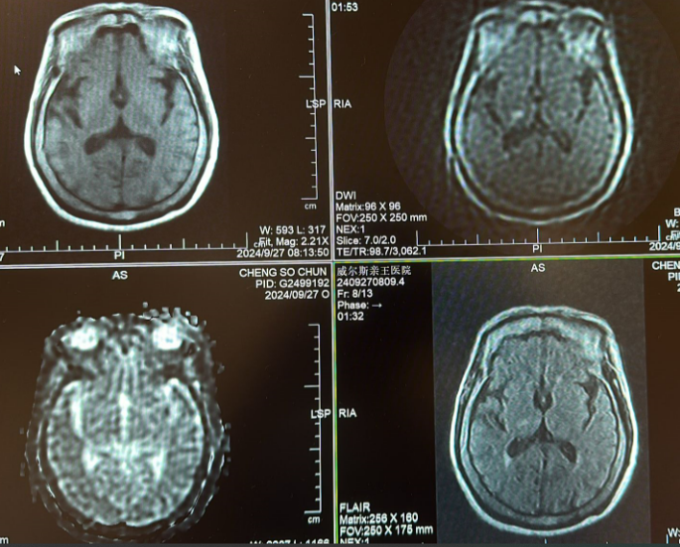
MCQ 2
FLAIR
DWI
DWI
FLAIR
MRI brain is shown on the left, capillary blood glucose was 5mmol/L. What should be the next immediate action?
Arrange CT angiography
Alert neurointervenion team
Prepare patient for intravenous thrombolytic therapy
Intravenous 0.9% NaCl
Consult physiotherapist for stroke rehabilitation

Slide 14
MCQ 2
FLAIR
DWI
DWI
FLAIR
MRI brain is shown on the left, capillary blood glucose was 5mmol/L. What should be the next immediate action?
Arrange CT angiography
Alert neurointervenion team
Prepare patient for intravenous thrombolytic therapy
Intravenous 0.9% NaCl
Consult physiotherapist for stroke rehabilitation

Slide 15
Case 4
66/F
PMH: DM, Atrial fibrillation refused anticoagulation
HPI:
Sudden onset of symptoms upon waking up
R sided weakness and L UMN facial weakness
Last-seen-well 10 hours ago before sleep
O/E:
Limb power 0/5 on the L side
Aphasic
Rest of neurological examination normal
NIHSS 19
BP 169/70

Slide 16
MCQ 1
Suppose your institute has CT, MRI and DSA suite available for use. What should be done next?
Plain CT brain
CT angiography with perfusion series
MRI brain
Direct digital subtraction angiography
(A and B) or C

Slide 17
MCQ 1
Suppose your institute has CT, MRI and DSA suite available for use. What should be done next?
Plain CT brain
CT angiography with perfusion series
MRI brain
Direct digital subtraction angiography
(A and B) or C.

Slide 18
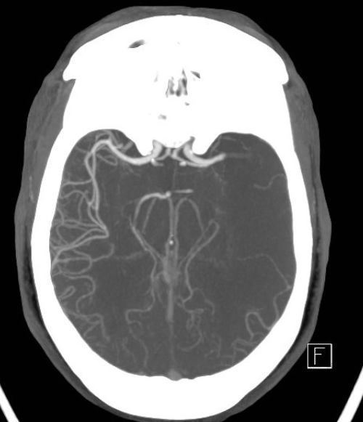
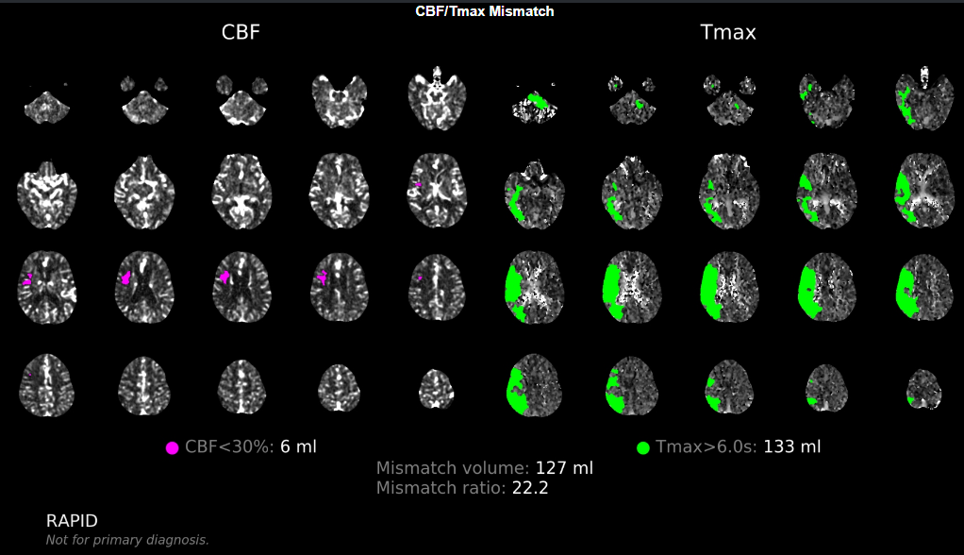
MCQ 2
FLAIR
DWI
DWI
FLAIR
CT angiogram and perfusion is shown on the left, capillary blood glucose was 5mmol/L. What should be the next immediate action?
Arrange MRI
Alert neurointervenion team
Prepare patient for intravenous thrombolytic therapy
Intravenous 0.9% NaCl
Consult physiotherapist for stroke rehabilitation

Slide 19
MCQ 2
FLAIR
DWI
DWI
FLAIR
CT angiogram and perfusion is shown on the left, capillary blood glucose was 5mmol/L. What should be the next immediate action?
Arrange MRI
Alert neurointervenion team
Prepare patient for intravenous thrombolytic therapy
Intravenous 0.9% NaCl
Consult physiotherapist for stroke rehabilitation

