Slide 1
Briefing for HKCEM IEEM Part 1 (SAQ)
Dr. Ko Shing
Chief Examiner, IEEM
Hong Kong College of Emergency Medicine

Slide 2
Background
College’s direction for exam transition to online format
PEEM (already online)
IEEM SAQ (written →online n 2025)
FEEM SAQ (plan for online in future)
Preparation for future conjoint
IEEM (Part 1 SAQ) and Singapore NUS MMedPart B (EM) in 2026

Slide 3

Softwave
ExamSoft online exam software

Slide 4
Features of SAQ online exam
Bring your own device
Download Examplify
16 questions (2hr 🡪 3hrs)
Question booklet with stems
Forward Navigation
Streaming for answer submissions

Slide 5
Overview of SAQ exam by ExamSoft (Examplify)
Pre-Exam after enrollment
Pre-Exam (1-day)
Exam Day
Registration
Disable Antivirus software
Download and Install Examplify
Downloading
Exam Questions
Answer Questions
Complete Questions
Familiarization
Submit Answers

Slide 6
Pre-Exam

Slide 7
Pre-exam Logistics
Application for HKCEM
Eligible to take IEEM
College sends confirmation emails
1. Login Name
2. Login Password
3. User Guide
Login ExamSoft
Download
and Install Examplify
(2 Weeks Before Exam)
Familiarization via Zoom
(1 Day Before Exam)
Download Questions

Slide 8
Minimum System Requirements https://examsoft.com/resources/examplify-minimum-system-requirements/#294
Examplify for Windows
Windows 10
Windows 11
Examplify for Mac
macOS Ventura
Sonoma
Sequoia
* If using a Microsoft Surface Device, need to disable “S mode” which is not compatible with Examplify
https://support.examsoft.com/hc/en-us/articles/11145775442829-Disable-S-Mode-on-Your-Microsoft-Device

Slide 9
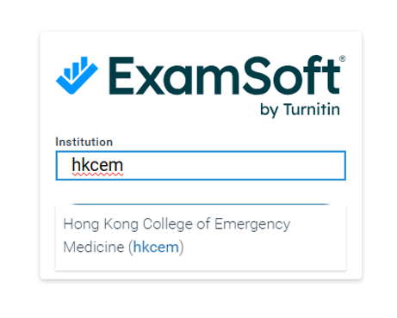
Step 1: Login ExamSoft https://www.youtube.com/watch?v=HzBVbuwm_A8&t=24s
Locate Institution: HKCEM

Slide 10
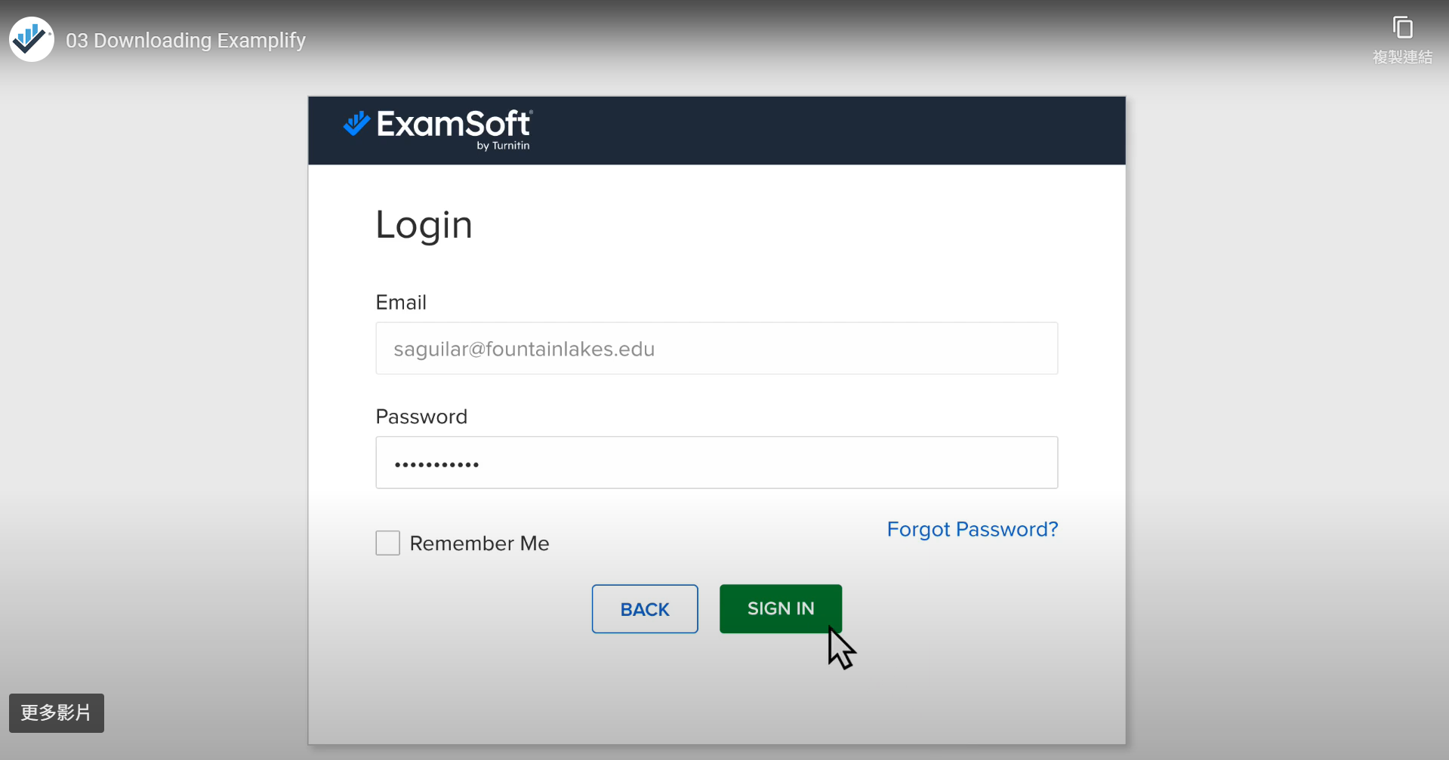
Step 1: Login ExamSoft https://www.youtube.com/watch?v=HzBVbuwm_A8&t=24s
College will offer the login email + password to you after successful enrollment

Slide 11
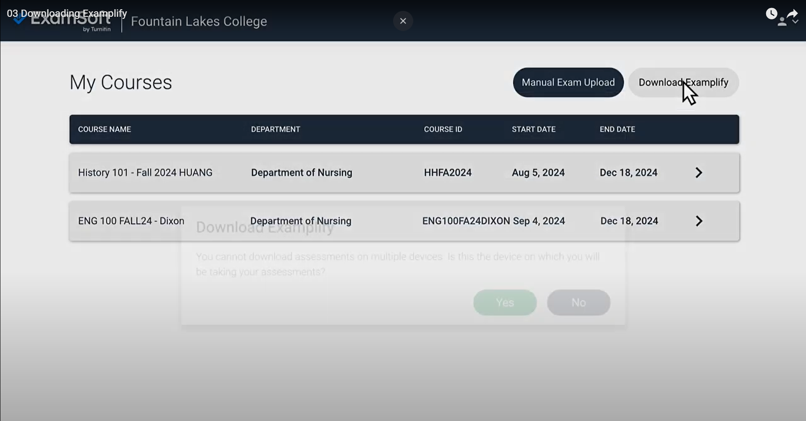
Step 2: Download Examplify https://www.youtube.com/watch?v=HzBVbuwm_A8&t=24s

Slide 12
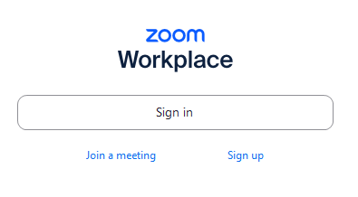
2 Weeks Before Exam
Zoom will be offered for ALL eligible candidates for familiarization
College (Chief Examiners + IEEM IT team)

Slide 13
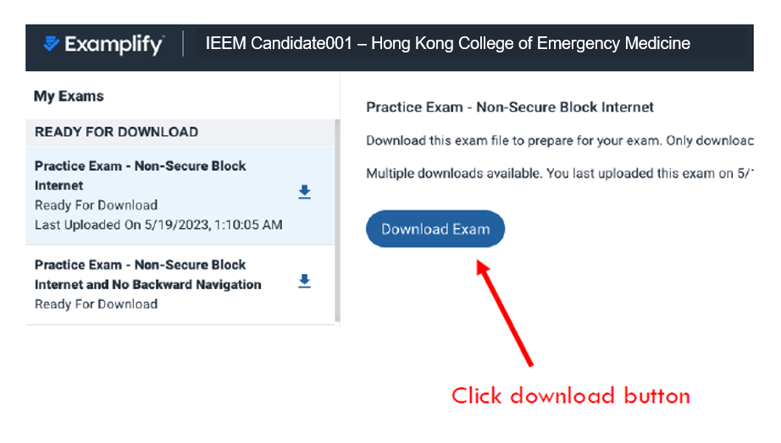
Take Exam Practice
Trials practice will be available for you to

Slide 14
Ready for Exam

Slide 15
Logistics for Exam
(1 Day Before Exam)
Download all Exam Questions on your device
Start Exam:
- Disable Anti-virus
- Login Examplify
- “Password will be offered by Chief Examiner onsite
During Exam:
Answer the Questions
*Forward Navigation*
During Exam:
Submit your answers one by one
End of Exam:
Chief Examiner ensure all your answer submissions
Exam Completed

Slide 16
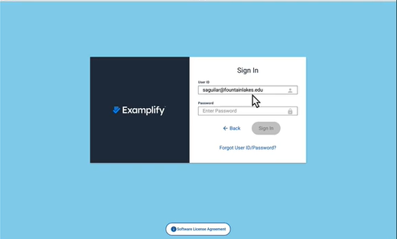
1 Day Before Exam: Download Questions https://www.youtube.com/watch?v=HzBVbuwm_A8&t=24s
Sign In ExamSoft with the same account previously offered by college

Slide 17
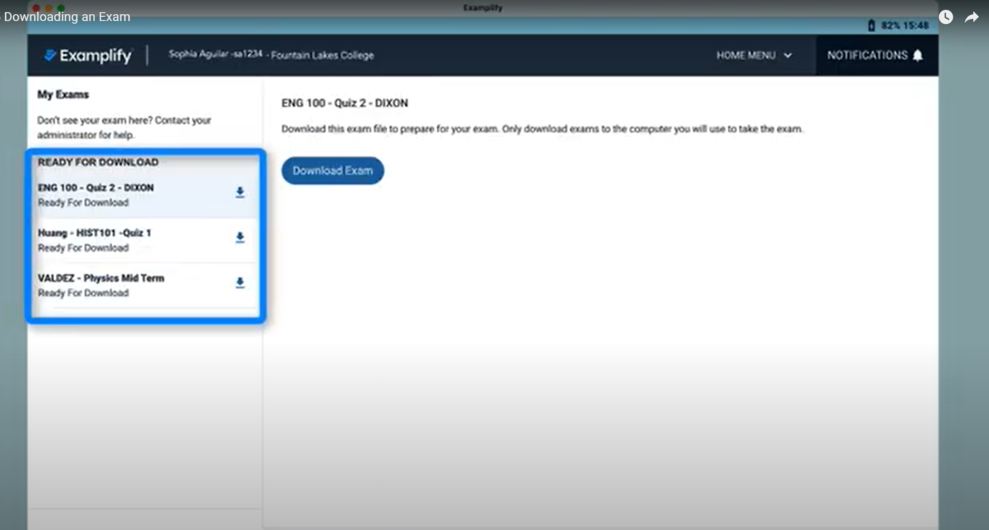
1 Day Before Exam: Download Questions https://www.youtube.com/watch?v=hjLtp2gaIN0&t=1s
After Login: 16 Questions are posted already for download
→ Click “Download Exam” →Pre-install all questions on your device
You are not able to read the questions until the “Password” to unlock for exam to start mane

Slide 18

Onsite IEEM Part 1(SAQ)
Bring your own device (or spare device)
Power socket available
Three things on your table:
Question booklet
A paper with Password
Blank A4 paper with pencil

Slide 19
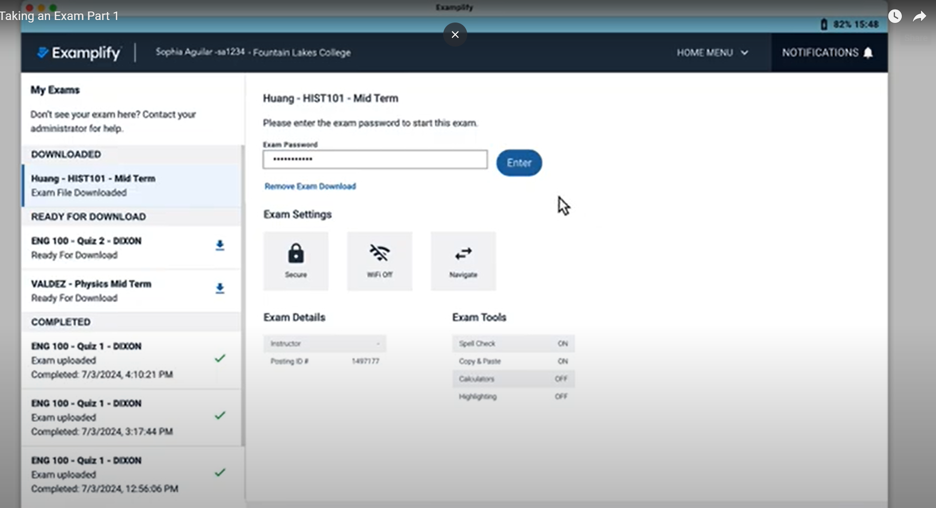
On Exam Date https://www.youtube.com/watch?v=hjLtp2gaIN0&t=1s
Step 1: Choose your question to start → Enter “Password” which is distributed on that day

Slide 20
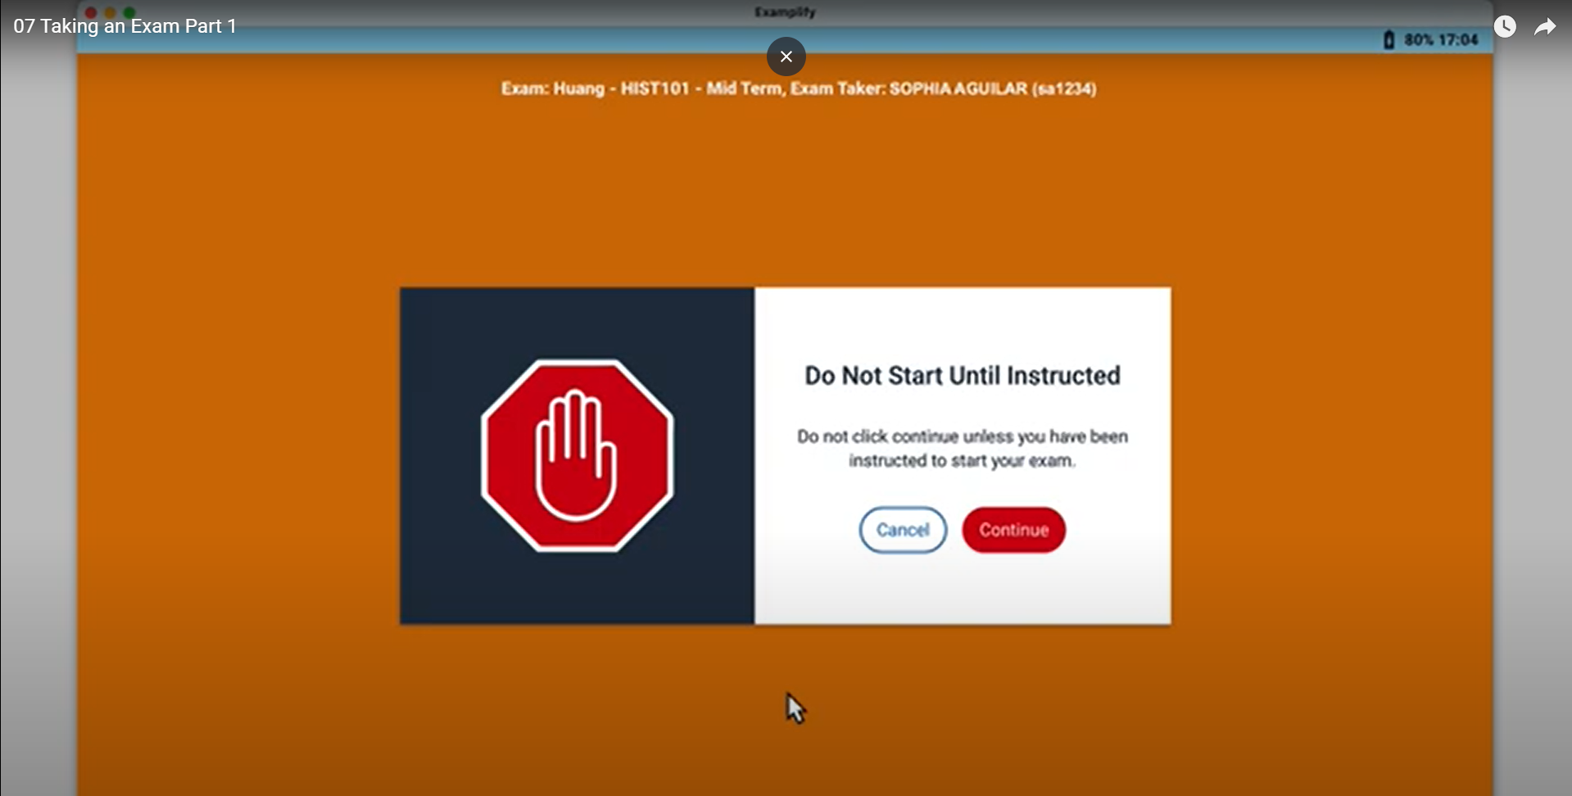
Taking an Exam https://www.youtube.com/watch?v=Is-d1765pBE&t=15s
Step 2: Wait until the examiner’s accountment of examination begin
→ Click “Continue”

Slide 21
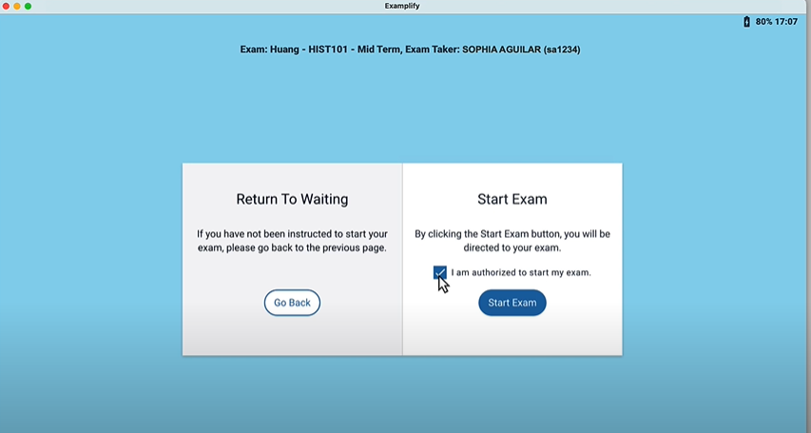
Taking an Exam https://www.youtube.com/watch?v=Is-d1765pBE&t=15s
Step 3: Authorizing to start examination
Computer will lock down and all other function will be disabled afterward

Slide 22
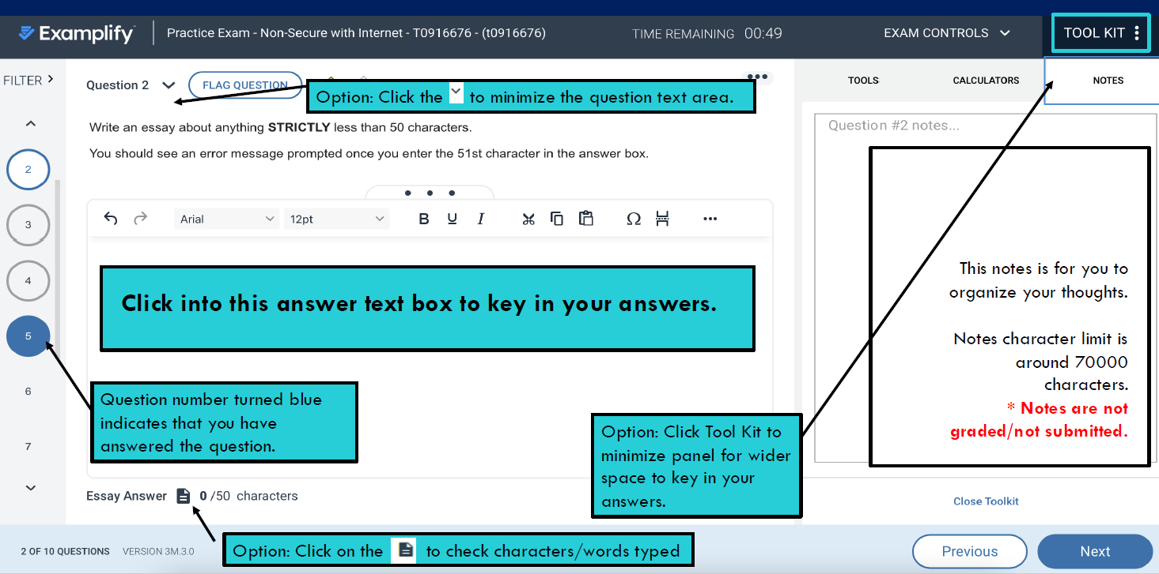
Taking an Exam https://www.youtube.com/watch?v=Is-d1765pBE&t=15s
Step 4: Submit the question by clicking “Finish

Slide 23
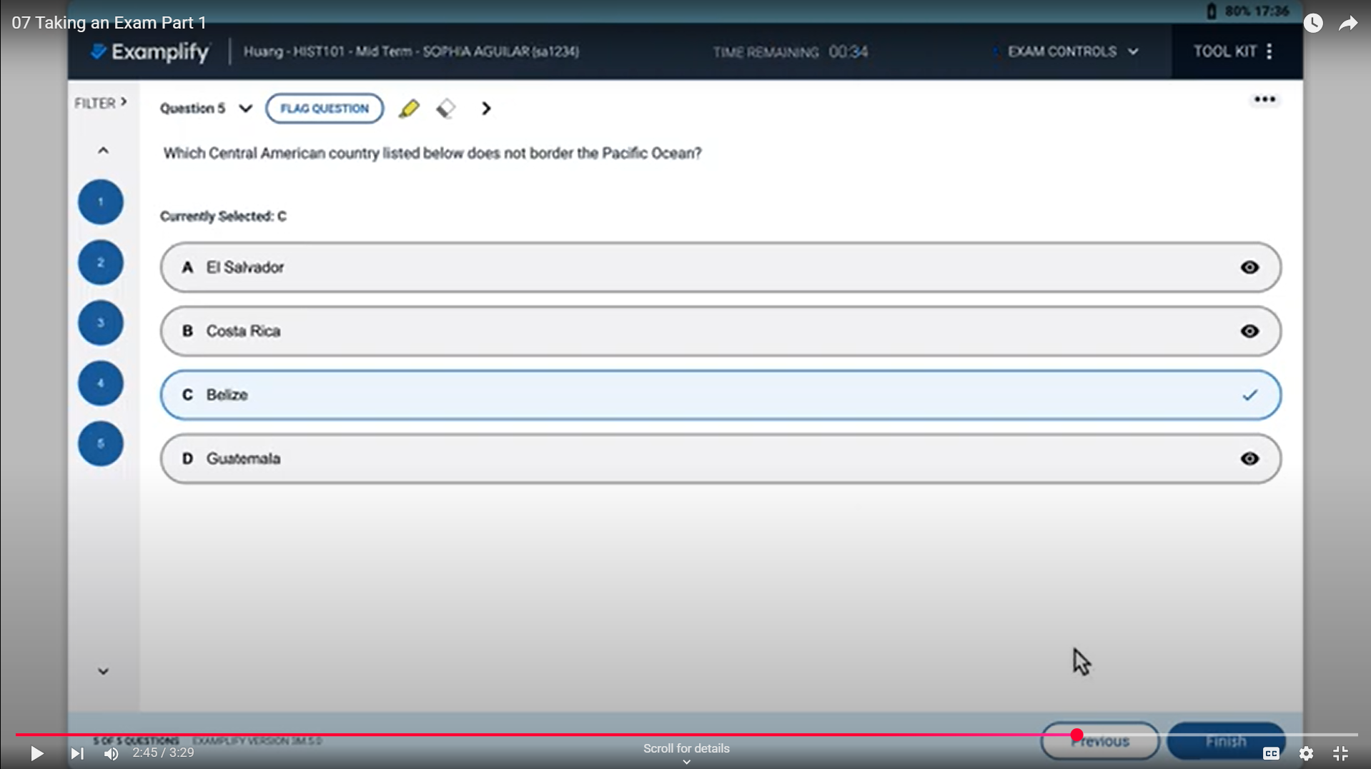
Taking an Exam https://www.youtube.com/watch?v=Is-d1765pBE&t=15s
Step 5: Submit the question by clicking “Finish”

Slide 24

Taking an Exam https://www.youtube.com/watch?v=Is-d1765pBE&t=15s
Step 5: Once the upload is successful, proceed to the next question by clicking “Return to Dashboard” to choose another question again

Slide 25
Contingency
Spare devices
You can bring your own spare device
Spare devices from college will be available
Network
HKAM wifi
College portable wifi
Hotspot
Power sockets available
** Time compensation:
- is allowed for technical issue and documented
- to be determined by the Chief Examiner

Slide 26
Summary: Best practice
Before examination
Check Your Device
Download and Install the Software Before Exam Day
Familiarization: Practicing mock and ask questions
Questions Downloads: Download all questions as soon as they are available (1-day before exam)
Date/Time Settings: Check that your computer’s date and time settings are accurate
On Exam Date
Arrive punctually so as to test the internet and computer
Disable Antivirus Software: Before you start an exam, disable all antivirus software
Other Programs: Before you start an exam, close all other programs
Time Management is essential

Slide 27
Useful Link
What is ExamSoft / Examplify
https://www.youtube.com/watch?v=n4fTppnTpU8&t=46s
Examplify : Get started
https://support.examsoft.com/hc/en-us/articles/11145989728525-Examplify-Get-Started-with-Examplify-Video-Guide

Slide 28
Thank You
Questions

Slide 29

Onsite IEEM Part 1(SAQ)
Bring your own device (or spare device)
Power socket available
Three things on your table:
Question booklet
A paper with Password
Blank A4 paper with pencil
Hong Kong College of Emergency Medicine
2025 Intermediate Examination for Emergency Medicine (IEEM)
Part 1 – SAQ
Question Booklet
Oct 2025 Diet

