Slide 1
JCM OSCE 6/2025
TMH A&E
Dr. Nelson Leung

Slide 2
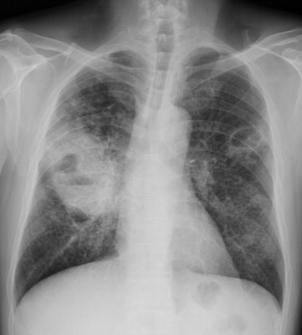
Case 1
A healthy man, aged 30 years, stayed in Thailand for 1 month and recently came back to Hong Kong.
He complained of persistent low grade fever, a productive cough for 1 week and three-week history of malaise.
Notes:
Interpret the CXR
Blood culture shows Aerobic, gram-negative (“safety pin” appearance) motile saprophytic bacillus. What organism can it be and is endemic in South East Asia?
What urological manifestation does it associate?
What are the choice of antibiotics?

Slide 3
Q1. Interpret the CXR

Slide 4
Q1. Interpret the CXR
Right middle zone mass with air-fluid level
Numerous cavitary nodules over the left lung

Slide 5
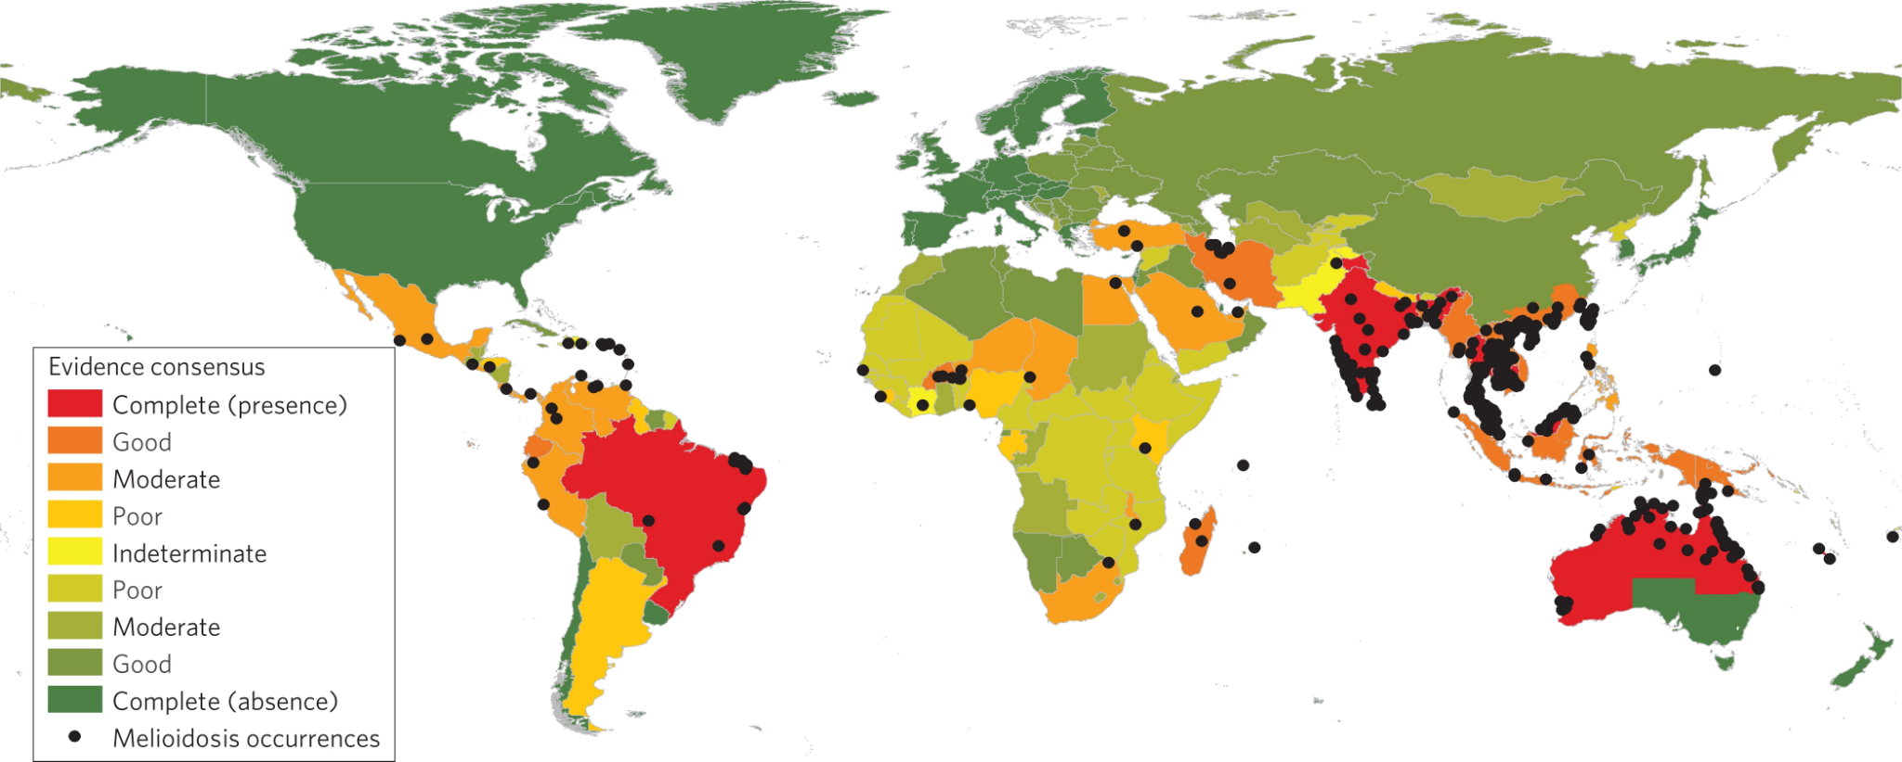
Q2.
Blood culture shows Aerobic, gram-negative (“safety pin” appearance) motile saprophytic bacillus.
What organism can it be and is endemic in South East Asia?

Slide 6
Q2.
Blood culture shows Aerobic, gram-negative (“safety pin” appearance) motile saprophytic bacillus. What organism can it be and is endemic in South East Asia?
Burkholderia pseudomallei
Ddx of safety pin appearance
Yersinia pestis: gram-negative, aerobic, non-motile bacillus
Pasteurella multocida: gram-negative, aerobic, non-motile bacilli
Limmathurotsakul D, Golding N, Dance DA, Messina JP, Pigott DM, Moyes CL, Rolim DB, Bertherat E, Day NP, Peacock SJ, Hay SI. Predicted global distribution of Burkholderia pseudomallei and burden of melioidosis. Nature microbiology. 2016 Jan 11;1(1):1-5.

Slide 7
Q3 What urological manifestation does it associate?

Slide 8
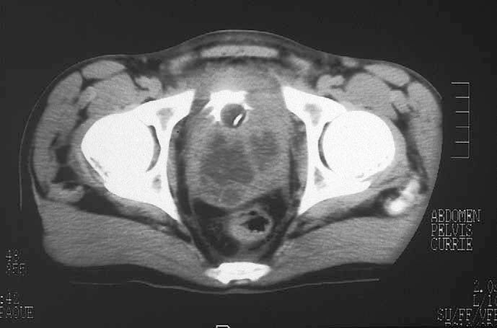
Q3 What urological manifestation does it associate?
Prostatic abscess
In Australia, prostatic abscesses occur in approximately 18% of males
Melioidosis prostatic abscesses in a 31-year-old man who presented with fever and urinary retention.
Currie BJ. Burkholderia pseudomallei and Burkholderia mallei: melioidosis and glanders. Mandell, Douglas and Bennett’s Principles and Practice of Infectious Diseases. 7th edn. Philadelphia: Churchill Livingstone Elsevier. 2010:2869-85.

Slide 9
Q4. What are the choice of antibiotics?

Slide 10
Q4. What are the choice of antibiotics?
IV Ceftazidime
IV Meropenem (especially in CNS)
Intrinsically resistant to penicillin, ampicillin, 1st and 2nd cephalosporins
Notes:
Relapse rate 6-17% in thailand
Intensive therapy: reduce bacterial load ASAP
IV Ceftazidime (fortum)/ meropenem (esp in CNS), 10-14 days
> 4-8 weeks if severe or complicated eg lung abscess, CNS, bacteremia

Slide 11
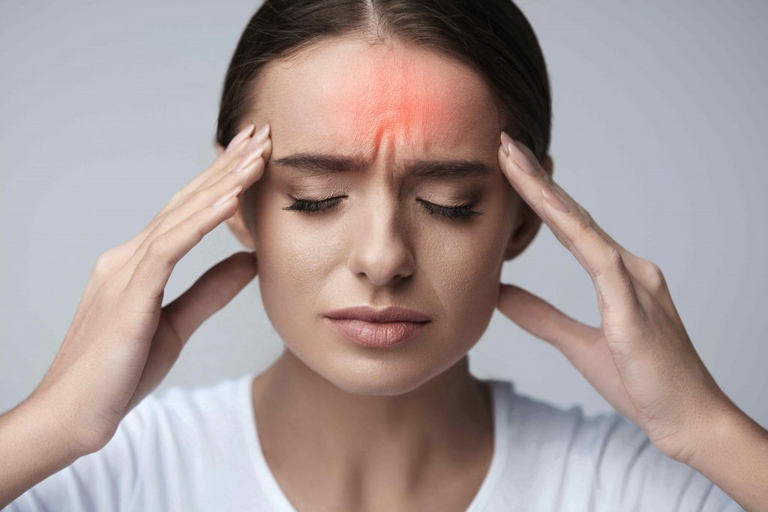
Case 2
31/F, GPH, ℅ headache x 3/7, insomnia, vomited undigested food x 3 times yesterday
Discharged from O&G yesterday after delivery
Now Postpartum Day 4
Vitals:
BP 165/86 P66 temp 37.3C SpO2 99% RA
Notes:
What are the red flags of headache?
What specific physical signs will you look for?
What are the differential diagnoses?
She developed loss of consciousness with 4 limbs twitching and uprolling eyeball around 5 minutes while waiting in A&E. What is the most likely diagnosis?
What are the management?

Slide 12
Q1. What are the red flags of headache?

Slide 13
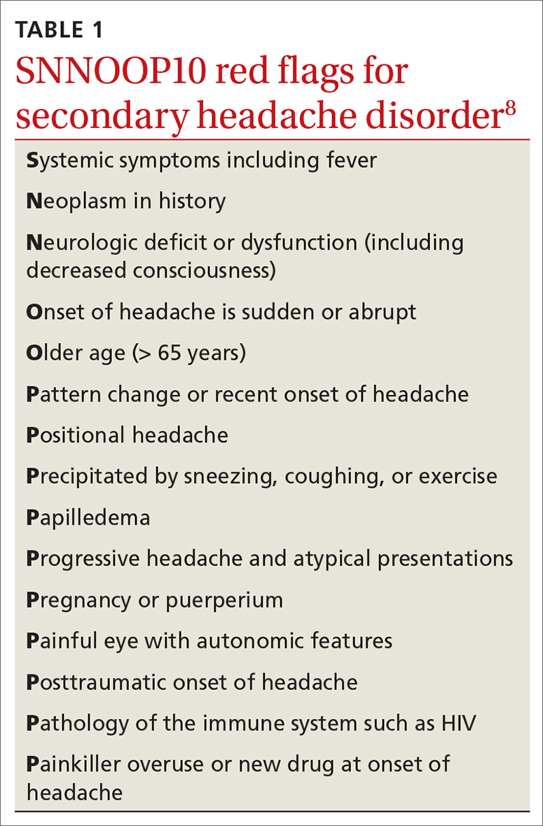
Q1. What are the red flags of headache?
What does a positional headache indicate?
Notes:
Positional headache - worse on lying down - raised ICP
SNNOOP10
Systemic symptoms
Neoplasm
Neurological deficits
Onset abrupt
Older age
Pattern change
Positional headache
Precipitated by sneezing
Papilledema
Progressive headache
Pregnancy/ puerperium
Painful eye
Post traumatic
Pathology of immune system
Painkiller overuse

Slide 14
Positional headache
May signal altered intracranial pressure
Improvement with Lying Down, Worsens When Upright
May indicate conditions such as spontaneous intracranial hypotension
Morning Headaches That Improve Upon Standing
May indicate elevated intracranial pressure.
Uptodate:
https://www.uptodate.com/contents/evaluation-of-headache-in-adults?search=positional%20headache&source=search_result&selectedTitle=1%7E150&usage_type=default&display_rank=1

Slide 15
Q2. What specific physical signs will you look for?

Slide 16
Q2. What specific physical signs will you look for?
General:
Generalized edema
Neurological examination
Central nervous system
visual field/ visual acuity
papilloedema
Peripheral nervous system
hyperreflexia
Abdominal examination
Epigastric tenderness

Slide 17
Q3. What are the differential diagnoses?

Slide 18

Q3. What are the differential diagnoses?
V: SAH
I: Infective causes: GE, meningitis
T: TBI
A: giant cell arteritis, cerebral lupus
M: hyponatremia, hypoglycemia
I: Primary headache
N: Brain tumor
OG: pre-eclampsia
Psy: panic attack

Slide 19
Q4
Developed loss of consciousness with 4 limbs twitching and uprolling eyeball around 5 minutes while waiting in A&E
What is the most likely diagnosis?

Slide 20
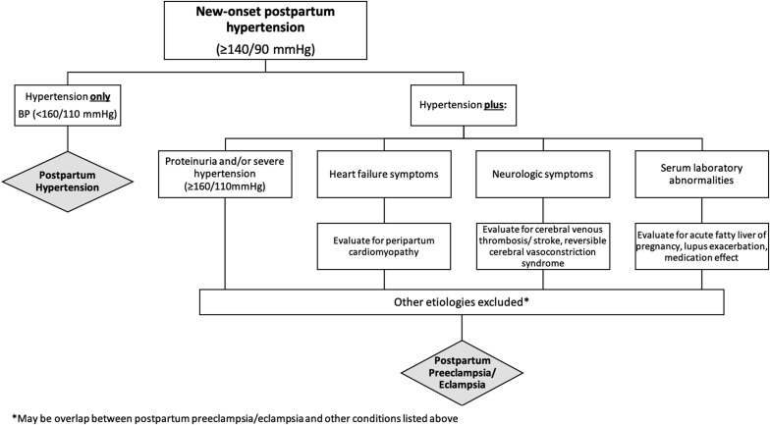
Q4
Developed loss of consciousness with 4 limbs twitching and uprolling eyeball around 5 minutes while waiting in A&E. What is the most likely diagnosis?
Postpartum eclampsia
Postpartum preeclampsia should be considered in women with new-onset hypertension 48 hours to 6 weeks after delivery.
Hauspurg A, Jeyabalan A. Postpartum preeclampsia or eclampsia: defining its place and management among the hypertensive disorders of pregnancy. American journal of obstetrics and gynecology. 2022 Feb 1;226(2):S1211-21.

Slide 21
Q5. What are the management?

Slide 22
Q5 What are the management?
Assess and secure airway
Magnesium sulphate IV 4g -6g over 30 min in D5/NS
BP control: e.g. IV labetalol 10 mg
CTB to look for/exclude intracranial hemorrhage
Consult ICU for intensive monitoring

Slide 23
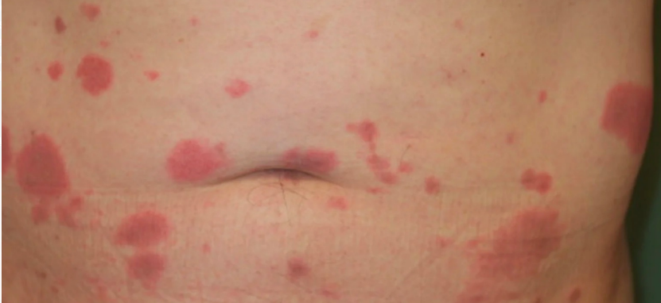
Case 3
Q1. What diagnosis do you suspect?
A 50/F, history of Crohn’s disease, newly started on azathioprine.
Temp: 38 ℃
℅ acute onset of painful, edematous, and erythematous plaques over abdomen, neck.
Notes:
https://knowyourskin.britishskinfoundation.org.uk/condition/sweets-syndrome/
What diagnosis do you suspect?
How to confirm the diagnosis?
How will you manage this patient in A&E?
What hematological disorder is most frequently associated?
What is the first line treatment?

Slide 24
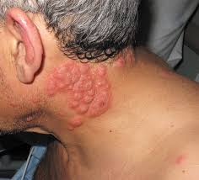
Q1. What diagnosis do you suspect?
Sweet syndrome (acute febrile neutrophilic dermatosis), likely drug induced
https://www.nejm.org/doi/full/10.1056/NEJMicm1911025

Slide 25
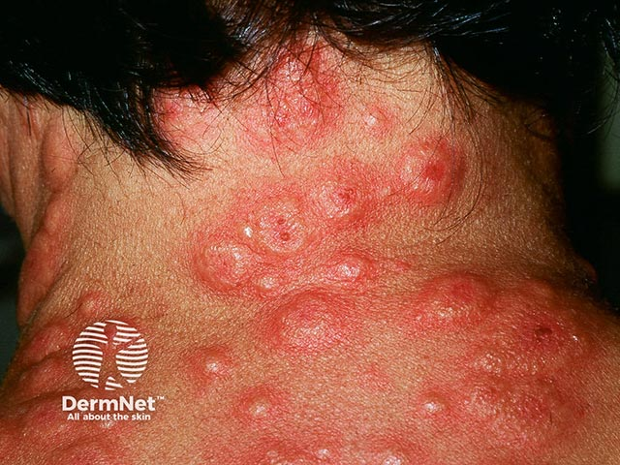
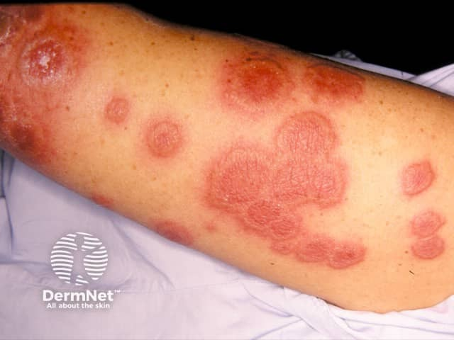
Sweet syndrome
an uncommon inflammatory disorder characterized by the abrupt appearance of painful, edematous, and erythematous papules, plaques, or nodules on the skin.
Causes:
Idiopathic, drug induced, malignancy associated
Classical Sweet syndrome: more common in female adults aged 40-60 years

Slide 26
Q2. How to confirm the diagnosis?

Slide 27
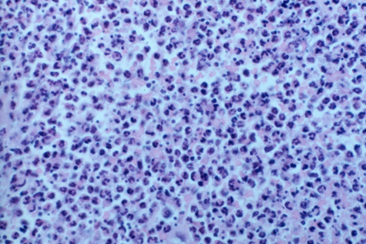
Q2. How to confirm the diagnosis?
Skin biopsy
Pathology findings
Prominent edema in the superficial dermis
Dense infiltrate of neutrophils in the upper and mid-dermis with sparing of the epidermis
Leukocytoclasis
Endothelial swelling
Absence of vasculitis

Slide 28
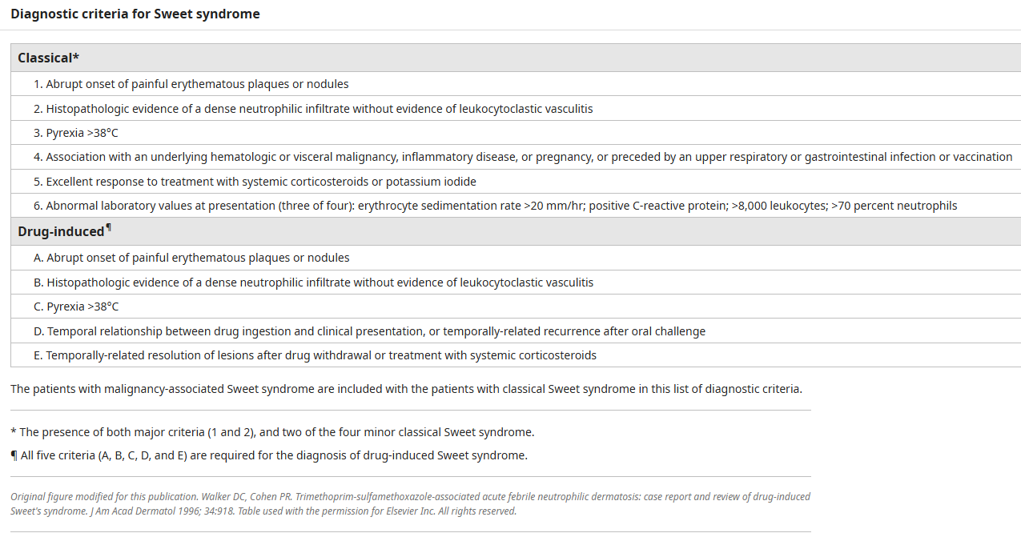
Diagnostic criteria

Slide 29
Q3. How will you manage this patient in A&E?

Slide 30
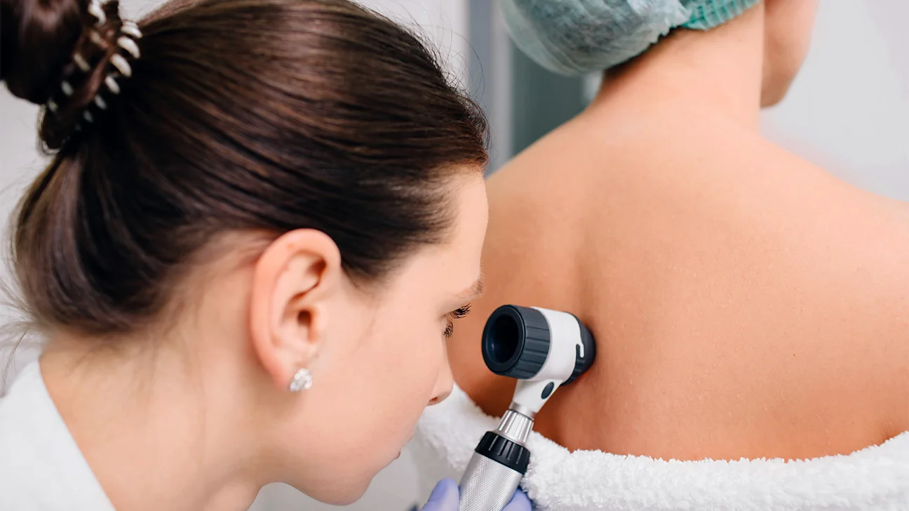
Q3. How will you manage this patient in A&E?
Pain control
Urgent referral to dermatologist for diagnosis and treatment

Slide 31
Q4. What hematological disorder is most frequently associated?

Slide 32
Q4. What hematological disorder is most frequently associated?
Acute myelogenous leukemia (AML)
AML is the malignancy most frequently associated with Sweet syndrome. In the review, AML accounted for 42 percent of the hematologic malignancies and myeloproliferative disorders constituted the second most common category of malignancy (22 percent)
Cohen PR, Talpaz M, Kurzrock R. Malignancy-associated Sweet's syndrome: review of the world literature. Journal of clinical Oncology. 1988 Dec;6(12):1887-97.

Slide 33
Q5. What is the first line treatment?

Slide 34
Q5. What is the first line treatment?
Systemic glucocorticoid therapy
It have been considered the 'gold standard' for the treatment of patients with Sweet's syndrome and usually results in dramatic clinical improvement.
Cohen PR, Kurzrock R. Sweet’s syndrome: a review of current treatment options. American journal of clinical dermatology. 2002 Apr;3:117-31.

Slide 35
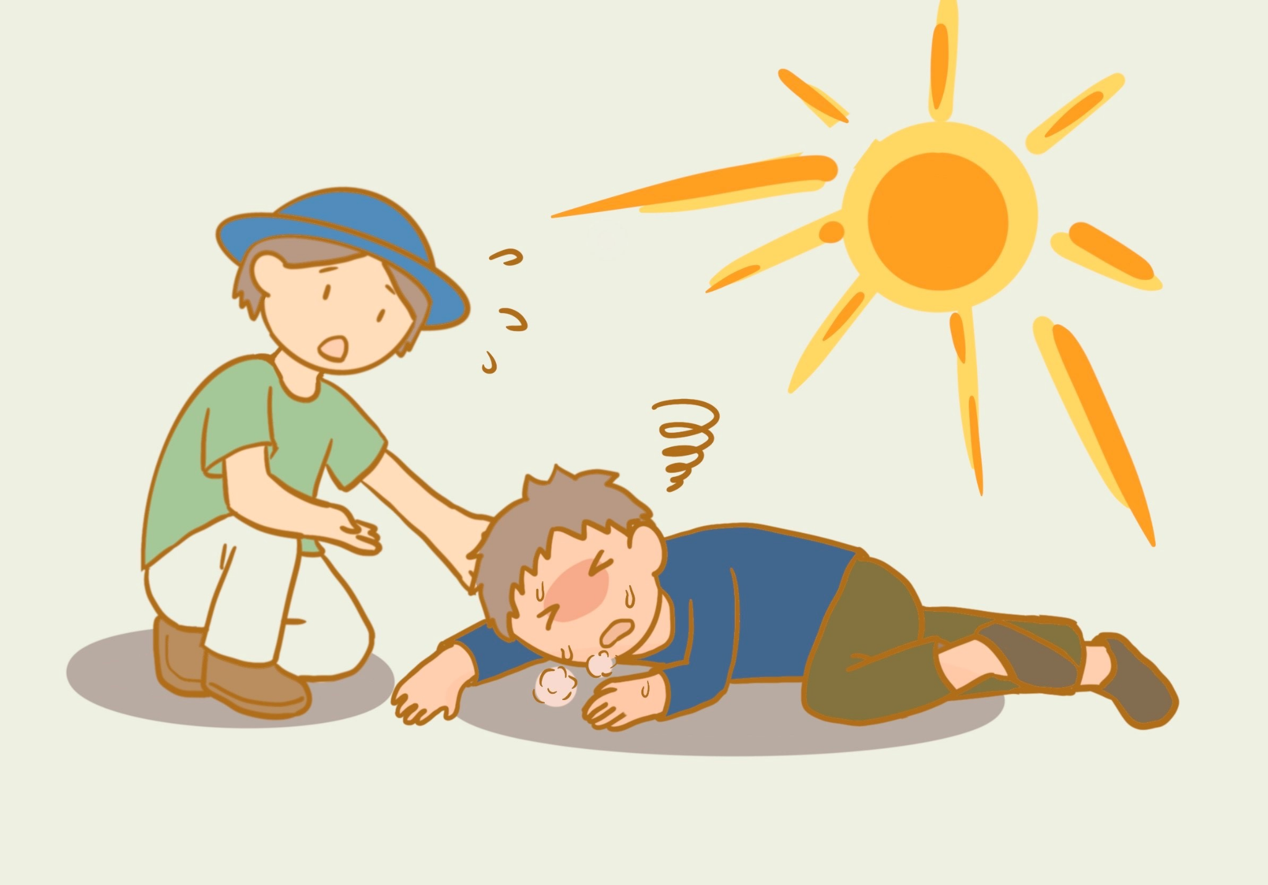
Case 4
64/F, GPH, Street cleaner
Brought to A&E in 8/2024, found unresponsive on street
Vitals:
Temp 42 ℃ (tympanic)
GCS E1V1M1 on arrival
BP 92/49, P 154 sinus tachycardia
SpO2 86% via non-rebreathing mask
Notes:
What immediate management will you do?
What are the differential diagnoses other than heat stroke? Name 4
A colleague suggest using succinylcholine as muscle relaxant. Do you agree?
What is the temperature target and cooling rate in heat stroke?
Should we use antipyretics such as paracetamol for temperature control in exertional heat stroke?

Slide 36
Q1. What immediate management will you do?

Slide 37
Q1. What immediate management will you do?
Airway protection with endotracheal intubation and mechanical ventilation

Slide 38
Q2. What are the differential diagnoses other than heat stroke? Name 4

Slide 39
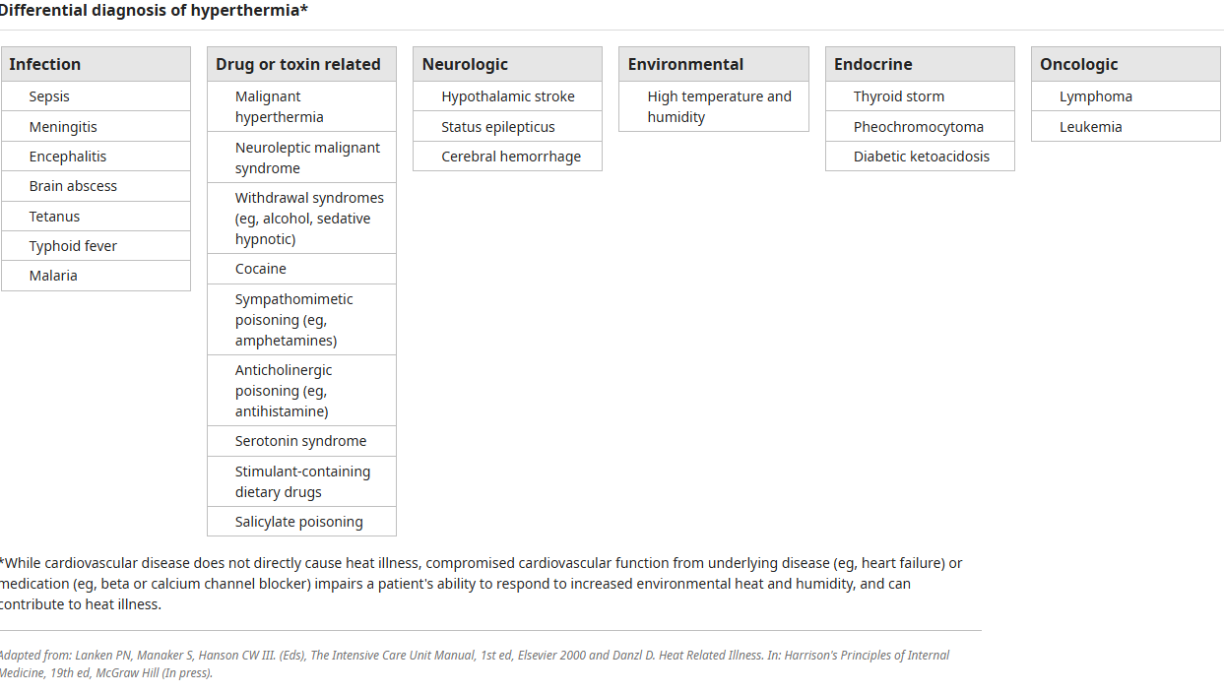
Q2. What are the differential diagnoses other than heat stroke? Name 4
Infection: meningitis, encephalitis, sepsis
Drug cause: serotonin syndrome, neuroleptic malignant syndrome, sympathomimetic toxidrome
Endocrine: thyrotoxicosis, pheochromocytoma
Oncologic: lymphoma, leukemia
Uptodate

Slide 40
Q3. A colleague suggest using succinylcholine as muscle relaxant. Do you agree?

Slide 41
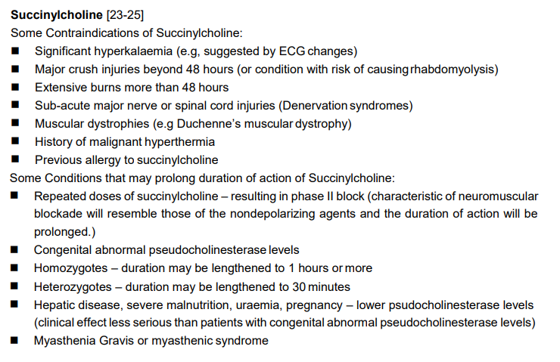
Q3. A colleague suggest using succinylcholine as muscle relaxant. Do you agree?
No, succinylcholine should be avoided
May confuse matters later regarding the possibility of malignant hyperthermia.
May worsen hyperkalemia

Slide 42
Q4. What is the temperature target and cooling rate in exertional heat stroke?

Slide 43
Q4. What is the temperature target and cooling rate in exertional heat stroke?
Uptodate:
Complete within 30 minutes of presentation, if possible
Cease cooling when rectal temperature reaches approximately 103°F (39.4°C)
In the absence of a specifically defined end-point temperature for safe cessation of cooling, common practice dictates a target temperature below 39°C (preferably 38.5° to 38.0°C) to lessen the risk of clinical deterioration.
For exertional heatstroke, a cooling rate faster than 0.10°C per minute is safe and is desirable for improving the prognosis.
Cold water immersion (CWI): achieving a cooling rate of 0.20° to 0.35°C per minute
Cooling rates >0.15 °C/min for EHS patients were significantly associated with surviving EHS without medical complications.
Filep EM, Murata Y, Endres BD, Kim G, Stearns RL, Casa DJ. Exertional heat stroke, modality cooling rate, and survival outcomes: a systematic review. Medicina. 2020 Nov 5;56(11):589.
Epstein Y, Yanovich R. Heatstroke. New England Journal of Medicine. 2019 Jun 20;380(25):2449-59.
Notes:
https://www.nejm.org/doi/full/10.1056/NEJMra1810762

Slide 44
Q5. Should we use antipyretics such as paracetamol for temperature control in exertional heat stroke?
Notes:
https://www.nejm.org/doi/full/10.1056/NEJMra1810762

Slide 45
Q5. Should we use antipyretics such as paracetamol for temperature control in exertional heat stroke?
Antipyretics, for example, paracetamol and aspirin, should not be routinely used to reduce the hyperthermia
Because the mechanism is excessive heat generation rather than hypothalamic-induced heat retention. (for exertional heat stroke)
The risk for known adverse effects (e.g., hepatotoxicity, acute kidney injury, bleeding), which may be particularly evident in patients with heat stroke due to their high risk for organ dysfunction
Barletta JF, Palmieri TL, Toomey SA, AlShamsi F, Stearns RL, Patanwala AE, Siparsky NF, Badjatia N, Schultz B, Breighner CM, Bruno E. Society of Critical Care Medicine Guidelines for the Treatment of Heat Stroke. Critical care medicine. 2025 Feb 21;53(2):e490-500.
Notes:
https://www.nejm.org/doi/full/10.1056/NEJMra1810762

Slide 46
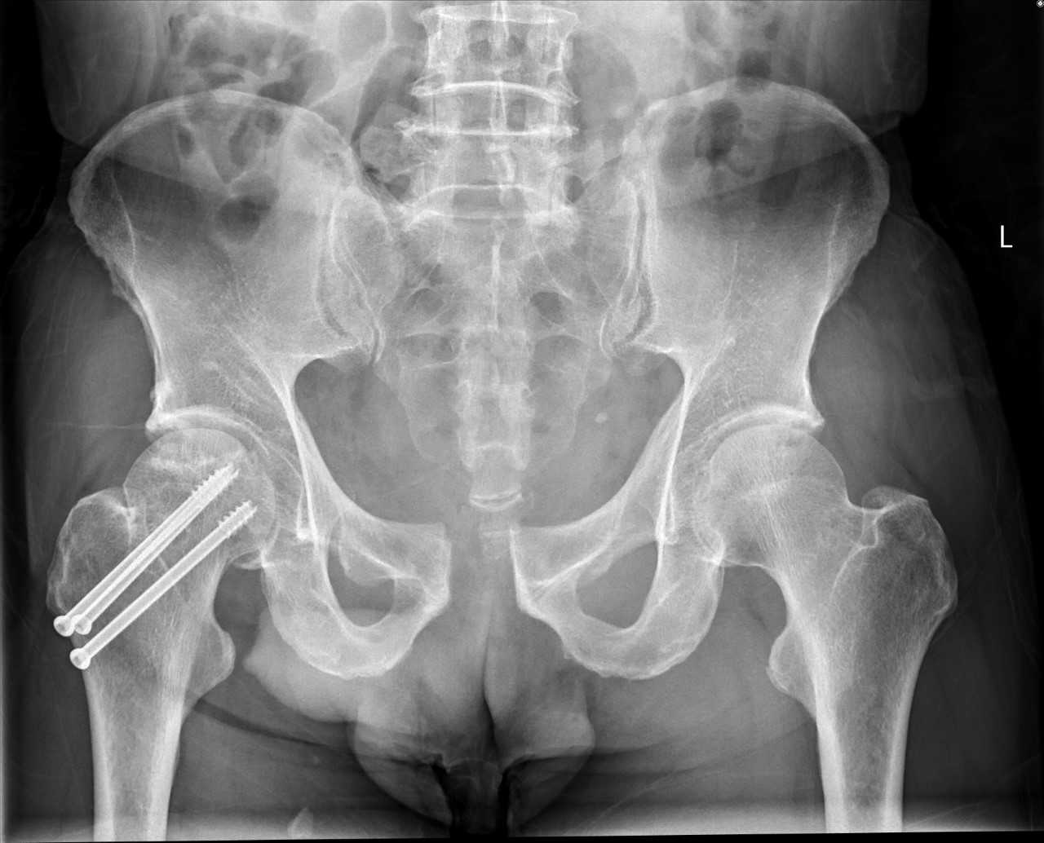
Case 5
A 70-year-old man c/o bilateral groin pain after riding a horse, with no prior history of falling.
Vitals:
GCS E4V5M6
BP 120/74 P110, SpO2 98% RA Temp 36
Xray of pelvis was performed
Notes:
Interpret the xray
What is your next immediate step of management?
What are the classification scheme?
Give 3 complications associated with this injury.
What are the further management?

Slide 47
Q1. Interpret the xray

Slide 48
Q1. Interpret the xray
The most striking feature is abnormal widening of the pubic bone suggestive of pelvic symphysis diastasis. (A width of >10 mm is considered diagnostic.)
The left sacroiliac joint appears disrupted.
Evidence of right hip screws.

Slide 49
Q2. What is your next immediate step of management?

Slide 50
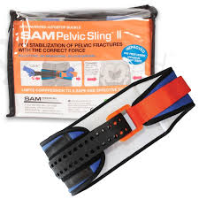
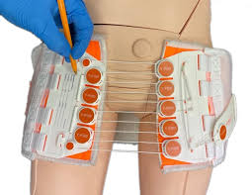
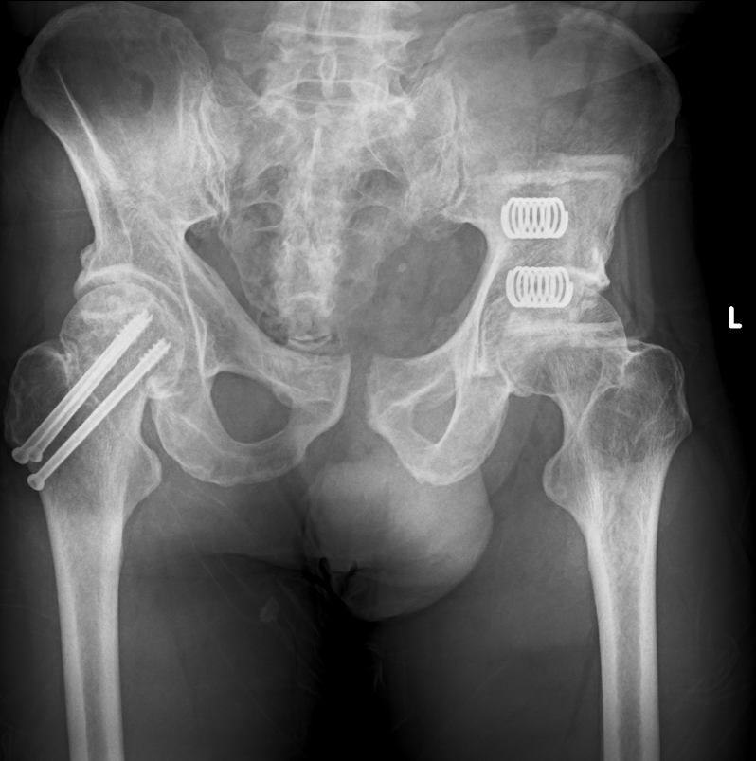
Q2. What is your next immediate step of management?
Pelvic binder
Apply at the level of the greater trochanter

Slide 51
Q3. What are the classification scheme?

Slide 52
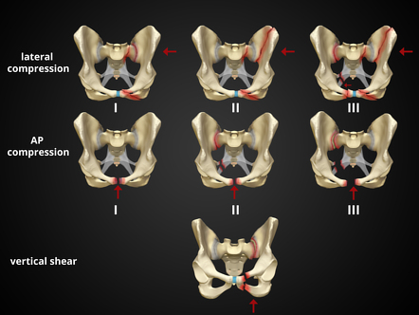
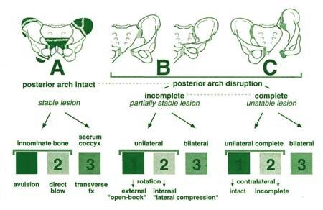
Q3. What are the classification scheme?
Tile classification
Tile A
Stable
Tile B
Rotationally unstable, vertically stable
Tile C
Rotationally and vertically unstable
Young-Burgess Classification
Anterior Posterior Compression (APC)
Lateral compression
Vertical shear

Slide 53
Q4. Give 3 complications associated with this injury.

Slide 54
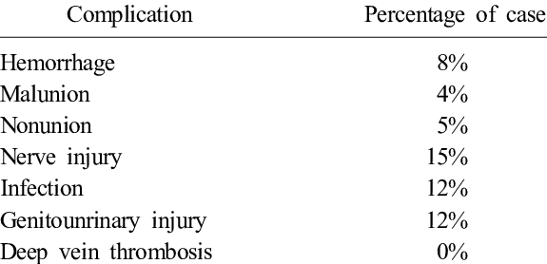
Q4. Give 3 complications associated with this injury.
Hemorrhage | Originate from the sacral venous plexus or internal iliac artery rupture
Urological injury | Urethral laceration, bladder rupture
Gynecological injury | Vaginal laceration, uterine injury. If the patient is pregnant --> high risk of fetal loss
Rectal injuries | PR: blood
Nerve injury | Lumbosacral plexus particularly the sciatic nerve, femoral nerve, and obturator nerve
DVT, PE
Infections
Min BW, Lee KJ, Kim GW, Kwon D. Complications of Pelvic Ring Injury. Journal of the Korean Fracture Society. 2013 Oct 1;26(4):348-53.
Saleh MH, Elashmawy A, Hazime M, Wallace B, Saad MA. Comprehensive Orthopedic Management of an Open-Book Pelvic Fracture: A Multidisciplinary Approach in Trauma Care. Cureus. 2024 Jul 2;16(7):e63669.

Slide 55
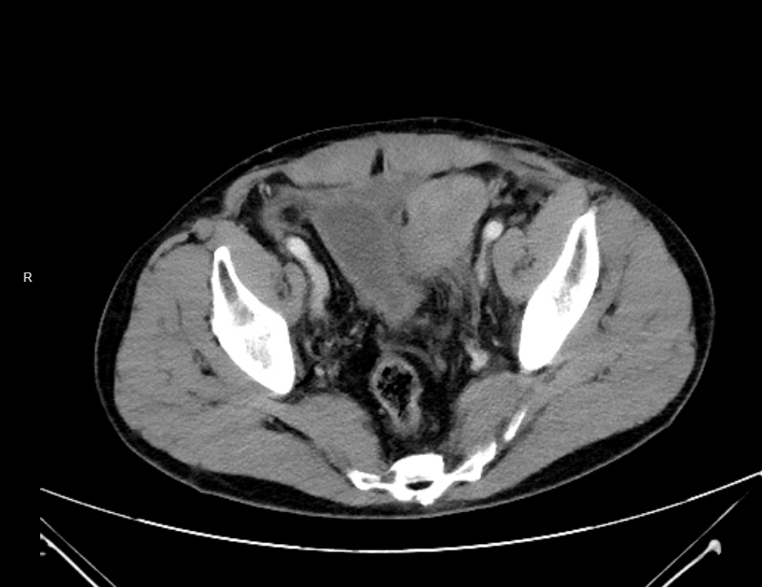
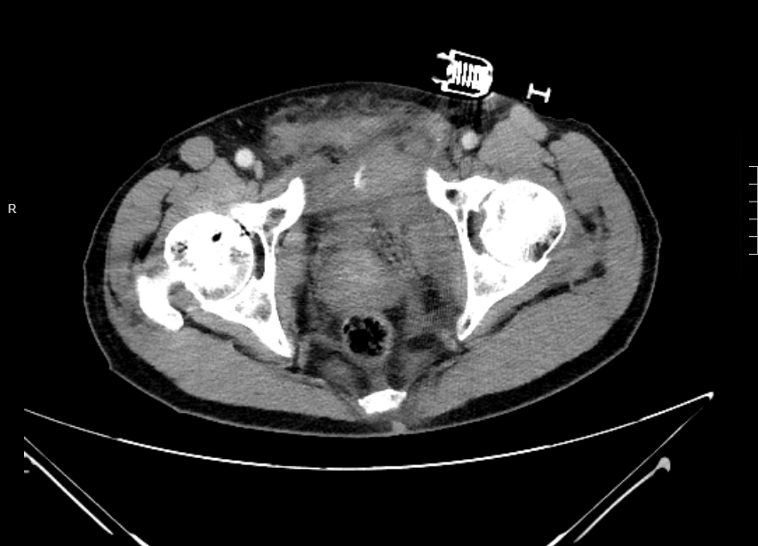
CT
Diastasis of pubic symphysis. Haematoma with active contrast extravasation at the paravesical region.

Slide 56
Q5. What are the further management?

Slide 57
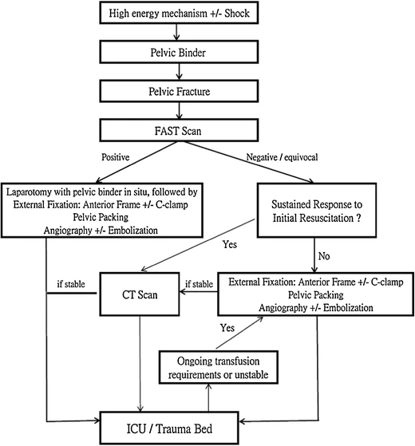
Q5. What are the further management?
Three-in-one protocol
External pelvic fixation
Retroperitoneal pelvic packing
Angiography +/- embolization
Cheng M, Lee KY, Chang AM, Ho HF, Chan LP, Lee KB, Kwok PC, Lee AC, Wong KY, Kam CW, Leung GK. Three-in-one protocol reduces mortality of patients with haemodynamically unstable pelvic fractures—a five year multi-centred review in Hong Kong. International Orthopaedics. 2018 Oct;42:2459-66.

Slide 58


