Slide 1
OSCE Questions
Presented by TKOH

Slide 2
Question A

Slide 3
Case scenario
M/26, good past health
AA case
Sustained a facial injury after being punched by someone
No LOC, nausea or vomiting
But left face swelling
Also expelled blood in nostril
CT was done for evaluation

Slide 4
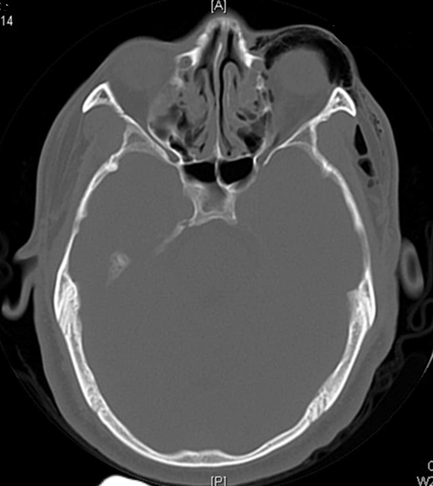
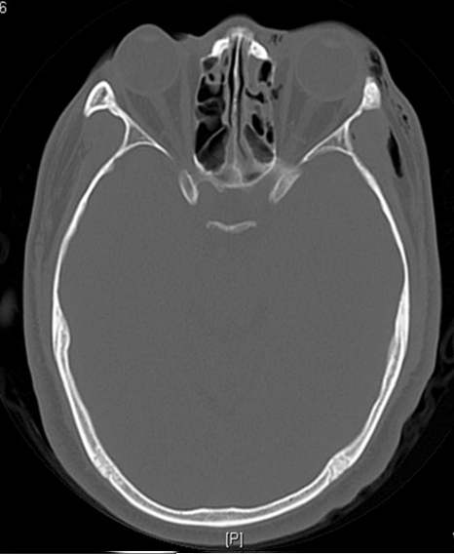
Q1. List 3 CT abnormalities (1.5 pts) What is the diagnosis based on the findings (0.5 pt)

Slide 5
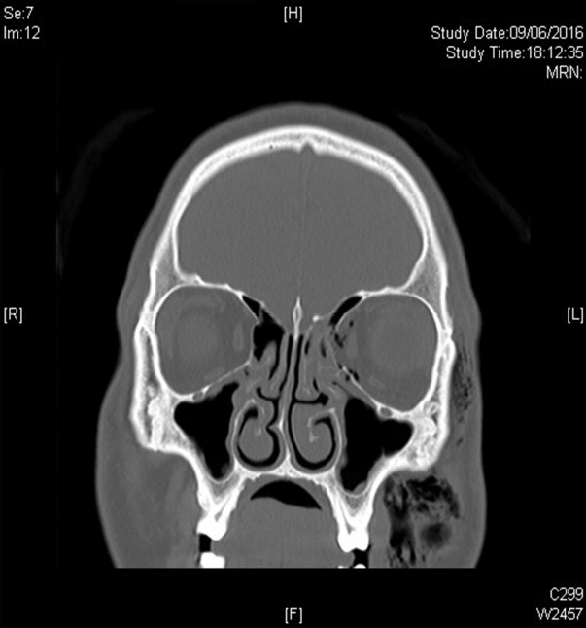
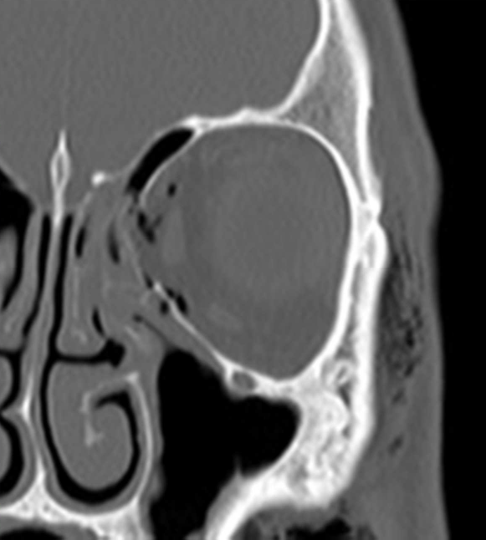
Q1. List 3 CT abnormalities (1.5 pts) What is the diagnosis based on the findings (0.5 pt)

Slide 6
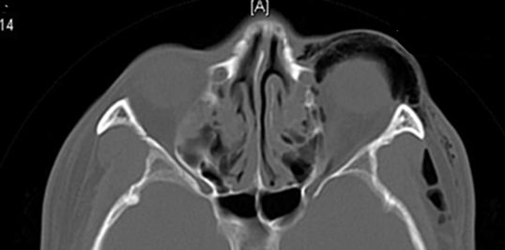
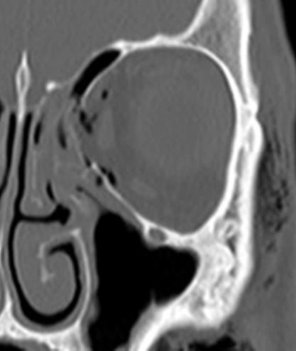
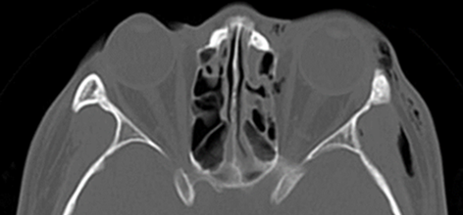
Q1. List 3 CT abnormalities (1.5 pts) What is the diagnosis based on the findings (0.5 pt)

Slide 7
Q1. List 3 CT abnormalities (1.5 pts) What is the diagnosis based on the findings (0.5 pt)
Surgical emphysema over left orbital and facial region
Fracture left medial orbital wall
Fracture left ethmoid sinus
Blowout fracture involved the medial wall
Fracture of the bones surrounding the eye socket, in this case, the medial wall, without involving the orbital rim

Slide 8
Q2. He complained of diplopia after the injury. Which muscle is most likely involved? (0.5 pt)
Left medial rectus muscle ⁽¹⁾
Herniation of medial rectus causing diplopia on horizontal gaze

Slide 9
Q3. Name 4 additional potential causes for his blurring of vision (0.5 pt each)
Corneal abrasion
Traumatic Hyphema
Vitreous Hemorrhage
Retinal detachment
Commontio retinae
Optic nerve injury
Rupture globe
Orbital compartment syndrome

Slide 10
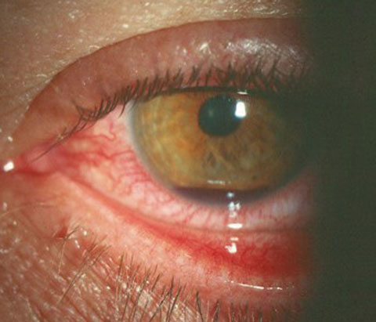
Q4. On eye examination, what is the diagnosis? (0.5 pt)
Traumatic hyphema

Slide 11
Q5. Please name 4 important management in the ED (0.5 pt each)
Upright position
Apply eye shield
Check drug Hx: avoid / reverse agents that may cause bleeding diathesis
Consult Ophthalmologist
Oral analgesia
Topical cycloplegics
Consider antiemetics
Identify and treat associated injuries

Slide 12
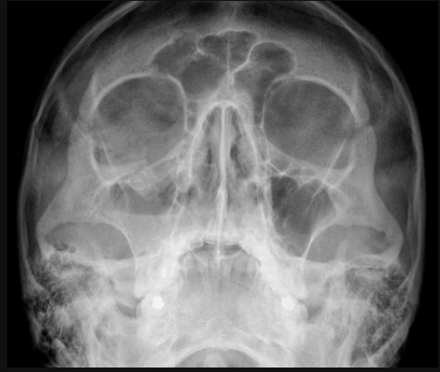
Q6. Another patient with similar pattern of injury.
What view was ordered? (0.5 pt)
Name 3 abnormal X ray findings
(1.5 pts)

Slide 13
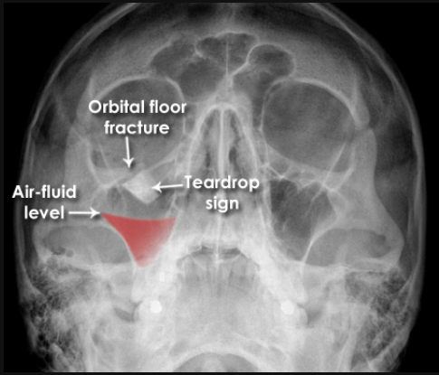
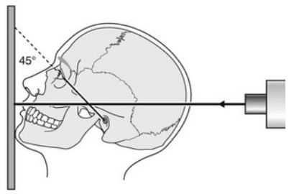
Occipitomental; OM view or Waters view
An angled PA SXR with the patient gazing slightly upwards
Better visualized the maxillary sinuses, facial bones, and orbital margin
Source: https://www.radiologymasterclass.co.uk

Slide 14
Q7. What was the site and pattern of injury? (0.5 pt) Which muscle is commonly being affected in such condition if patient also complained of diplopia? (0.5 pt)
Orbit floor blow out fracture
Inferior rectus muscle ⁽²⁾

Slide 15
Reference
Pearls of Orbital Trauma Management. Semin Plast Surg. 2010 Nov;24(4):398–410.
Orbital fractures: a review. Clin Ophthalmol. 2011 Jan 12;5:95–100.
Management of Traumatic Hyphema and Prevention of Its Complications. Cureus. 2021 Jun 20;13

Slide 16
Question B

Slide 17
Case scenario
A 42 year old female presented with headache for 5 days
She also complained of left side weakness and expressive dysphasia for 8 hours
BP 150/90 mmHg P 90/min
Afebrile SpO2 100% RA
GCS E4V4M6
Power right side 5/5 left side 4/5

Slide 18
Q1. List 4 differential diagnosis (2 pts)
Stroke: ischemic, hemorrhagic, SAH
Brain tumor
Brain abscess
Migraine: hemiplegic migraine / status migrainosus

Slide 19
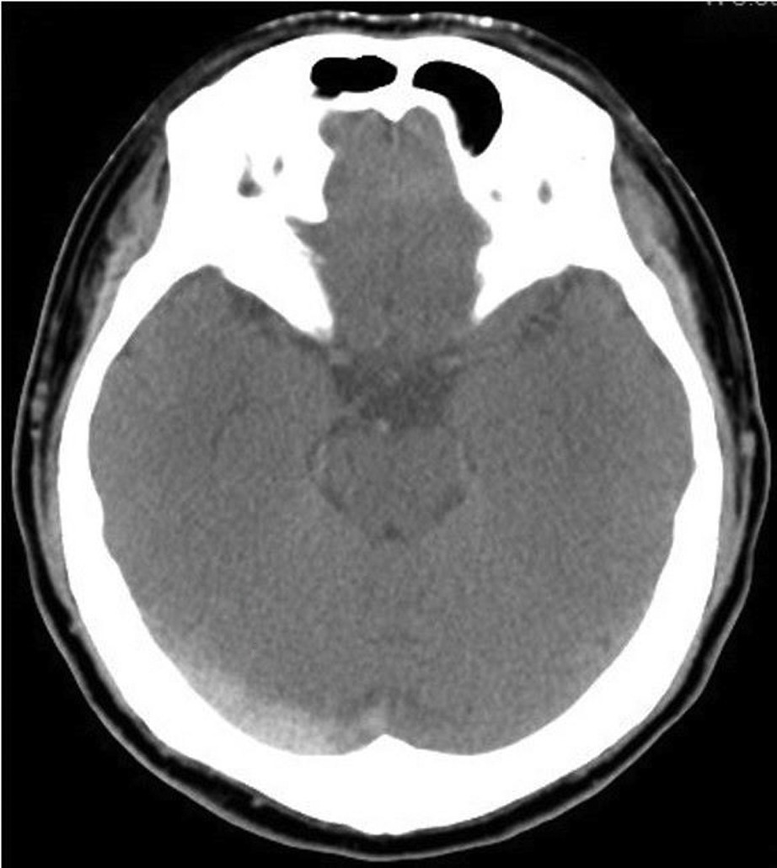
Q2. Name 1 abnormality in this CTB (0.5 pt) What is this sign called ? (0.5 pt)
A cord like hyperattenuation within the region of right transverse sinus
Cord sign

Slide 20
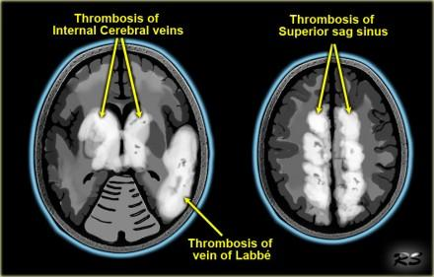
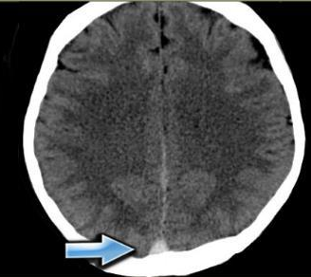
Q3. State the provisional diagnosis (1 pt) List other possible CTB findings of the diagnosis (2 pts)
Cerebral venous sinus thrombosis
Indirect signs:
  Venous hemorrhage or infarct, especially in parasagittal and bi-thalamic regions, also temporal lobes
Direct signs:
  Dense clot sign, cord sign

Slide 21
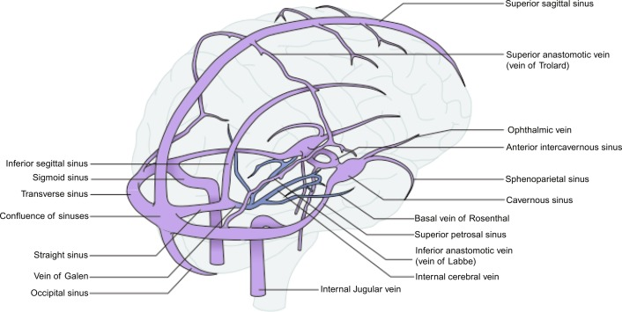

Slide 22
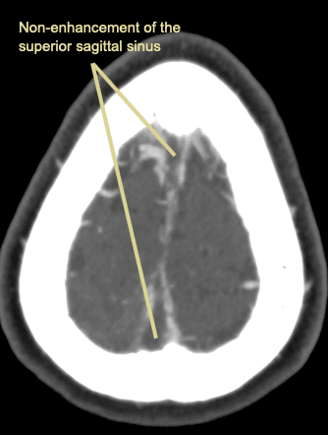
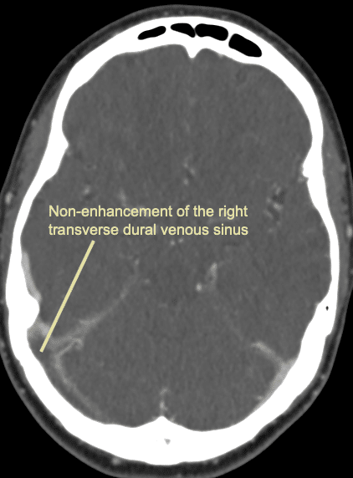
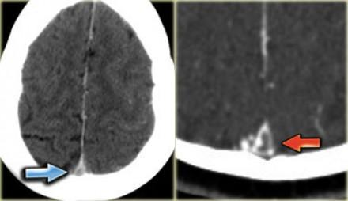
Q4. Suggest 2 other imaging modalities to aid diagnosis (1 pt)
CT venogram
MR venogram

Slide 23
Q5. Briefly state the management plan (4 pts)
Resuscitation and ICP management
Anticoagulation: LMWH then oral anticoagulants
Catheter based endovascular therapy: if CI or deterioration after anticoagulation
Treat underlying causes and prevent complications

Slide 24
Q6. If venous hemorrhage (indirect sign) is seen, should anticoagulant be given? (0.5 pt)
Yes, anticoagulant is NOT a contraindication in venous hemorrhage
Supported by studies, low rates of cerebral hemorrhage were shown after anticoagulant, no significant increase in morbidity or mortality even if new hemorrhage
Einhäupl KM, Villringer A, Meister W, Mehraein S, Garner C, Pellkofer M, Haberl RL, Pfister HW, Schmiedek P. Heparin treatment in sinus venous thrombosis. Lancet. 1991;338:597–600.
Preter M, Tzourio C, Ameri A, Bousser MG. Long-term prognosis in cerebral venous thrombosis: follow-up of 77 patients. Stroke. 1996;27:243–246.

Slide 25
Q7. Name 4 etiologies of young stroke (2 pts)
CNS infection and tumor
Cerebral venous sinus thrombosis
Carotid or vertebral artery dissection: trauma, marfan syndrome, ehlers danlos syndrome
Vasculitis: moya moya disease, takayasu arteritis, behcets disease
Cardiac emboli: IE, prosthetic heart valve
Drugs: cocaine, amphetamine

Slide 26
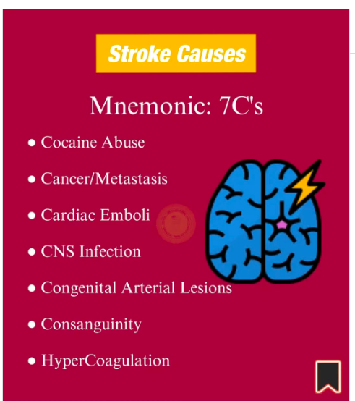

Slide 27
Reference
AHA/ASA Journals: Diagnosis and Management of Cerebral Venous Thrombosis: A Scientific Statement From the American Heart Association
Radiopaedia: Dural venous sinus thrombosis

Slide 28
Question C

Slide 29
Case scenario
A 67-year-old woman fell from 2 meters, landing on her outstretched right hand
She presented with right elbow pain and swelling
Examination showed gross swelling of the right elbow with reduced range of movement
X-ray of the right elbow was taken

Slide 30
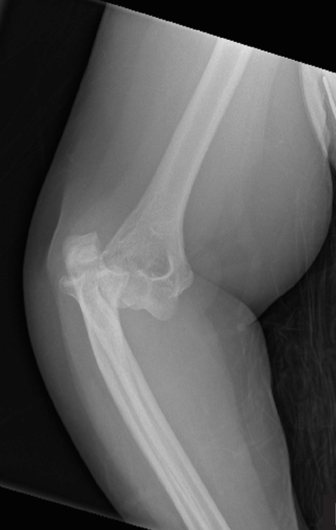
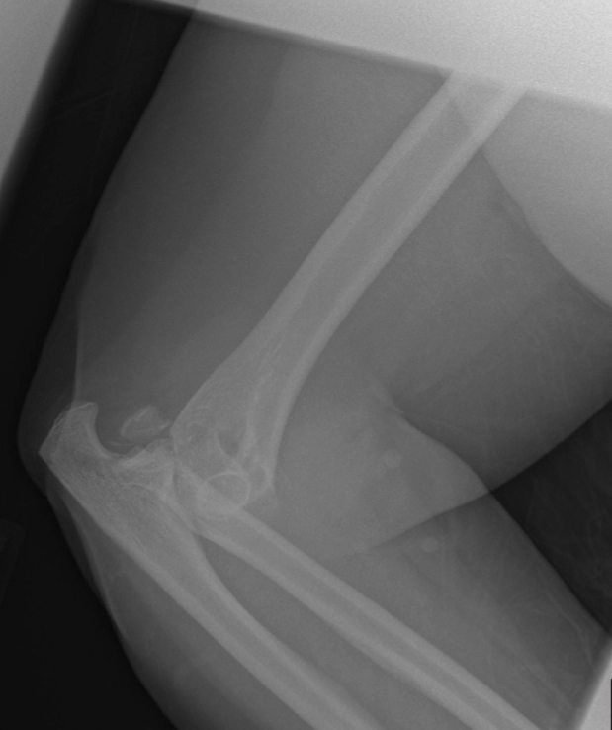
Q1. Name 3 abnormal findings on the X-rays (3 pts)

Slide 31

  Posterior elbow dislocation
  Radial head fracture
  Coronoid process fracture
1
2
3

Slide 32
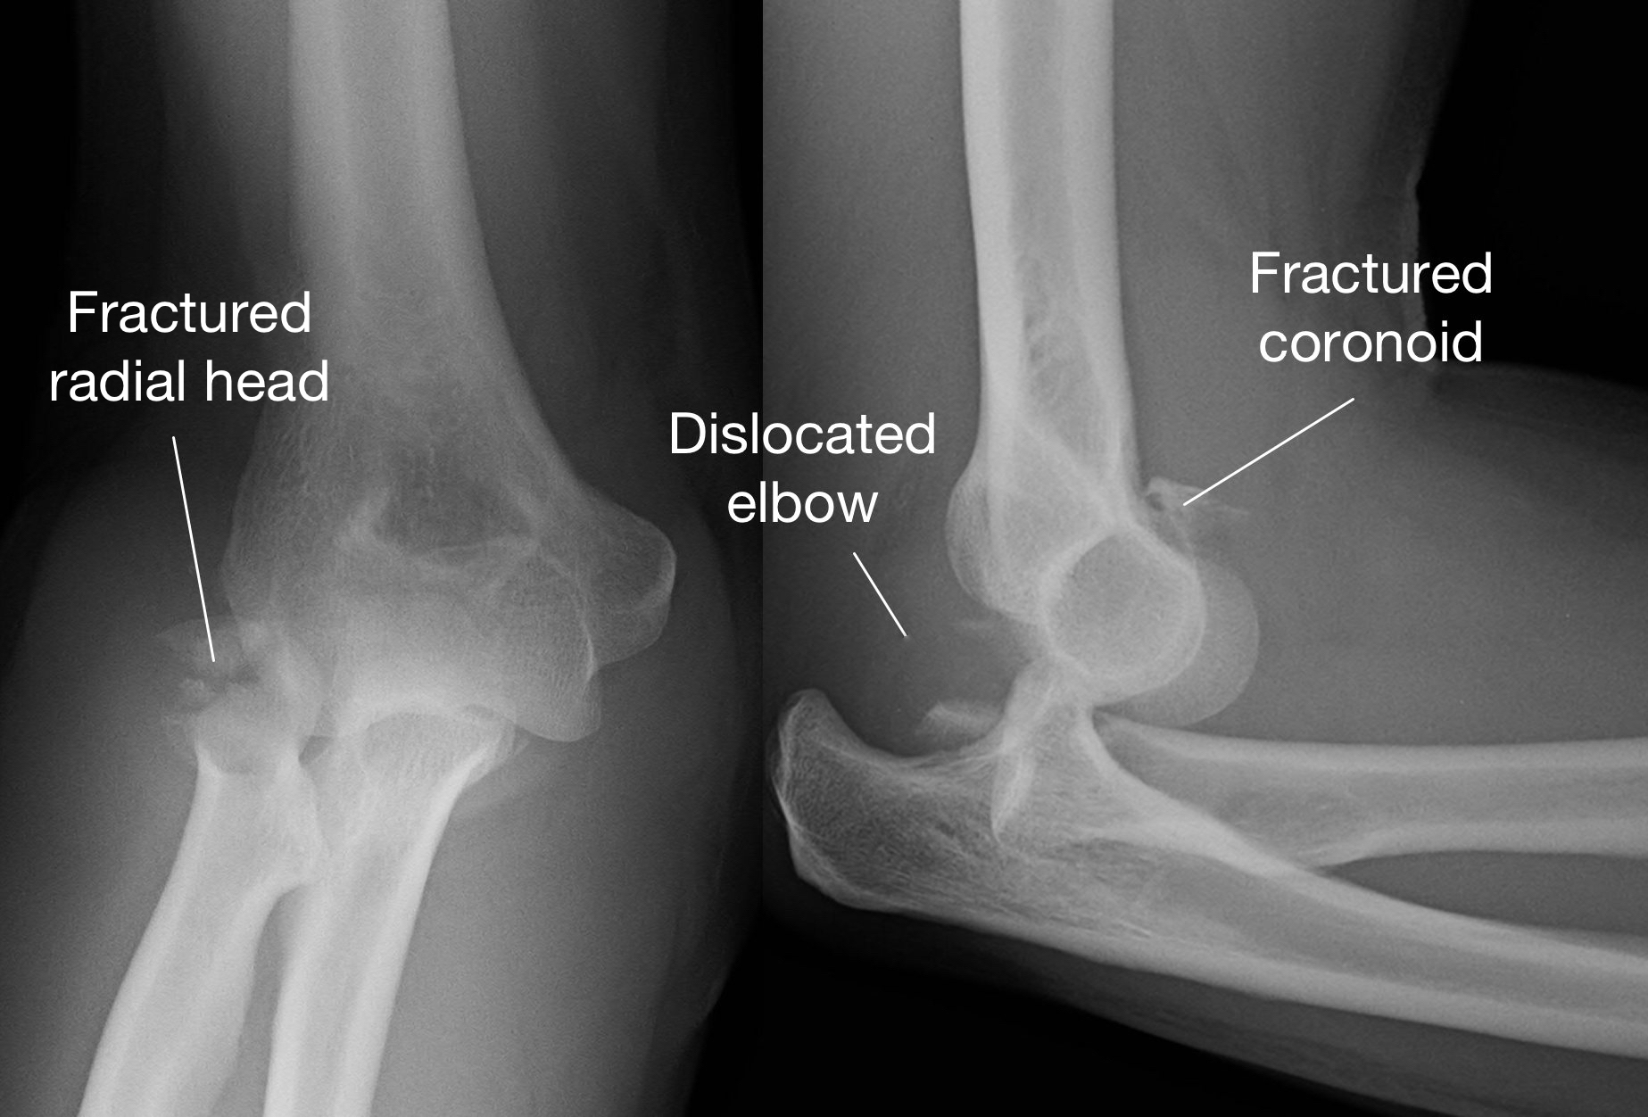
Q2. What is this condition called? (1 pt)
Terrible triad of the elbow
A traumatic injury pattern of the elbow characterized by elbow dislocation, radial head or neck fracture, and ulnar coronoid process fracture
Mechanism:
  fall on supinated forearm and extended arm that results in a combination of valgus, axial, and posterolateral rotatory forces
  produces posterolateral dislocation

Slide 33
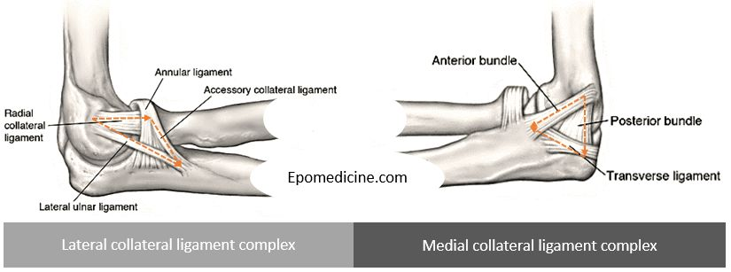
Q3. Name 2 ligaments that are usually involved in this condition (2 pts)
  Medial collateral ligament
  Lateral collateral ligament

Slide 34
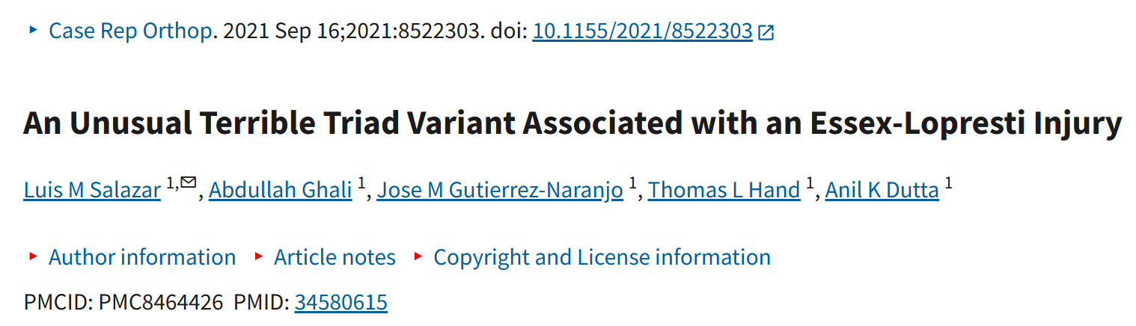
Q4. If the patient also complains of wrist and forearm pain and swelling, what should you look for? (1 pt)
Essex-Lopresti injury, in the presence of ALL of the 3 following:
  Fracture radial head
  Distal radio-ulnar joint dislocation
  Interosseous membrane rupture
Terrible triad of the elbow and Essex-Lopresti injuries are rare injuries respectively, but there have been case reports of both in high energy trauma

Slide 35
Q5. What is your immediate management in the emergency room for this condition? (1 pt)
Attempt closed reduction under procedural sedation

Slide 36
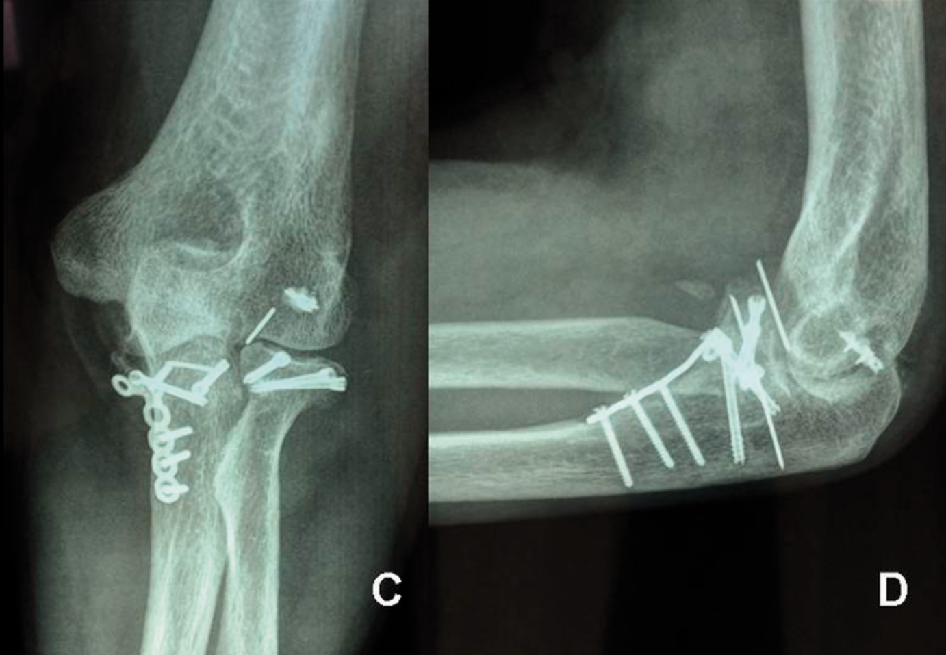
Q6. What is the definitive treatment for this condition? (1 pt)
Surgical repair
  ORIF / radial head arthroplasty
  Coronoid ORIF
  LCL reconstruction
  MCL reconstruction

Slide 37
Q7. Name 3 complications from this condition
(3 pts)
Any 3 of the followings
  Post-traumatic arthritis
  Joint instability
  Failure of internal fixation
  Post-traumatic stiffness
  Heterotrophic ossification
Terrible triad of the elbow generally has a poor prognosis due to instability, stiffness and arthrosis

Slide 38
References
Batista C and Cohen M. “Terrible Triad of Elbow.” Orthobullets. Updated Jul 12, 2025. https://www.orthobullets.com/trauma/1021/terrible-triad-injury-of-elbow
Salazar LM, Ghali A, Gutierrez-Naranjo JM. An Unusual Terrible Triad Variant Associated with an Essex-Lopresti Injury. Case Rep Orthop. 2021 Sep 16;2021:8522303. doi: 10.1155/2021/8522303. PMID: 34580615; PMCID: PMC8464426.

Slide 39
Question D

Slide 40
Case scenario
45 year-old male
GPH, TOCC -ve
5 days of progressive weakness starting from his legs, now involving his arms, along with tingling in his hands and feet
Diarrhea 2 weeks ago after eating undercooked chicken
No prior injury
Bilateral LL power 4/5, diminished reflexes and mild respiratory distress

Slide 41
Q1. What are the top 4 DDx to consider? (2 pts)
Guillain-Barre syndrome
Spinal Cord Lesions
  - Transverse myelitis, spinal cord tumors, and spinal epidural abscesses
Myasthenia gravis
Polymyositis
Toxicology
  Heavy metal poisoning (e.g. lead, arsenic) or Organophosphate poisoning

Slide 42
Q2. Name 4 important physical examination to differentiate the cause of the disease (2 pts)
Tendon reflex
Sensory deficit / level
Muscle fatigability
Cranial nerve
Guillain-Barre syndrome
  Areflexia (LMN)
  Sensory symptoms: tingling or numbness
  Symmetrical ascending pattern from lower limb with respiratory muscle involvement in severe cases
Spinal cord compression
  Hyperreflexia (UMN)
  Sensation impairment with sensory level
  No respiratory muscle involvement unless above C5
Myasthenia gravis
  Normal tendon reflex
  No sensory deficit
  Fatigue

Slide 43
Q3. Based on the clinical finding, GBS was suspected. Name 4 risk factors for occurrence of GBS (2 pts)
Preceding infections
  Bacterial: Campylobacter jejuni, Mycoplasma pneumoniae
  Viral: Cytomegalovirus, Epstein-Barr virus, Zika virus, influenza, HIV
Vaccination: Vaccine for influenza, COVID-19, tetanus
Age: Older adults > 50 years old slightly higher risk
Gender: Male slightly more common
Recent surgery (post surgical GBS)

Slide 44
Q4. What is the most common subtype of GBS? (0.5 pt) What antecedent infection is classically related in our case? (0.5 pt)
A. Acute inflammatory demyelinating polyneuropathy (AIDP)
  ~66% of cases
B. Campylobacter jejuni (post-diarrheal)
  Other triggers: Cytomegalovirus, EBV infection, Zika virus
  Causes destruction of myelin in peripheral nervous system

Slide 45
Q5. Patient complained of SOB, how can we monitor the respiratory function of this patient? (0.5 pt) When to consider intubation? (0.5 pt)
Respiratory failure from diaphragmatic weakness is the number one cause of mortality in GBS
Monitoring:
  Forced vital capacity (FVC) Q2-4 hours
  If FVC <20 mL/kg → intubate

Slide 46
Q6. What are the 3 useful treatment for GBS? (1.5 pts) Is steroid useful? (0.5 pt)
Intravenous immunoglobulin (IVIG)
Plasmapheresis
Supportive care: mechanical ventilation, pain control with Gabapentin
Steroid is not effective

Slide 47
Reference
Leonhard, S. E., Mandarakas, M. R. [Evidence based guidelines. Diagnosis and management of Guillain-Barré syndrome in ten steps]. Nat Rev Neurol. 2019 Nov;15(11):671-683
Hughes RAC. Guillain-Barré syndrome: History, pathogenesis, treatment, and future directions. Eur J Neurol. 2024 Nov;31(11)

Slide 48
Question E

Slide 49
Case scenario
58/F GPH
Feeling weak, heart beating for weeks
SOB for few days, now worse on lying down
Mild chest discomfort with palpitations
Repeated vomiting and diarrhea since yesterday
Cough and runny nose a few days before, seen TCM
GCS full
BP 141/98 mmHg
HR 174/min
RR 22/min
SpO2 99% on RA
Temp 36.1 deg

Slide 50
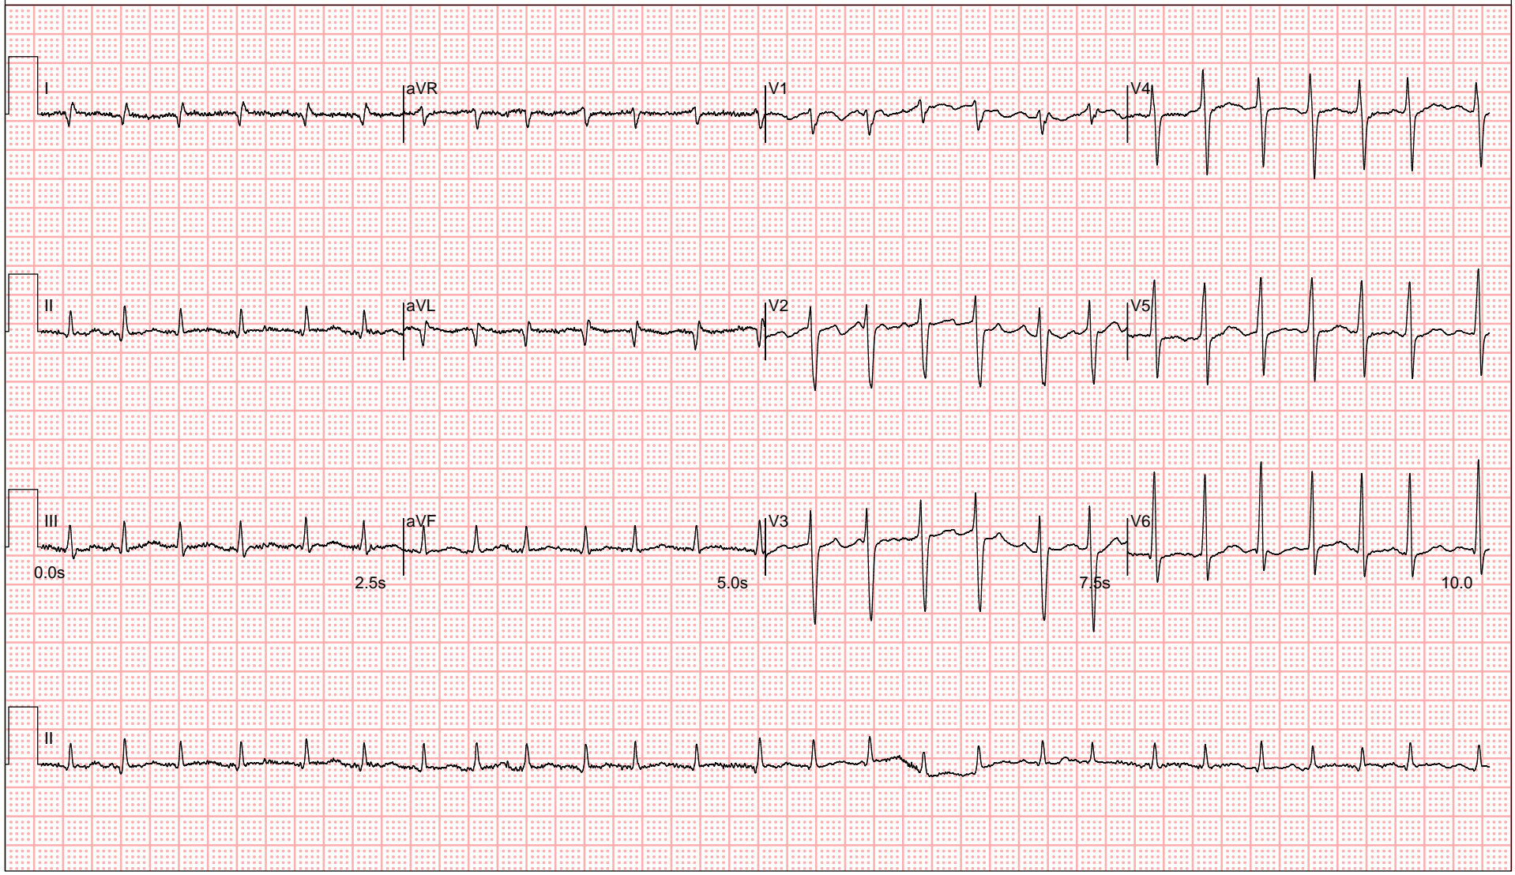
Q1. State the ECG diagnosis (0.5 pt)
Fast atrial fibrillation

Slide 51
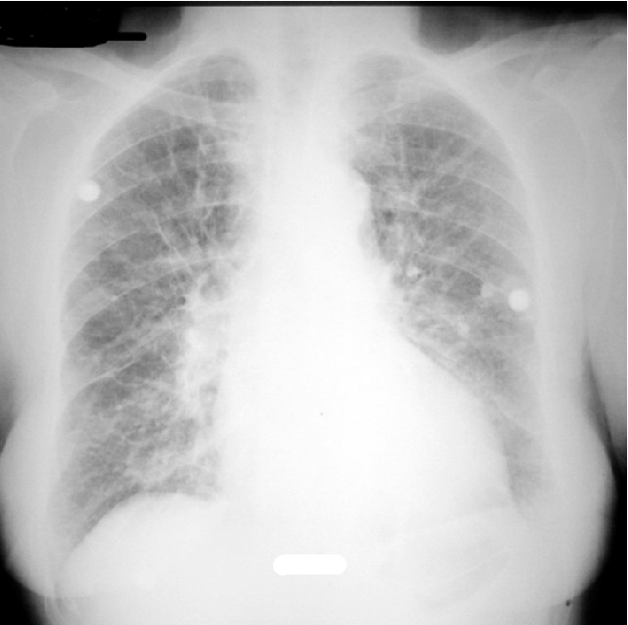
Q2. Give 3 X-ray findings (1.5 pts) What is the CXR diagnosis? (0.5 pt)
Upper lobe diversion
Presence of Kerley lines
Septal line
Left pleural effusion
Cardiomegaly
→ Severe congestive heart failure

Slide 52
Q3. Name 3 important Ddx in this case (1.5 pts)
APO secondary to fast AF
Sepsis +/- ARDS
Thyroid storm
Myocarditis / Pericarditis
Intoxication

Slide 53
Subsequent blood tests showed fT4 84.5, TSH <0.01.
The diagnosis was made and patient was sent to ICU.
Q4. Name a commonly applied diagnostic criteria used in this condition (1 pt) Name 4 clinical parameters in this criteria (2 pts)

Slide 54
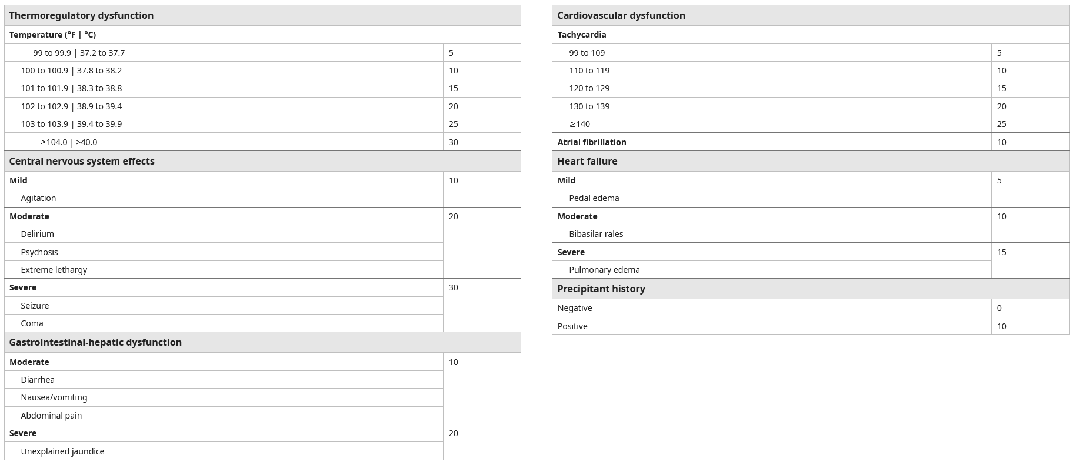
Burch-Wartofsky Point Scale
Point >45 - Highly suggestive of thyroid storm

Slide 55
Q5. Name 4 disease-specific initial management in ED (2 pts)
Beta-blocker
Thionamide
Iodine solution
Steroid

Slide 56
Q6. A medical staff would like to prescribe aspirin as cardiac enzymes are markedly elevated. Should aspirin be prescribed and why? (0.5 pt + 0.5 pt)
Aspirin should be avoided in thyroid storm
It can exacerbate thyroid storm by displacing bound T3, T4, increasing free thyroid hormone levels
In cases where a patient with thyroid storm is also suspected of having ACS, other antiplatelet agents like clopidogrel might be considered instead of aspirin

Slide 57
Question F

Slide 58
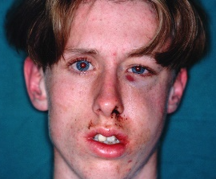
Case scenario
A 35-year-old construction site worker attended after the left side of his face was hit by a heavy metal bar at work
BP/P normal
He can breathe and speak normally
Obeying command
https://passport.world.rugby/player-welfare-medical/immediate-care-in-rugby/facial-injuries-in-sport/hard-tissue/zygomatic-fractures/

Slide 59
Q1. In physical examination, name 4 regions, each with 2 specific signs you will look for?
(1/2 pt for each region)
(1/4 pt for each sign)
Total 4 pts

Slide 60
Eyes
  Unequal pupil sizes
  Diplopia
  Hyphema
Ears
  Haemo-tympanium
  Rupture ear membrane
  Battle’s sign
  Pinna haematoma

Slide 61
Nose
  Septal hematoma of nose
  Nasal deformity
  CSF rhinorrhea
Face
  Facial sensation
  Bony Crepitus
  Facial Asymmetry
  Trismus

Slide 62
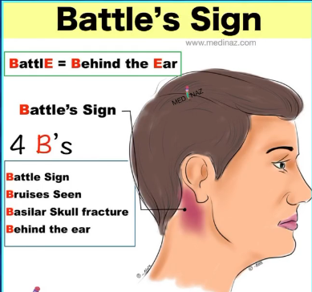
Source: medinaz_academy

Slide 63
Q2. What is the most important investigation to make the diagnosis and assess severity? (0.5 pt)
CT Brain and Face (Plain)

Slide 64
Q3. The investigation was carried out, besides the abnormal collection of air and fluid, name 3 abnormalities that your can identify? (1.5 pts)

Slide 65
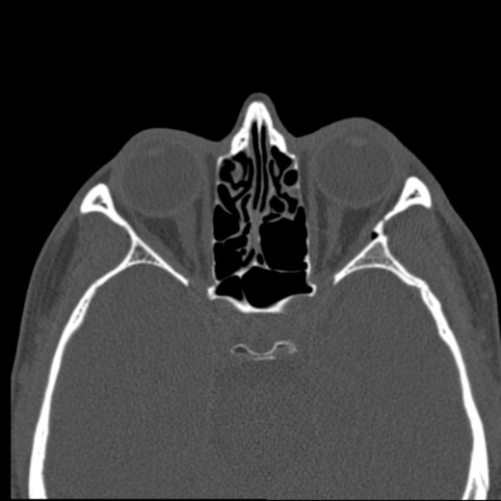
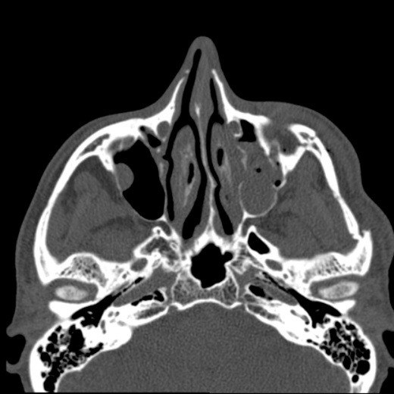
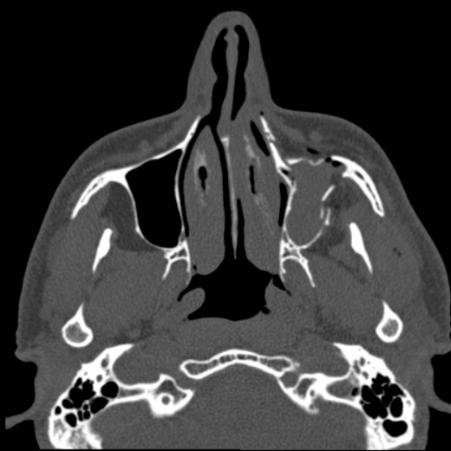
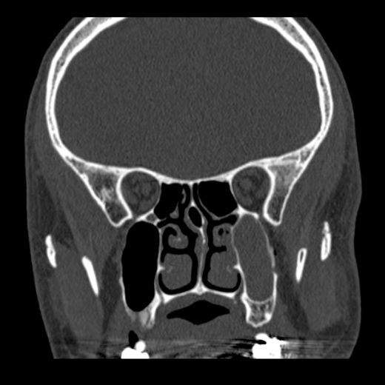
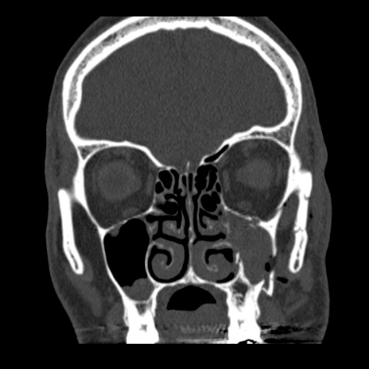
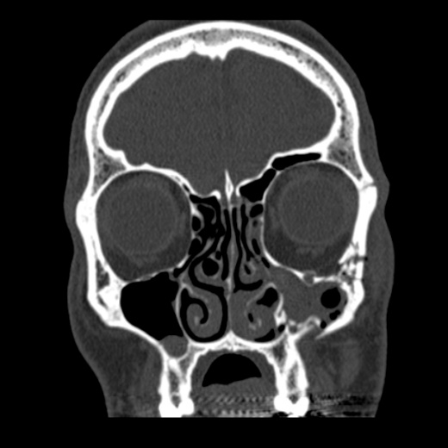
Axial Cut
Coronal Cut

Slide 66
Axial Cut
Coronal Cut

Slide 67
Q3. The investigation was carried out, besides the abnormal collection of air and fluid, name 3 abnormalities that your can identify? (1.5 pts)
Fracture of the zygomatic arch
Fractures of the inferior orbital rim and anterior and posterior maxillary sinus walls
Fracture of the lateral orbital wall

Slide 68
Q4. What is your diagnosis? (0.5 pt)
Tripod Fracture / Zygomaticomaxillary complex fracture

Slide 69
Q5. Name 3 other specialties you would consult for management of this patient? (1.5 pts)
ENT
Eye
Dental

Slide 70
Q6. Name 3 types of medications that should be prescribed for this patient? (1.5 pts)
Board spectrum antibiotics e.g. Augmentin
Anti-tetanus Toxoid
Analgesics

Slide 71
Q7. What action should be avoided in patients with tripod fracture? (0.5 pt)
Avoid nose blowing
  → the disrupted orbital walls can allow air to be forced into the retrobulbar space and cause pain and visual loss.

Slide 72
References
Medscape - Zygomatic Complex Fractures
UptoDate - Initial evaluation and management of facial trauma in adults
Radiopedia - Zygomaticomaxillary complex fracture

Slide 73
The End
Credit to Dr. Ng HW and my colleagues

