Slide 1
HKCEM JCM DEC 2025
Dr Li YH Thomas
Associate Consultant
Prince of Wales Hospital

Slide 2
Question 1
An 8 year old girl attended your ED for recurrent palpitation attacks for 6 months. Despite the chronicity of her condition, she felt this episode was unusually prolonged.
Triage notes:
BP (omitted) P 200 Cap refill: brisk
SpO2 99% (Room Air)
Temp 36.8 degrees Celsius
CATEGORY: II
What bedside investigation do you want to order first?

Slide 3
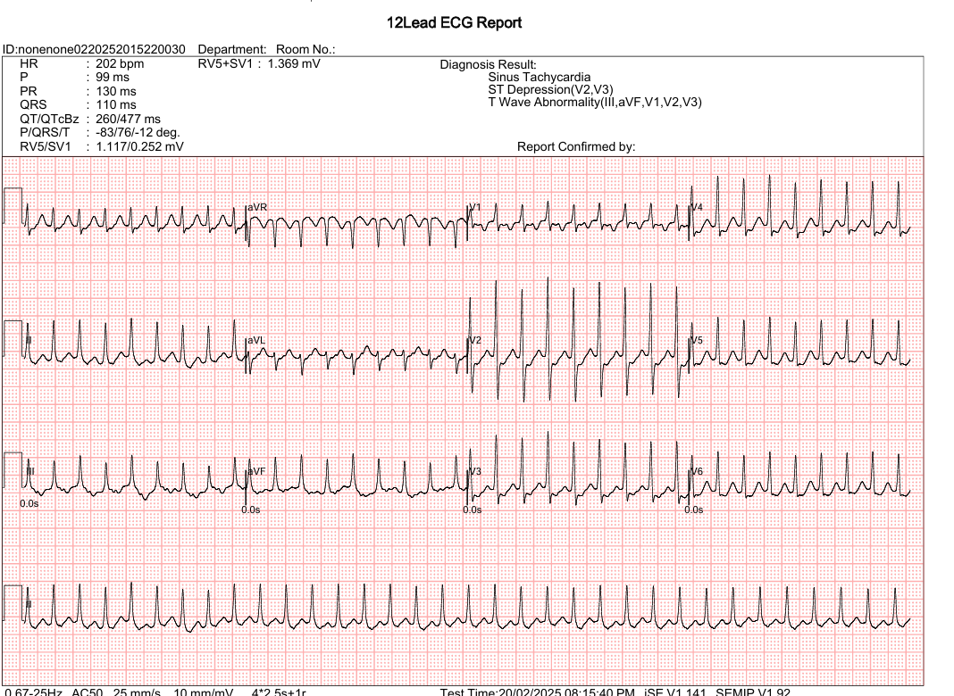
Question 1

Slide 4
Question 1
What emergency condition you are dealing with?
What initial treatment you would offer?
Name 3 possible causes of recurrent/repetitive SVT

Slide 5
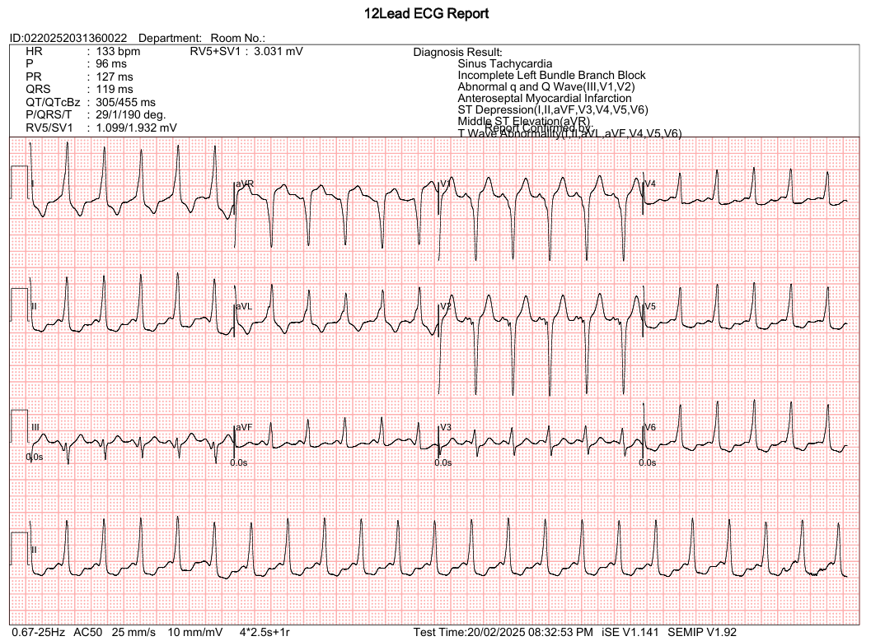
Question 1
After your treatment…

Slide 6
Question 1
Describe the essential features of this ECG.
What is the diagnosis?
What drugs should be avoided if the patient comes with unstable AF?

Slide 7
Question 2
60 yr/M presented to emergency for syncope. On arrival he had impaired consciousness and distended neck veins. PMH: MR.
Triage notes:
BP 70/40 P 140
SpO2 90% on NRM
Temp 38 degrees Celsius
CATEGORY II

Slide 8
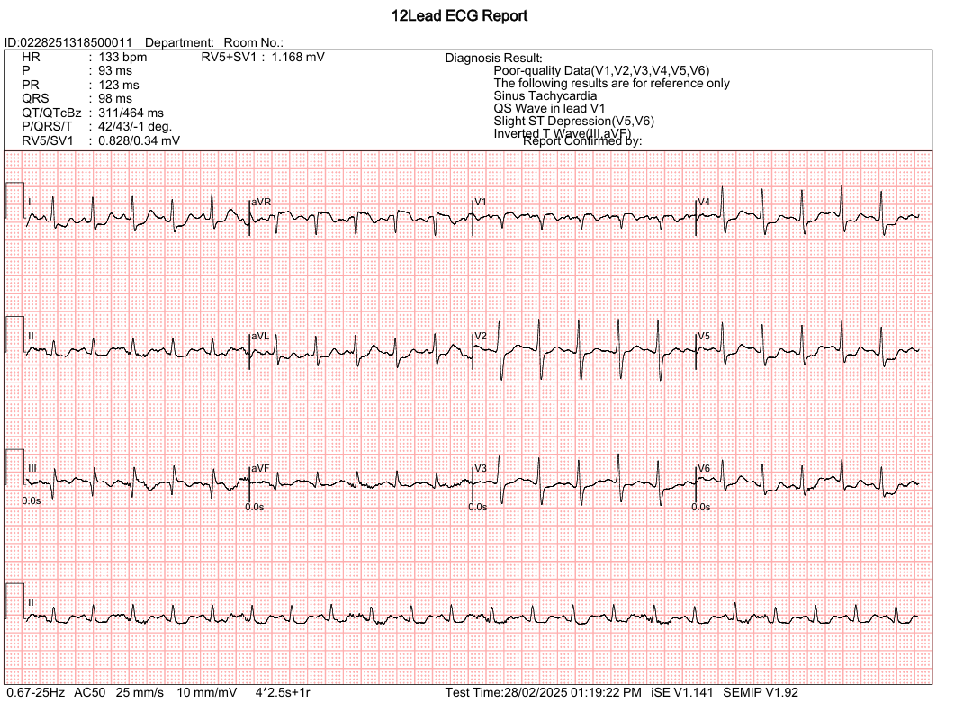
Question 2

Slide 9
Question 2
Describe the features of this ECG.
What is the most likely diagnosis?
Point out some of the bedside Transthoracic Echocardiography features of this condition?

Slide 10
Question 2
You liaised with ICU and arranged CT pulmonary angiogram. It confirmed saddle PE.
How could you save this patient’s life?

Slide 11
Question 3
55 years old gentleman with history of RA on multiple immunosuppressants , attended through ambulance for low back pain and left sciatica for 1 week.
Triage notes:
STRETCHER
BP 145/80 P 70
SpO2 99% Room Air
Temp 37.8 degrees Celsius
CATEGORY IV

Slide 12
Question 3
Please explain the indications for Lumbosacral Spine X Ray for this patient.

Slide 13
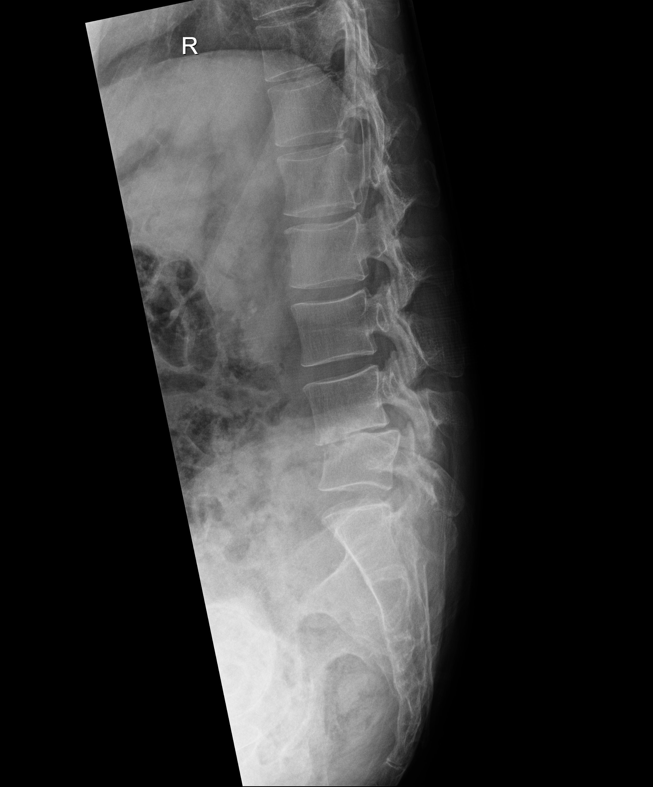
Question 3

Slide 14
Question 3
What are the abnormalities in this LS spine X Ray?

Slide 15
Question 3
What further imaging you would consider?

Slide 16
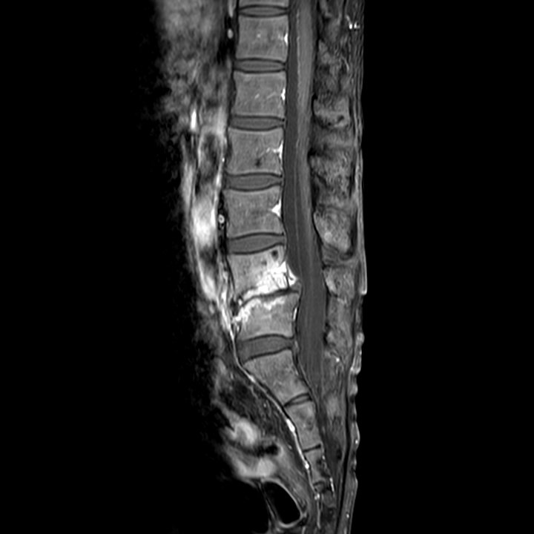
Question 3
Could you describe the image?

Slide 17
Question 3
What is your provisional diagnosis?
What are the potential risk factors for this condition?

Slide 18
Question 3
What are the possible culprit bacteria?
What is the recommended duration, choice and route of antibiotics treatment?

Slide 19
Question 4
57 years old/M
Presented with 1 week history of epigastric pain. He had long history of racing heartbeats, ankle edema and unexplained malaise. He received open heart surgery 10 years ago.
Triage notes:
BP 105/65 P90
SpO2 99% Room Air
Temp 38 degrees Celsius
CATEGORY III

Slide 20
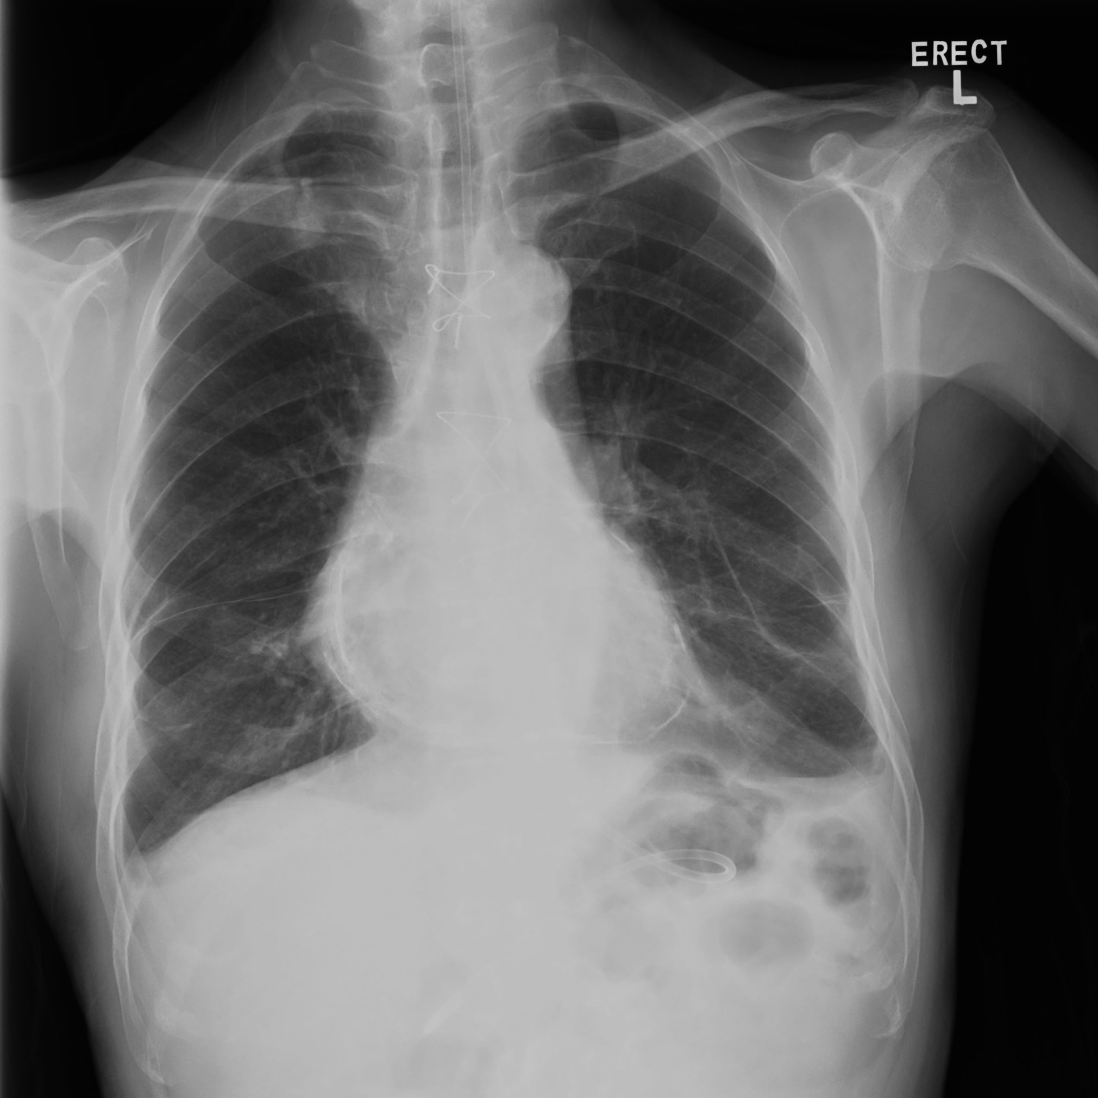
Question 4
Here is his CXR.
Comment on this X Ray.

Slide 21
Question 4
What is the most likely diagnosis of his chest discomfort and heart failure symptoms?
What are the possible aetiologies of this diagnosis?

Slide 22
Question 4
After extensive work up in medical unit, he was diagnosed with Crohn’s Disease, which accounted for his abdominal pain.
What other systems of his body could possibly be affected?

Slide 23
Question 5
A 40-year-old/F was transferred from private hospital with her friends for acute confusion for 1 day. She had CT brain performed in private with diagnosis : idiopathic intracranial hypertension.
Triage Notes:
BP 150/80 P 87
SpO2 100% RA
Temp 38 degrees Celsius
H’stix 6, H’cue 4.5
CATEGORY II

Slide 24
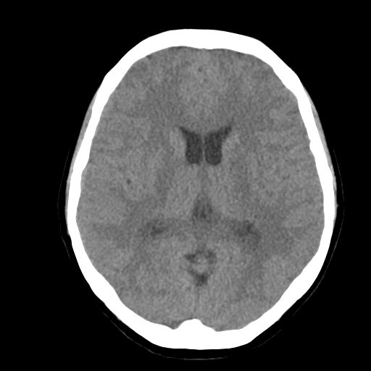
Question 5
Comment on this CT brain.

Slide 25
Question 5
Is the presentation compatible with the provided diagnosis?
Please suggest a few possible causes of BILATERAL cerebral sulci effacement in this case?

Slide 26
Question 5
She did not have travel history/drug/TCM misuse. No further history was available from friends. Physical examination showed generalized petechiae and ecchymosis all over the lower limbs. She was jaundiced and pale looking. H’cue was 5.0. Abdomen examination was unremarkable. PR no blood no melena.
Suggest a few possible causes of her acute confusion?

Slide 27
Question 5
Hematologist informed you that the patient has low RBC and low platelet count, microscopy showed increased schistocytes, high retic count. Please suggest tests to differentiate DIC and TTP?
What is the first line treatment for TTP?
Suggest one blood test to prognosticate this patient’s condition.

Slide 28
THE END. THANK YOU.
PWH A&E JCM OSCE 2025

