Slide 1
JCM Oct 2025
CMC AED
8/10/2025

Slide 2
Case 1
A 26-month-old boy ingested an unknown amount of his mother’s antidiarrheal medication, Lomotil, one hour ago. He was asymptomatic and playful on arrival.
a) Name two pharmacological ingredients of Lomotil (2 marks)
Atropine, diphenoxylate
b) Name two toxidromes in Lomotil poisoning (2 marks)
Anticholinergic toxidrome, opioid toxidrome

Slide 3
Case 1
c) Give two reasons why symptoms can occur late (2 marks)
Delayed gastric emptying due to anticholinergic and opioid effects (1 mark) Diphenoxylate (or its active metabolite, difenoxin) is a long-acting opioid (1 mark)
d) What is the cause of death in severe pediatric Lomotil poisoning and what is the antidote? (2 marks)
Cause of death: respiratory depression (not likely anti-cholinergic effects as opioid is in the one pill kill list in paediatric patient) (1 mark)
Antidote: naloxone (1 mark)

Slide 4
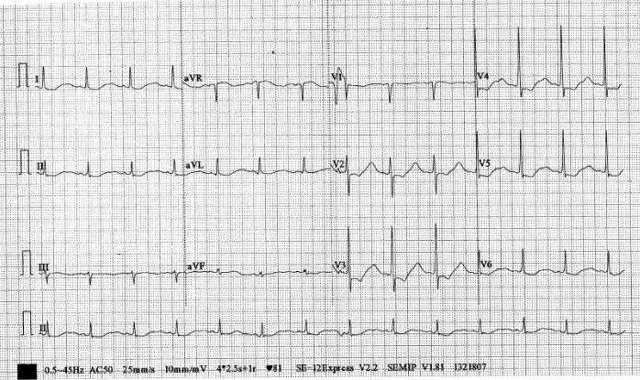
Case 2
A 52-year-old gentleman with a history of chronic alcoholism and hypertension presented after a fall with bilateral lower-limb weakness for one week. He did not complain of chest pain. An ECG was performed.

Slide 5
Case 2
a) Give four ECG findings? (2 marks)
Sinus rhythm
T-wave flattening
ST-segment depression
U waves
(@ 0.5 marks)
b) What is the most likely diagnosis and how do you confirm it? (2 marks)
Most likely diagnosis: hypokalemia (1 mark)
Confirmation: serum potassium level e.g. point-of-care blood gas analysis by GEM 4000 (1 mark)

Slide 6
Case 2
c) Name four medications that can cause hypokalemia (2 marks)
Diuretics
Laxatives
Insulin
Antibiotics (amphotericin B, chloroquine)
COPD medications (e.g., Ventolin, theophylline)
Etomidate
(any four, @ 0.5 marks)

Slide 7
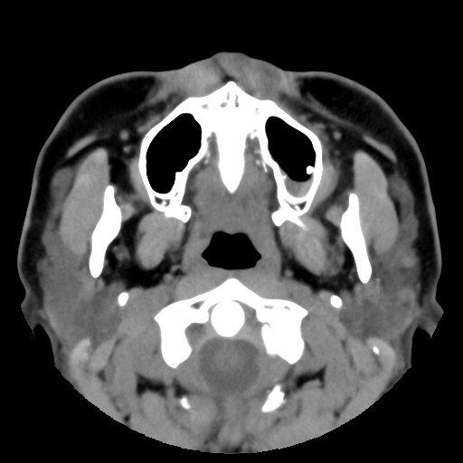
Case 3
A 25-year-old lady enjoyed good past health. She received root canal therapy over left maxillary molar from dentist 2 days ago. She complained of left sided headache and left nasal discharge since yesterday. A CT is performed.

Slide 8
Case 3
a) List the finding in the selected CT image (1 mark)
Air-fluid level in left maxillary sinus High attenuation focus inside left maxillary sinus
(any 1, @ 1 mark)
b) What is the diagnosis and the cause of the condition? (2 marks)
Acute odontogenic maxillary sinusitis (1 mark), secondary to iatrogenic perforation with protrusion of root canal sealant to left maxillary sinus (1 mark)

Slide 9
Case 3
c) List 2 likely pathogens for this patient (2 marks)
Oral anaerobes
Peptostreptococcus
Prevotella intermedia
Fusobacterium nucleatum
Streptococci of the anginosus group
Streptococcus constellatus
Streptococcus intermedius
Streptococcus anginosus
(any 2, @ 1 mark)

Slide 10
Case 3
d) List 3 treatments should be given in AED (3 marks)
Antibiotics:
Augmentin or
2G/3G cephalosporin + metronidazole or
Levofloxacin + metronidazole or
Doxycycline
Saline nasal irrigation
Antiseptic mouthwash eg. Chlorhexidine
Analgesics
(Any 3, @ 1 mark)

Slide 11
Case 3
e) List 3 potential complications of this disease. (3 marks)
Chronic sinusitis
Preseptal cellulitis
Orbital cellulitis
Subperiosteal abscess
Osteomyelitis of sinus bones
Meningitis
Intracranial abscess
Septic cavernous sinus thrombosis
(Any 3 , @ 1 mark)

Slide 12
Case 4
A 20-year-old lady with good past health presented with urinary frequency, frothy urine and generalized swelling x 3 days. She claimed that she had used skin whitening cream bought from an unknown shop 2 weeks ago. CXR ECG unremarkable. LFT normal, RFT Cr 140. Urine protein ++++, PT -ve, WBC, nitrite –ve.
a) What is the most likely diagnosis and the cause of the condition? (2 marks)
Nephrotic syndrome (1 mark) due to inorganic mercury toxicity (1 mark)

Slide 13
Case 4
b) Could you name 3 other symptoms that may also present due to the subacute/ chronic toxicity? (3 marks)
Neurological (tremor, erethism, neurasthenia, ataxia)
GI (nausea, gingivostomatitis)
Skin (acrodynia ‘pink disease’; primarily affects children under 5-year-old)
c) How many forms of mercury exists? (3 marks)
Elemental
Organic
Inorganic

Slide 14
Case 4
d) Could you list 4 symptoms of acrodynia? (4 marks)
7P:
Puffy
Pinkish-red discoloration of hands and feet
Painful (peripheral neuropathy)
Peeling and desquamation of skin
Paresthesia
Perspiring (block degeneration of catecholamine → profuse sweating)
Pruritis
(any 4, @ 1 mark)

Slide 15
Case 4
e) How do you check for the level of poisoning? (1 mark)
24 hour urine mercury for inorganic mercury
f) What chelating agent would you use in subacute/ chronic poisoning of the above agent? (1 mark)
Oral succimer DMSA

Slide 16
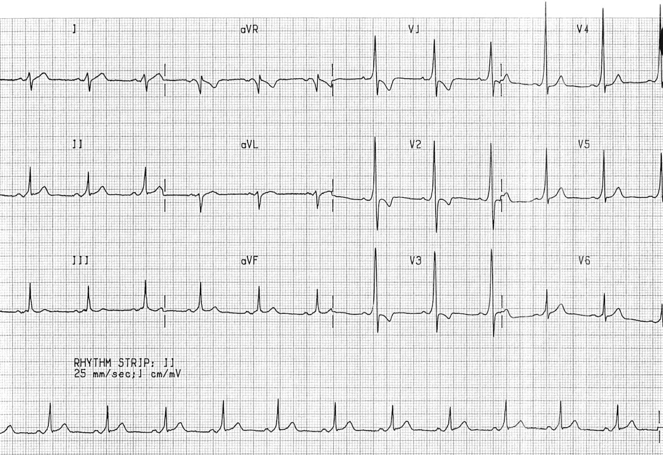
Case 5
A 25-year-old man presented with dizziness to your department. ECG was done.

Slide 17
Case 5
a) Give 2 ECG findings. (2 marks)
Short PR interval
Delta wave
b) What is the diagnosis? (1 mark)
Wolff-Parkinson-White Syndrome

Slide 18
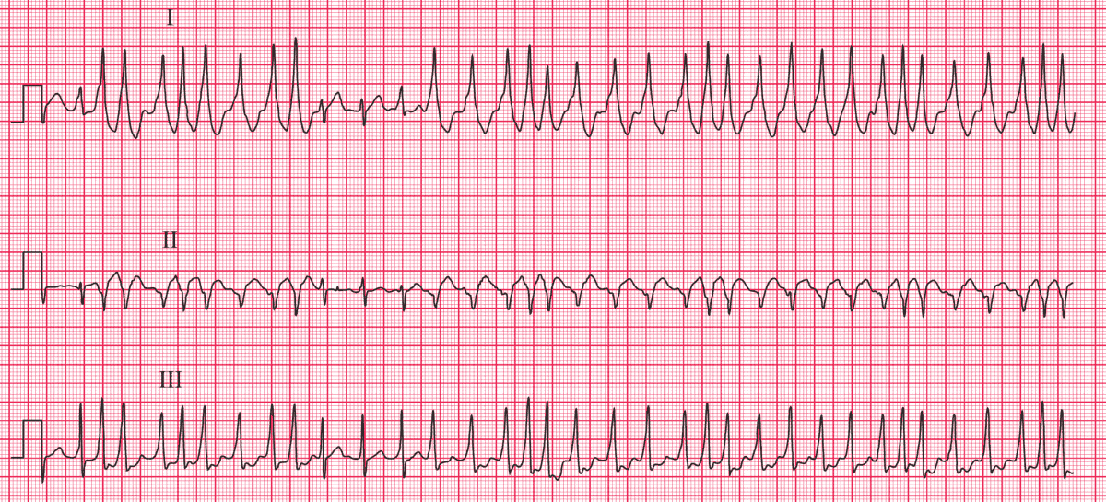
Case 5
Patient deteriorated during observation, another ECG was done.

Slide 19
Case 5
c) What is the diagnosis? (1 mark)
WPW syndrome with atrial fibrillation
d) Give 3 ECG findings that support your diagnosis. (3 marks)
Irregular wide complex tachycardia
No P wave
Slurred upstroke of QRS complex compatible with Delta wave

Slide 20
Case 5
e) Name 3 drugs should be avoided? (3 marks)
Adenosine
Beta blocker
Calcium channel blocker
Digoxin
(any 3, @ 1 mark)

Slide 21
Case 5
f) Give 2 treatment options for this condition (2 marks)
Synchronized cardioversion if patient is unstable
Procainamide
g) Name 1 more pre-excitation syndrome (1 mark)
Lown-Ganong-Levine (LGL) Syndrome
Mahaim-Type Pre-excitation
(any 1, @ 1 mark)

Slide 22
Case 6
A 7-year-old boy presented to the emergency department with a 3-day history of a purpuric rash on his legs.
a) Give 4 differential diagnoses? (4 marks)
Idiopathic thrombocytopenic purpura
Meningococcemia
Leukaemia
Henoch-Schonlein purpura
Drug-induced purpura
Infective endocarditis
Coagulopathies like haemophilia or von Willebrand disease
Mechanical purpura
(any 4, @ 1 mark)

Slide 23
Case 6
Further history revealed that the child had multiple joint pain in his knees and ankles. His mother reported he had an upper respiratory infection about two weeks ago. He was otherwise healthy, with no significant past medical history. On examination, he had palpable purpura on his legs and buttocks, mild swelling in his knees, abdomen was soft and non-tender. His vital signs were stable, and he had no fever.
b) What is the diagnosis? (1 mark)
Henoch-Schonlein purpura

Slide 24
Case 6
c) Give 4 investigations would you order? (4 marks)
CBC with differential counts
Clotting profile
Urine dipstick for RBC and protein
Urine albumin:creatinine ratio
Renal function test
ESR and CRP
(any 4, @ 1 mark)

Slide 25
Case 6
d) What are the potential complications of this condition? (3 marks)
Renal – haematuria (persistent or recurrent in 5%), proteinuria, nephrotic syndrome, isolated hypertension, renal insufficiency and renal failure (<1%)
Gastrointestinal – intussusception, haematemesis, spontaneous bowel perforation, and pancreatitis
Subcutaneous oedema – particularly affects the scrotum, hands, feet, and sacrum. Can be very painful and may present as an acute scrotum in boys
Rare CNS complications like seizure
(any 3, @ 1 mark)

Slide 26
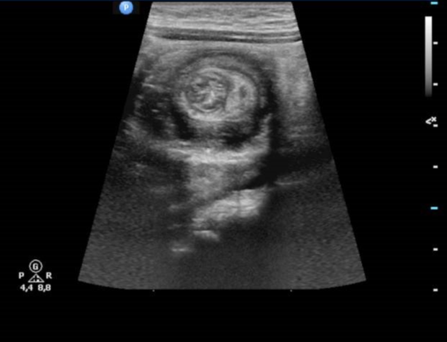
Case 6
Patient was admitted and developed sudden severe abdominal pain.
Abdominal ultrasound was performed.

Slide 27
Case 6
e) Describe the abdominal ultrasound imaging and what is the likely cause of patient’s pain (3 marks)
The transverse view of abdominal ultrasound shows target sign or doughnut sign (1 mark), which is characterized by concentric alternating echogenic (mucosa and muscularis) and hypoechoic layers (submucosa) (1 mark)
The diagnosis is intestinal intussusception. (1 mark)
f) What is another classic ultrasound finding for the above condition? (1 mark)
The longitudinal scan will show the "pseudokidney sign" (1 mark) that represents invagination of the proximal segment of the bowel into the lumen of the distal segment

