Slide 1
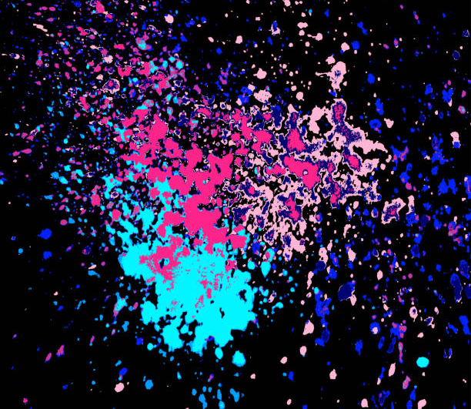
JCM OSCE
NOV25
TSWH

Slide 2
CASE 1
A 79 year-old presented with headache and transient right eye black-out for a few minutes 2 days ago. Initial headache improved but the patient noted progressive loss of right visual field and non-specific dizziness. He was brought in fully conscious on a stretcher.
Questions
a. Name a prognostic score for short-term risk of stroke following episode of amaurosis fugax. (1)

Slide 3
CASE 1
A 79 year-old presented with headache and transient right eye black-out for a few minutes 2 days ago. Initial headache improved but the patient noted progressive loss of right visual field and non-specific dizziness. He was brought in fully conscious on a stretcher.
Questions
a. Name a prognostic score for short-term risk of stroke following episode of amaurosis fugax. (1)
ANS: ABCD2 score

Slide 4
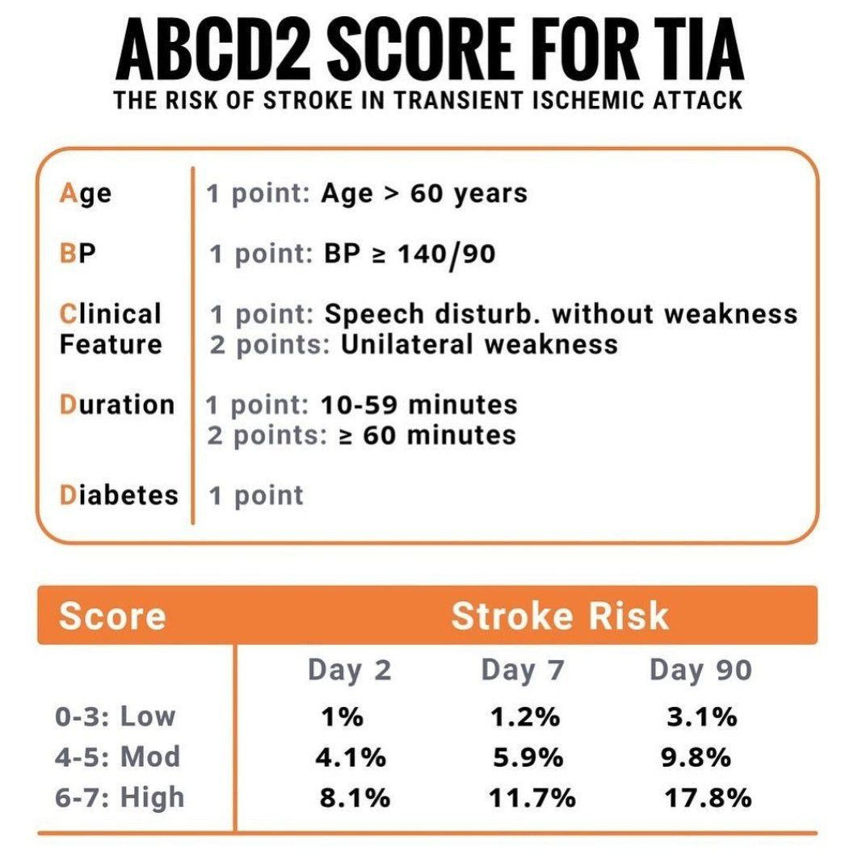

Slide 5
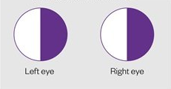
CASE 1
b. Please describe the visual field defect according to confrontation examination. (1)

Slide 6
CASE 1
b. Please describe the visual field defect according to confrontation examination. (1)
ANS: Right homonymous hemianopia

Slide 7
CASE 1
b. Please describe the visual field defect according to confrontation examination. (1)
ANS: Right homonymous hemianopia
c. Locate a probable lesion along the primary visual pathway with regarding to the presenting visual field defect. (1)

Slide 8
CASE 1
b. Please describe the visual field defect according to confrontation examination. (1)
ANS: Right homonymous hemianopia
c. Locate a probable lesion along the primary visual pathway with regarding to the presenting visual field defect. (1)
ANS: Left Optic tract/ lateral geniculate body/ optic radiations (any location behind optic chiasm)

Slide 9
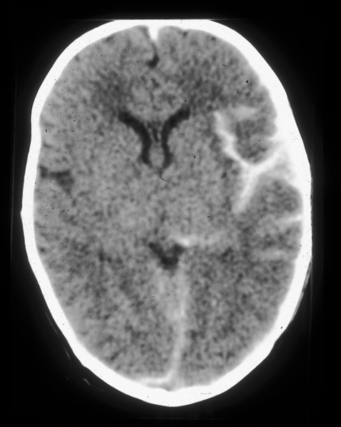
CASE 1
d. Describe CT brain abnormality.(1)

Slide 10
CASE 1
d. Describe CT brain abnormality.(1)
ANS: Right fronto-parietal subarachnoid hemorrhage with midline shift/ mass effect
State
i. the specific calcium channel blocker indicated(1)
ii. the complication intended to reduce.(1)

Slide 11
CASE 1
d. Describe CT brain abnormality.(1)
ANS: Right fronto-parietal subarachnoid hemorrhage with midline shift/ mass effect
State
i. the specific calcium channel blocker indicated(1)
ii. the complication intended to reduce.(1)
ANS: Nimodipine, vasospasm and delayed cerebral ischemia

Slide 12
CASE 1
f. State 3 other emergency room managements.(3)

Slide 13
CASE 1
f. State 3 other emergency room managements.(3)
ANS:
Neurosurgery consult
BP control (SBP=< 140 mmHg)
Pain, nausea and agitation control
Osmotic ICP control
Airway and ventilatory support in case of decrease GCS or hypopnoea
Seizure control if necessary
Reverse coagulopathy if indicated

Slide 14
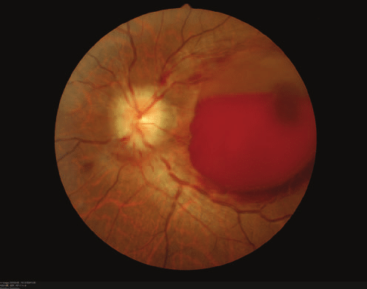
CASE 1
In another case, a fundoscopy photo was shown.
g. Please state the pathology.(1)

Slide 15
CASE 1
In another case, a fundoscopy photo was shown.
g. Please state the pathology.(1)
ANS: Subhyaloid hemorrhage/ collection of blood beneath the retina in posterior pole in the left eye
Sudden increase in intracranial pressure from a SAH can cause blood to be forced along the optic nerve sheath into the eye.

Slide 16
CASE 1
h. In the non-traumatic cause, is initial fibrinolysis i.e. use of tranexamic acid use routinely recommended? (Bonus)

Slide 17
CASE 1
h. In the non-traumatic cause, is initial fibrinolysis i.e. use of tranexamic acid use routinely recommended? (Bonus)
ANS: No. The role of TXA in spontaneous SAH remains controversial. It can reduce the risk of the aneurysm rebleeding in the first 24 hours, but a potential risk of delayed cerebral ischemia exists if there is nil or surgical treatment being extended beyond 72 hours.

Slide 18
The sunsetted prophylactic triple H therapy
Formerly widely accepted for spontaneous/ aneurysmal SAH (aSAH) (c.f. tSAH)
HHH stands for 1. induced Hypertension 2. hypervolemia, and 3. hemodilution.
intended to prevent and treat delayed cerebral ischemia (DCI) caused by cerebral vasospasm after an aneurysm has been managed (either surgically clipped or coiled).
Current evidence and guidelines have shifted due to a lack of strong evidence for its efficacy in improving clinical outcomes and a high risk of serious systemic complications, e.g. Cerebral edema or hemorrhage/ Pulmonary Edema/ MI/ HypoNa etc.
Routine prophylactic HHH therapy is no longer recommended.

Slide 19
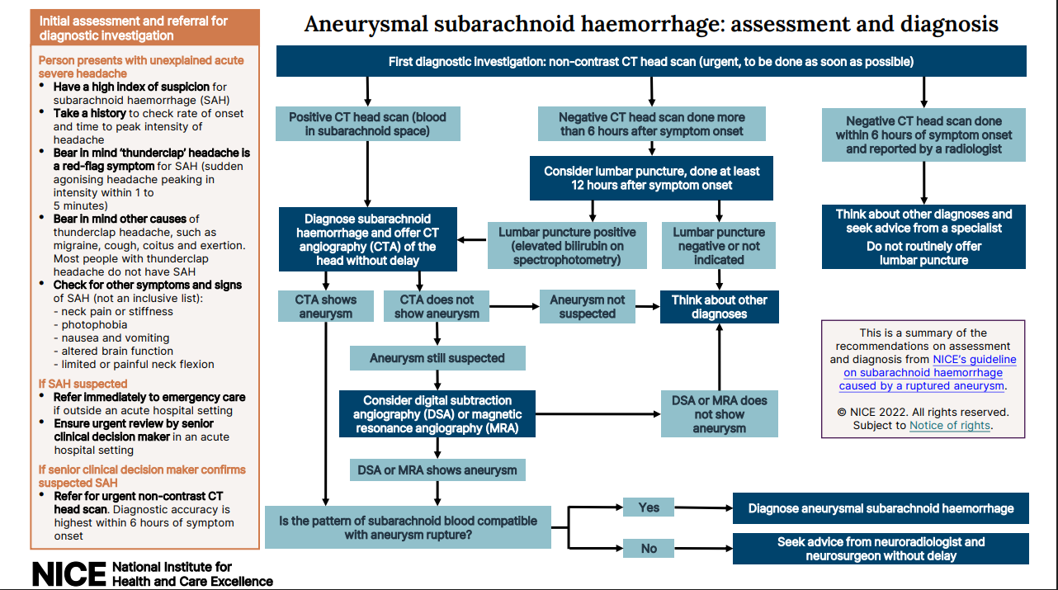

Slide 20
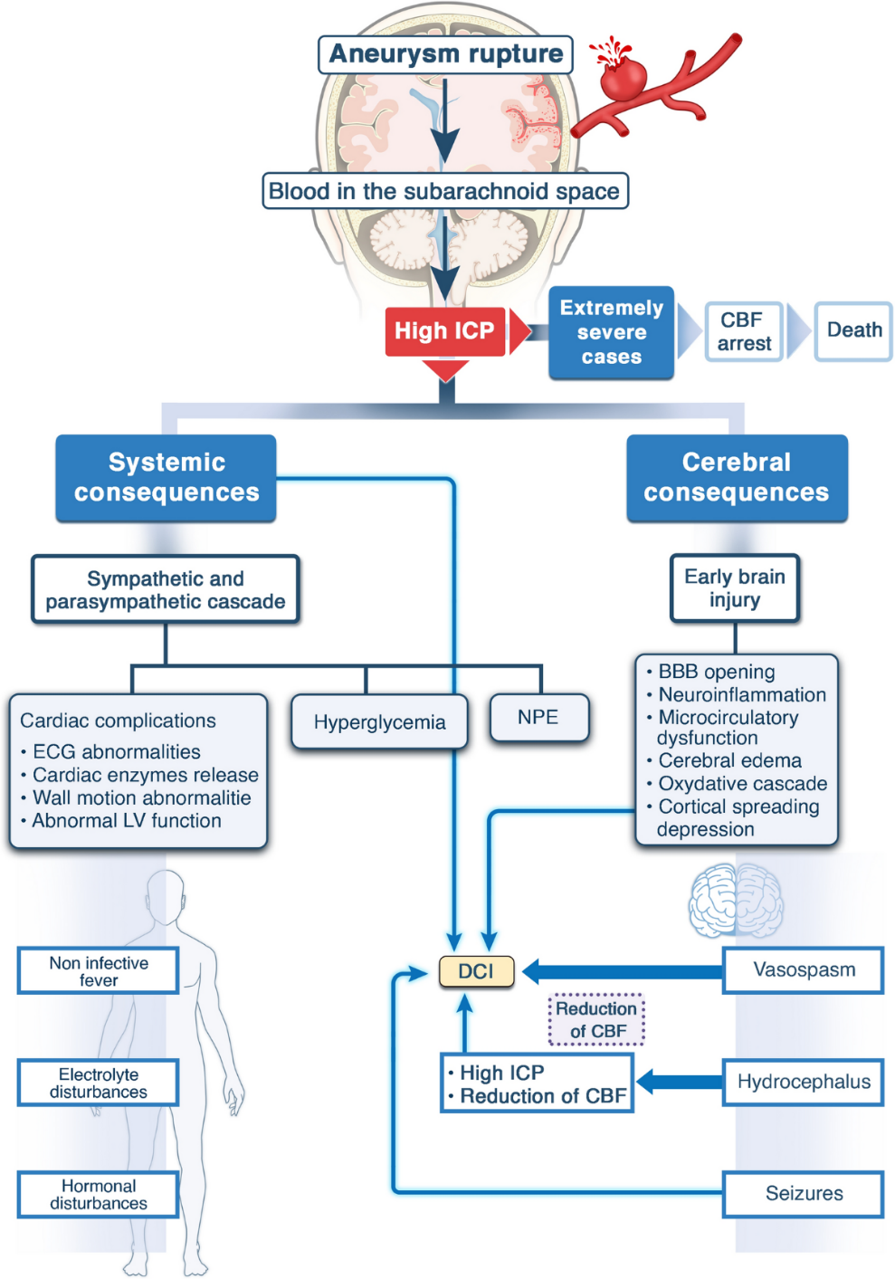
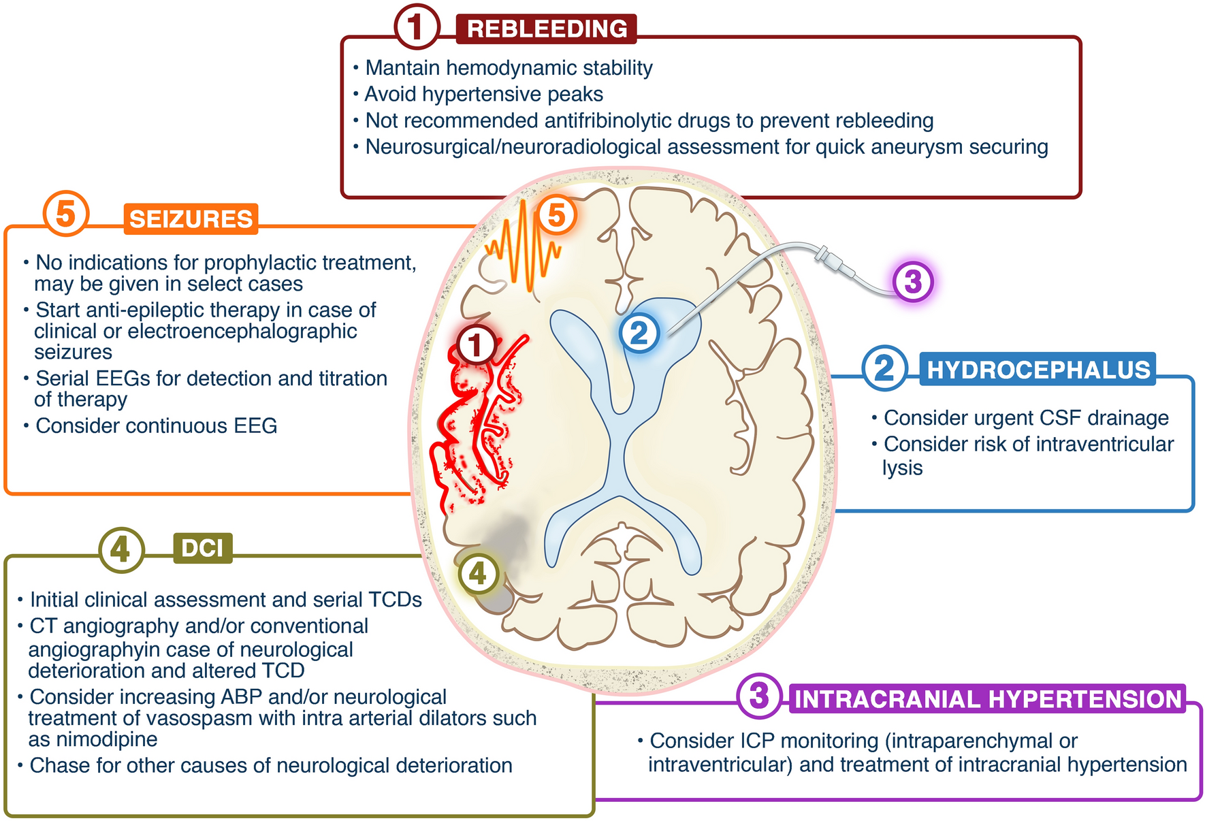

Slide 21
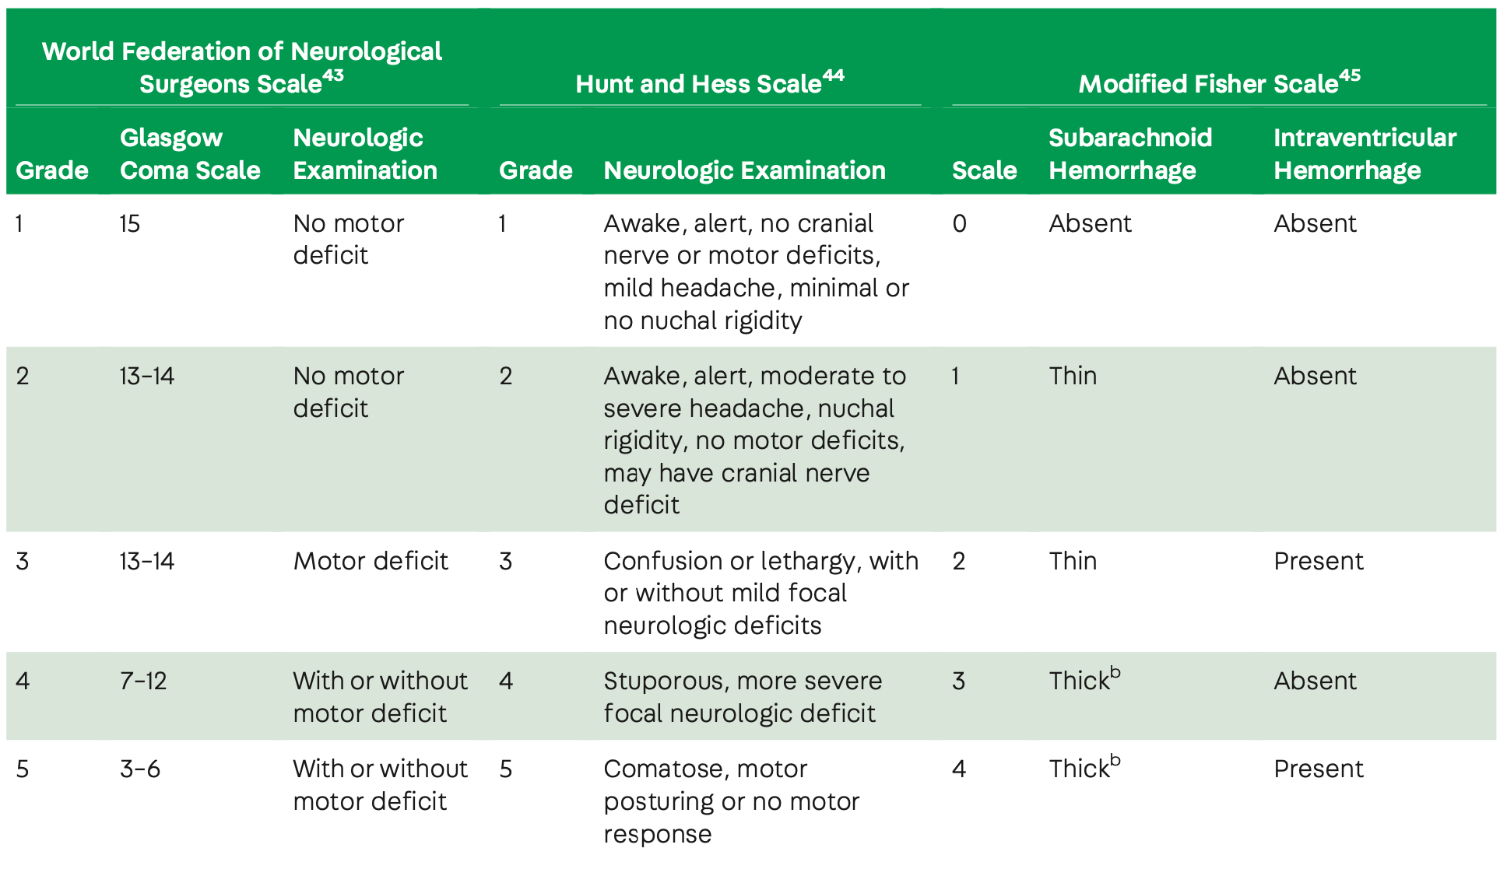
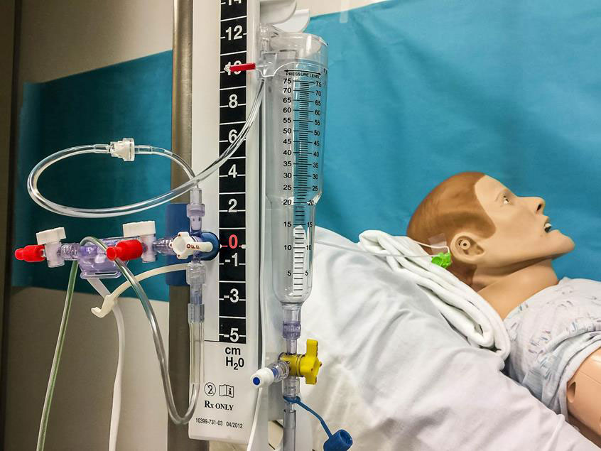
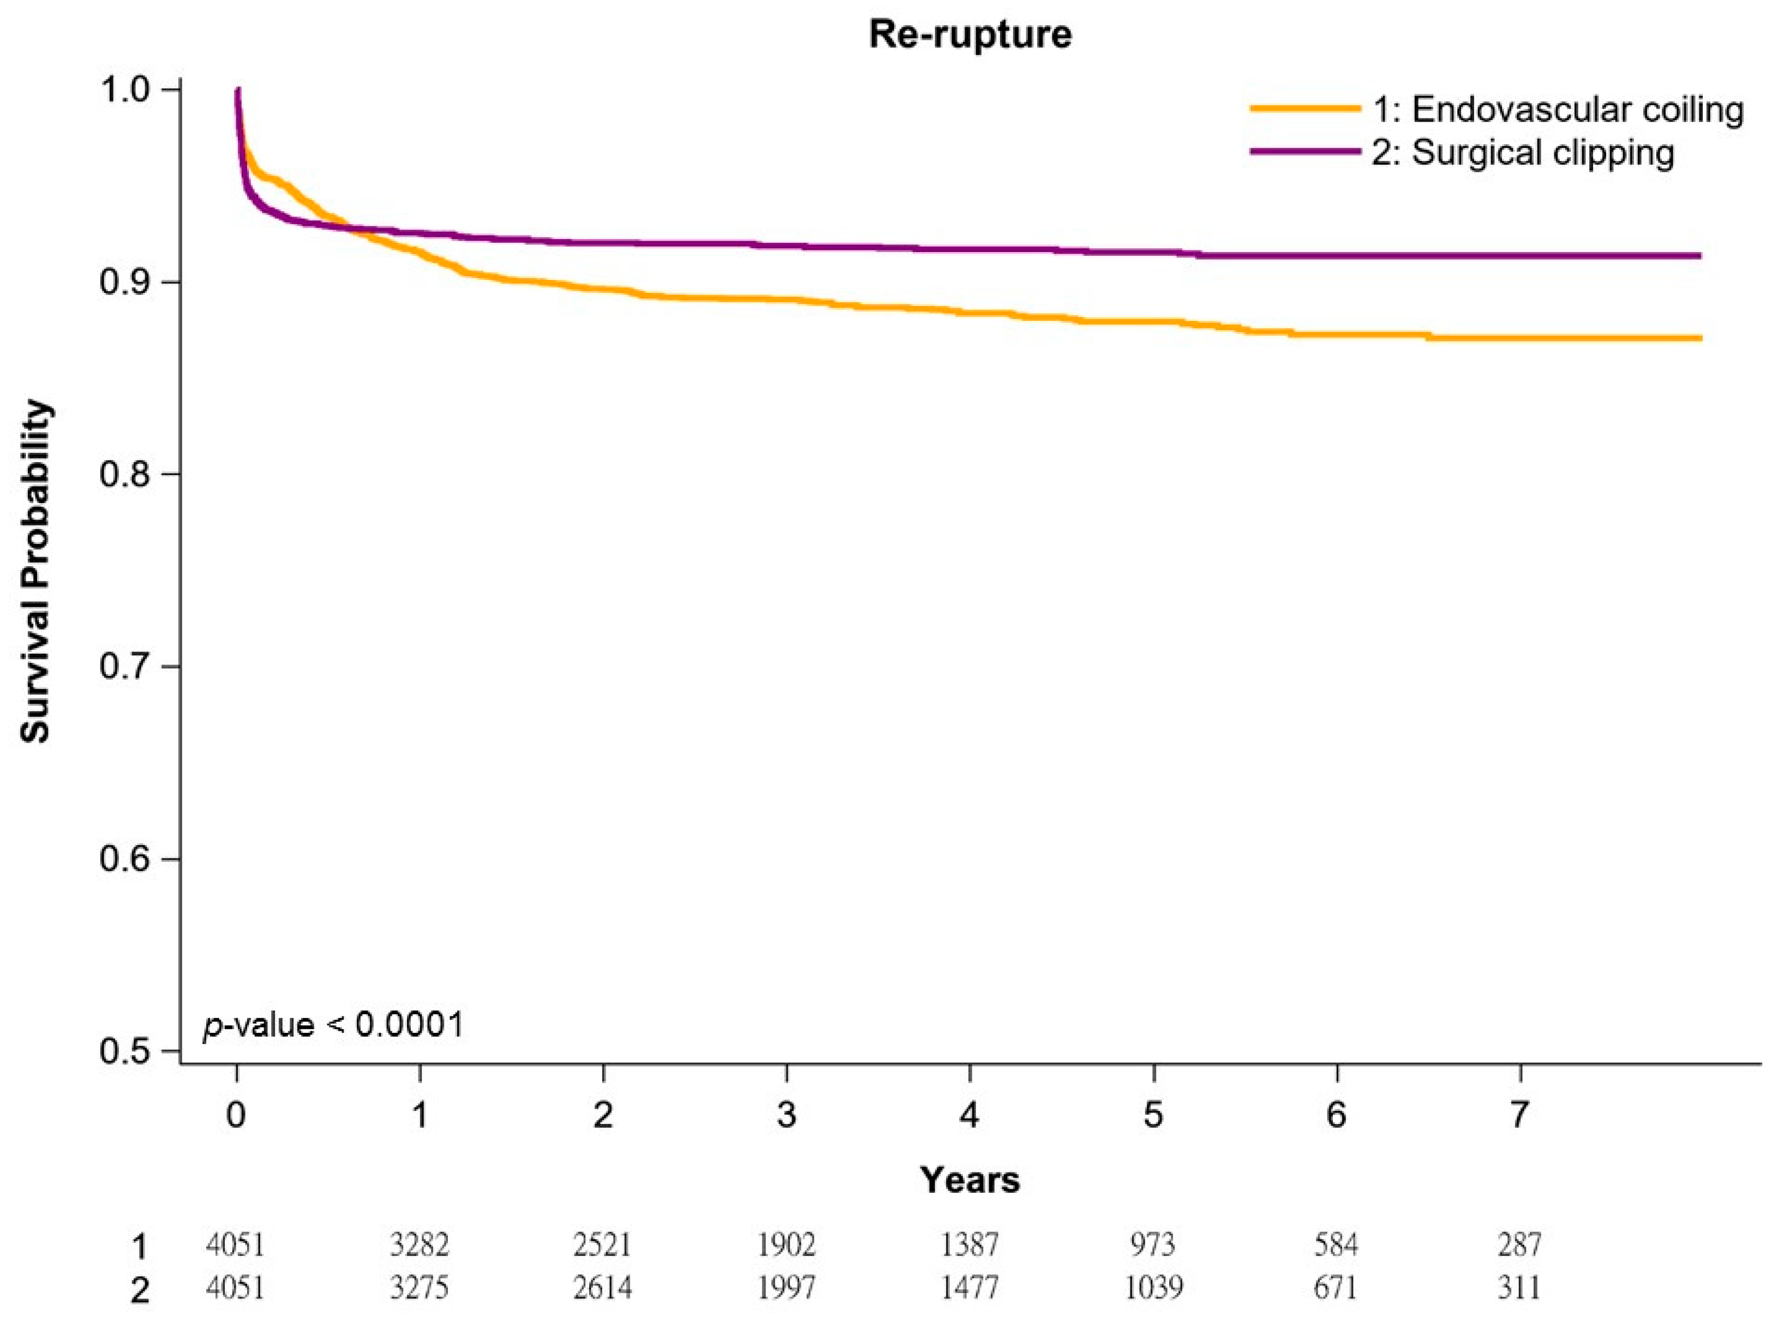
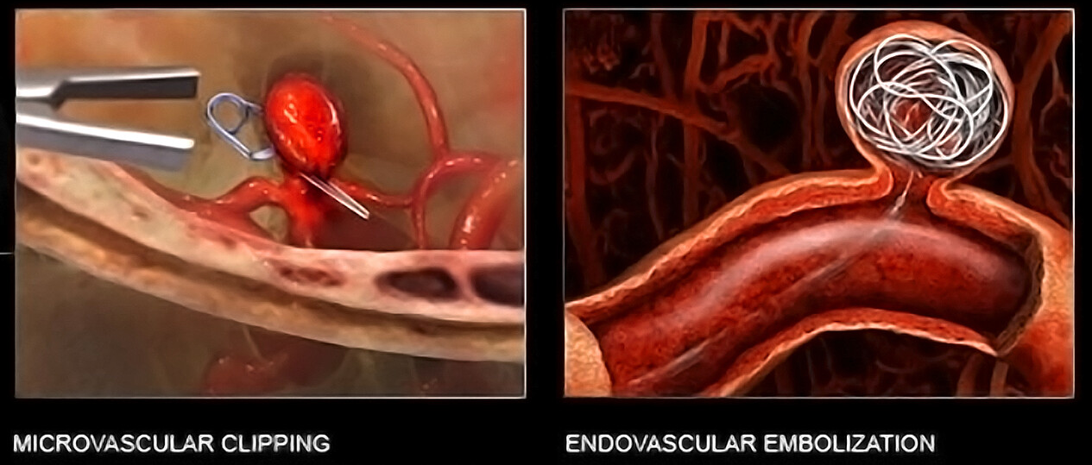

Slide 22
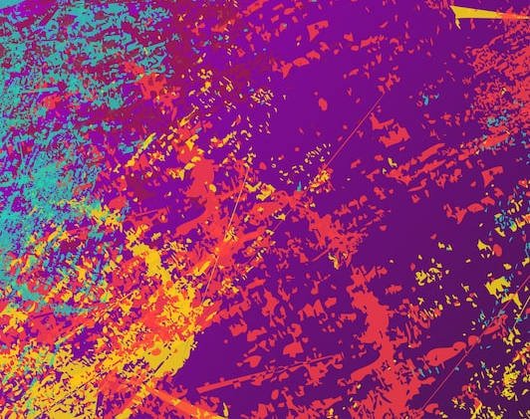
CASE 1 Learning Objectives
Typical and atypical presentations of aSAH
Different management approach between aSAH and tSAH
Common complications and their prevention

Slide 23
CASE 2
A 42 year-old male was referred from the GOPD for atypical presentation of syncope. He presented with repeated episodes of loss of consciousness preceded by brief abdominal cramps then visual disturbance characterized by the perception of yellow vision, right before collapse. Every time he was able to revive to full consciousness spontaneously. Length of loss of consciousness varies from a few minutes to over an hour.
Name a clinical decision tool that helps assess the risk of serious outcomes in patients presenting with syncope. (1) also state 2 components. (1)

Slide 24
CASE 2
A 42 year-old male was referred from the GOPD for atypical presentation of syncope. He presented with repeated episodes of loss of consciousness preceded by brief abdominal cramps then visual disturbance characterized by the perception of yellow vision, right before collapse. Every time he was able to revive to full consciousness spontaneously. Length of loss of consciousness varies from a few minutes to over an hour.
Name a clinical decision tool that helps assess the risk of serious outcomes in patients presenting with syncope. (1) also state 2 components. (1)
ANS: San Francisco Syncope rule/ Canadian syncope risk score

Slide 25
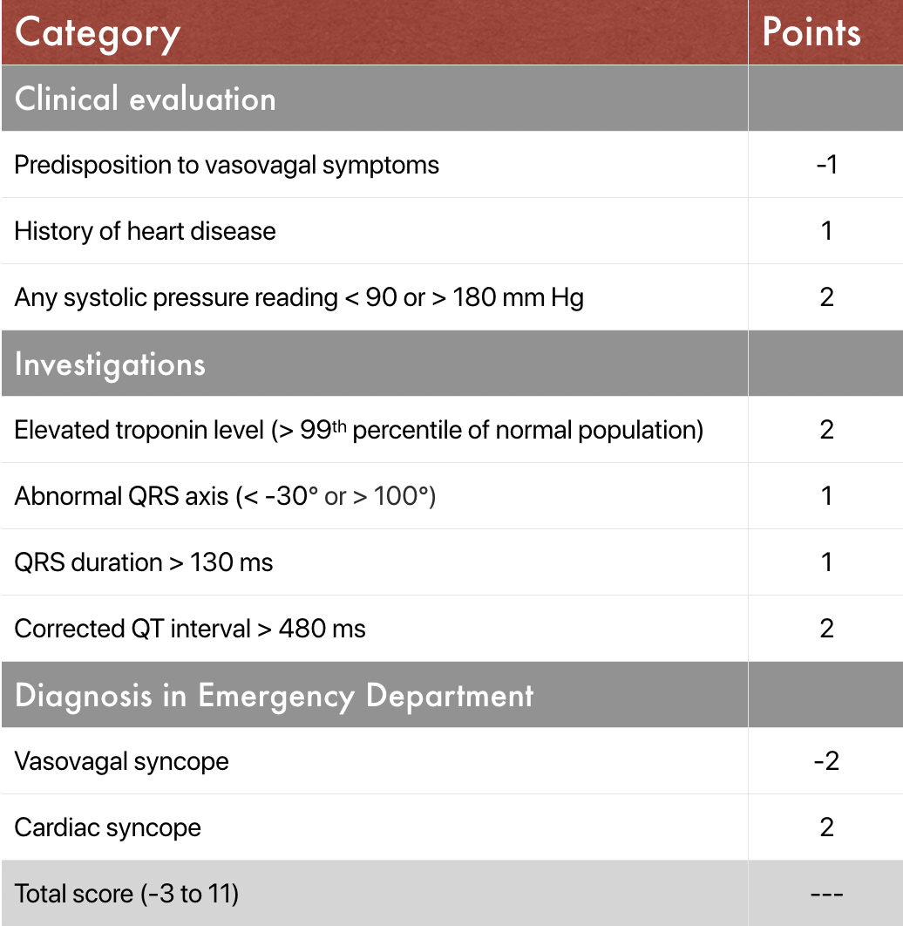
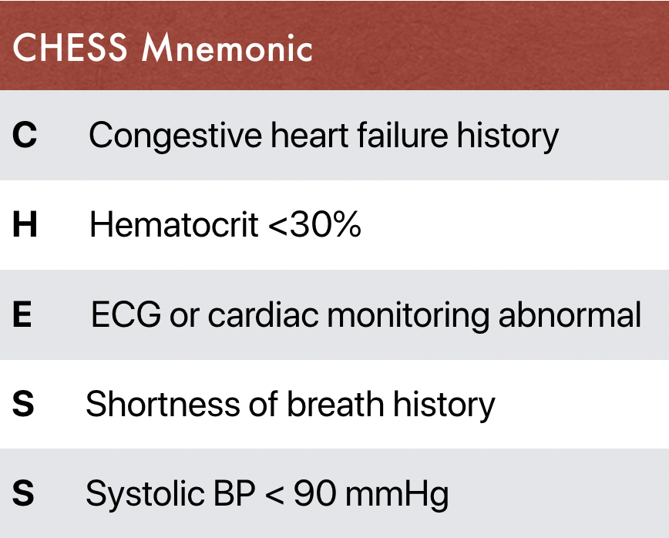

Slide 26
CASE 2
b. Name 2 drugs commonly associated with xanthopsia.(2)

Slide 27
CASE 2
b. Name 2 drugs commonly associated with xanthopsia.(2)
ANS: Digitalis, Thiazide, Sulphonamides, Barbiturates, Ether, Anticonvulsants (any 2)
The patient was arranged with inpatient electroencephalogram (EEG) that showed asymmetric intermittent rhythmic delta activity (IRDA) which is considered epileptiform equivalent.
c. State the most probable diagnosis. (1)

Slide 28
CASE 2
b. Name 2 drugs commonly associated with xanthopsia.(2)
ANS: Digitalis, Thiazide, Sulphonamides, Barbiturates, Ether, Anticonvulsants (any 2)
The patient was arranged with inpatient electroencephalogram (EEG) that showed asymmetric intermittent rhythmic delta activity (IRDA) which is considered epileptiform equivalent.
c. State the most probable diagnosis. (1)
ANS: Temporal lobe epilepsy

Slide 29
CASE 2
Another patient is a 7 year-old girl who presented to the ED with high fever and recurrent generalized tonic-clonic convulsions without a full recovery of consciousness in between, for almost 10 minutes. You have already administered intramuscular Midazolam and intravenous Lorazepam. Now you are trying intravenous phenytoin.
d. Why rapid infusion of phenytoin is contraindicated? (1)

Slide 30
CASE 2
Another patient is a 7 year-old girl who presented to the ED with high fever and recurrent generalized tonic-clonic convulsions without a full recovery of consciousness in between, for almost 10 minutes. You have already administered intramuscular Midazolam and intravenous Lorazepam. Now you are trying intravenous phenytoin.
d. Why rapid infusion of phenytoin is contraindicated? (1)
ANS: Severe hypotension, Bradycardia or Asystole (only acceptable answer in this case)
Other adverse effects for reference: Respiratory depression or arrest, Purple glove syndrome and tissue necrosis

Slide 31
CASE 2
e. Name 2 other second line agents in status epilepticus (2).

Slide 32
CASE 2
e. Name 2 other second line agents in status epilepticus (2).
ANS: Levetirazetam, Phenobarbitone, Valproate
Finally you intubated the patient following rapid sequence induction using Propofol and Rocuronium. An uncuffed ET tube of internal diameter 5.5mm was used. Ventilator was set at Volume-Controlled Synchronized Intermittent Mandatory Ventilation (VC/ SIMV) mode with PEEP 5 cmH2O. Midazolam and fentanyl maintenance infusion were started.
f. State 2 complications within Propofol Infusion Syndrome.

Slide 33
CASE 2
e. Name 2 other second line agents in status epilepticus (2).
ANS: Levetirazetam, Phenobarbitone, Valproate
Finally you intubated the patient following rapid sequence induction using Propofol and Rocuronium. An uncuffed ET tube of internal diameter 5.5mm was used. Ventilator was set at Volume-Controlled Synchronized Intermittent Mandatory Ventilation (VC/ SIMV) mode with PEEP 5 cmH2O. Midazolam and fentanyl maintenance infusion were started.
f. State 2 complications within Propofol Infusion Syndrome.
ANS: (High Anion Gap/ lactic and uremic) Metabolic acidosis, rhabdomyolysis, AKI, HyperK, CVS collapse, hyperlipidemia

Slide 34
CASE 2
Finally you intubated the patient following rapid sequence induction using Propofol and Rocuronium. An uncuffed ET tube of internal diameter 5.5mm was used. Ventilator was set at Volume-Controlled Synchronized Intermittent Mandatory Ventilation (VC/ SIMV) mode with PEEP 5 cmH2O. Midazolam and fentanyl maintenance infusion were started.
After connecting the ventilator, you notice gradual diminishing and finally absence of capnography tracing. Low expired minute ventilation alarm was alerting you. However, it appears normal when you switch to manual bagging with BVM alone. The patient was well oxygenated all along.
g. Postulate the most probable reason and a possible solution.

Slide 35
CASE 2
Finally you intubated the patient following rapid sequence induction using Propofol and Rocuronium. An uncuffed ET tube of internal diameter 5.5mm was used. Ventilator was set at Volume-Controlled Synchronized Intermittent Mandatory Ventilation (VC/ SIMV) mode with PEEP 5 cmH2O. Midazolam and fentanyl maintenance infusion were started.
After connecting the ventilator, you notice gradual diminishing and finally absence of capnography tracing. Low expired minute ventilation alarm was alerting you. However, it appears normal when you switch to manual bagging with BVM alone. The patient was well oxygenated all along.
g. Postulate the most probable reason and a possible solution.
ANS: Air leakage; Reduce or Remove PEEP/ Reduce inspiratory pressure/ tidal Volume/ replace with a cuffed tube or a larger size uncuffed tube

Slide 36
Debriefing for MV troubleshooting in this case
Uncuffed ETT prevents trauma to the subglottic region in childhood.
Main disadvantage of an uncuffed ETT is air leakage, and of lesser extent, aspiration.
Persistent air leakage creates problems in reaching target tidal volumes and CO2 retention.
Studies demonstrated that uncuffed ETT increased the need for tube changes. Other complications between the cuffed vs uncuffed ETT groups had no differences.
Cuffed tubes may be an optimal option for pediatric patients, especially those requiring PEEP or overcoming high airway resistance.

Slide 37
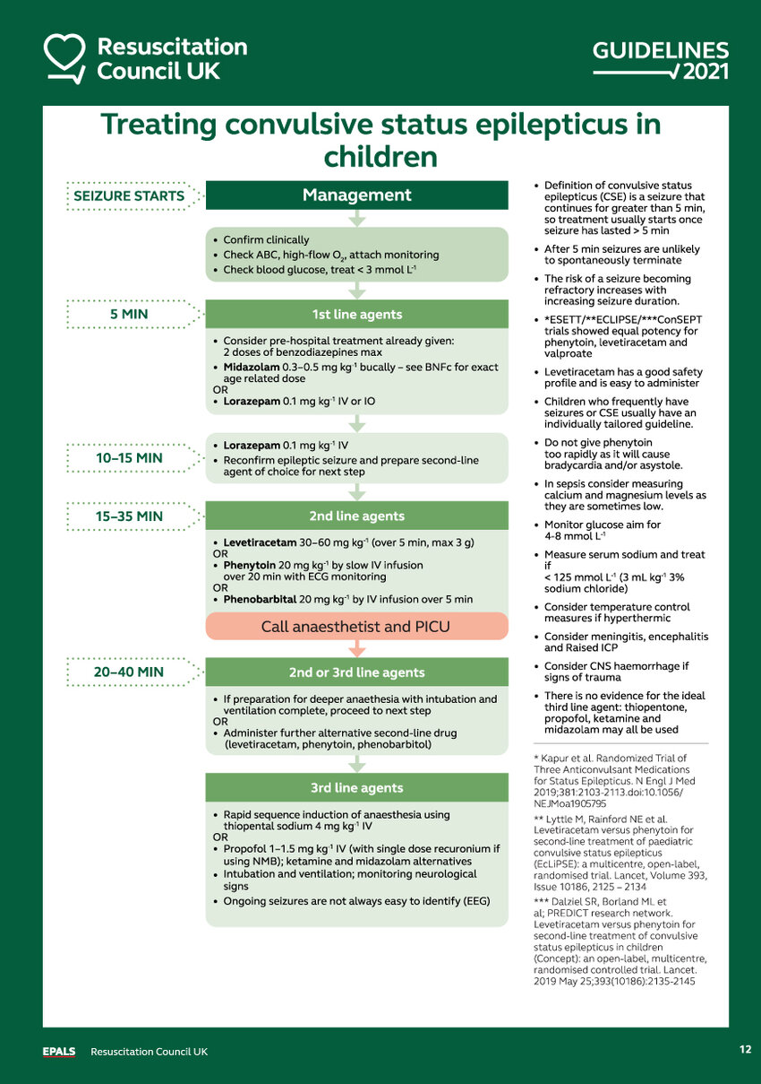
Highlights of SE in children
Do not give Phenytoin too rapidly
DO obtain POCT glucose, sodium, iCa
In case of suspected sepsis, consider meningitis, encephalitis and start sepsis bundle right at ED
Paralysis is NOT convulsion treatment. You need maintenance infusions, at least sedative and analgesia en-route, especially during IFT

Slide 38

CASE 2 Learning Objectivess
Differentiate between Syncope and neurogenic causes of loss of consciousness
Management of Status Epilepticus in children
Mechanical Ventilation Troubleshooting

Slide 39
CASE 3
You are working in a remote ED without Orthopedic or Anesthetic specialty support. A 72-year-old female tripped and fall on level ground on street. She complained of severe right leg pain and numbness. She could not feel over dorsum of foot, otherwise distal circulation was preserved. There was no associated injuries.

Slide 40
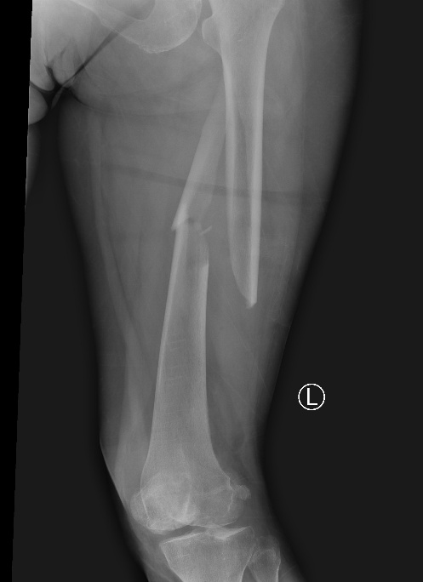
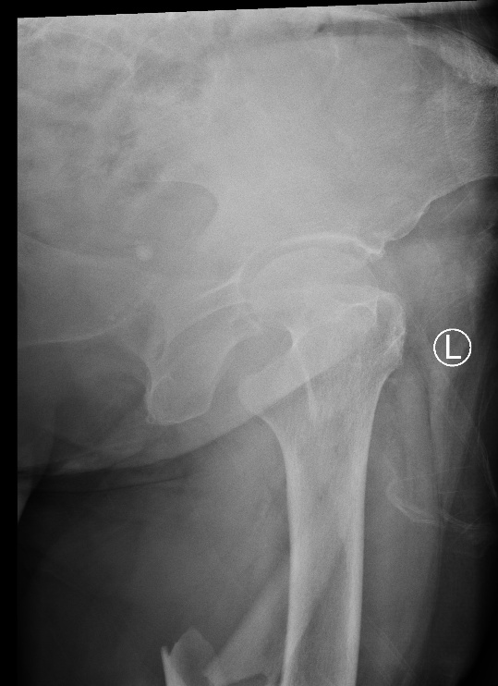
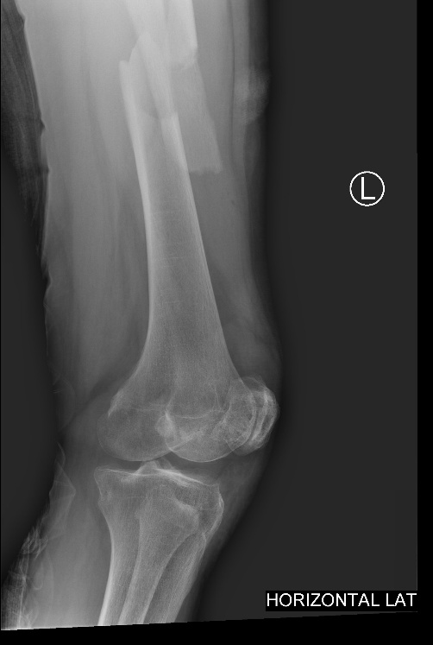
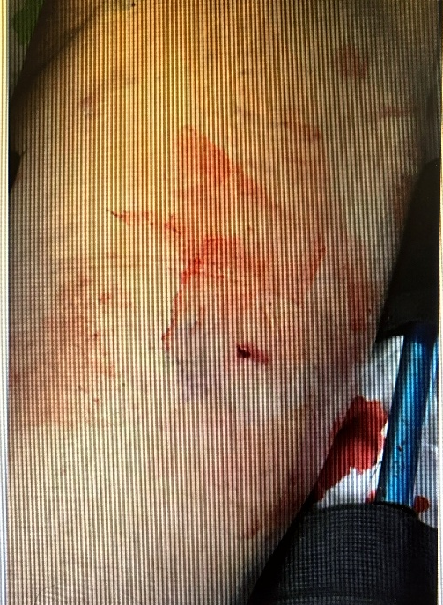
a. Give the diagnosis. (2)
ANS: Open comminuted fracture of midshaft femur with displacement
b. Given the most important Emergency Room intervention and how it helped managing the above trauma.(2)
ANS: Traction Splintage, improve anatomical stability (not accepting alignment), reduce blood loss, better pain control, reduce nerve injury or restore distal circulation (any 2)

Slide 41
a. Give the diagnosis. (2)
ANS: Open comminuted fracture of midshaft femur with displacement
b. Given the most important Emergency Room intervention and how it helped managing the above trauma.(2)
ANS: Traction Splintage, improve anatomical stability (not accepting alignment), reduce blood loss, better pain control, reduce nerve injury or restore distal circulation (any 2)

Slide 42
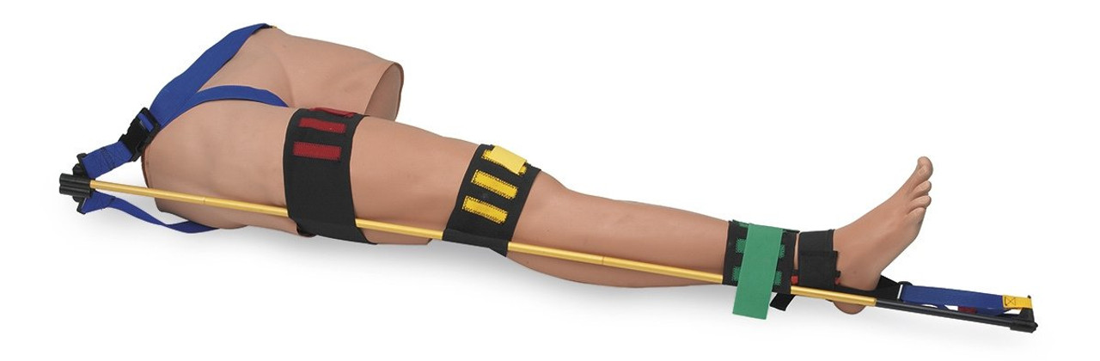
CASE 3 Remarks on Traction Splintage
Traction splints are generally contraindicated for hip fractures, including undisplaced ones.
Fracture of pelvis without binding or stabilization occurring with a fracture mid-shaft Femur is generally a contraindication for the use of a traction splint of any type. Kendrick Traction Splint can be used in a patient with concurrent fracture pelvis.
Supracondylar fractures of the distal end of the Femur are contraindicated because traction can cause anterior rotation of the distal bone fragment forcing the sharp fractured bone end down into the Popliteal Artery and Nerve. These fractures should be splinted as found or presenting.

Slide 43
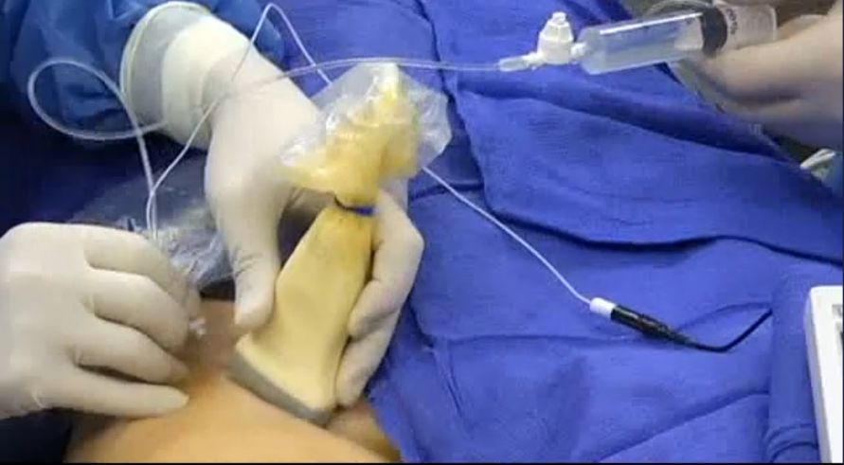
CASE 3
You are offering Ultrasound-guided femoral nerve block prior to the procedure for better and more prolonged analgesia.

Slide 44
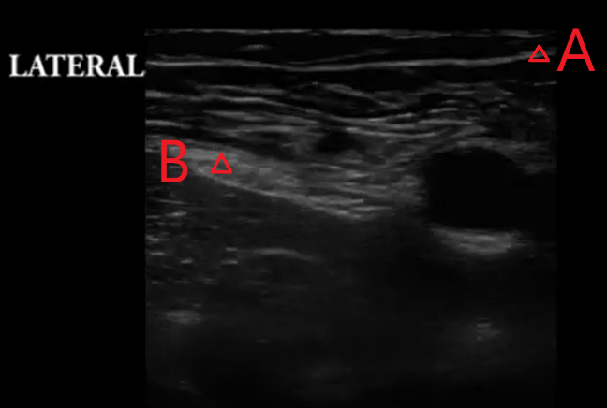
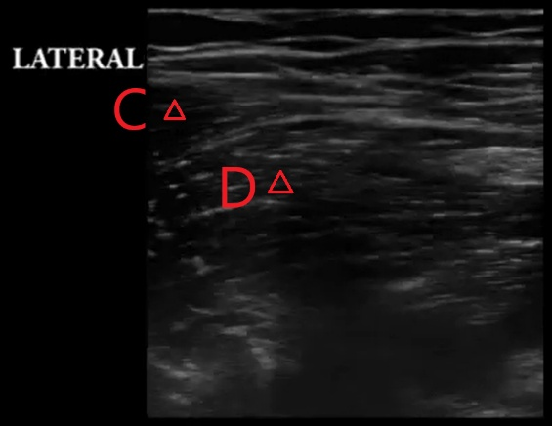
CASE 3
c. Name layers A and B; and muscles C and D (2)

Slide 45
CASE 3
c. Name layers A and B; and muscles C and D (2)
ANS: A: Fascia lata; B: Fascia ilica; C: Sartorius; D: Iliopsoas

Slide 46
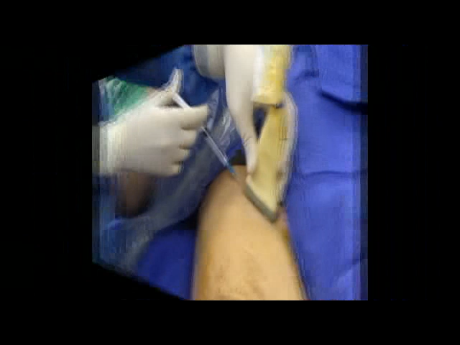
CASE 3
d. Please refer to the video. What is the approach show in the video and what is the advantage? (1)
ANS:
In plane approach; Better needle tip precision through real-time, whole-needle observation; Easier to track the needle's path and adjust its direction

Slide 47
CASE 3
e. The lady was 43kg. What is the maximum dosage of 1% Lidocaine in use for the femoral nerve block, including initial local anesthesia. (1)
ANS: 3mg/kg x 43kg= 129mg
(Some centers would offer 0.5% Levobupivacine, with 2.5mg/kg as maximum)
With a safe lidocaine dose was drawn, additional 0.9% normal saline was added to a total volume of 15-20 ml for instillation.
f. Why is normal saline added into the syringe containing local anesthetic?(1)
ANS: The block works by volume effect, so to ensure its efficacy a minimum volume is required depending on patient size.

Slide 48
CASE 3
e. The lady was 43kg. What is the maximum dosage of 1% Lidocaine in use for the femoral nerve block, including initial local anesthesia. (1)
ANS: 3mg/kg x 43kg= 129mg
(Some centers would offer 0.5% Levobupivacine, with 2.5mg/kg as maximum)
With a safe lidocaine dose was drawn, additional 0.9% normal saline was added to a total volume of 15-20 ml for instillation.
f. Why is normal saline added into the syringe containing local anesthetic?(1)
ANS: The block works by volume effect, so to ensure its efficacy a minimum volume is required depending on patient size.

Slide 49
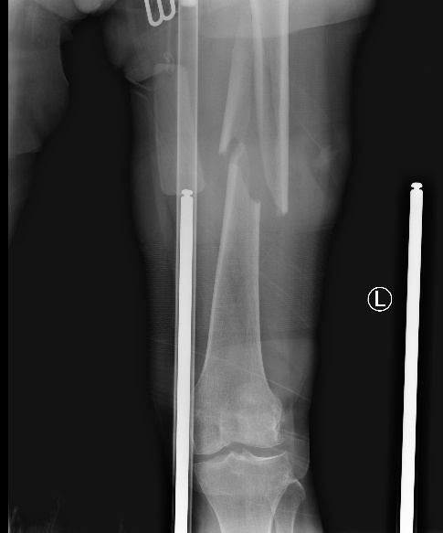
CASE 3
g. You are preparing for inter-facility transport. In view of anticipated potential Local Anesthetic Systemic Syndrome (LAST), state 4 resuscitation medications you would prepare and their respective indications? (2)
ANS:
Benzodiazepines e.g. midazolam, lorazepam or low doses of Propofol for convulsion (avoid phenytoin)
Amiodarone for Wide complex tachycardia (avoid CCB/ BB)
Epinephrine (avoid vasopressin) for cardiovascular collapse
Atropine for unstable bradycardia
20% Intravenous Lipid emulsion (for suspected LAST) (must include)

Slide 50
CASE 3
g. You are preparing for inter-facility transport. In view of anticipated potential Local Anesthetic Systemic Syndrome (LAST), state 4 resuscitation medications you would prepare and their respective indications? (2)
ANS:
Benzodiazepines e.g. midazolam, lorazepam or low doses of Propofol for convulsion (avoid phenytoin)
Amiodarone for Wide complex tachycardia (avoid CCB/ BB)
Epinephrine (avoid vasopressin) for cardiovascular collapse
Atropine for unstable bradycardia
20% Intravenous Lipid emulsion (for suspected LAST) (must include)

Slide 51
CASE 3
h. If the patient develops desaturation en-route with SpO2 around 85-90% despite high flow oxygen delivery and good ventilatory effort. What is the most probable pathology? (1)
ANS: Methemoglobinemia

Slide 52
CASE 3
h. If the patient develops desaturation en-route with SpO2 around 85-90% despite high flow oxygen delivery and good ventilatory effort. What is the most probable pathology? (1)
ANS: Methemoglobinemia

Slide 53
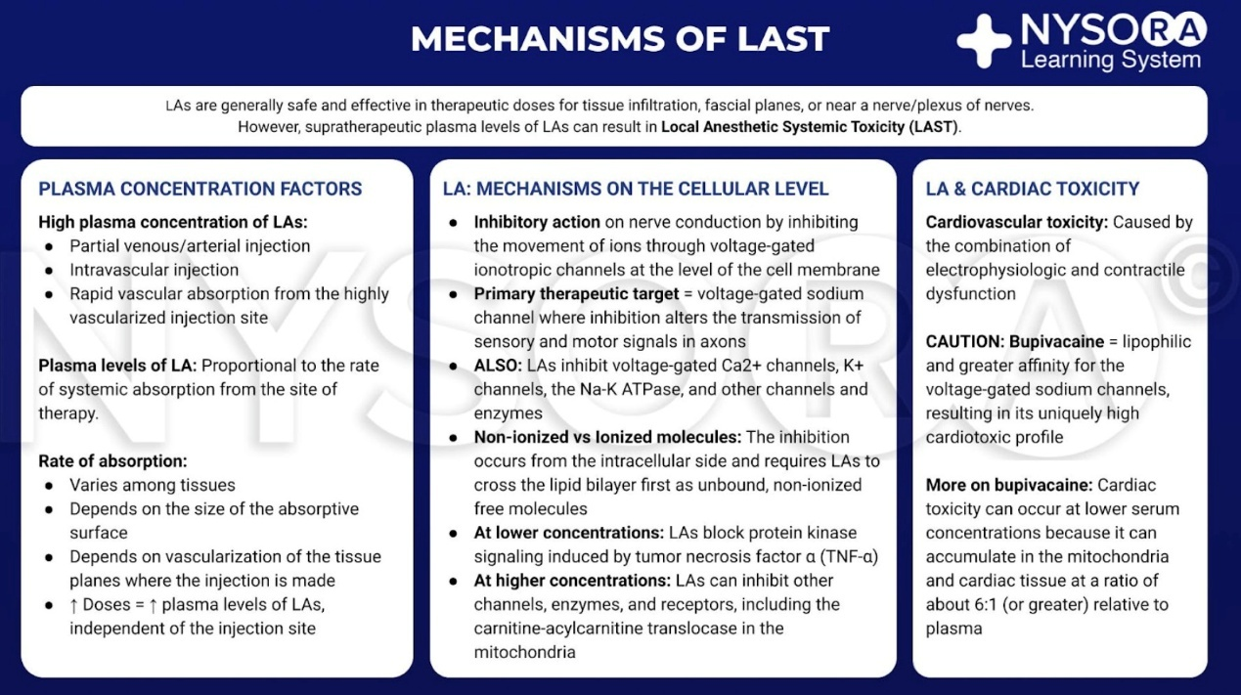

Slide 54
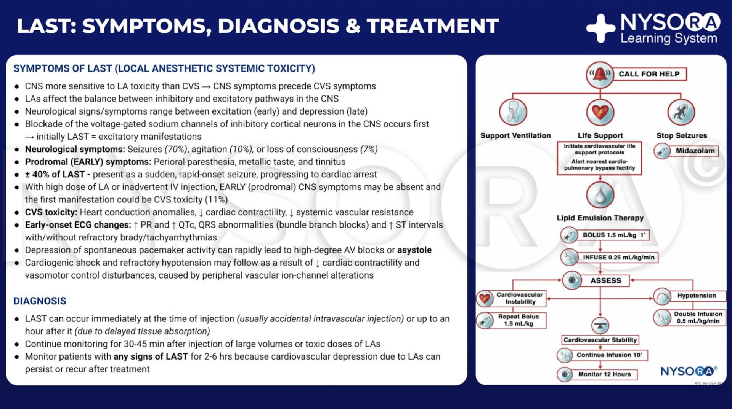

Slide 55
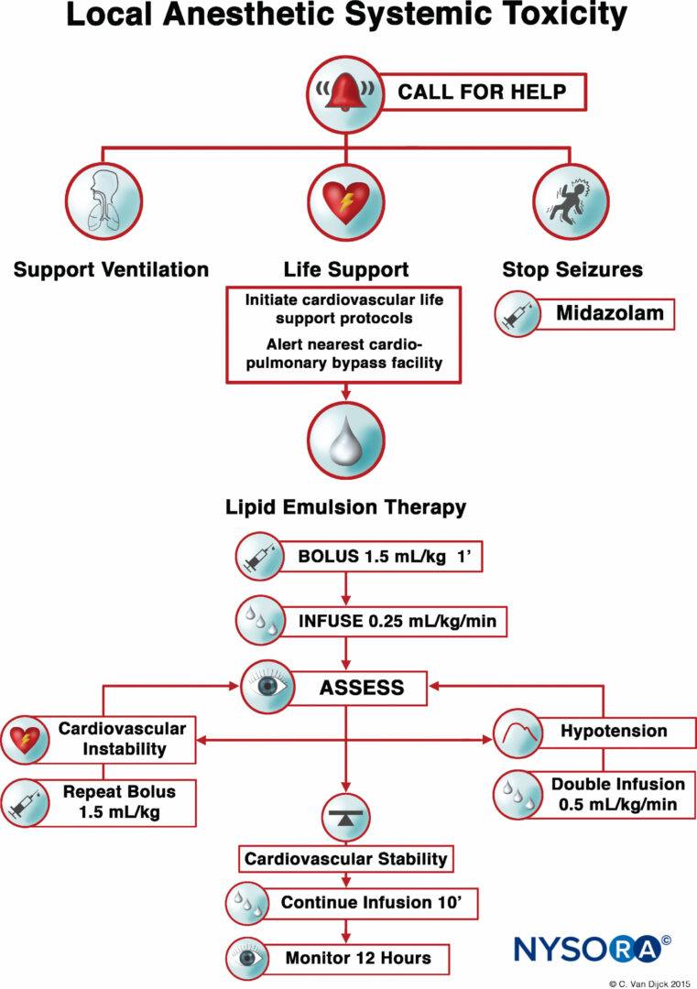
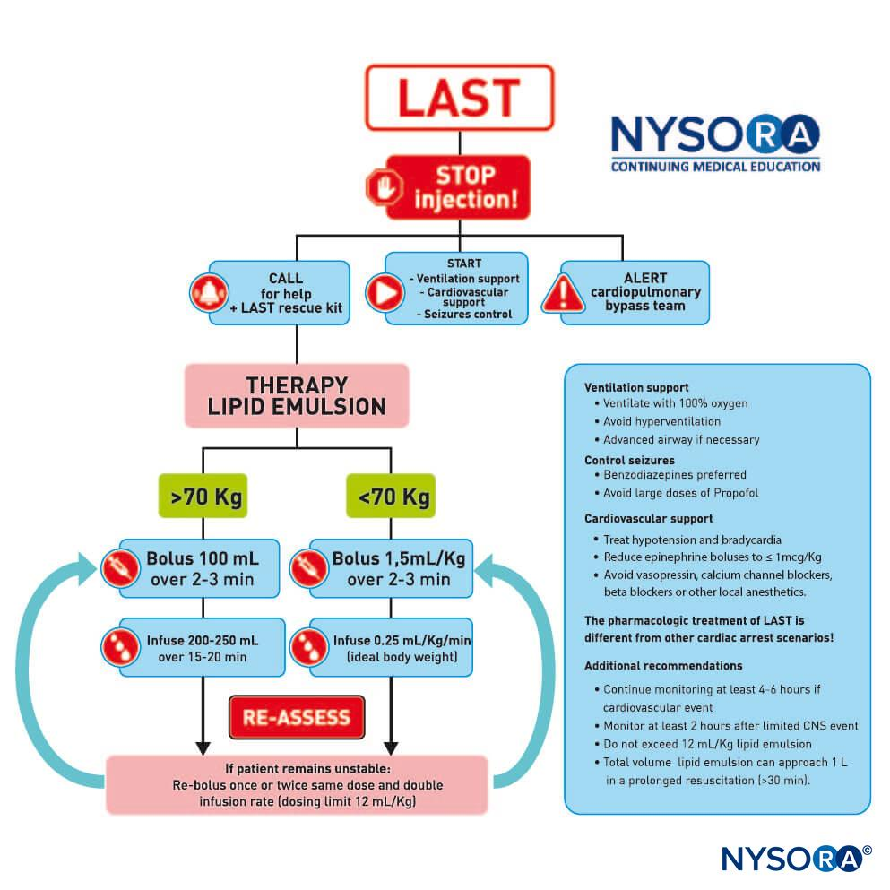

Slide 56
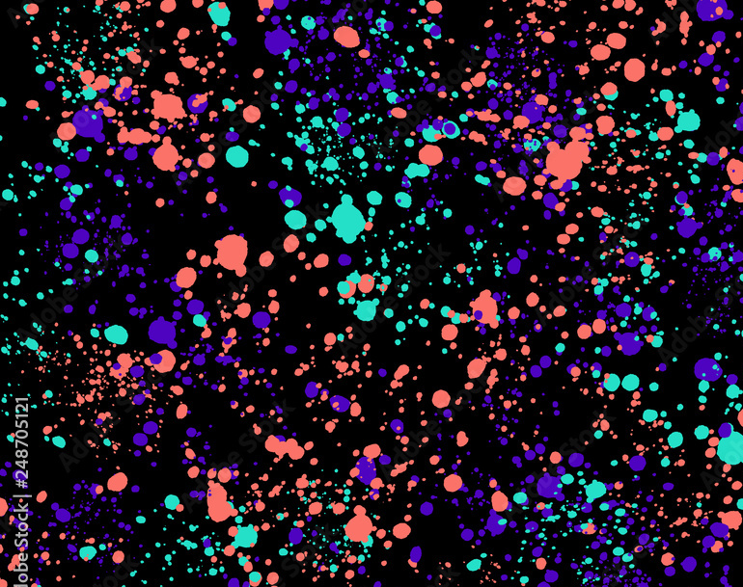
CASE 3 Learning Objectives
Indication and C/I of traction splintage
USG-guided Femoral/ Fasia Ilica nerve block administration
Local Anesthetic Systemic Toxicity (LAST), peri- and post-procedural monitoring and management of complications

Slide 57
CASE 4
A 27 year-old male, with history of schizoaffective disorder, was brought in for altered mental state. A package of 50 tablets of 12.5mg Olanzapine was found emptied beside him. Ingestion time was unknown to paramedics. Below shows the set of vital signs upon arrival to ED:
GCS E3V2M5
Pupils 3.5mm bilaterally, slowly reactive
NIBP/P 120/78 mmHg P 164/min (12-lead ECG attached)
RR >40 breath/ min
SpO2 88-90% (NRB)
Core temp 41C

Slide 58
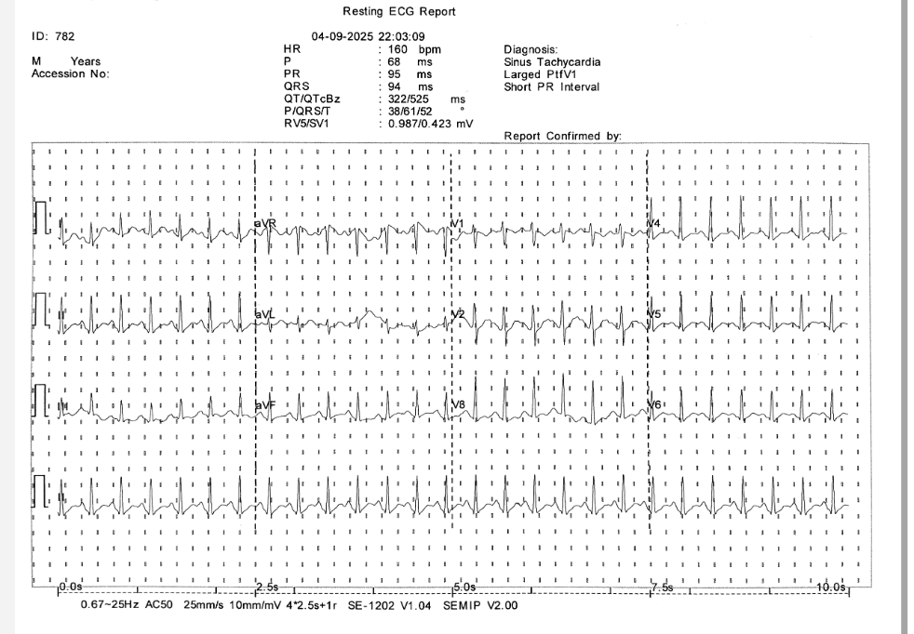
CASE 4

Slide 59
CASE 4
You hear occasional snoring sounds from the patient which can still be managed by repositioning by lying him left lateral. Auscultation showed coarse crackles. Skin was hyperemic and sweaty. You notice muscle rigidity over upper and lower limbs.
POCT (arterial blood)
pH 7.51
pCO2 3.41 kPa
PO2 6.9 kPa
BE -1
CO3 20.3
SaO2 90%
Na 141 K3.5 iCa 1.16
Lactate 2.6

Slide 60
CASE 4
a. Give the most probable diagnosis. (1)
ANS: Neuroleptic Malignant Syndrome
b. Give 3 distinctive clinical features that differentiate with hyper-serotonin syndrome (1.5)
ANS:
(1) NMS associated with culprit neuroleptic agent i.e. antipsychotic especially with prolonged exposure or acute withdrawal
(2) NMS usually accompanied by hyperthermia and severe muscle rigidity (c.f. hyperreflexia, myoclonus, shivering, mydriasis in HSS)
(3) NMS more frequently associated with rhabdomyolysis, AKI and multi-organ failure

Slide 61
CASE 4
a. Give the most probable diagnosis. (1)
ANS: Neuroleptic Malignant Syndrome
b. Give 3 distinctive clinical features that differentiate with hyper-serotonin syndrome (1.5)
ANS:
(1) NMS associated with culprit neuroleptic agent i.e. antipsychotic especially with prolonged exposure or acute withdrawal
(2) NMS usually accompanied by hyperthermia and severe muscle rigidity (c.f. hyperreflexia, myoclonus, shivering, mydriasis in HSS)
(3) NMS more frequently associated with rhabdomyolysis, AKI and multi-organ failure

Slide 62
CASE 4
You intended to intubate the patient due to hypoxemia.
c. What neuromuscular blockade agent would you choose? Also state its antidote available. (2)
ANS: Rocuronium, Sugammadex
Comments:
Not accepting conventional anticholinesterase reversing agent. In GA setting neostigmine, edrophonium, or pyridostigmine, in conjunction with an anticholinergic agent such as atropine or glycopyrrolate are commonly used in reversal. However, they take up to 8 minutes. Sugammadex, a selective relaxant binding agent (SRBA) exclusively for rocuronium and vecuronium, only takes only 2.7 minutes.
Also, suxamethonium risks malignant hyperthermia. It can also cause hyperkalemia and increase intracranial pressure (ICP), so is the agent to avoid in this scenario of NMS.

Slide 63
CASE 4
You intended to intubate the patient due to hypoxemia.
c. What neuromuscular blockade agent would you choose? Also state its antidote available. (2)
ANS: Rocuronium, Sugammadex
Comments:
Not accepting conventional anticholinesterase reversing agent. In GA setting neostigmine, edrophonium, or pyridostigmine, in conjunction with an anticholinergic agent such as atropine or glycopyrrolate are commonly used in reversal. However, they take up to 8 minutes. Sugammadex, a selective relaxant binding agent (SRBA) exclusively for rocuronium and vecuronium, only takes only 2.7 minutes.
Also, suxamethonium risks malignant hyperthermia. It can also cause hyperkalemia and increase intracranial pressure (ICP), so is the agent to avoid in this scenario of NMS.

Slide 64
CASE 4
d. Give 3 possible pharmacological management with stated intention for each of them.(3)
ANS:
Sedative and analgesics: Benzodiazepine/ dexmedetomidine/ Propofol/ fentanyl
Dopamine agonist/ repuptake inhibitor: Bromocriptine/ Amantadine
Direct acting muscle relaxant: Dantrolene
e. Give 3 non-pharmacological managements either in ED or subsequent inpatient setting. (1.5)
ANS: Cooling, Fluid resuscitation, ventilatory support, renal support, Electroconvulsive therapy
Foley catheter was inserted. There was no evidence of myoglobinuria. The patient was then transferred to ICU. Creatinine was peaked at 2324 mmol/L and amylase 2761. Triglyceride level was normal.

Slide 65
CASE 4
d. Give 3 possible pharmacological management with stated intention for each of them.(3)
ANS:
Sedative and analgesics: Benzodiazepine/ dexmedetomidine/ Propofol/ fentanyl
Dopamine agonist/ repuptake inhibitor: Bromocriptine/ Amantadine
Direct acting muscle relaxant: Dantrolene
e. Give 3 non-pharmacological managements either in ED or subsequent inpatient setting. (1.5)
ANS: Cooling, Fluid resuscitation, ventilatory support, renal support, Electroconvulsive therapy
Foley catheter was inserted. There was no evidence of myoglobinuria. The patient was then transferred to ICU. Creatinine was peaked at 2324 mmol/L and amylase 2761. Triglyceride level was normal.

Slide 66
CASE 4
Below describes a hypothetical airway crisis in this patient.
Given the patient was administered etomidate and rocuronium for rapid sequence intubation. After waiting approximately 1 minute for the rocuronium to take effect, the patient became apneic but developed trismus and his mouth opening was approximately 20 mm on maximum which could not permit a laryngoscope blade. Despite these challenges, ventilation and oxygenation were able to be maintained via BVM and jaw thrust.
f. While you are preparing a double set up for cricothyroidotomy, suggest an alternative intubation method which can run in parallel. (1)

Slide 67
CASE 4
Given the patient was administered etomidate and rocuronium for rapid sequence intubation. After waiting approximately 1 minute for the rocuronium to take effect, the patient became apneic but developed trismus and his mouth opening was approximately 20 mm on maximum which could not permit a laryngoscope blade. Despite these challenges, ventilation and oxygenation were able to be maintained via BVM and jaw thrust.
While you are preparing a double set up for cricothyroidotomy, suggest an alternative intubation method which can run in parallel. (1)
ANS: Fiberoptic video bronchoscopy assisted intubation/ LMA assisted Fiberoptic intubation/ intubating LMA +/- use of airway exchange catheter

Slide 68
CASE 4
Given the patient was administered etomidate and rocuronium for rapid sequence intubation. After waiting approximately 1 minute for the rocuronium to take effect, the patient became apneic but developed trismus and his mouth opening was approximately 20 mm on maximum which could not permit a laryngoscope blade. Despite these challenges, ventilation and oxygenation were able to be maintained via BVM and jaw thrust.
Discussion
Malignant hyperthermia with associated muscle rigidity that can be refractory to neuromuscular blockade, especially when succinylcholine was given.
Trismus is generally defined as limited jaw opening less than 30 mm. The evaluation of trismus is a component of the 3-3-2 rule. When trismus occurs, unconventional methods might be required to achieve and maintain the airway.

Slide 69
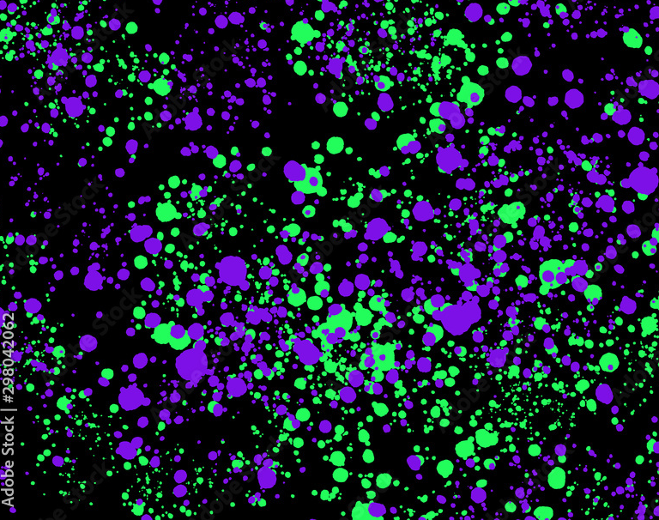
CASE 4 Learning Objectives
Recognition of Neuroleptic Malignant Syndrome(NMS) and other possible toxidromes like anticholinergic/ serotonergic etc.
Clinical management of NMS with special considerations
Anticipated difficult airway management and double set-up

Slide 70
CASE 5
A 57 year-old male was admitted to the Emergency Medicine Ward for new onset exertional dyspnoea and palpitations. He otherwise has no remarkable medical history. Here shows the ECG on admission.

Slide 71
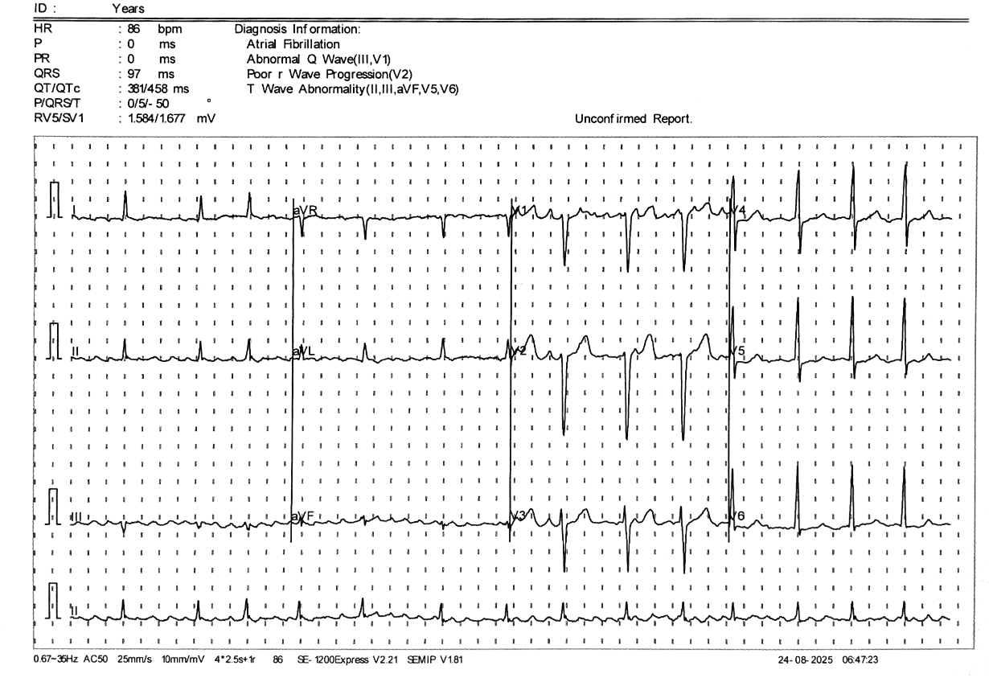
CASE 5
Name the ECG diagnosis and the score for risk stratification.(1)
ANS: Atrial Fibrillation; CHA2DS2-VASc score

Slide 72
CASE 5
Name the ECG diagnosis and the score for risk stratification.(1)
ANS: Atrial Fibrillation; CHA2DS2-VASc score

Slide 73
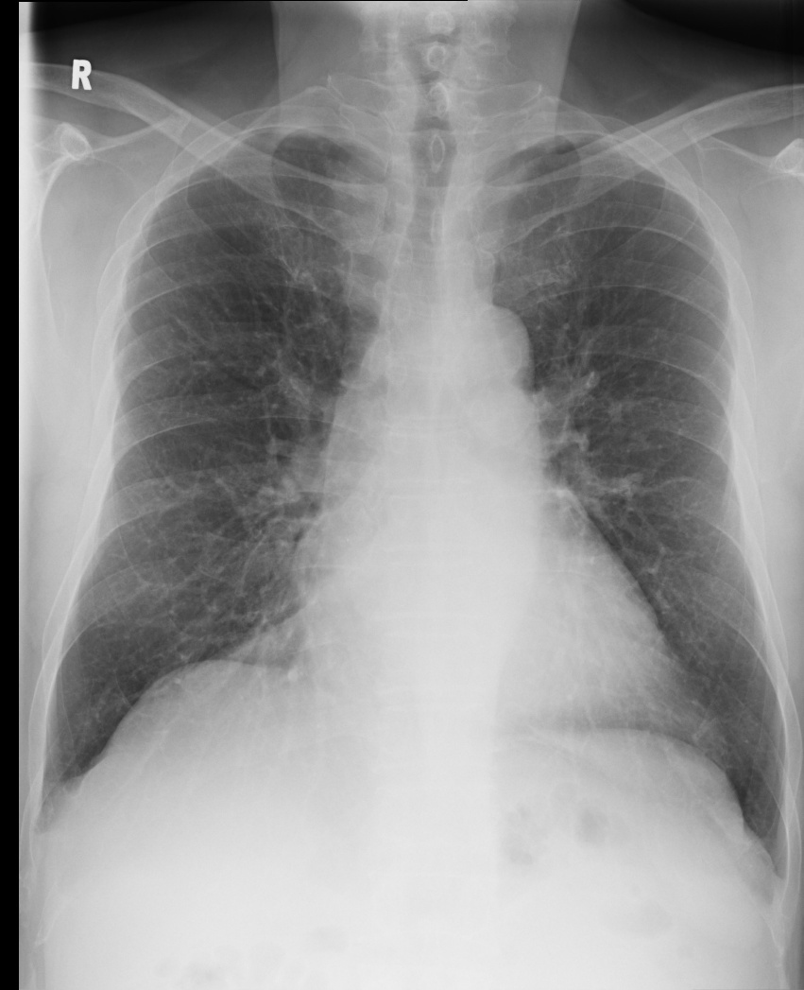
CASE 5
You suspected the patient having congestive heart failure.
b. Suggest a serum marker for heart failure. (1)
ANS: N-terminal prohormone of brain natriuretic peptide/ NT-pro BNP/ BNP

Slide 74
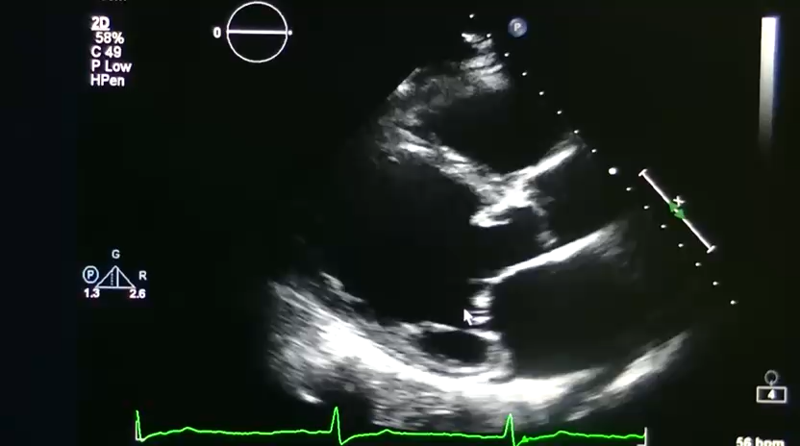
CASE 5
You also performed screening bedside transthoracic echocardiography for the patient.
c. Describe abnormality shown in the bedside TTE video clip.(1) (Clip A)
ANS: Global LV hypokinesia/ Reduced LV contractility/systolic function / LV dilated and thin (Dilated cardiomyopathy)

Slide 75
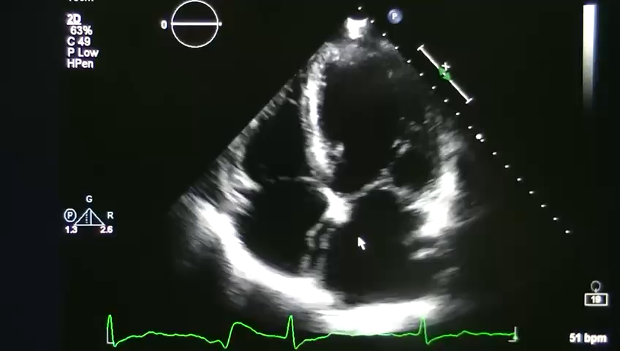
CASE 5
You also performed screening bedside transthoracic echocardiography for the patient.
c. Describe abnormality shown in the bedside TTE video clip.(1) (Clip B)
ANS: Global LV hypokinesia/ Reduced LV contractility/systolic function / LV dilated and thin (Dilated cardiomyopathy)

Slide 76
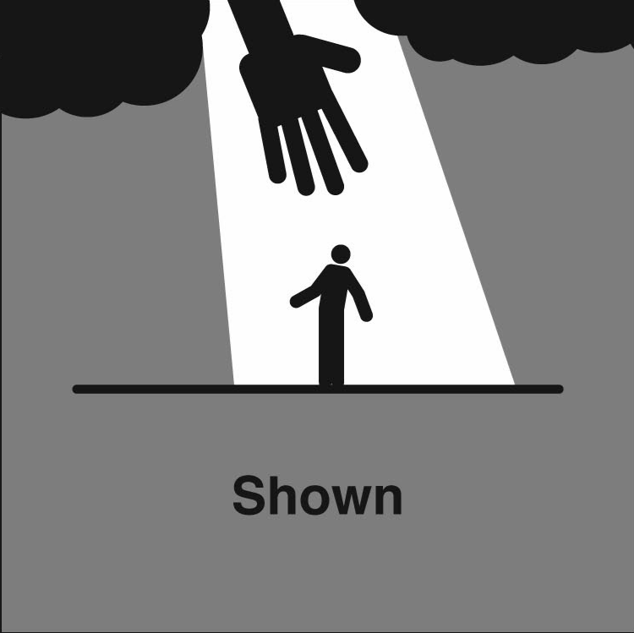
CASE 5
You also performed screening bedside transthoracic echocardiography for the patient.
c. Describe abnormality shown in the bedside TTE video clip.(1)
ANS: Global LV hypokinesia/ Reduced LV contractility/systolic function / LV dilated and thin (Dilated cardiomyopathy)

Slide 77
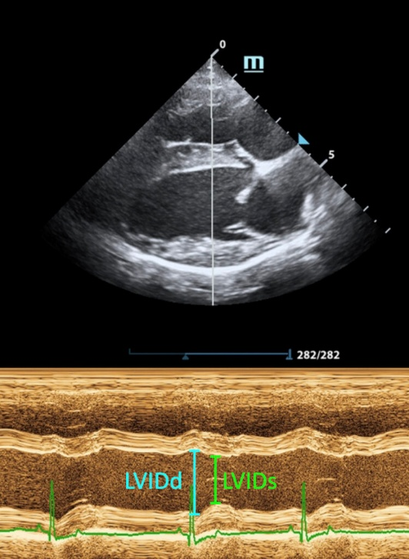
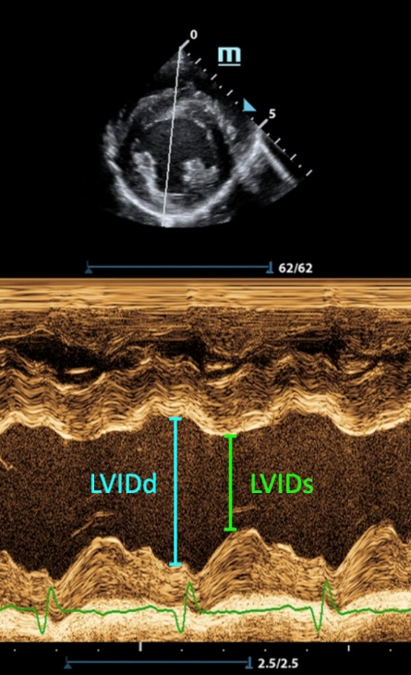
CASE 5
d. Give formula for Fractional shortening(0.5)
ANS: (LVIDd-LVDIs)/ LVIDd
Ref. LVEF~ FS X 2

Slide 78
CASE 5
d. Give formula for Fractional shortening(0.5)
ANS: (LVIDd-LVDIs)/ LVIDd
Ref. LVEF~ FS X 2

Slide 79
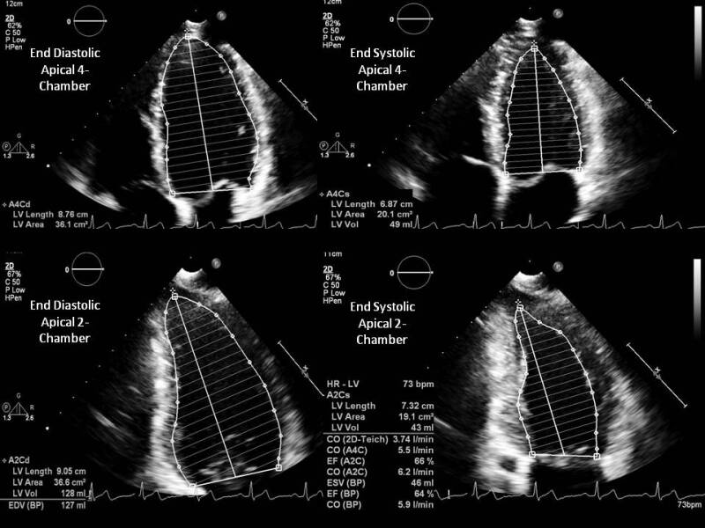
CASE 5
e. Give the name of the method shown to determine Left Ventricle Ejection Fraction. (0.5)
ANS: Simpson’s Biplane Method

Slide 80
CASE 5
e. Give the name of the method shown to determine Left Ventricle Ejection Fraction. (0.5)
ANS: Simpson’s Biplane

Slide 81
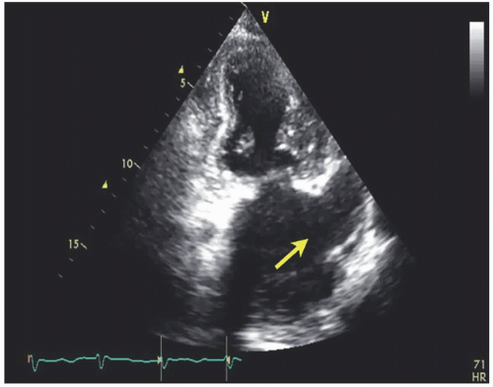
CASE 5
f. Name the structure shown in the captioned TTE photo? What is its significant in this case?
ANS: Left Atrial Appendage (LAA). 90% of AF-related clots form in the LAA.

Slide 82
CASE 5
f. Name the structure shown in the captioned TTE photo? What is its significant in this case?
ANS: Left Atrial Appendage (LAA). 90% of AF-related clots form in the LAA.

Slide 83
CASE 5
Guideline Directed Medical Therapy(GDMT) and anticoagulation by NOAC were initiated in the EMW.
g. Please give the 4 components of GDMT and for each give an example (4)
ANS:
Beta Blocker: Bisoprolol/ Metoprolol/ Carvedilol
Angiotensin Converting Enzyme Inhibitor/ Angiotensin Receptor Blocker: Zestril/Sacubitril / Losartan/ Valsartan
Mineralocorticoid Receptor Antagonist: Spironolactone(Aldactone)/ eplerenone
Sodium Glucose Co-transporter-2 inhibitor (SGLT-2i): Dapagloflozin/ Empagliflozin
h. Give a potential curative treatment option for this particular case w.r.t. etiology. (1)
ANS: Catheter ablation

Slide 84
CASE 5
Guideline Directed Medical Therapy(GDMT) and anticoagulation by NOAC were initiated in the EMW.
g. Please give the 4 components of GDMT and for each give an example (4)
ANS:
Beta Blocker: Bisoprolol/ Metoprolol/ Carvedilol
Angiotensin Converting Enzyme Inhibitor/ Angiotensin Receptor Blocker: Zestril/Sacubitril / Losartan/ Valsartan
Mineralocorticoid Receptor Antagonist: Spironolactone(Aldactone)/ eplerenone
Sodium Glucose Co-transporter-2 inhibitor (SGLT-2i): Dapagloflozin/ Empagliflozin
h. Give a potential curative treatment option for this particular case w.r.t. etiology. (1)
ANS: Catheter ablation

Slide 85
CASE 5
Discussion
This is a case of newly revealed persistent AF with HFrEF (LVEF 22%), likely DCM. Inpatient liaison with Internal Medicine was arranged and the patient was transferred to medical ward for subsequent arrangement of diagnostic coronary angiogram and cardiac MRI. No coronary obstruction was conclude. After 3 weeks of anticoagulation, direct current cardioversion (DCCV) was performed uneventfully.
According to NIH, AF is diagnosed in >1/2 patients with new onset heart failure. Approximately 1/3-1/2 newly diagnosed AF patients already have heart failure.

Slide 86
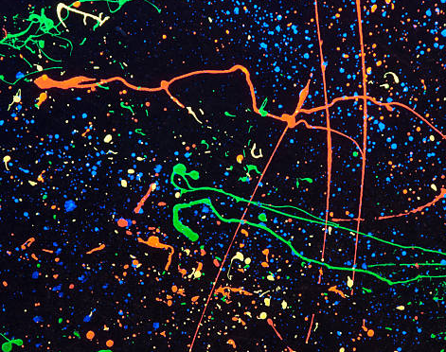
CASE 5 Learning Objectives
POCUS Echo Assessment of LV systolic function
new onset AF management in EM
GDMT in HFrEF
Of AF patients, no matter newly diagnosed or chronic, HF is common.

Slide 87

Disclaimer
All cases included are from TSWH AED/ EMW Q2-3 2025
Some clinical information is adjusted or added for extended illustration.

