Slide 1
JCM Sep 2025
QMH AED

Slide 2
Q1
A 44 year-old man suddenly collapsed when playing basketball. He spontaneously regained consciousness after 30s. He had no chest pain all along and no GTC movements. His vital signs were within normal range. His ECG is shown in the next page

Slide 3
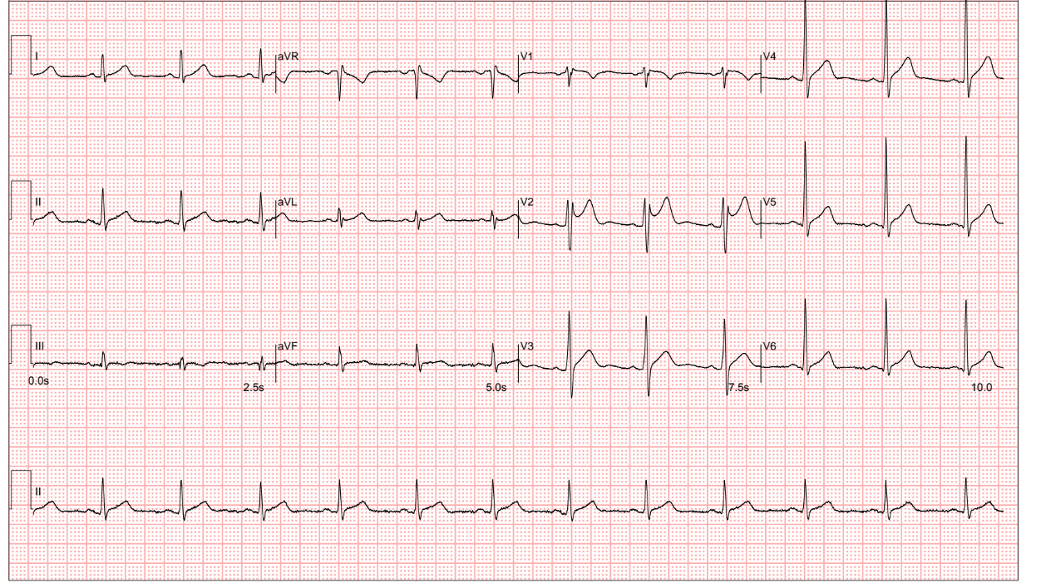

Slide 4
Q1
1. Describe the ECG
2. What clinical diagnosis do you suspect in this case?
3. State 2 other history you would ask to support your clinical suspicion?
4. What additional information in the CMS (if available) can be helpful for your management decision?
5. What is the criteria to confirm the diagnosis?

Slide 5
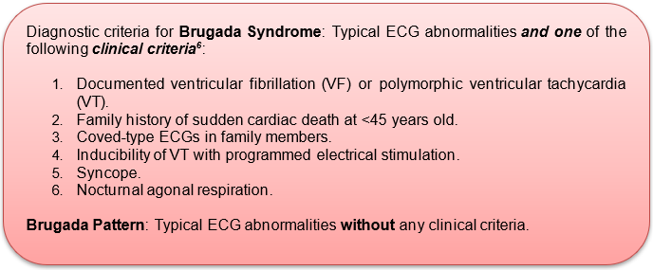
Q1 answers
1. saddleback shaped ST elevation over V2, a Brugada pattern
2. Brugada syndrome
3. Hx of sudden cardiac death, prior episodes of syncope
4. old ECG
5. ECG pattern + clinical criteria

Slide 6
Q2
A 75 year-old man fell with an outstretched left hand.
Left hand tender over 5th MC

Slide 7
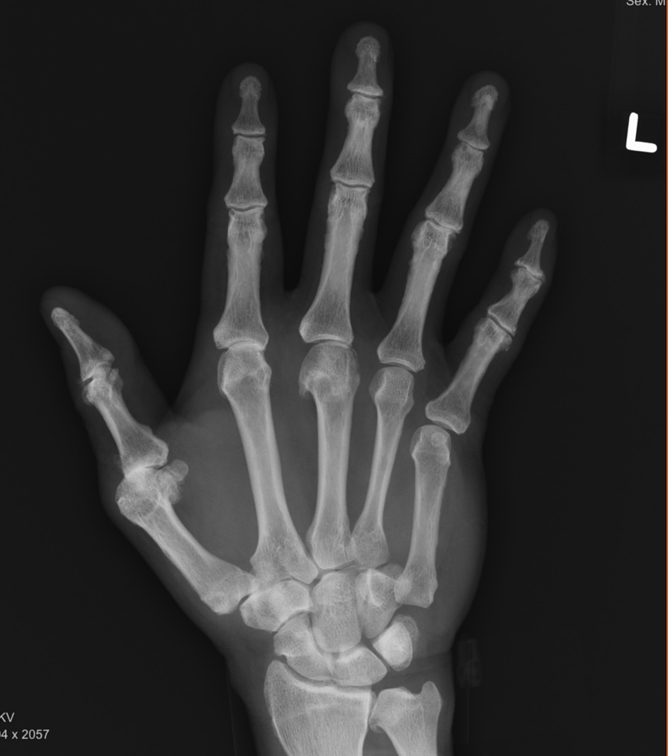
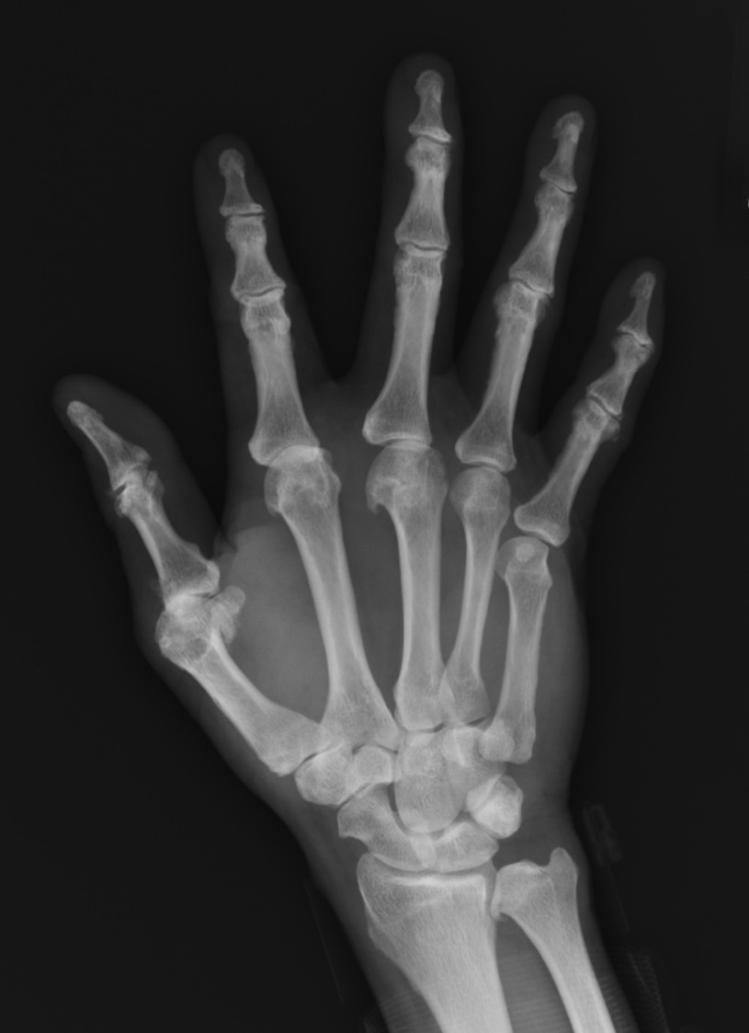


Slide 8
Q2
1. Comment on this XR
2. Name another MOI for this type of injury
3. Name 3 common associated injuries
4. What management can you give in the AED? How would you perform your management?
5. What splint would you give to this patient?

Slide 9
Q2 answers
1. left hand 5th CMCJ dislocation
2. punch
3. 5th MC base #, hamate #, ulnar nerve injury (due to proximity to hook of hamate)
4. closed reduction
  Apply longitudinal traction to the 5th finger to disengage the dislocated metacarpal base
  Use one hand to push the metacarpal head dorsally, while the other hand presses the base of the 5th metacarpal volarly toward the hamate, until a clunk is felt or heard

Slide 10
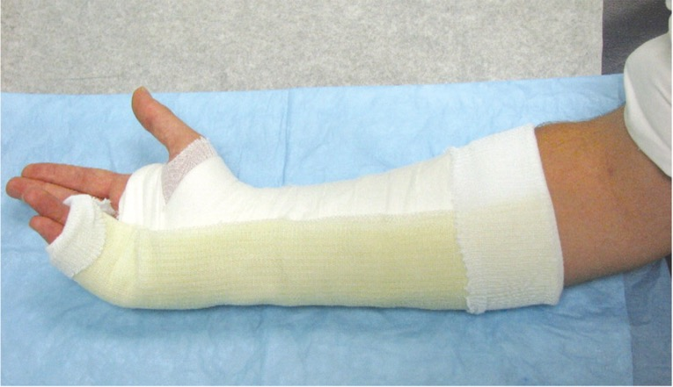
5. Ulnar gutter splint

Slide 11
Q3
80 year-old man fell with right hand injury, landed on dorsum of hand
Right hand swollen, cannot extend right M/F

Slide 12
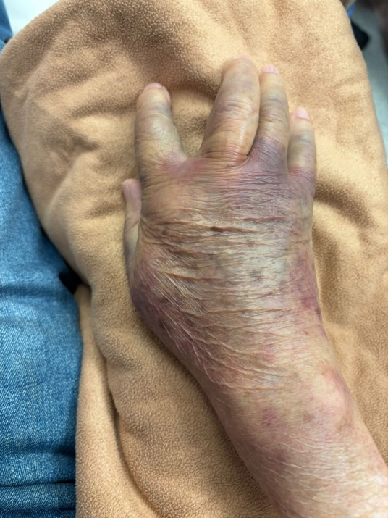
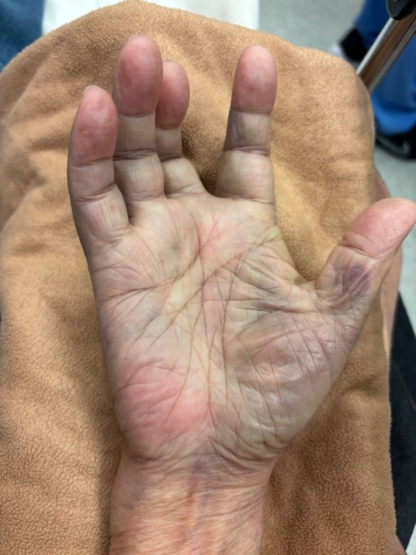

Slide 13
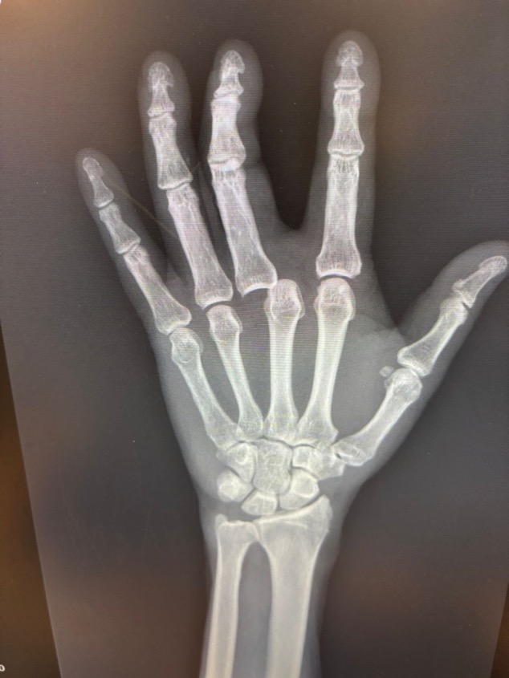
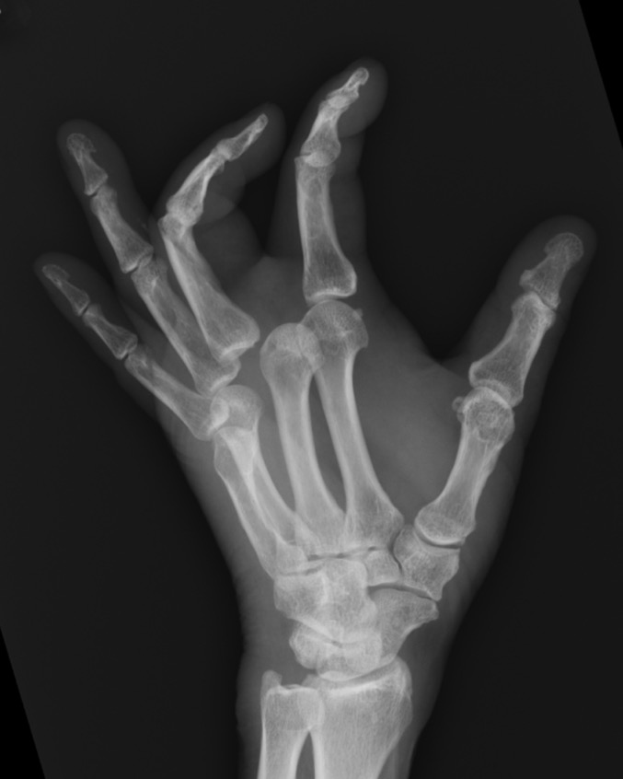

Slide 14
Q3
1. Please comment on this XR.
2. How would you perform closed reduction for this patient?

Slide 15
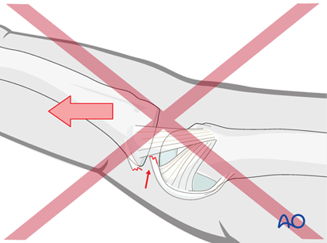
Q3 answers
1. right hand 3rd MCPJ dislocation
  2. closed reduction
    apply direct pressure over dorsal aspect of proximal phalanx with the wrist in flexion to take tension off the intrinsic and extrinsic flexors
    avoid longitudinal traction during closed reduction as it may pull volar plate into joint and convert to a irreducible dislocation

Slide 16
Q4
A 80 year old man with history of HT and DM presented with chest pain radiating to back for 1 day. His vitals were BP 201/117 P72 SpO2 100% in RA. ECG showed no acute change. CXR showed widened mediastinum. A CT aortogram was ordered.

Slide 17
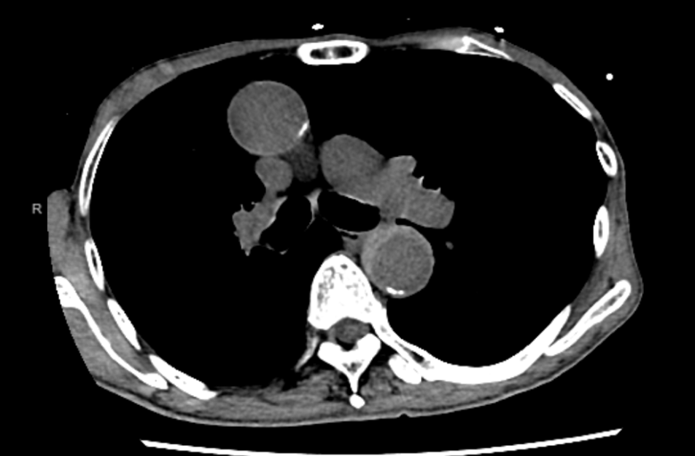
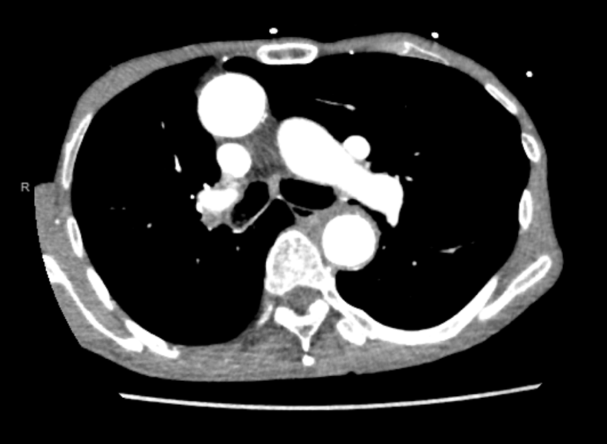

Slide 18
Q4 questions
1. Please comment on the CT cuts.
2. What is the pathophysiology for this condition?
3. What is the management for this patient?

Slide 19
Q4 answers
1. Type B intramural hematoma
2. rupture of vasa vasorum, resulting in bleeding into the media layer
3. medical (BP control)

Slide 20
Q5
A 53 year old man sustained a HI after trip and fall. CTB done showed no ICH or skull fracture. An XR and CT of C-spine was also done due to neck pain.

Slide 21
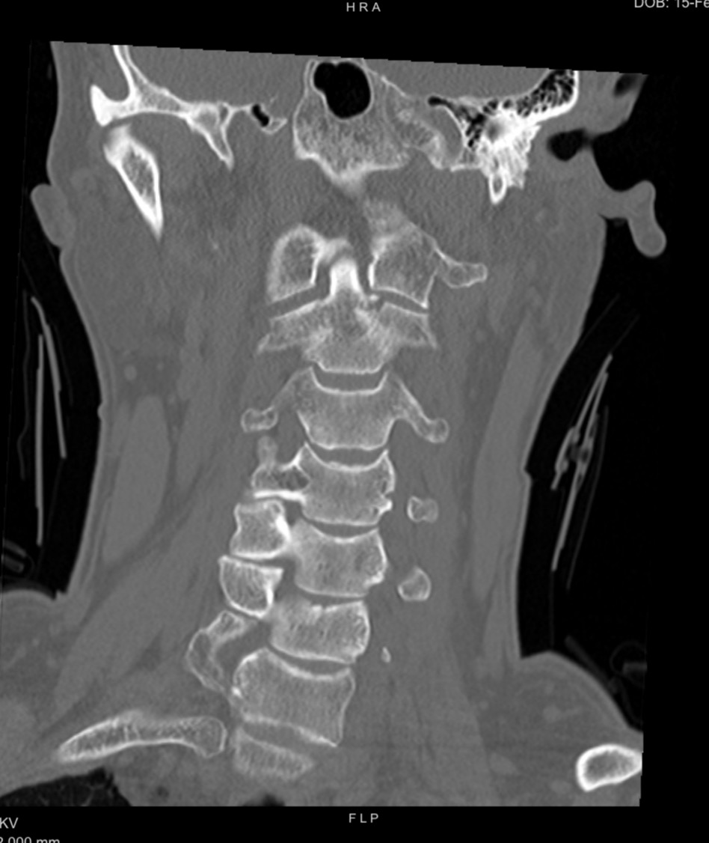
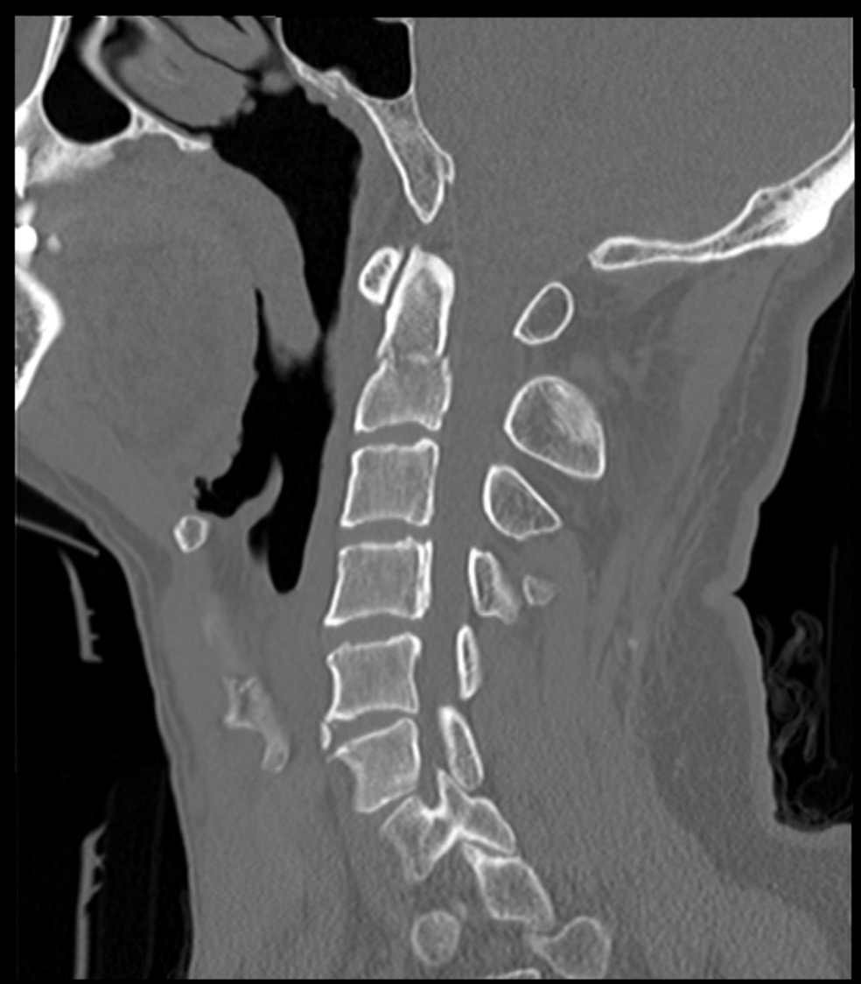

Slide 22
Q5
1. Please comment on the CT.
2. Name one classification for this injury.
3. Which type has the worst prognosis?
4. What is the underlying disease to exclude for this condition to have occurred in the patient?

Slide 23
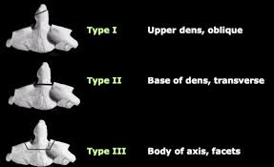
Q5 answers
1. fractured odontoid process
2. Anderson & D’Alonzo, Type I-III
3. Type II (unstable)
4. osteoporosis

Slide 24
Q6
A middle-aged man fell with left shoulder contusion.

Slide 25
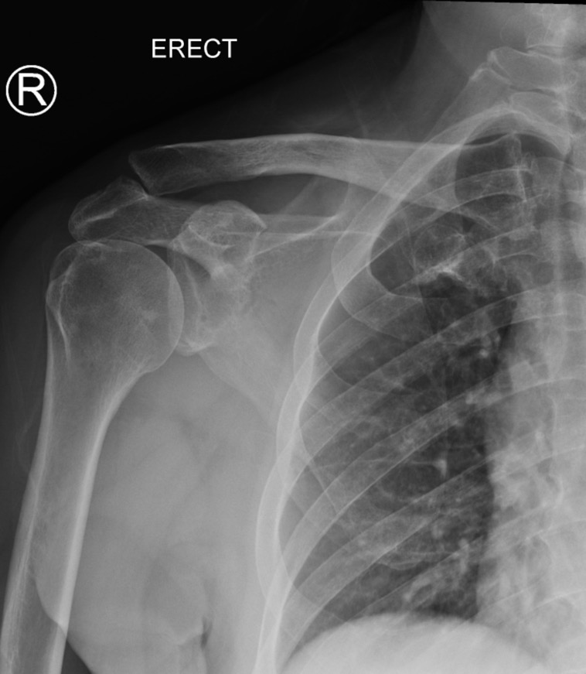
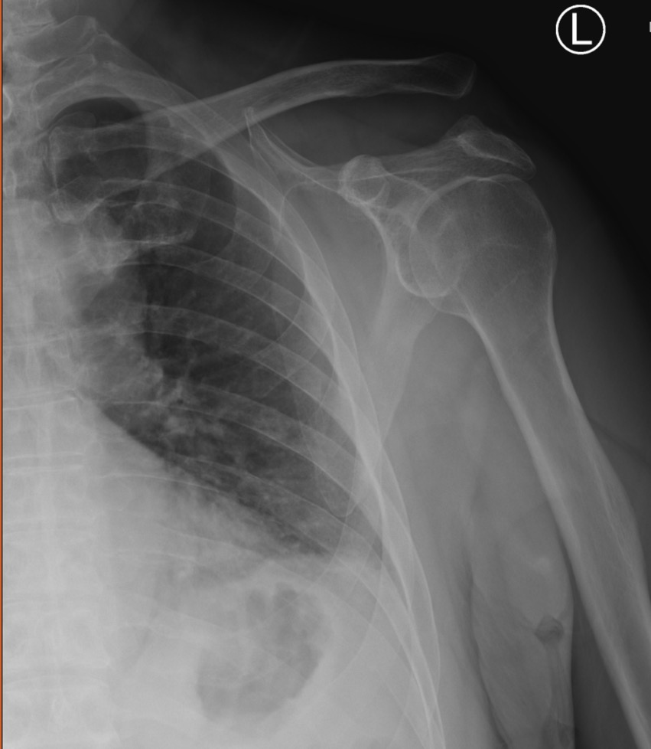

Slide 26
Q6
1. Please comment on this XR
2. What other XR views would be useful for your diagnosis and management?
3. What is the classification for this type of injury?
4. What grade is this?
5. What is the management?

Slide 27
Q6 answers
1. Increased in coracoclavicular distance
2. bilateral shoulder AP weight bearing view
3. Rockwood classification
4. Grade V (>100% increased CC distance)
5. Surgical (IV – VI)

Slide 28
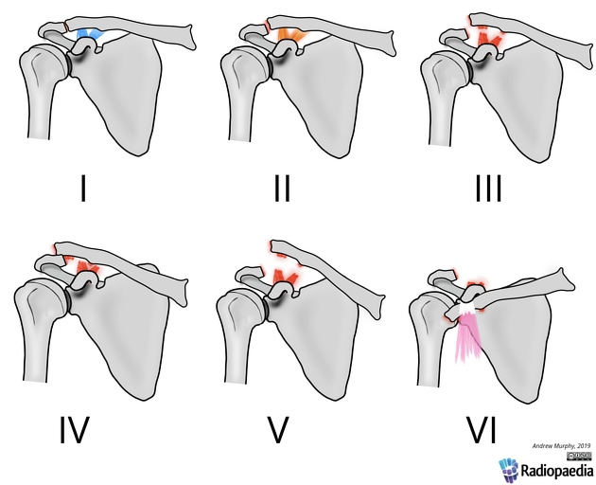
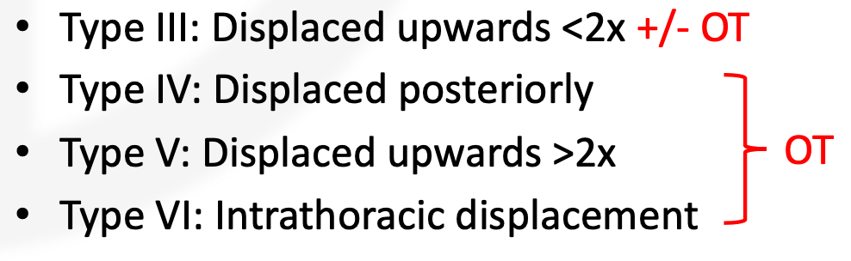
ROCKWOOD CLASSIFICATION

Slide 29
Q7
2 year-old boy fell from his grandfather’s embrace when grandfather was walking
Noted irritability on manipulating right leg

Slide 30
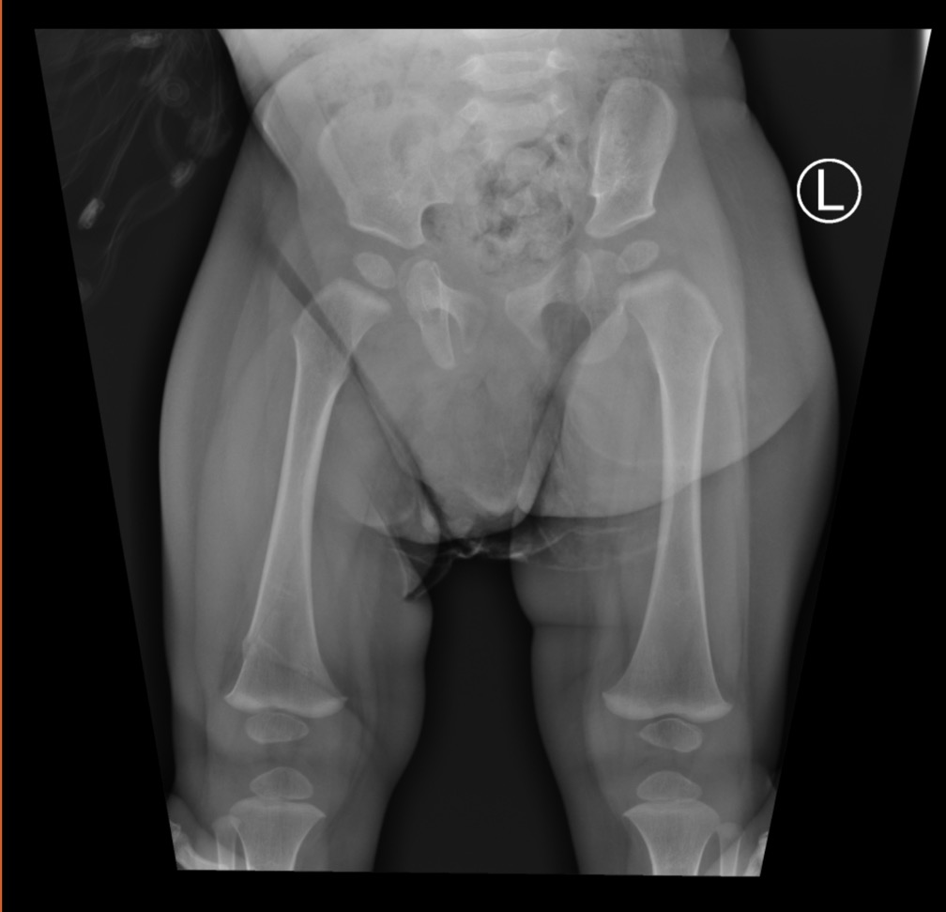
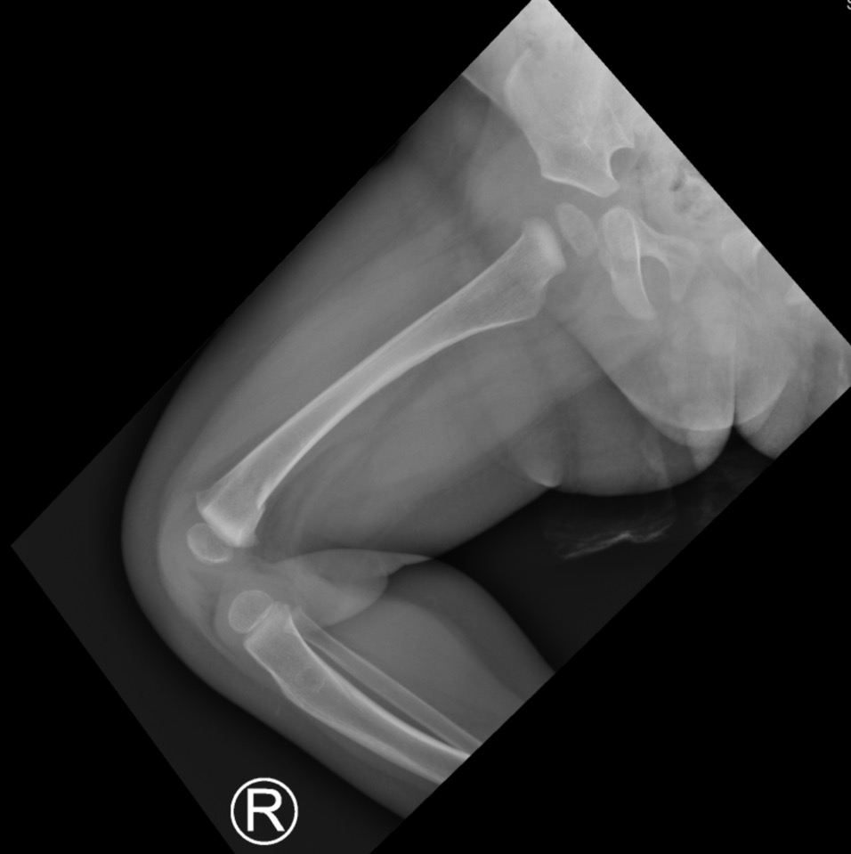

Slide 31
Q7
1. Please comment on this pelvic XR.
2. What is the management?
3. What is one crucial mechanism of injury to exclude?

Slide 32
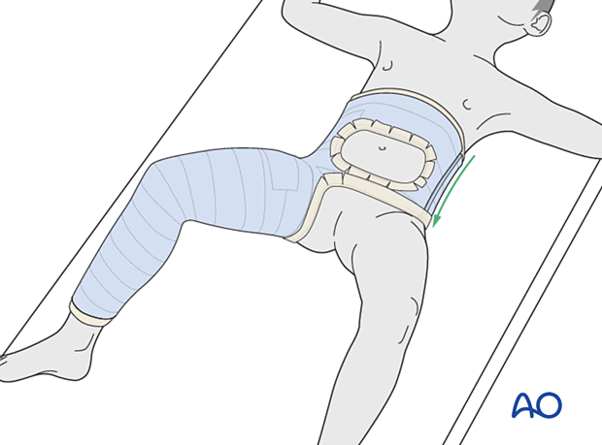
Q7 answers
1. fractured R distal femur
2. hip spica
3. non-accidental injury

