Slide 1
2026 February
JCM OSCE
QEH
Dr Jimmy Leung Hei Jim

Slide 2

Case 1
A young male (~30-years-old) with unknown identity and past health was found collapsed during jogging
Bystander CPR was performed for 3 minutes with AED shock x 1
ROSC achieved at scene
Unresponsive, BP 119/80 P84 on ambulance
On arrival to A&E:
GCS 3/15, BP 108/64, P81, SpO2 97% on 15L NRM, PERL
(AI generated)

Slide 3
Q1. Outline your post-cardiac arrest management following ACLS guideline

Slide 4
Q1. Outline your post-cardiac arrest management following ACLS guideline
ACLS 2025:
- Airway: advanced airway as necessary
- Breathing: SPO2 target 90-98%, PCO2 target 35-45mmHg
- Hemodynamics: target MAP > 65mmHg
- Early diagnostic: ECG, CT, USG
- Treat arrest etiologies and complications
- Consider coronary angiography and/or mechanical circulatory support
- Deliberate Temperature Control 32C-37.5C
- EEG
- Ongoing critical care

Slide 5
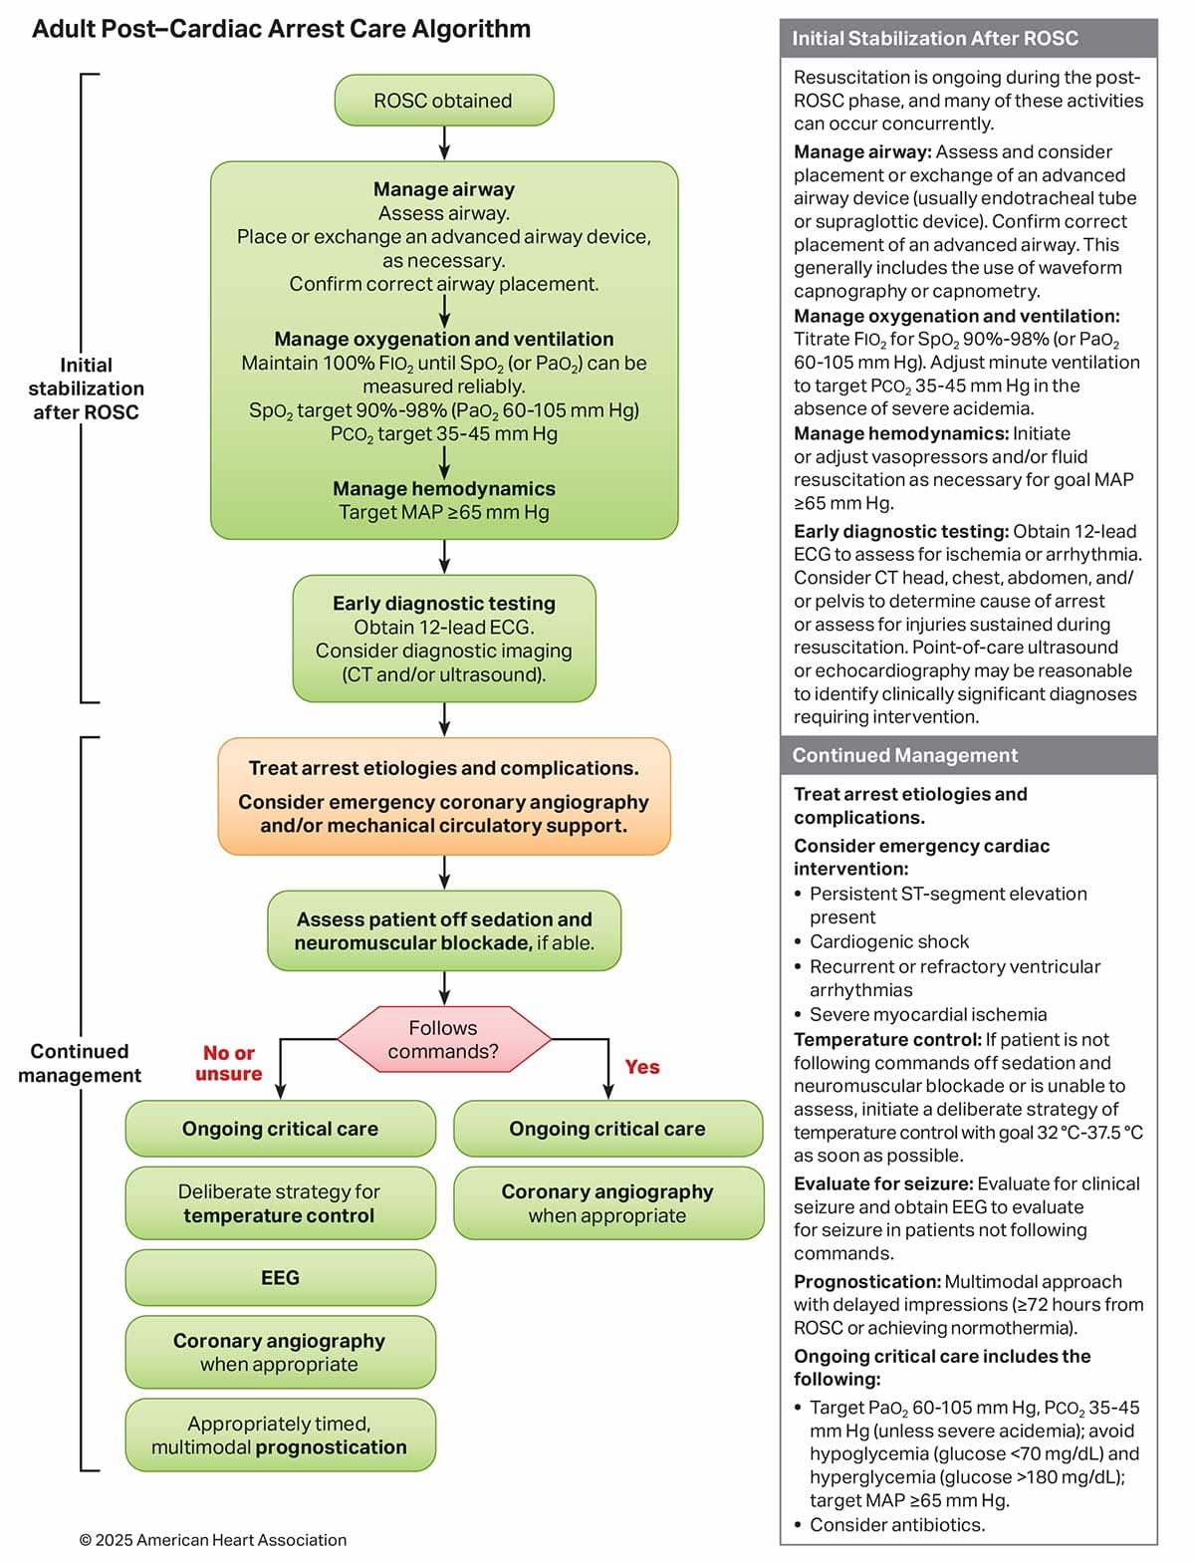
2025 American Heart Association Guidelines for Cardiopulmonary Resuscitation and Emergency Cardiovascular Care

Slide 6
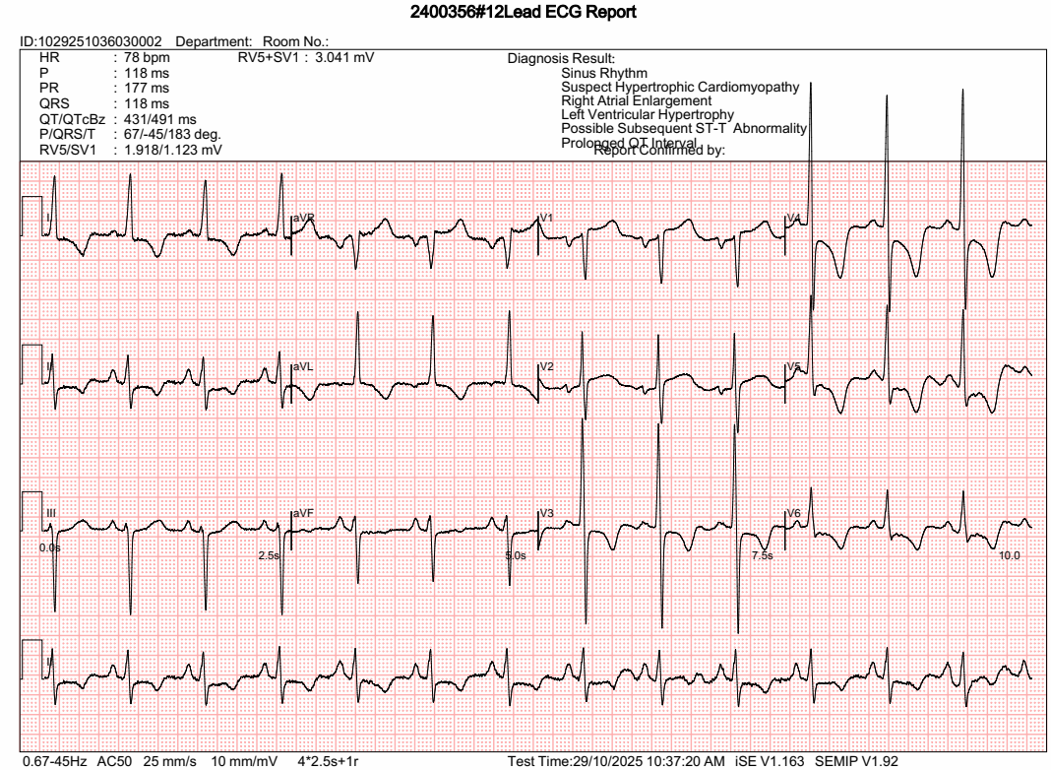
Q2. Describe the ECG findings

Slide 7
Q2. Describe the ECG findings
Sinus rhythm
LVH by voltage criteria
    R wave in V5 or V6 plus S wave in V1 > 35 mm
    R wave in V4, V5 or V6 > 26 mm
    R wave in lead I + S wave in lead III > 25 mm
ST depression and T wave inversion in I, II, aVL, V2-V6
Prolonged QTC
Notes:
R wave in lead I + S wave in lead III > 25 mm
R wave in aVL > 11 mm
R wave in V5 or V6 plus S wave in V1 > 35 mm
R wave in V4, V5 or V6 > 26 mm
?mild LAD (0 to 30’)
QTC

Slide 8
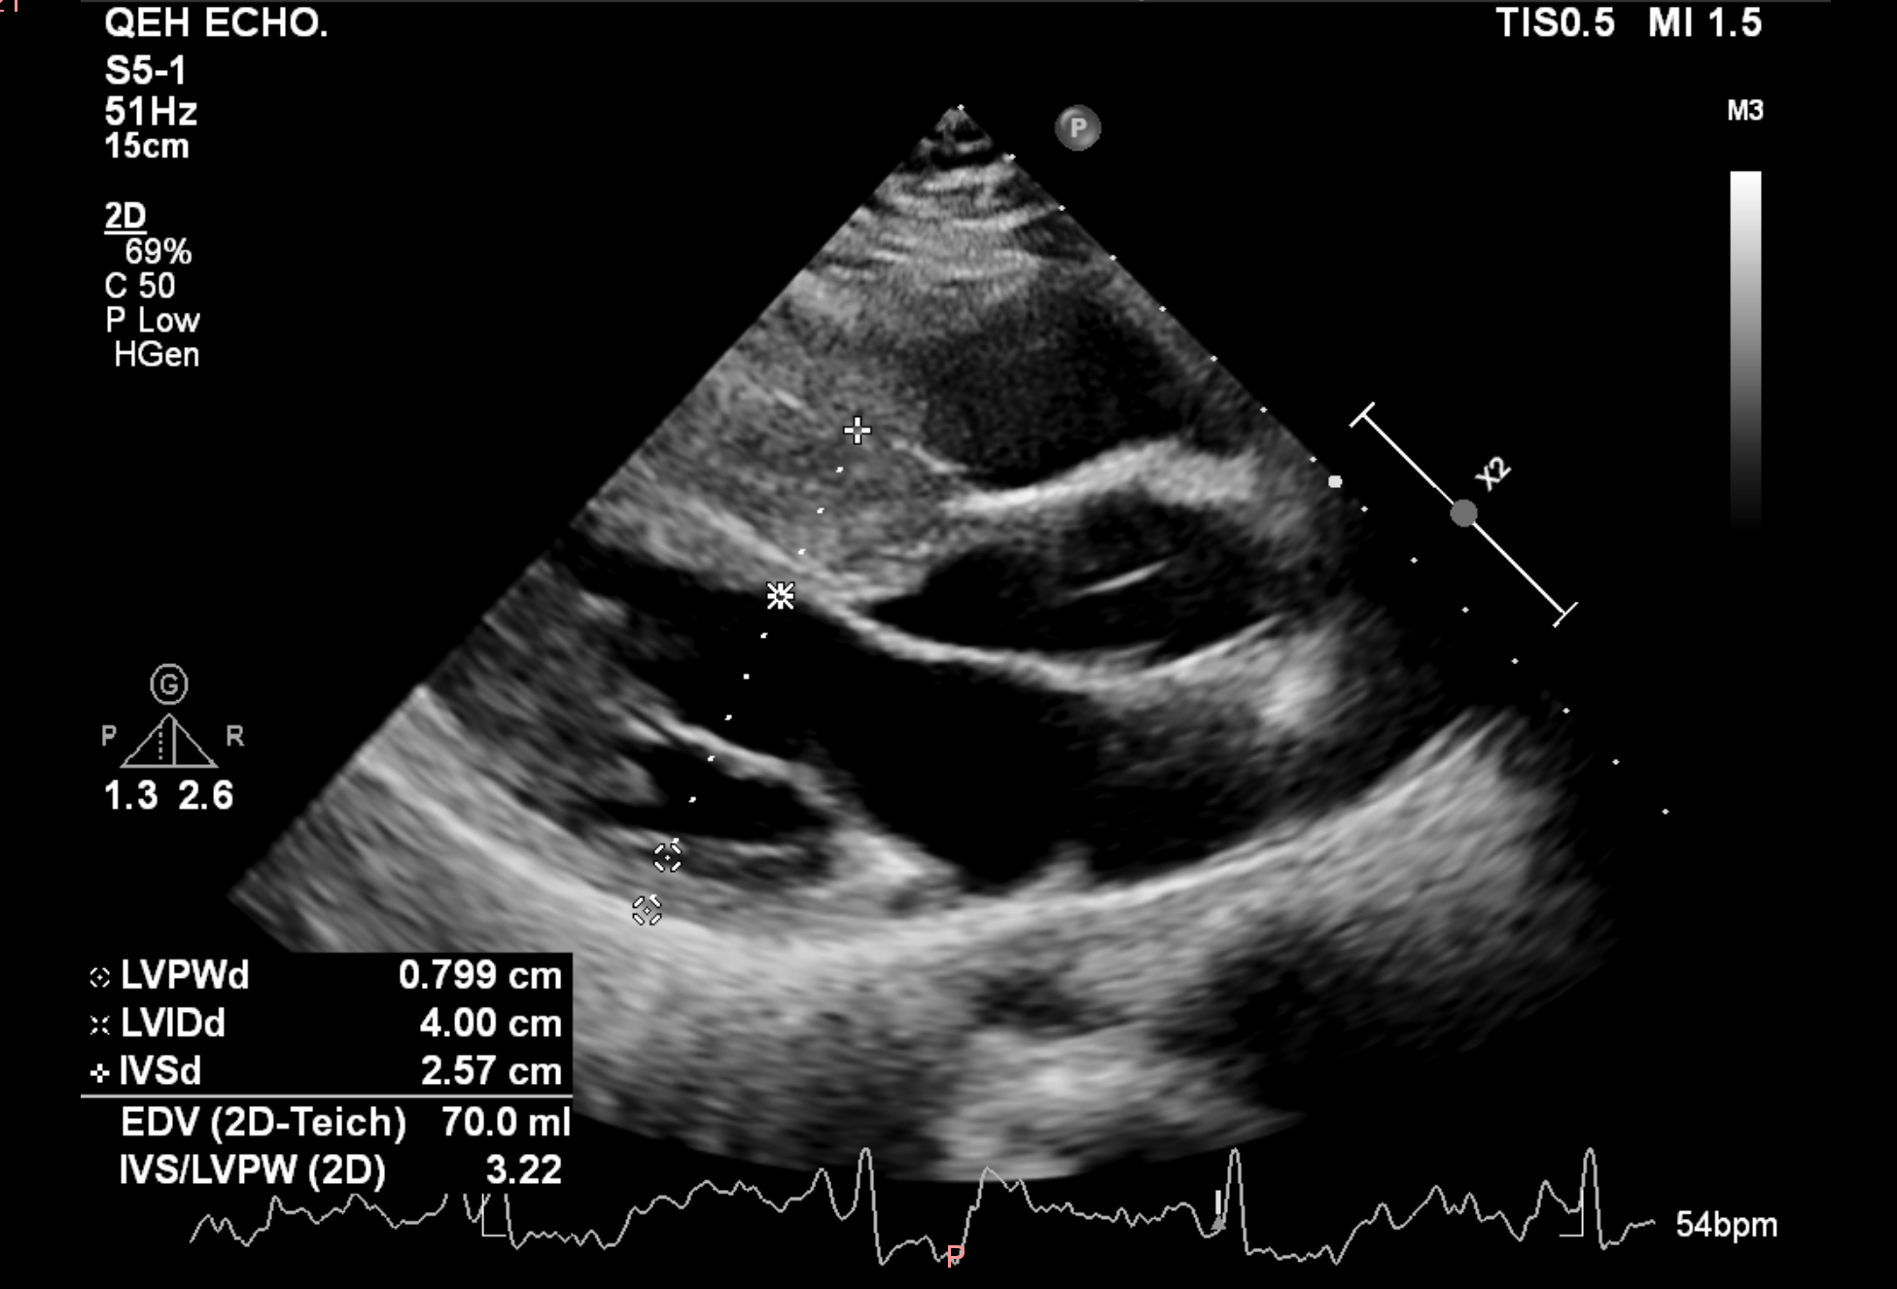
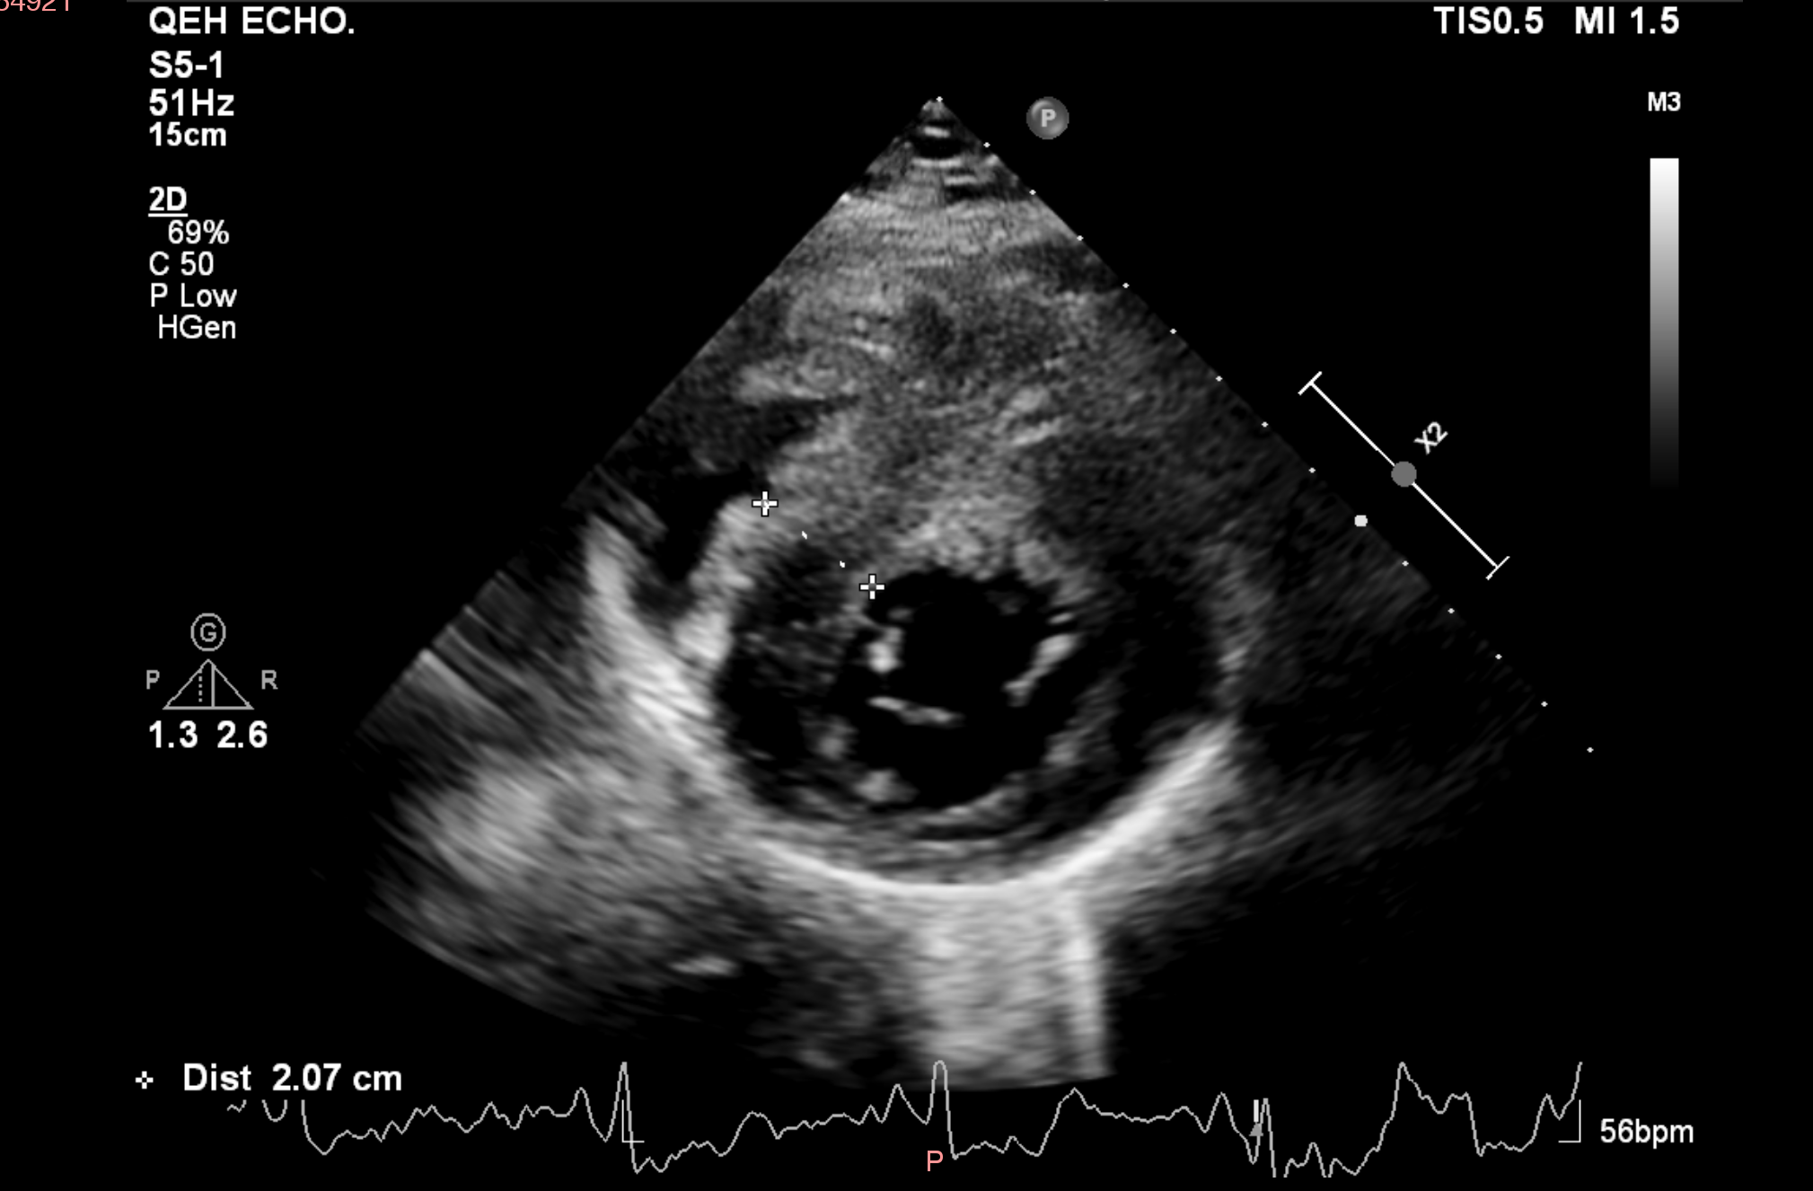
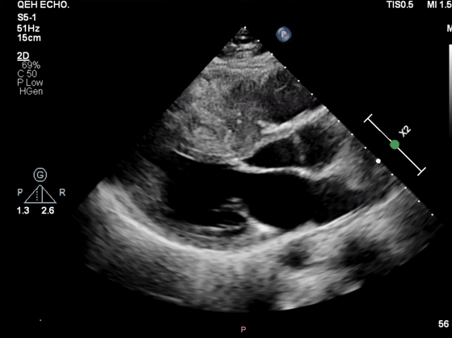
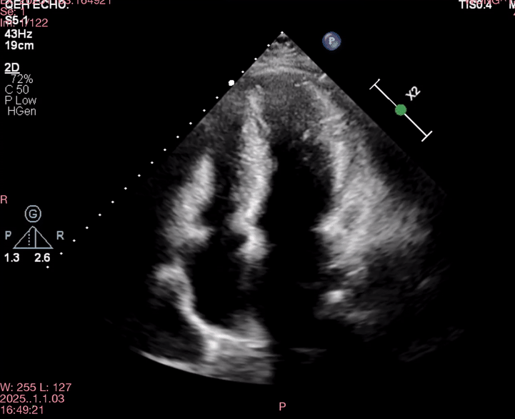
Q3. Describe the echo findings
Interventricular septum distance = 2.57cm

Slide 9
Q3. Describe the echo findings
Thickened LV wall and septum (IVSd = 2.57cm)
No D-shaped LV/RV dilatation
No pericardial effusion

Slide 10
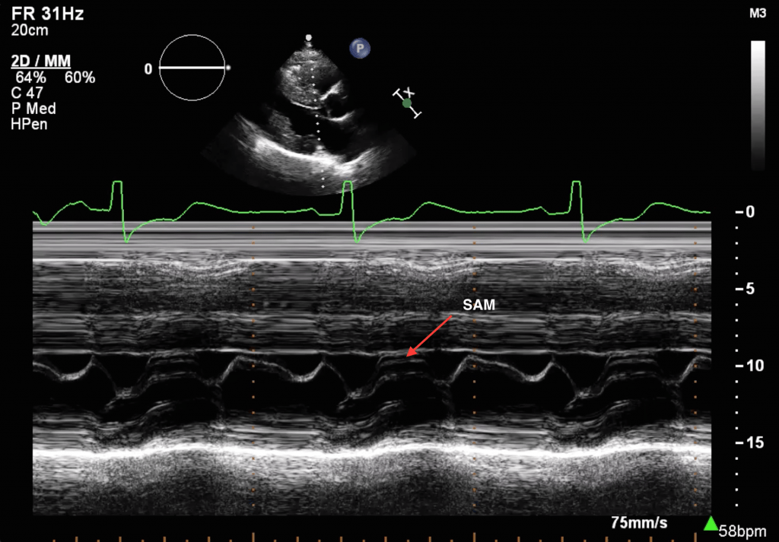
Q4. This is an M-mode image at the mitral valve (PLAX view) . What does the red arrow indicate?

Slide 11
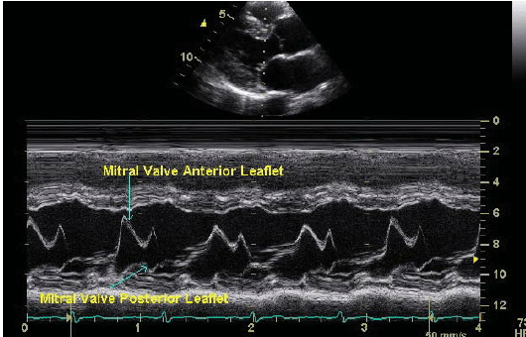
Q4.
Systolic Anterior Motion (SAM)
Abnormal displacement of the mitral valve leaflets (typically anterior leaflet) toward the interventricular septum during systole
Resulting in dynamic LVOT obstruction
Normal
Notes:
the enlarged papillary muscles and thickening of the left ventricle,

Slide 12
Urgent coronary angiogram was done → non-obstructive coronaries
Extubated with full neurological recovery
Started on Bisoprolol
cMRI done → HCM
Q5. What is the most important management for this patient before discharge?

Slide 13
Q5. What is the most important management for this patient before discharge?
Implantable Cardioverter-Defibrillator (ICD) implantation

Slide 14
Q6. What are the drugs to avoid in patients known to have this condition?
Notes:
Drop in preload
Reflex tachycardia
Increase cardiac contractility

Slide 15
Q6. What are the drugs to avoid in patients known to have this condition?
Dihydropyridine CCBs e.g. Nifedipine, amlodipine
Nitrates
Digoxin
Frusemide, diuretics
Arterial vasodilators e.g. ACEI, ARB
Notes:
Drop in preload
Reflex tachycardia
Increase cardiac contractility

Slide 16
Case 2
M/64
Good past health
Presented with acute left lower limb swelling for 1 day, associated with severe pain and numbness.
No weakness, fever, chest pain or dypsnoea.
No injury

Slide 17
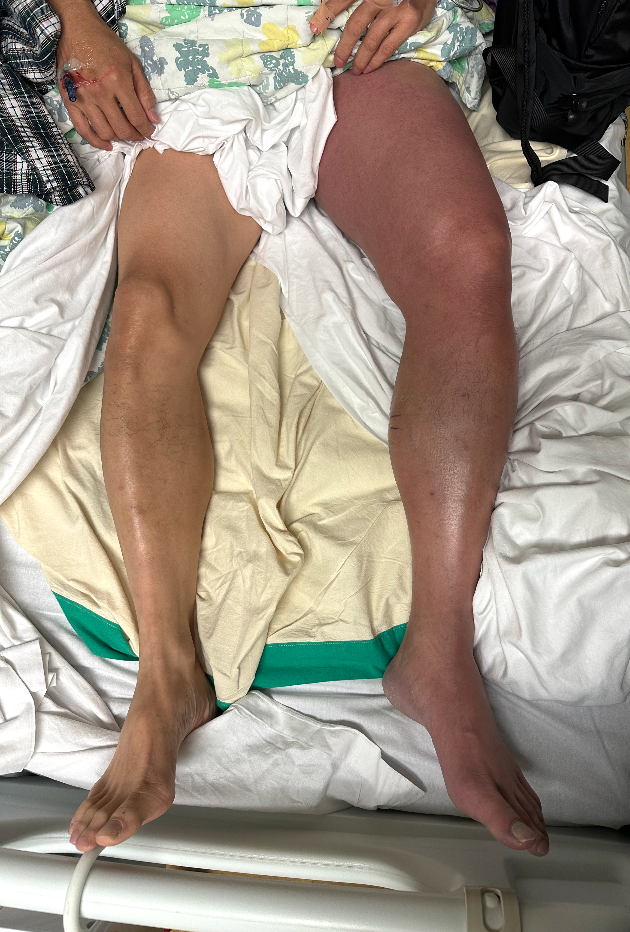
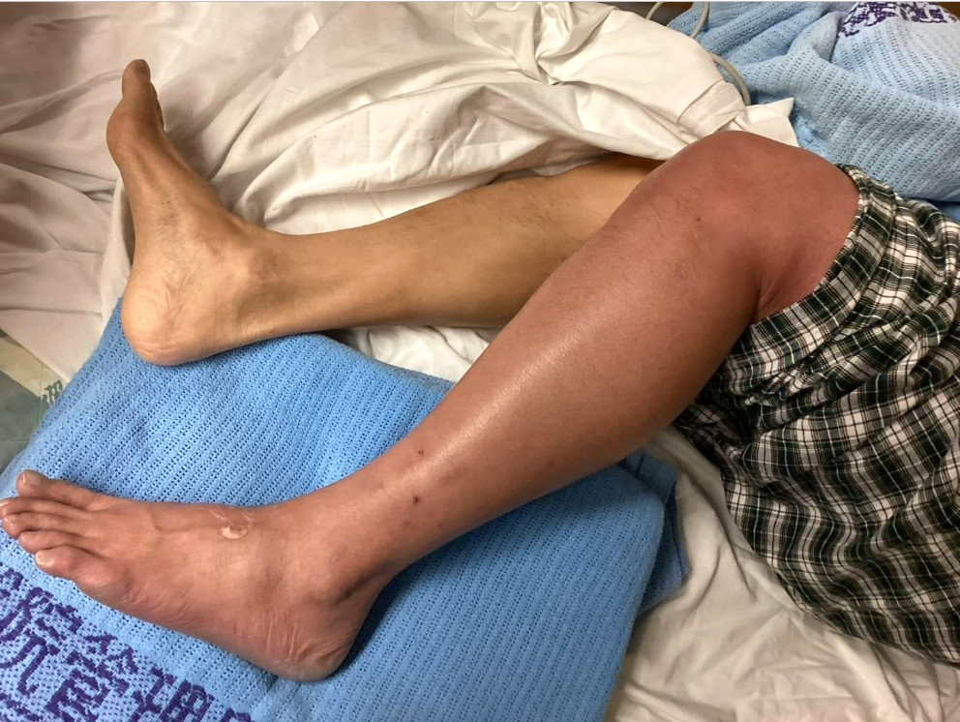
Q1. Describe the findings on physical examination

Slide 18
Q1. Describe the findings on physical examination
- Diffuse, severe swelling of the entire left lower limb
- Cyanotic appearance
- No blisters, bullae or gangrenous change

Slide 19
Q2. What are the differential diagnosis?

Slide 20
Q2. What are the differential diagnosis?
- Cellulitis/necrotizing fasciitis
- Acute limb ischemia
- Venous thrombosis
- Lymphedema
- Superficial thrombophlebitis

Slide 21
D-dimer: 5055ng/mL
USG showed complete obstruction at left SFJ, FV and PV with absent doppler flow.
Q3. What is the diagnosis and underlying pathophysiology?

Slide 22
Q3. What is the diagnosis and underlying pathophysiology?
- Phlegmasia cerulea dolens (Latin “painful blue inflammation”)
- Triad of worsening pain, severe swelling and cyanosis
- Large vessel venous thrombosis of deep and collateral venous system, causing severe obstruction to venous flow
Notes:
Phlegmasia originates from the Greek root phlegma (inflammation), cerulea originates from Latin root caeruleus (dark blue), and dolens originates from Latin word dolens (suffering).^{[33]}

Slide 23
Q4. What are the potential complications of this condition?

Slide 24
Q4. What are the potential complications of this condition?
- Pulmonary embolism
- Massive fluid sequestration can lead to hypovolemia and shock
- Compartment Syndrome
- Venous gangrene
- Amputation risk (reported 12-50%)
- High mortality (reported mortality rates 20-66%)

Slide 25
Urgent CT was performed, showing left EIV and proximal CFV thrombosis.
Q5. What is the management for this condition?

Slide 26
Q5. What is the management for this condition?
- Bed rest, elevate affected limb
- Pain control
- Fluid resuscitation
- Anticoagulation with Unfractionated Heparin (UFH)
- Vascular intervention: Endovenous Mechanical Thrombectomy/Endovascular thrombolysis/open surgical thrombectomy
- Fasciotomy (if compartment syndrome)
- Amputation

Slide 27
Intra-op venogram and IVUS showed left Common Iliac Vein (EIV) compression by Right Common Iliac Artery (CIA).
A stent was placed and patency was confirmed.
Q6. What is the name of this syndrome?

Slide 28
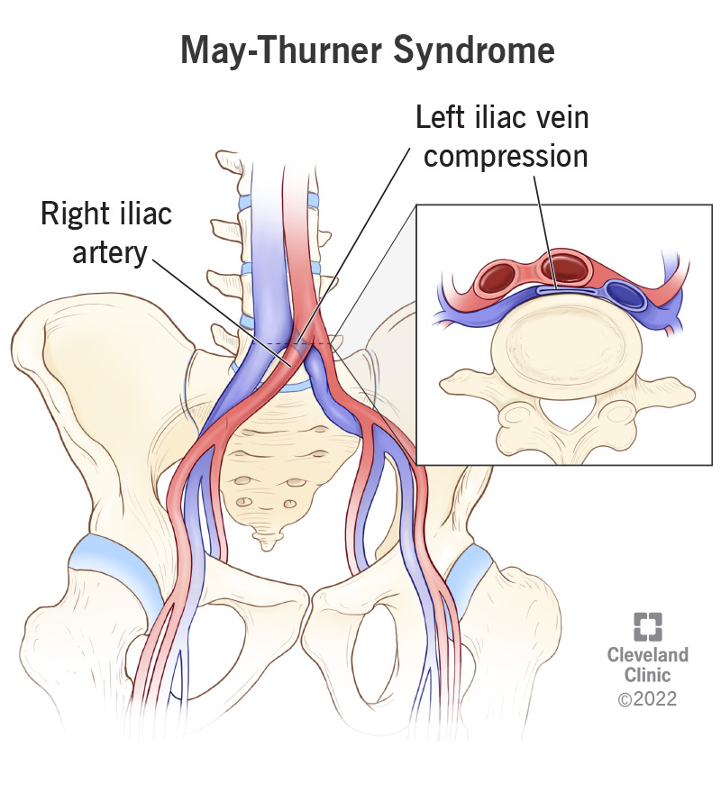
Q6. What is the name of this syndrome?
- May Thurner Syndrome
- (iliac vein compression syndrome)
- Left CIAV compression by Right CIA against the vertebra

Slide 29
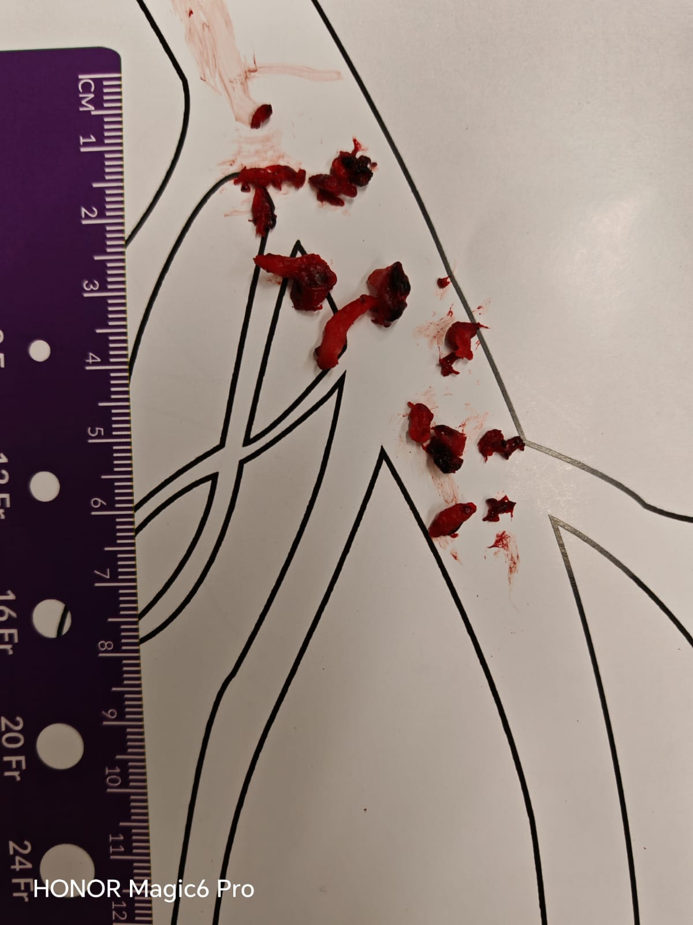
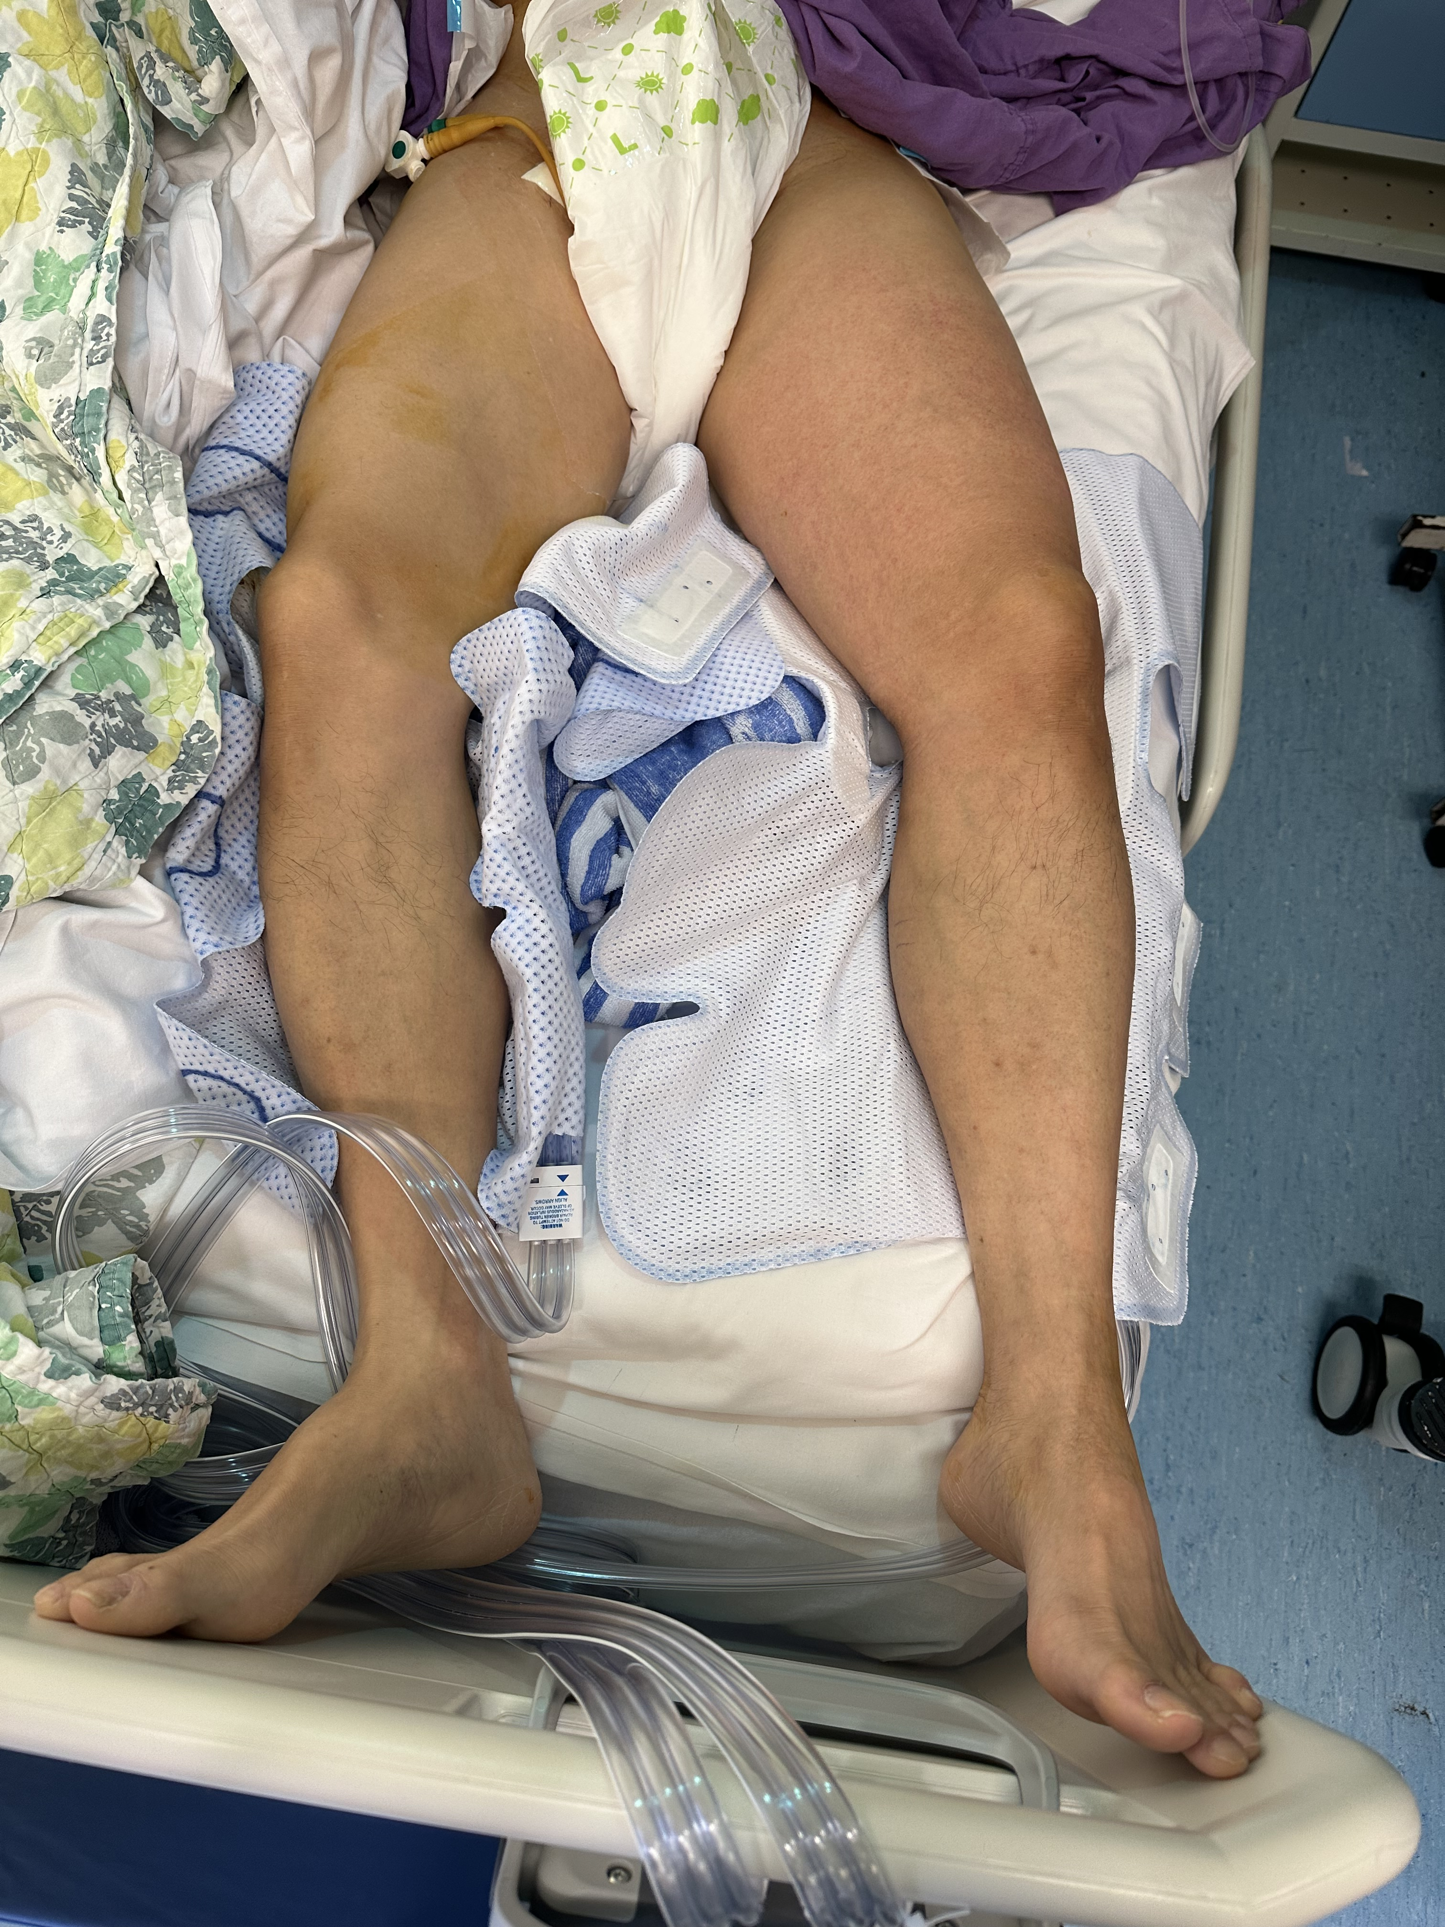
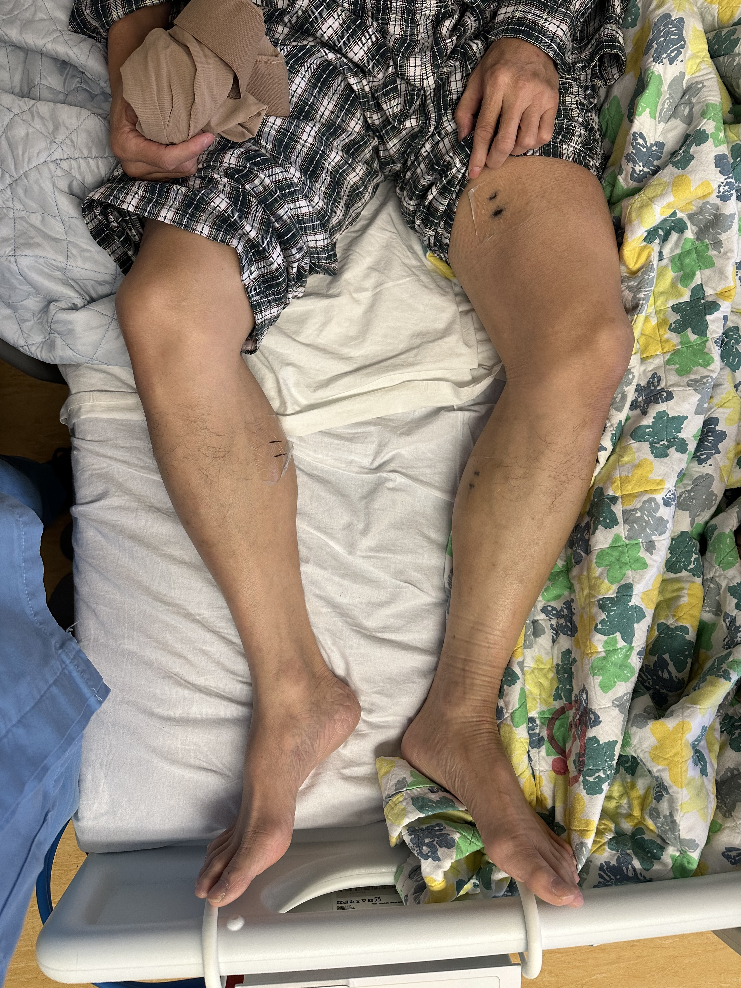
Mechanical thrombectomy and stenting was performed
POD1
POD4

Slide 30
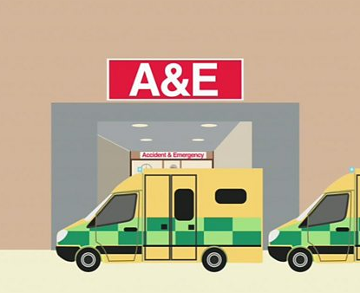
Case 3
M/30, Good past health
Progressive worsening blistering on both feet
Lips and throat pain
Scrotal blistering
Lips and genitalia itchiness
Progressive worsening oral and foot ulcers
Oct 19
Oct 29
Oct 23
Oct 22
Visit GP
IM Chlorpheniramine given
Prescribed 3 day course:
Lansoprazole
Azithromycin
Omeprazole
Prednisolone
Etoricoxib
Fexofenadine
URTI symptoms
Took home stock meds:
Cetirizine
Codeine
Etoricoxib
Paracetamol
Famotidine
Notes:
URTI symptoms on Oct 22, then took old stock of meds (Cetirizine, Etoricoxib, Bisolovon, Panadol, Pepcidine, Codeine, Chlorpheniramine) once
Developed itchiness on lips and external genitalia after 30 mins
Progressive worsening over 1 day, with oral cavity ulcers and sole ulcers
Visit GP on Oct 23, given Lansoprazole, Azithromycin, Omeprazole, prednisolone, Etoricoxib, Fexofenadine x 3 days
Attended A&E on Oct 29 for oral pain and scrotal blistering

Slide 31
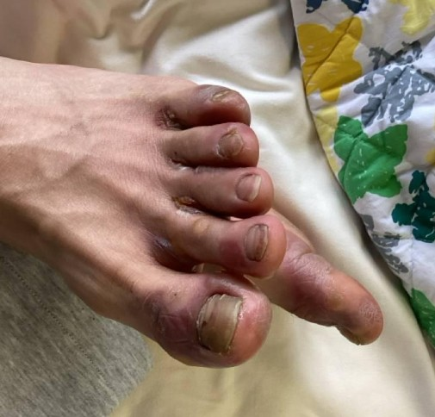
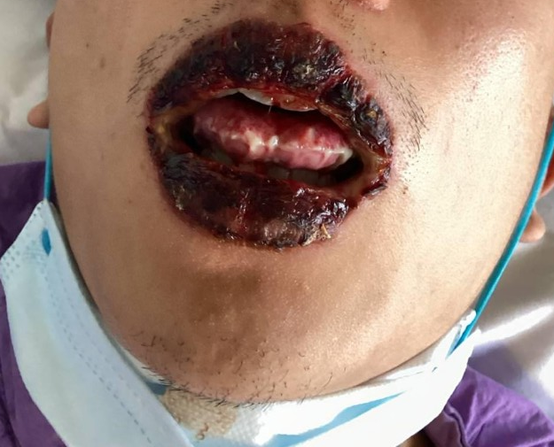
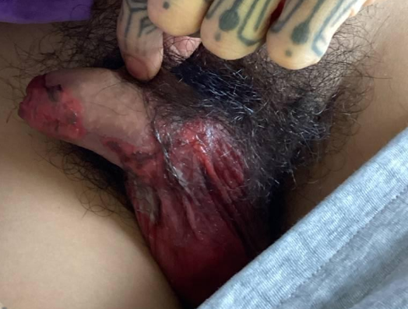
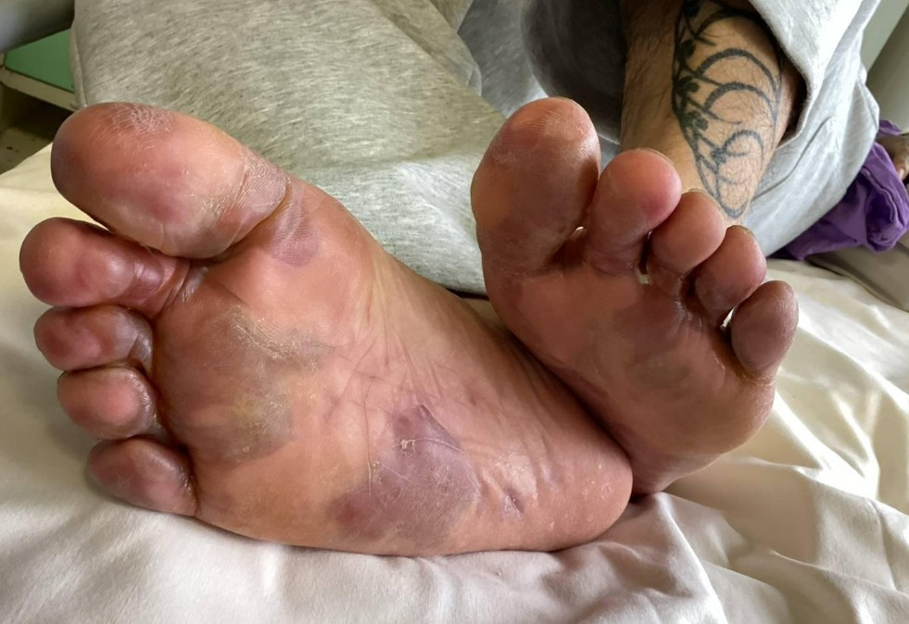
Q1. Describe the findings on physical examination.
What is the diagnosis?
Feet
Face
Scrotum

Slide 32
Q1. Describe the findings on physical examination.
What is the diagnosis?
Lips swollen with hemorrhagic blisters
Erosions over tongue and buccal mucosa
Bilateral foot and toe web blisters/bullaes
Scrotal skin erythema and erosions; glans penis erythema
Dx: Stevens-Johnson syndrome (affecting <10% BSA)
(c.f. Toxic Epidermal Necrolysis (TEN) involves >30% BSA)
Notes:
Blister <1cm
Bullaes >1cm

Slide 33
Q2. What are the most common causes of this condition?

Slide 34
Q2. What are the most common causes of this condition?
Medications
Infection e.g. mycoplasma, HSV, EBV, CMV
Idiopathic (15%)
Strongly associated | Associated
- Allopurinol - Oxicam NSAIDS (piroxicam, tenoxicam) - Etoricoxib - Anticonvulsants (Lamotrigine, Carbamazepine, phenytoin) - Sulfonamides | Diclofenac Amoxicillin/ampicillin Ciprofloxacin, Levofloxacin Doxycycline Rifampicin

Slide 35
Q3. What are the potential complications of this condition?

Slide 36
Q3. What are the potential complications of this condition?
Sepsis, bacteremia (up to 30-50%)
Dehydration, electrolyte imbalance
Respiratory complications - pneumonia, respiratory failure
Ocular – corneal ulceration, uveitis, panopthalmitis
GI – bleeding, esophageal stricture
Urogenital – strictures, vaginal stenosis, adhesions
Multiorgan failure - Kidney/liver/hematological
Notes:
Can have sloughing of bronchial epithelium leading to cough, pneumonia, hypoxemia, and dyspnea.¹⁻³
Can have sloughing of the GI epithelium leading to dysphagia and odynophagia from esophageal ulcers and diarrhea, melena, intussusception, and bowel ulceration/perforation from small bowel and colon involvement.

Slide 37
Q4. What is the management of this condition?

Slide 38
Q4. What is the management of this condition?
Discontinue offending drug
Manage in burns unit/ICU/specialized units
Supportive care, including airway management
Fluid and electrolyte management
Pain management
Nutritional support/NGT feeding
Wound care
+/- Broad spectrum antibiotics (if signs of infection)
Systemic treatments: corticosteroids, IVIG, Cyclosporine

Slide 39
Q5. What type of hypersensitivity reaction does this condition belong to?

Slide 40
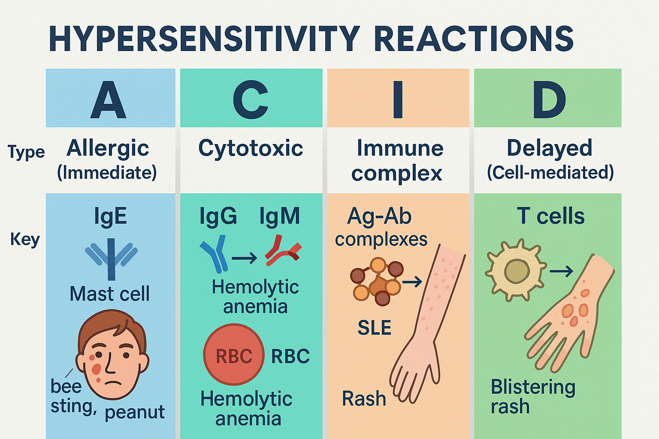
Q5. What type of hypersensitivity reaction does this condition belong to?
Type IV
T-cell mediated, delayed hypersensitivity reaction

Slide 41
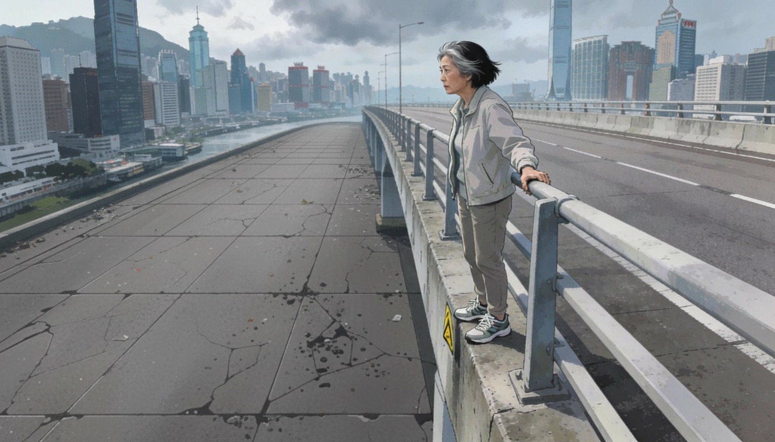
Case 4
F/56, Good past health
Jumped from bridge ~8meters high
Vitals on arrival: BP 98/62, P120, SpO2 97% on 15L NRM, GCS 14/15
In distress
Right ankle open fracture with active bleeding
(AI generated)

Slide 42
Q1. Outline the initial management in the Resuscitation room, following the ATLS algorithm

Slide 43
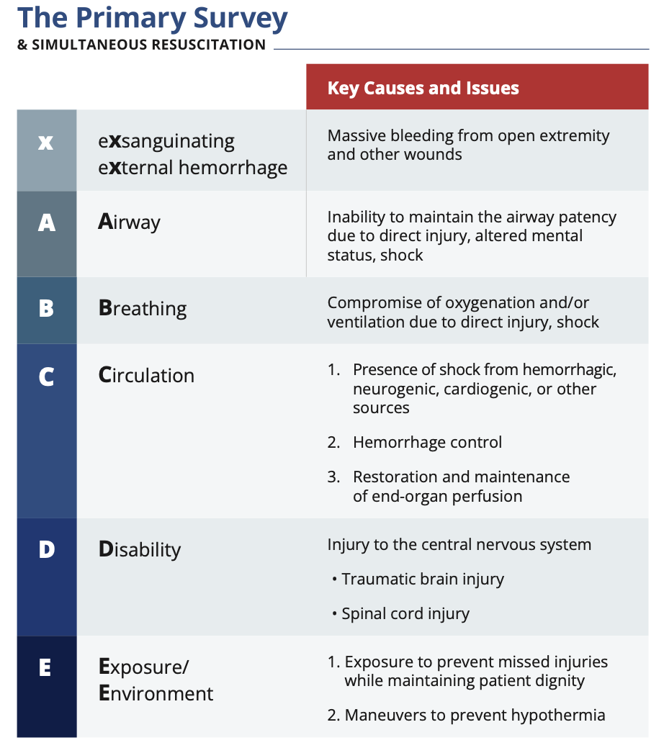
Q1. Outline the initial management in the Resuscitation room, following the ATLS algorithm (11th edition)
X – pressure dressing +/- limb tourniquet if massive bleeding
A – Airway mx, cervical spine motion restriction
B – maintain oxygenation
C – “Balanced resuscitation” early blood products, minimize crystalloid use
MTP, Tranexamic acid, Pelvic Binder, FAST, X-ray, prevent TIC
D – assess disability
E – exposure, prevent hypothermia
Notes:
Blood product is the best resuscitation fluid

Slide 44
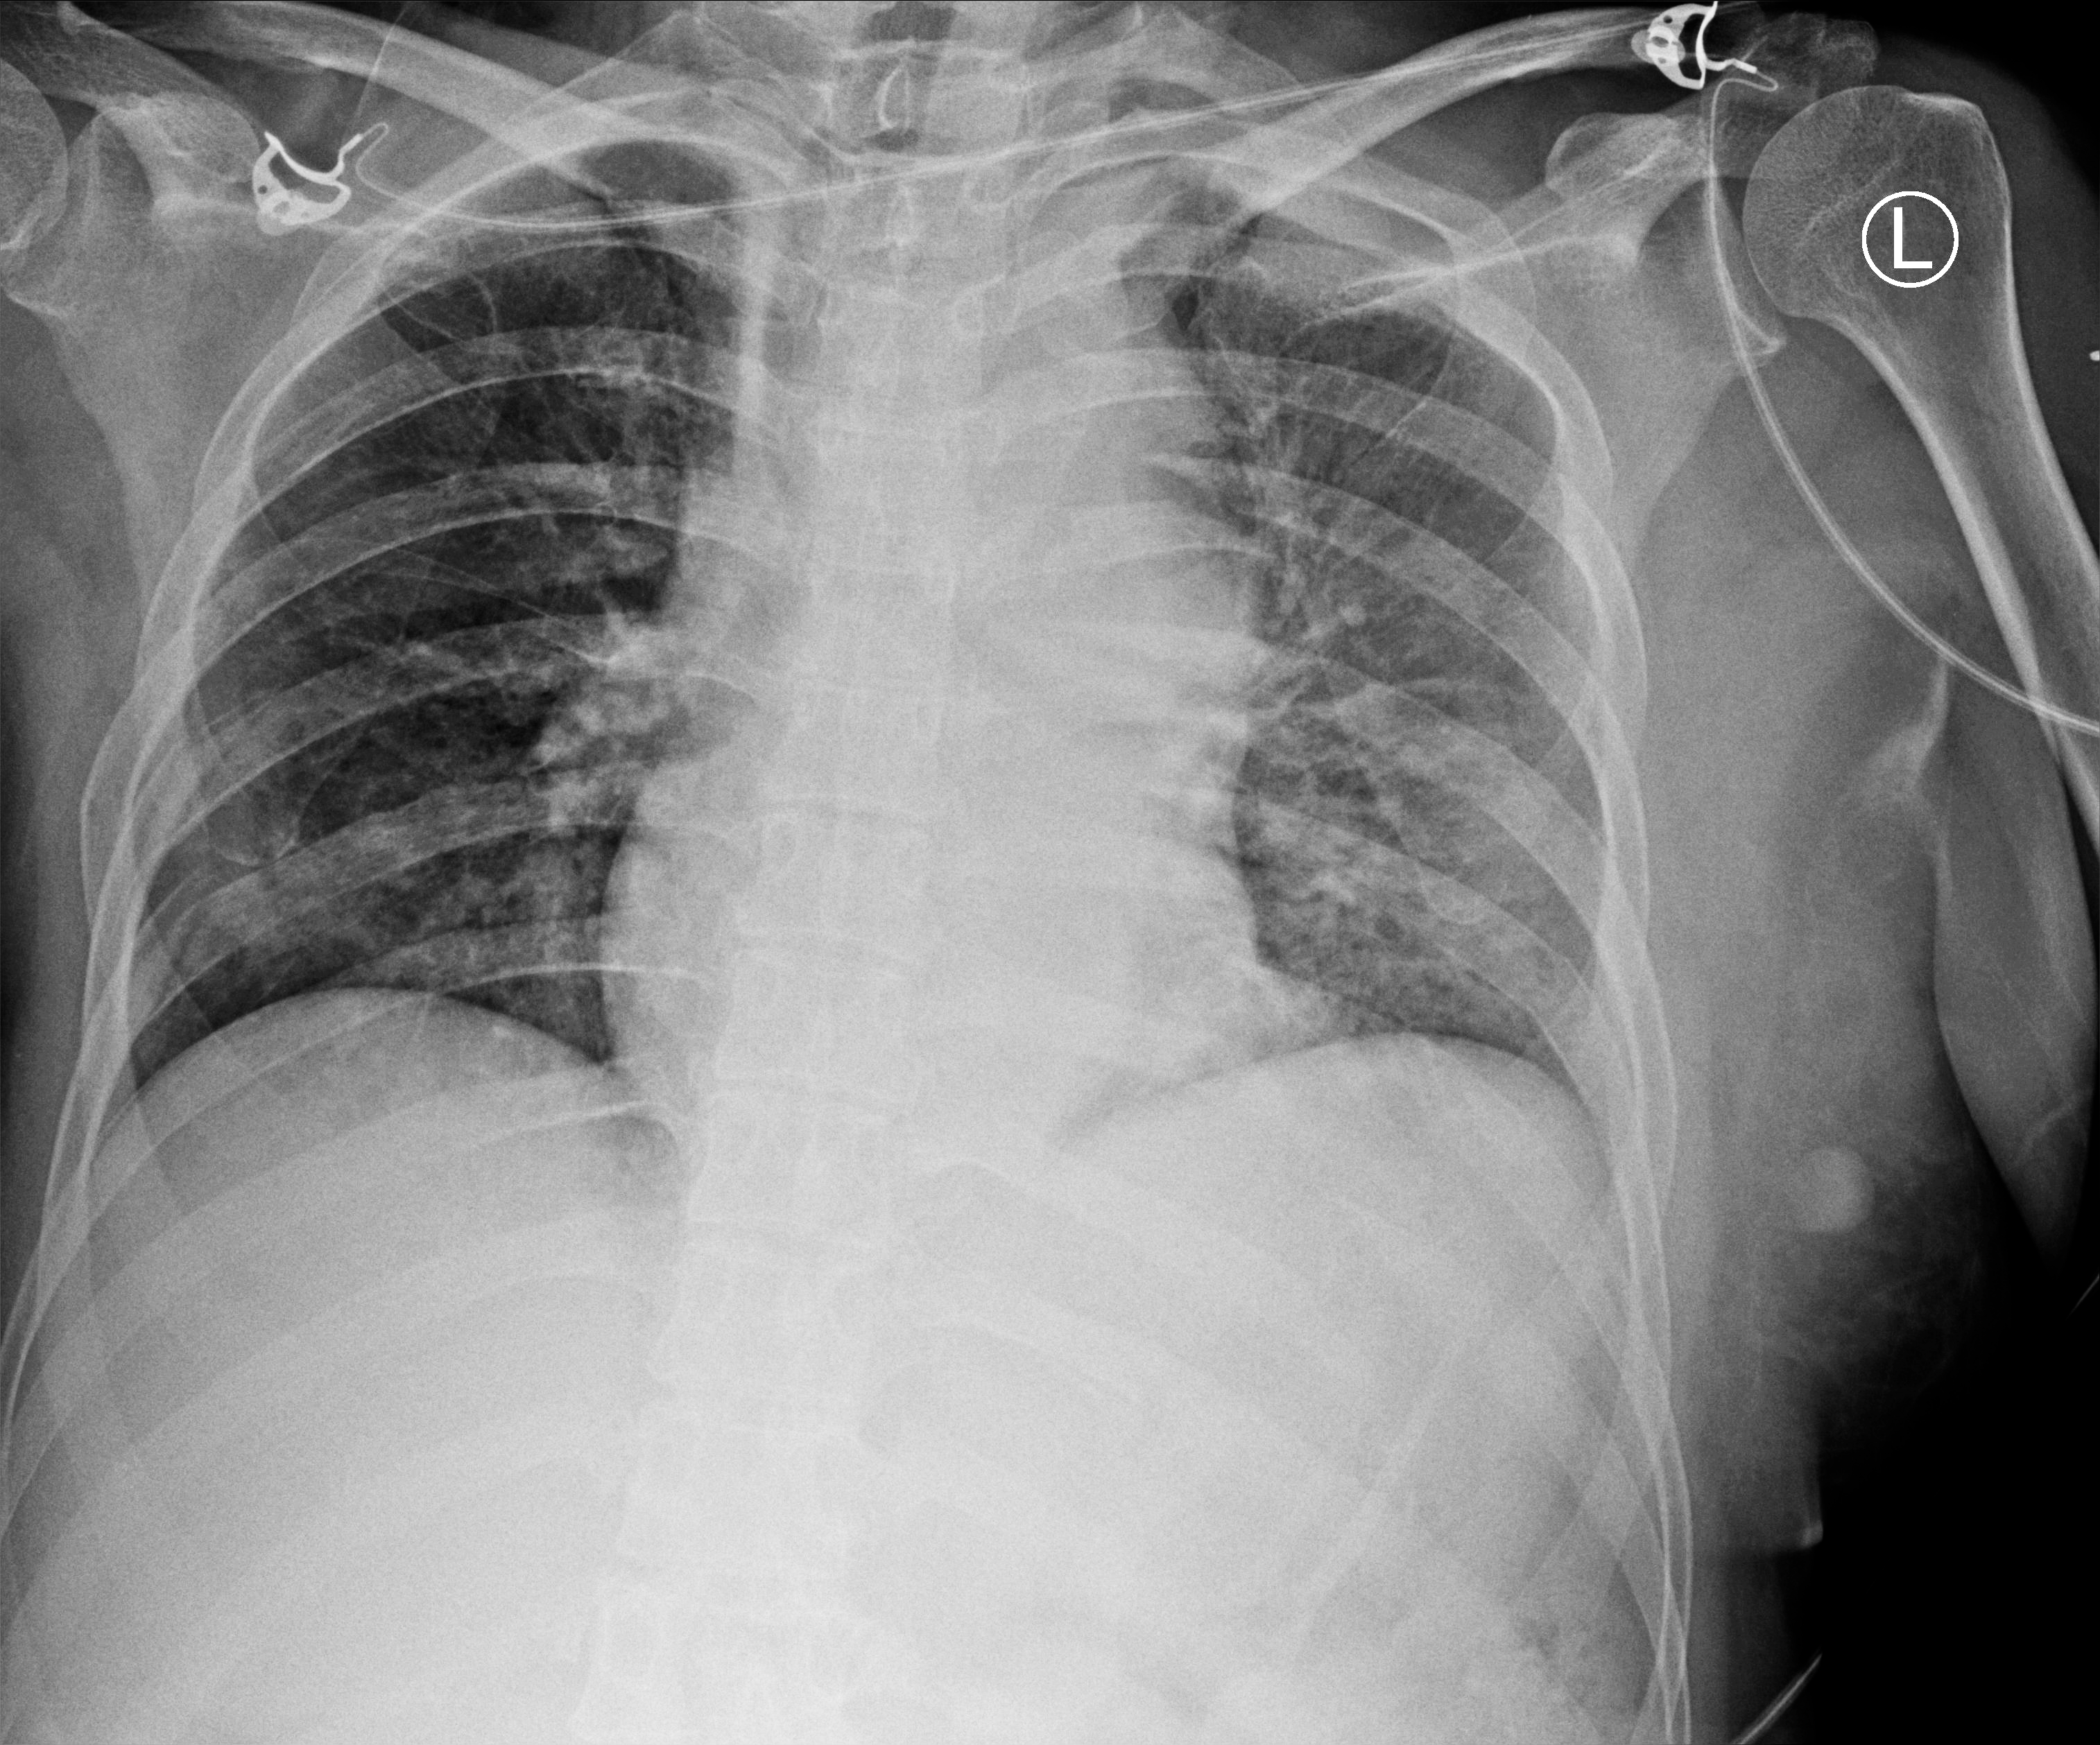
Q2. Describe the abnormalities on her CXR.

Slide 45
Q2. Describe the abnormalities on her CXR.
- Multiple, bilateral rib fractures with displacement
- Widened mediastinum
- Deviation of trachea to right
- Left apical cap
- Left haemothorax

Slide 46
CXR signs
Widened mediastinum (supine chest radiograph [CXR] >8 cm; upright CXR >6 cm)
Obscured, indistinct, or enlarged aortic knob
Abnormal aortic arch contour
Left "apical cap"
Large left hemothorax
Displacement of the left main stem bronchus
Deviation of nasogastric tube rightward
Deviation of trachea rightward and/or right mainstem bronchus downward
Widened paravertebral stripe

Slide 47
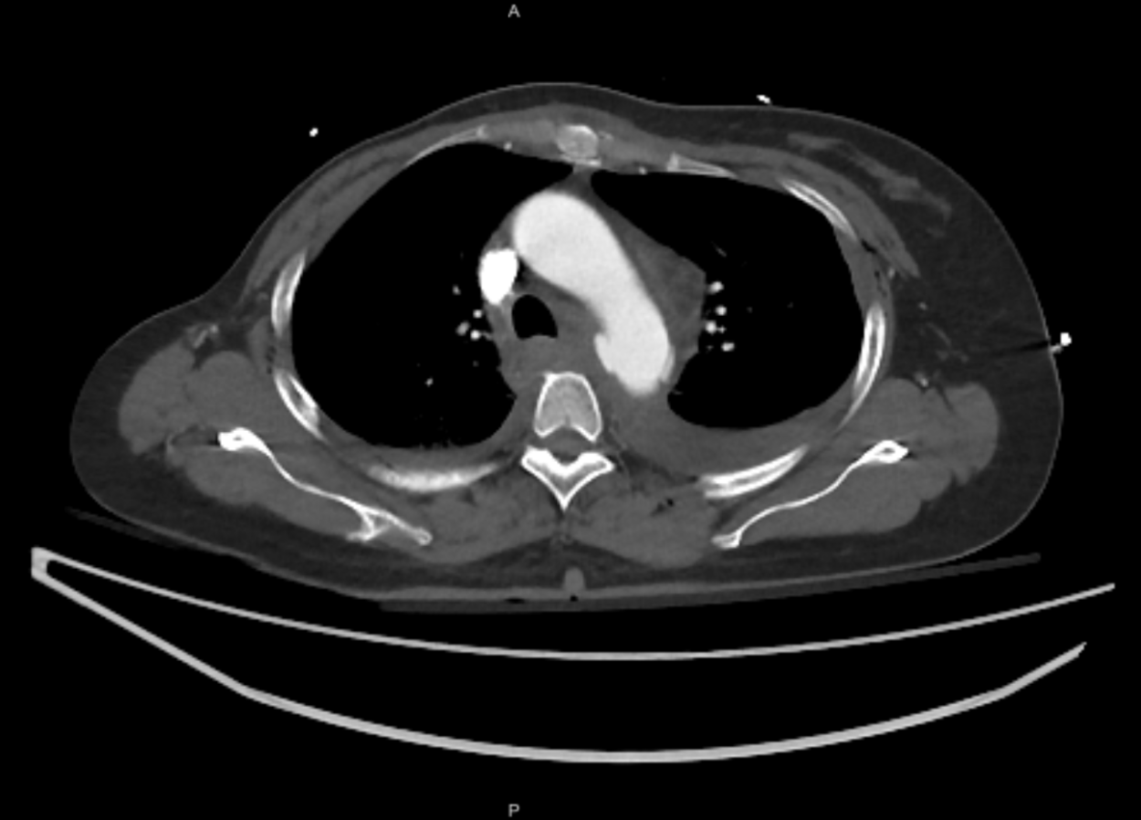
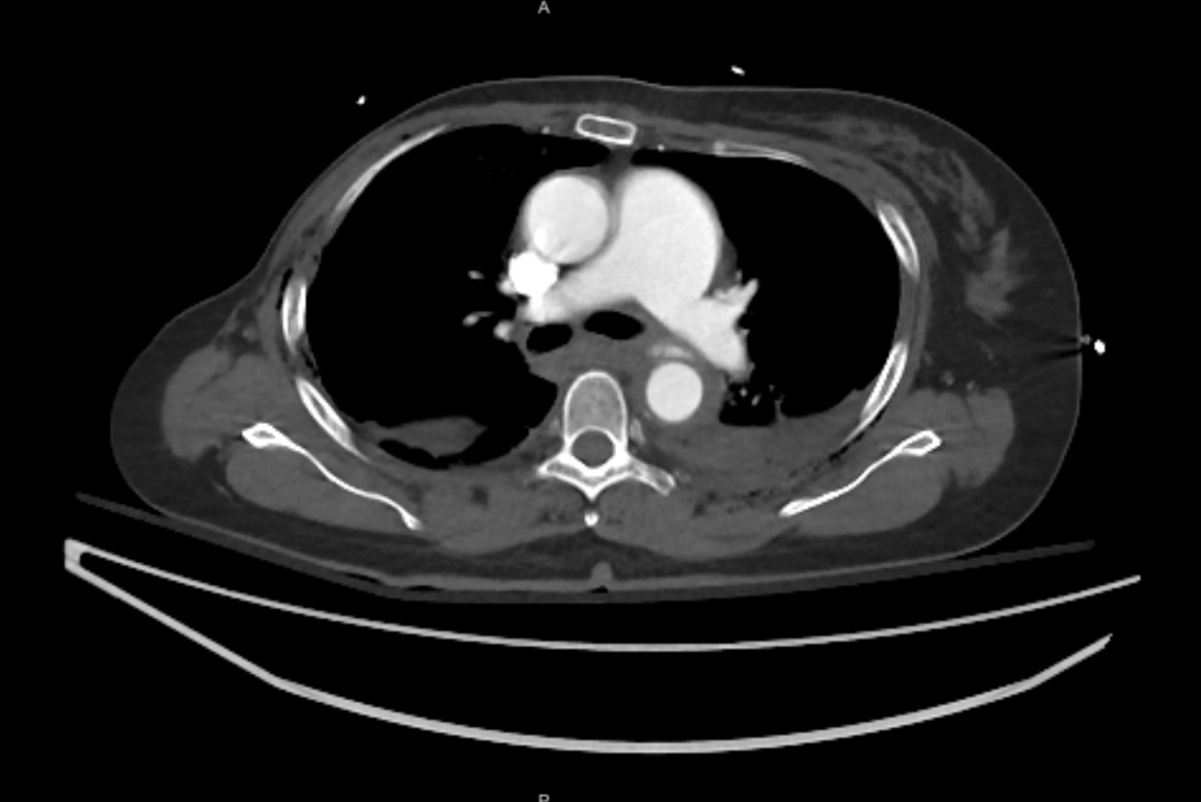
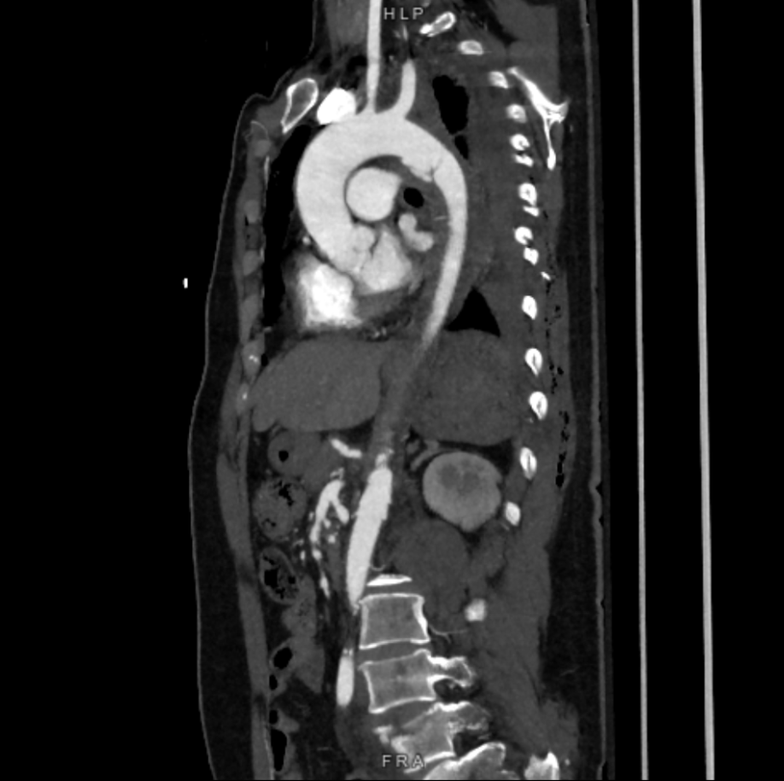
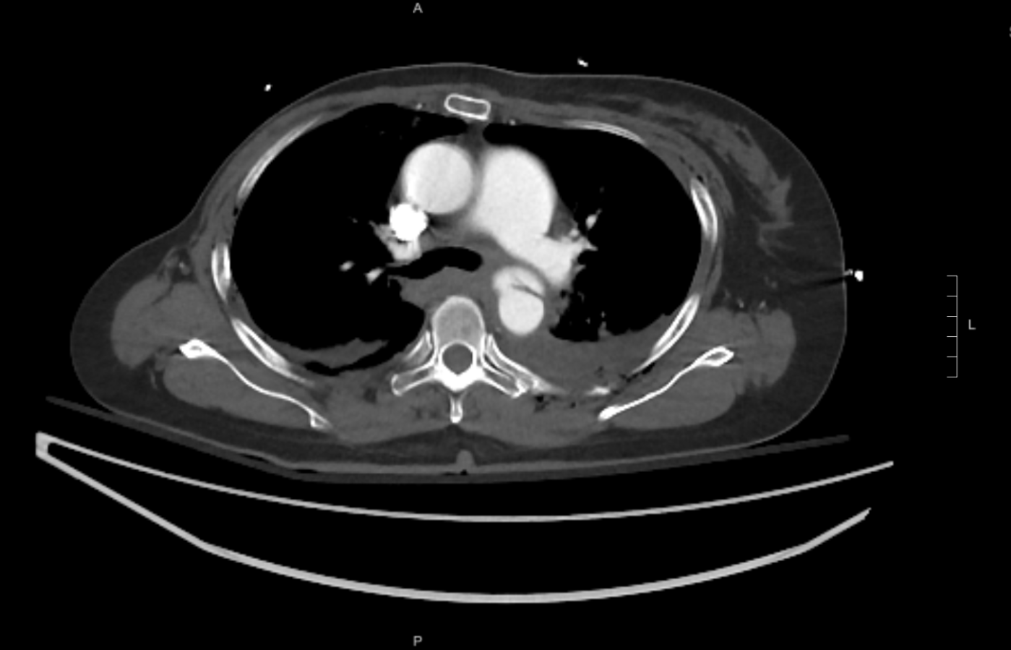
She was stabilized and CT was performed.
Q3. Describe the CT findings.

Slide 48
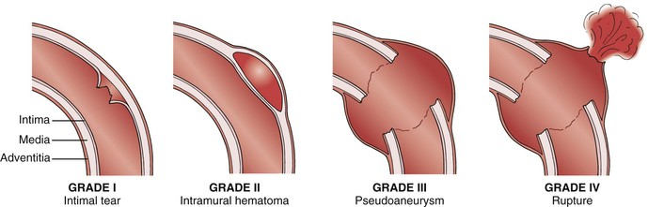
Q3. Describe the CT findings.
Discontinuity of the aortic wall contour
Left haemothorax
Fluid around proximal descending aorta
Presence of mediastinum hematoma
Dx: Aortic transection (rupture) with periaortic hematoma
Aortic injury grading
Non- operative | Operative* | Operative
*Observational studies have shown conservative management with BP control and serial imaging are safe in grade 2 injuries, with < 5% progressing to TEVAR and an aortic-related mortality rate < 2%

Slide 49
Q4. What is the management of this specific condition?

Slide 50
Q4. What is the management of this specific condition?
Blood pressure and heart rate control
- Target: SBP <100mmHg, HR <100/min (ATLS 11th Edition)
- Use titratable short-acting beta blockers e.g. Esmolol
(Often challenging due to co-existing injuries, hemorrhagic shock, concomitant TBI)
Endovascular repair (TEVAR) VS. Open repair

Slide 51

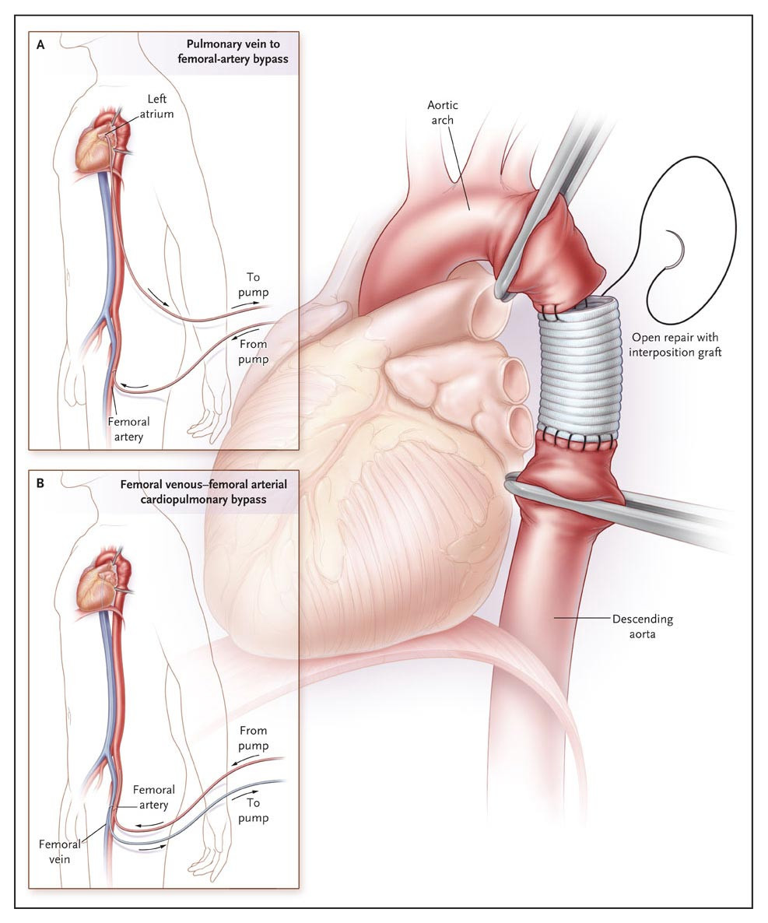
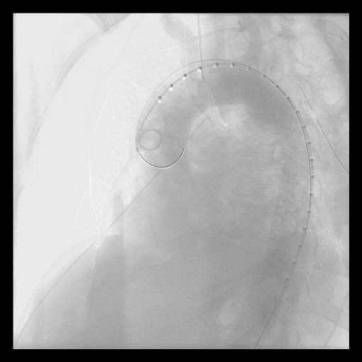
Surgical repair
ENDOVASCULAR
Requires suitable anatomy
Lower mortality and early complications (stroke, paraplegia, limb ischemia
Short procedure
Risk of migration, endoleak
May need reintervention
Longer surveillance
OPEN
Indicated when anatomically not suitable for endovascular Tx, or thoracotomy required for other injuries
Primary repair/graft
Requires open thoracotomy, cross clamping, single lung ventilation , +/-bypass
Higher mortality and morbidity rate
Less re-intervention

Slide 52
Q5. Where is the most common site of this injury and why?

Slide 53
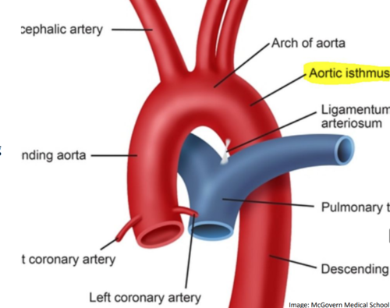
Q5. Where is the most common site of this injury and why?
Aortic isthmus
54-66% in autopsy studies
>85% patients who arrive to hospital alive
Transition zone from unfixed aortic arch & fixed descending aorta
Weaker strength
Compression point between bony structures
Notes:
Injury Mechanism
Sudden deceleration, as in motor vehicle accidents, causes the mobile aortic arch and heart to shift forward relative to the fixed descending thoracic aorta, which is anchored by the ligamentum arteriosum and mediastinal structures. This differential motion creates shear, tensile, and torsional forces concentrated at the isthmus, the ligamentum's attachment point just distal to the left subclavian artery.​
Anatomical Factors
The isthmus lies at the transition between the flexible arch and rigid descending aorta, trapped between bony thorax elements, amplifying localized stress. Histologically weaker intima and media layers here tear first under these combined loads, unlike other aortic segments

Slide 54
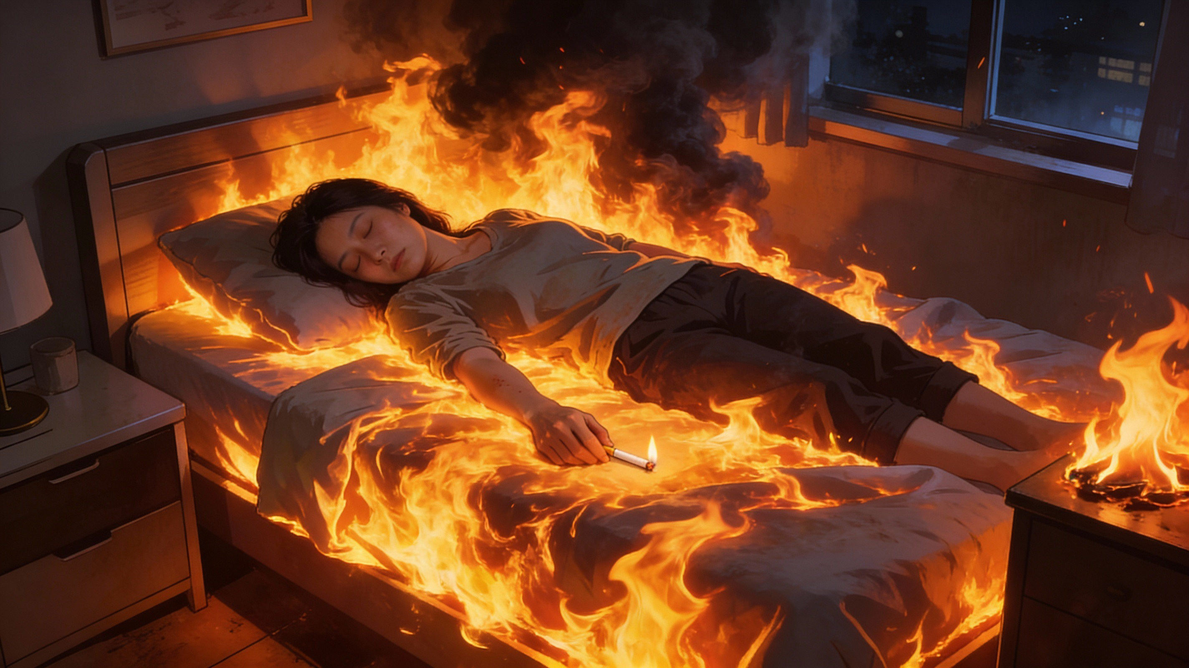
Case 5
F/31
PMHx: harmful stimulant use, ex IVDA
At 2am, fell asleep while smoking cigarette on bed → bedsheets caught fire
Extensive burns over face, neck, trunk and upper limbs
Vitals on arrival: GCS full BP=131/82 P=68 SPO2=99% on 15L NRM
(AI generated)

Slide 55
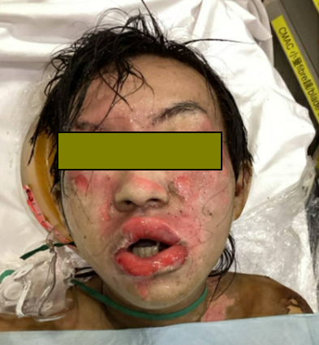
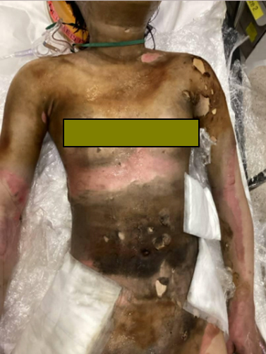
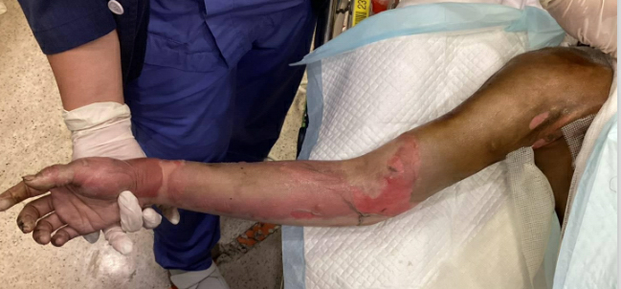
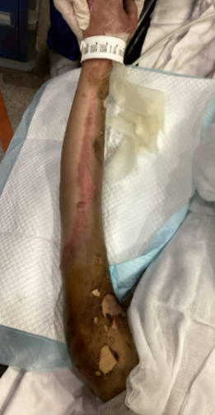
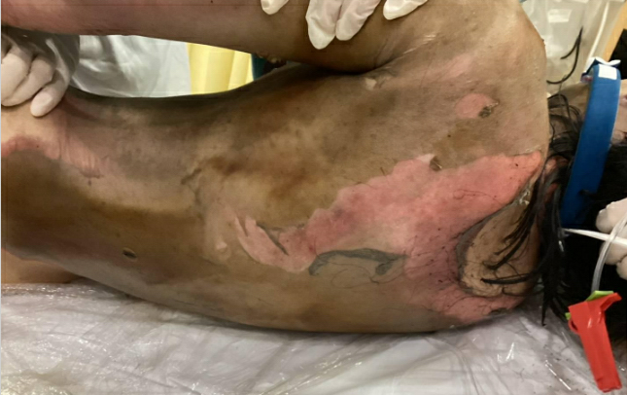
Right UL
back
Left UL

Slide 56
Q1. Name 3 methods for determining the Total Body Surface Area (TBSA) in this patient

Slide 57
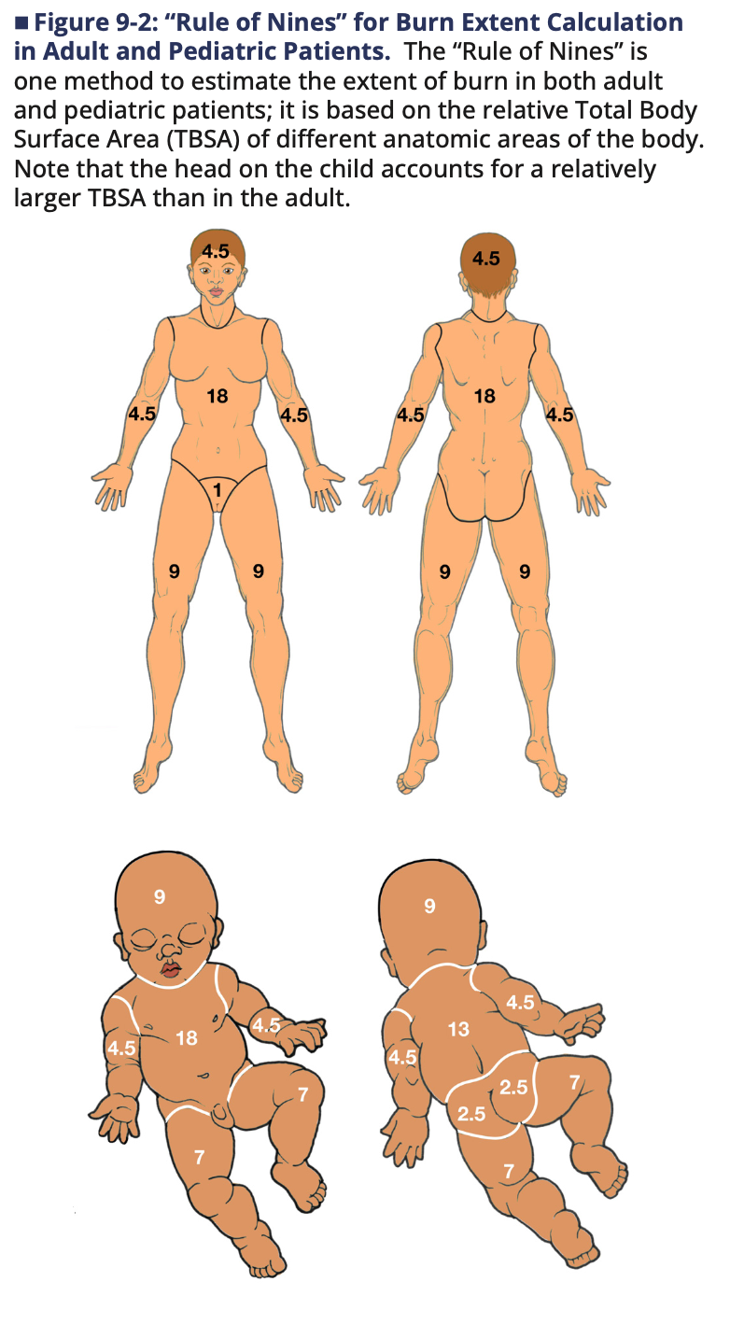
Q1. Name 3 methods for determining the Total Body Surface Area (TBSA) in this patient
Rule of Nines
Palmar method
Lund-Browder Chart

Slide 58
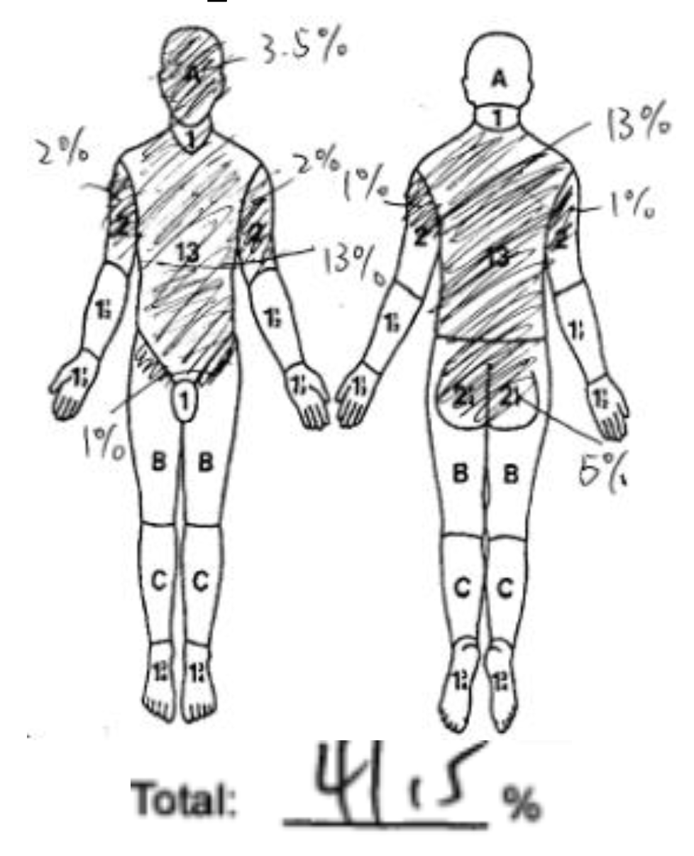
Her TBSA is 41.5%. Assume body weight =50kg.
Q2. According to ATLS, what is the recommended fluid management for this patient?

Slide 59
Q2. According to ATLS, what is the recommended fluid management for this patient?
Warmed isotonic crystalloid, preferably LR
ATLS 10th edition
=2ml x kg x TBSA%
=2ml x 50kg x 41.5% = 4150ml
Half in first 8 hours, half in subsequent 16 hours
2075ml/8=260ml/hr
Titrate according to U/O
ATLS 11th edition
Calculate Adjusted Hourly Fluid Rate
= (2ml x kg x TBSA%)/16
= 2ml x 50kg x 41.5% /16 = 4150ml/16
= 260ml/hr
Not adjusted for time of injury/volume administered prior to calculation
Insert foley catheter, target 0.5ml/kg/hr (30-50ml/hr)
If urine output below target, hourly rate increased by 10-30% (vice versa)
Notes:
Bolus fluids promote “third spacing”
rather than simply increasing intravascular volume. Peripheral
pulses should be evaluated in all extremities during the primary
survey
Modified brookes formula
Fluid rates are adjusted hourly based on urine output. Bolus fluid administration is
avoided except temporarily during management of hypotension. If hypotension is
present, evaluation for a non-burn injury etiology is performed.

Slide 60
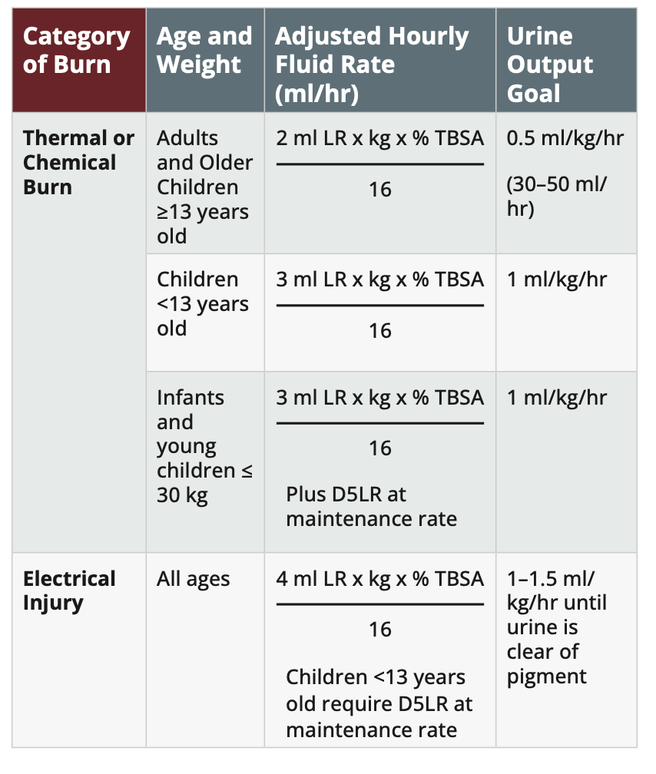
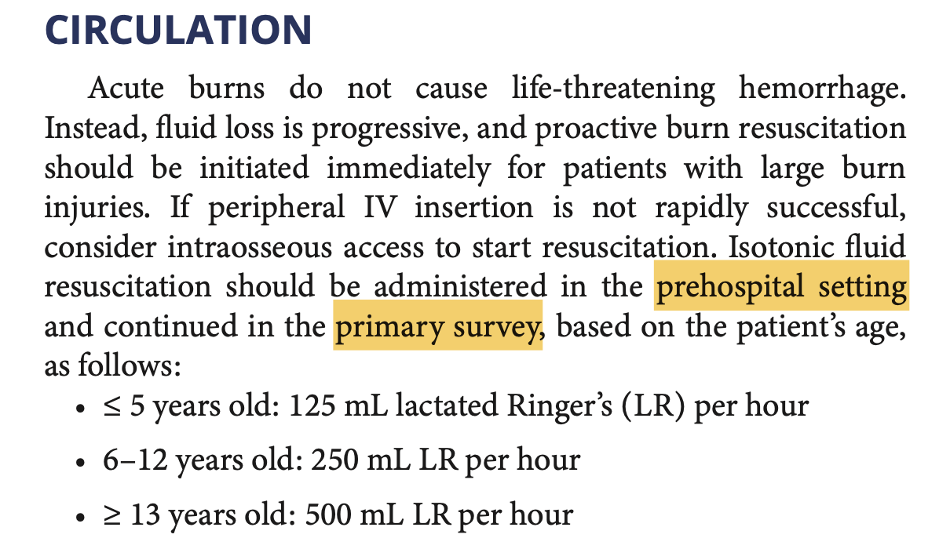
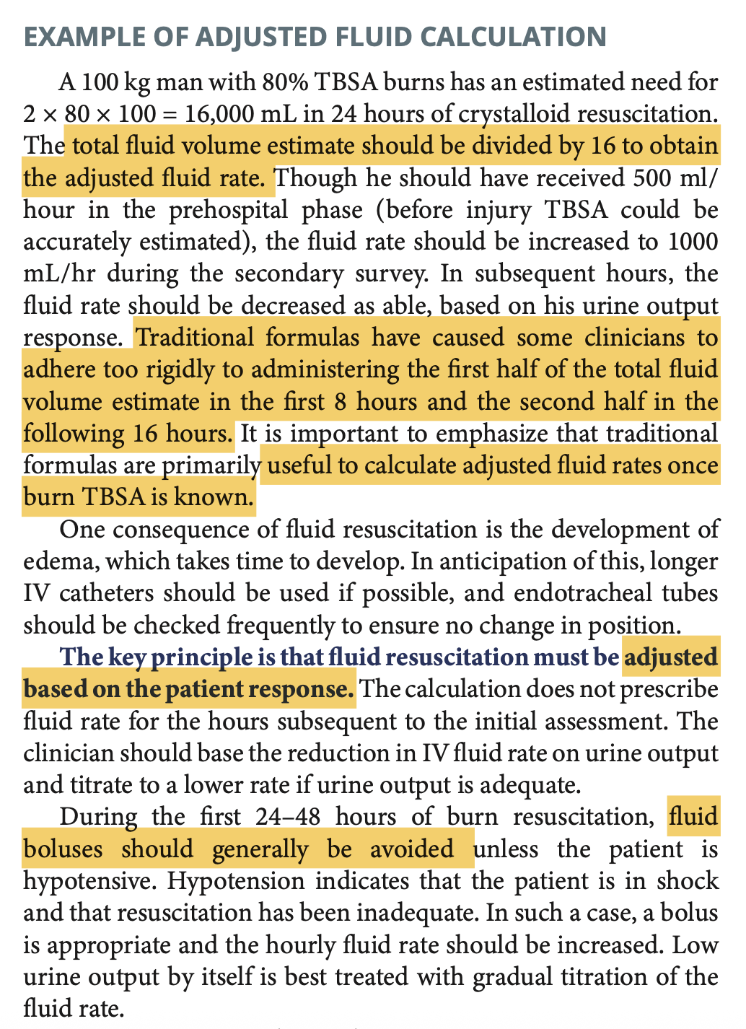
ATLS 11th Edition

Slide 61
Q3. What factors should be considered when determining whether a burns patient requires endotracheal intubation?

Slide 62
Q3. What factors should be considered when determining whether a burns patient requires endotracheal intubation?
- Signs of inhalation injury (e.g. soot in pharynx, singed nasal hair, carbonaceous sputum)
- Signs of airway obstruction (e.g. hoarseness, stridor, accessory muscle use)
- Signs of Respiratory compromise (e.g. inability to clear secretions, poor oxygenation)
- Decreased level of consciousness (impaired airway protective reflexes)
- Very large TBSA (typically >40%-50%)
- Extensive and deep facial burns
- Burns inside mouth

Slide 63
Transferal to Burns Center was arranged.
While waiting in A&E, you noticed her bilateral radial pulses were weak, and CR >2 seconds on both hands
Q4. What are the signs and symptoms of Compartment Syndrome?

Slide 64
Q4. What are the signs and symptoms of Compartment Syndrome?
Pain greater than expected and out of proportion to the injury
Pain on passive stretch of the affected muscle
Tense swelling of the affected compartment
Paraesthesia or altered sensation distal to the affected compartment
Loss of pulse (late finding)

Slide 65
Q5. What is the next step of management?

Slide 66
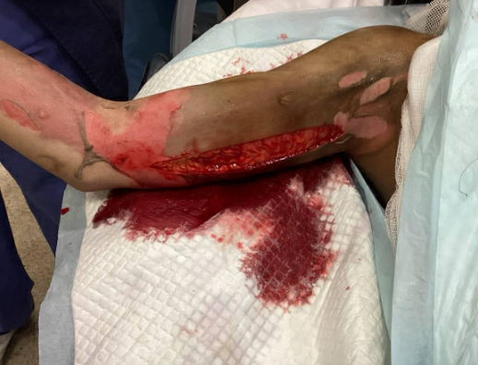
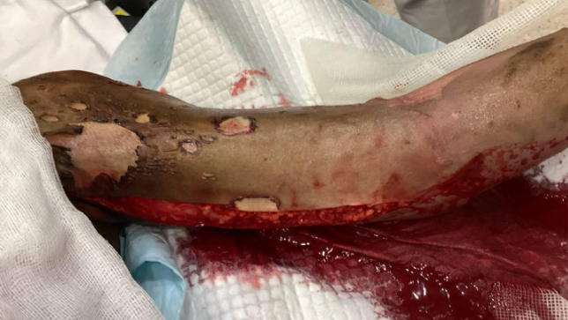
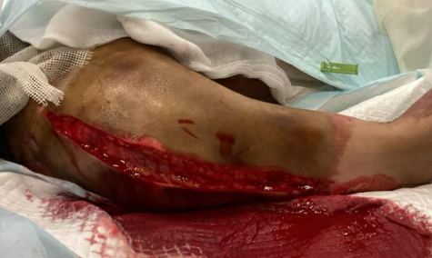
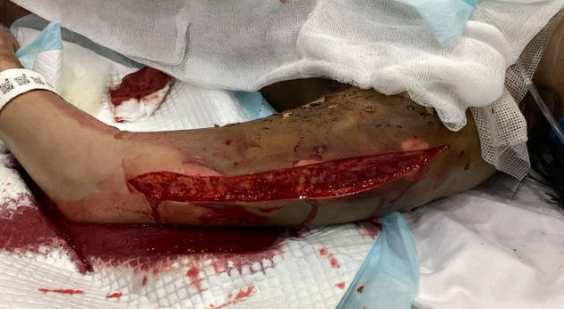
Q5. What is the next step of management?
Escharotomy
Left UL (inner) post escharotomy
Right UL (inner) post escharotomy
Right UL (outer) post escharotomy
Left UL(outer) post escharotomy

