Slide 1
OSCE 04/2026
PMH

Slide 2
The febrile traveller
A 28-year-old male presents to the ED with a 3-day history of high fever, chills, severe headache, and myalgias. He returned from a 2-week backpacking trip in rural Ghana 5 days ago. He took doxycycline for malaria prophylaxis but stopped the day he returned home.
Vital Signs:
HR 128 bpm, BP 105/60 mmHg, RR 22 bpm, Temp 39.8°C (103.6°F), SpO2 95% on RA.
Physical Exam:
Ill-appearing, diaphoretic. No meningismus.
Chest clear. Abdomen soft, non-tender. No skin rash.
Bedside glucose = 3.3mmol/L

Slide 3
Besides malaria, list three critical infectious differentials for a febrile patient returning from West Africa.

Slide 4
Besides malaria, list three critical infectious differentials for a febrile patient returning from West Africa.
Typhoid (Enteric) Fever
Caused by Salmonella typhi
presents with step-ladder fever, relative bradycardia, and abdominal pain.
Viral Hemorrhagic Fever (e.g., Ebola, Lassa, Yellow Fever):
Region-specific (West Africa: Lassa, Yellow Fever)
presents with similar prodrome; requires strict infection control.
Meningococcal Septicemia
Can present with fever, shock, and rash (though rash is absent here, it remains a possibility in any febrile traveller).

Slide 5
How would you investigate this patient?
Suggest four laboratory tests and explain the underlying rationale for each.

Slide 6
How would you investigate this patient?
Suggest four laboratory tests and explain the underlying rationale for each.
Thick and thin blood films
Gold standard for malaria diagnosis; allows speciation of Plasmodium and quantification of parasitemia to assess severity.
Blood cultures
Essential to rule out bacteremia, particularly typhoid fever (Salmonella typhi), a common cause of febrile illness in returning travellers from West Africa.
Complete blood count
Detects thrombocytopenia (common in malaria and VHF), anemia (hemolysis in malaria), or leukocytosis (suggestive of bacterial sepsis).
Renal and liver function tests
Establishes baseline and identifies end-organ dysfunction, which is a key criterion for severe malaria and VHF.

Slide 7
The thick and thin film returns showing Ring forms of Plasmodium falciparum with parasitemia of 10% .
Other lab results: Hb 8.5 g/dL, Platelets 35 x 10^9/L , Creatinine 189 umol/L Glucose 60 mg/dL.
What is your preliminary diagnosis?

Slide 8
The thick and thin film returns showing Ring forms of Plasmodium falciparum with parasitemia of 10% .
Other lab results: Hb 8.5 g/dL, Platelets 35,000, Creatinine 1.8 mg/dL, Glucose 3.3mmol/L.
What is the preliminary diagnosis?
Severe Plasmodium falciparum Malaria

Slide 9
List 2 clinical and 2 laboratory features of severe malaria

Slide 10
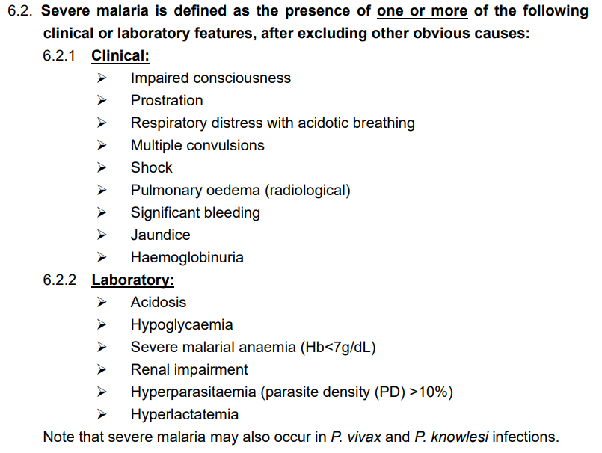

Slide 11
What is the first-line drug of choice for severe P. falciparum malaria in ED?

Slide 12
What is the first-line drug of choice for severe P. falciparum malaria in ED?
IV or IM Artesunate 2.4mg/kg
given on arrival (time = 0), then at 12h and 24h,
and then once daily until oral medication could be taken

Slide 13
The patient's level of consciousness deteriorates, and he has a seizure.
What is this complication called, and what is the immediate management step?

Slide 14
The patient's level of consciousness deteriorates, and he has a seizure.
What is this complication called, and what is the immediate management step?
Complication: Cerebral Malaria
Immediate Management
Secure airway (intubation if GCS < 8).
Administer anticonvulsants i.e. benzodiazepines
Correct hypoglycemia
Do NOT give steroids (they are harmful in cerebral malaria)
Maintain strict fluid balance
ICU disposal

Slide 15
If this patient were a pregnant lady i.e. 20 weeks gestation with uncomplicated P. falciparum malaria
What are the specific fetal / obstetric risks, and what is the recommended treatment?

Slide 16
If this patient were a pregnant lady i.e. 20 weeks gestation with uncomplicated P. falciparum malaria
what are the specific fetal / obstetric risks, and what is the recommended treatment?
Fetal/Obstetric risks:
Spontaneous miscarriage, stillbirth, preterm delivery, intrauterine growth restriction (IUGR), and low birth weight (LBW).
Placental malaria is a defining feature of P. falciparum in pregnancy, leading to chronic fetal hypoxia.

Slide 17
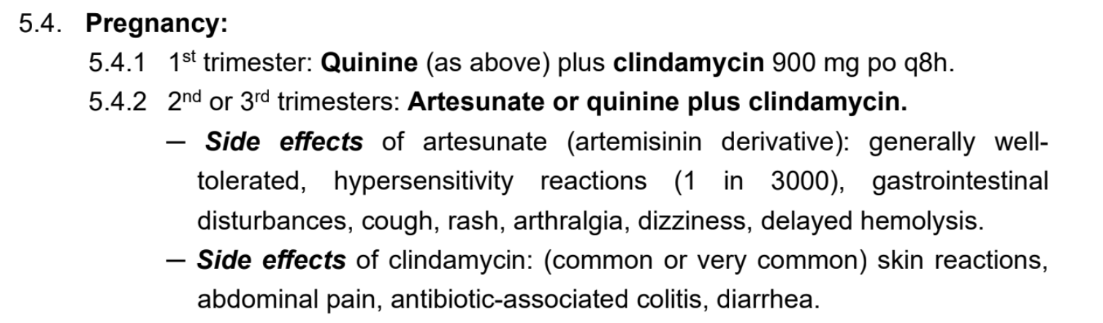
Avoid Doxycycline and Tetracycline: These are contraindicated in the second and third trimesters due to the risk of permanent tooth discoloration and inhibition of bone growth in the fetus.
Avoid Primaquine: Contraindicated in pregnancy due to the risk of hemolytic anemia in the fetus (G6PD status unknown) and the inability to rule out G6PD deficiency in the neonate.
Notes:
Historically, artemisinins were avoided in the first trimester due to animal embryotoxicity data; however, extensive human data in the second and third trimesters have confirmed they are safe, well-tolerated, and highly effective.

Slide 18
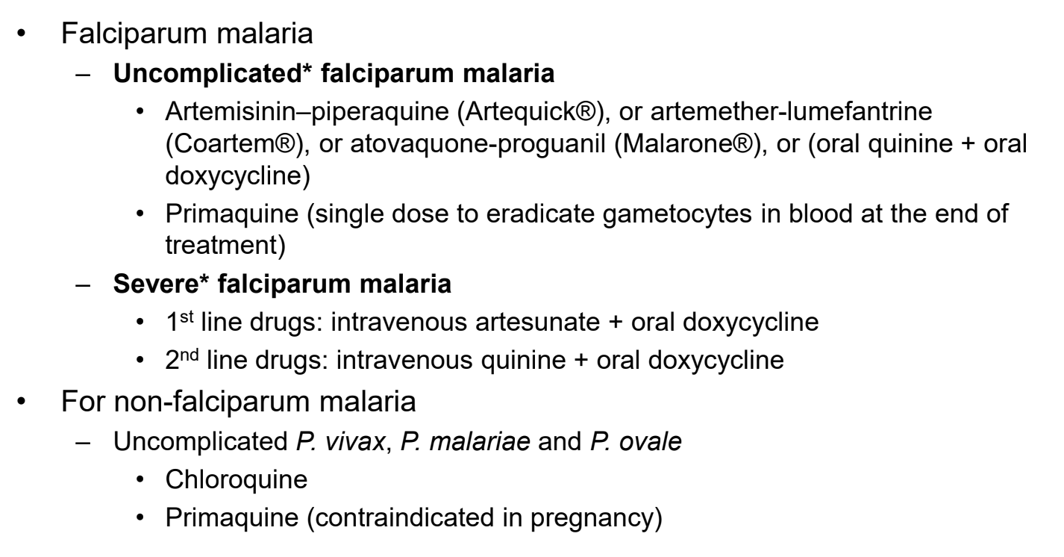

Slide 19
2. Pregnant lady
A 28-year-old pregnant woman, G1P0 at 18 weeks gestation, presents to the ED for counseling. She reports that her 3-year-old son was sent home from daycare yesterday with a fever of 38.5°C (101.3°F) and is now developing a rash. The daycare provider mentioned that several children in the same classroom have recently been ill with a rash. The patient is asymptomatic—she has no fever, no rash, no arthralgias, and feels well overall. Her prenatal course has been uncomplicated to date.
Vital Signs:
HR 82 bpm, BP 110/70 mmHg, RR 16 bpm, Temp 36.8°C (98.2°F), SpO2 100% on RA.
Physical Exam unremarkable
Well-appearing, no rash, no lymphadenopathy, oropharyngeal mucosa clear, joints without swelling or tenderness.
Fundal height consistent with 18 weeks gestation. Fetal heart tones via Doppler are 155 bpm and regular.

Slide 20
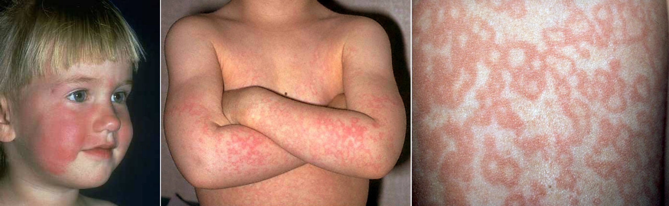
As for her son…

Slide 21
What is the most likely infectious diagnosis for her son?

Slide 22
What is the most likely infectious diagnosis for her son?
Fifth Disease (Erythema Infectiosum) caused by Parvovirus B19.
Facial erythema: Symmetrical, bright red rash sparing perioral area (“slapped cheek”)
Lacy body rash: Reticulated maculopapular rash starting on limbs, spreading to trunk
incubation period is typically 7–10 days
spreads through respiratory droplets
arthralgia or arthritis (more common in adult women)
mild constitutional symptoms (sore throat, cough, low fever)
rash usually fades without desquamation or pigmentation
recurrent rash: May recur for weeks/months triggered by sunlight, exercise, heat, or stress

Slide 23
List 4 ddx for “slapped cheek” rash

Slide 24
List 4 ddx for “slapped cheek” rash
Systemic Lupus Erythematosus (SLE): malar ("butterfly") rash. typically spares the nasolabial folds.
In a pregnant patient, distinguishing new-onset SLE from Parvovirus is critical, as SLE flare can mimic infection but requires immunosuppression rather than supportive care.
Erysipelas / Cellulitis: Unilateral, warm, tender, raised border. Unlike Fifth disease, this is bacterial and requires antibiotics
Kawasaki Disease: In pediatric cases, the rash is polymorphic, but the facial rash is less prominent; the key distinguishing features are conjunctival injection, cervical lymphadenopathy, and mucosal changes.
Viral exanthems
  Measles "3 Cs" (Cough, Coryza, Conjunctivitis), Koplik spots
  Rubella Post-auricular and suboccipital lymphadenopathy
  Roseola high fever for 3–5 days, followed by rash as fever breaks
  Enteroviruses (e.g. Echovirus, Coxsackievirus) Vesicular (hand-foot-mouth) or polymorphic
Notes:
Kawasaki, SLE, erysipelas/cellulitis, drug eruption

Slide 25
What is the primary maternal concern with Parvovirus B19 infection?

Slide 26
What is the primary maternal concern with Parvovirus B19 infection?
Maternal concern is generally mild (arthralgia/arthritis, fever, rash).
However, in pregnant women with underlying hematologic conditions (e.g., sickle cell disease, hereditary spherocytosis), Parvovirus B19 can cause transient aplastic crisis (severe anemia due to suppressed erythropoiesis).

Slide 27
What specific fetal complication is this infection associated with, particularly in the first half of pregnancy?

Slide 28
What specific fetal complication is this infection associated with, particularly in the first half of pregnancy?
Hydrops Fetalis
Mechanism: The virus infects fetal red blood cell precursors, causing severe anemia, high-output cardiac failure, and generalized edema.
Timing: Risk is highest when infection occurs before 20 weeks gestation (during active fetal erythropoiesis).

Slide 29
What is your management plan in the ED? List 4 specific steps.

Slide 30
What is your management plan in the ED? List 4 specific steps.
Confirm the diagnosis in the child: clinically diagnosed / lab confirmed
Determine infectious period exposure: Ask when the child had the rash. The child was infectious 10 days before the rash appeared until the day the rash started (once rash appears, they are no longer contagious).
Order maternal serology: Send Parvovirus B19 IgM and IgG.
IgM+, IgG- : Acute infection (highest risk).
IgM+, IgG+ : Recent infection (weeks ago).
IgM-, IgG+ : Past infection/immune (no risk).
IgM-, IgG- : Susceptible (repeat serology in 2-4 weeks to check for seroconversion).
Referral and Counseling: If acute infection is confirmed, counsel the patient regarding the 10% risk of fetal hydrops and consider admission / arrange urgent follow-up with early antenatal clinic for serial ultrasounds.

Slide 31
A few days later, the patient returns to the ED with severe headache and neck stiffness. What complication of her infection must now be considered?

Slide 32
A few days later, the patient returns to the ED with severe headache and neck stiffness. What complication of her infection must now be considered?
Aseptic Meningitis or Encephalitis
Rationale: Although rare, Parvovirus B19 is neurotropic and can cause central nervous system complications including meningitis, encephalitis, and seizures.

Slide 33
Is there any specific antiviral therapy or vaccine available for this condition?

Slide 34
Is there any specific antiviral therapy or vaccine available for this condition?
Specific antiviral therapy? No
Vaccine? No
Treatment:
Supportive care (antipyretics, analgesics).
In severe cases (aplastic crisis), IVIG (Intravenous Immunoglobulin) can be used in non-pregnant immunocompromised patients but is not standard in pregnancy.

Slide 35
3. The pustular rash
A 30-year-old male presents to the ED with a 5-day history of fever, chills, profound fatigue, and a rash that started on his face and has spread to his arms, legs, and trunk. He reports the lesions started as red macules, then became raised and firm, and are now pus-filled. He mentions new lesions are still appearing. He has no significant past medical history.
Vital Signs:
HR 110 bpm, BP 115/70 mmHg, RR 20 bpm, Temp 38.9°C (102.0°F), SpO2 96% on RA.
Physical Exam:
Alert and oriented.
Multiple firm, deep-seated, umbilicated pustules on an erythematous base on the face, trunk, and extremities.
Some lesions are crusted over.
He has significant, tender lymphadenopathy in the cervical and inguinal regions. Oropharynx is clear.

Slide 36
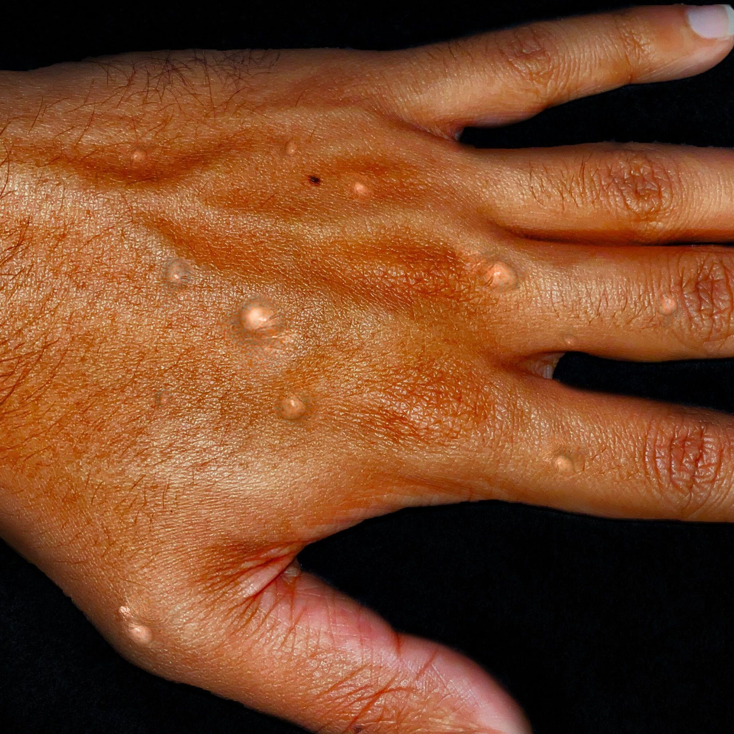
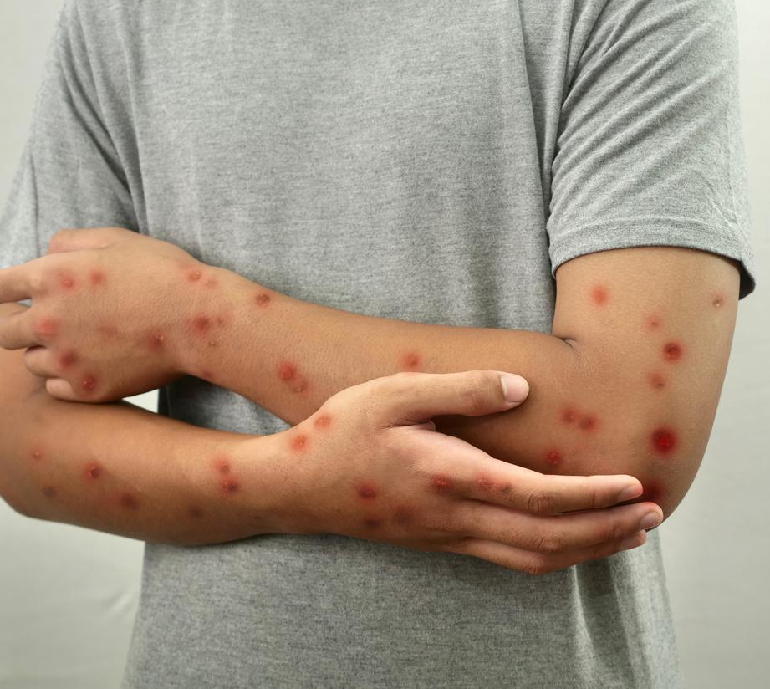

Slide 37
What is the most likely diagnosis?

Slide 38
What is the most likely diagnosis?
Diagnosis: Mpox (monkeypox)

Slide 39
What specific questions would you ask this patient to identify the likely mode of transmission and his risk profile?

Slide 40
What specific questions would you ask this patient to identify the likely mode of transmission and his risk profile?
Skin-to-skin, mouth-to-skin, or sexual contact (saliva/body fluids) with new / multiple partners in past 3/52
Contaminated objects (linen/clothing)?
Sharps injury / Tattoo parlors?
Recent travel?
Risks groups: MSM / multiple sexual partner, history of STI in past 12 months

Slide 41
What infection control precautions should be implemented immediately for this patient?

Slide 42
What infection control precautions should be implemented immediately for this patient?
Isolation: Single room, negative pressure if available.
Precautions: Contact + Droplet + Airborne
Staff should wear full personal protective equipment (PPE) which include a surgical respirator, a gown, eye protection (goggles or faceshield) and disposable gloves when collecting samples

Slide 43
Swab specimens just sent to Public Health Laboratory Services Branch (PHLSB) of CHP for testing by polymerase chain reaction (PCR) and electron microscopy (EM).
(For swabs, use sterile polyester or Dacron swab. Do not use wooden swab as it may cause PCR inhibition and false negative result. The swab should be sent dry by putting in a sterile container without viral transport medium.)

Slide 44
Mpox is now confirmed. The patient asks if this is the "severe" type. How would you explain the two clades and their typical severity?

Slide 45
Mpox is now confirmed. The patient asks if this is the "severe" type. How would you explain the two clades and their typical severity?
Clade I (Congo Basin): Traditionally more severe, higher mortality (historically ~10% in Africa, now 1-3%).
Clade II (West African): Less severe, caused 2022 global outbreak. Global case fatality rate is 0.2%.
Explanation: Current circulating strain is likely Clade IIb with low mortality, but severity depends on immune status and complications.

Slide 46
The patient asks if there is a cure.
What is the mainstay of treatment for most patients?

Slide 47
The patient asks if there is a cure. What is the mainstay of treatment for most patients?
Mainstay: Supportive care.
Components: Hydration, nutrition, pain management, treatment of secondary bacterial infections.
Rationale: Most cases from 2022-2023 outbreak were mild and recovered with supportive care alone.

Slide 48
4. For each of the following infections, please suggest the most appropriate empirical antibiotic regimen. For your chosen regimen, provide:
The rationale for your selection
The target bacteria (or likely pathogens)

Slide 49
A 24-year-old male presents to the emergency department with a 3-day history of acute-onset right knee pain, swelling, and inability to bear weight. He reports having unprotected sexual intercourse with a new female partner approximately 2 weeks ago. He denies any prior history of joint disease, trauma, or intravenous drug use. He has no other joint symptoms.
Vital Signs:
HR 102 bpm, BP 128/76 mmHg, RR 18 bpm, Temp 38.9°C (102.0°F), SpO2 99% on RA.
Physical Exam:
The right knee is markedly swollen, erythematous, warm, and tender to palpation. Range of motion is severely limited due to pain. There is no evidence of rash, urethral discharge, or conjunctival injection. The left knee and other joints are unremarkable.

Slide 50
Septic arthritis
IV Ceftiaxone if Neisseria gonorrhoeae or other gram -ve organisms suspected
Other common organisms: Staphaylococcus aureus, Group B streptococcus

Slide 51
A 45-year-old male with Child-Pugh B cirrhosis presents to the emergency department with severe pain and swelling of his left lower extremity. He reports that while fishing 48 hours ago, he sustained a small puncture wound to his calf from a fish fin. Over the past 24 hours, the pain has become excruciating, disproportionate to the physical findings. On examination, the affected area shows erythema, edema, warmth, and violaceous bullae with surrounding crepitus. He is febrile (39.2°C), tachycardic, and hypotensive.

Slide 52
Necrotising fasciitis following exposure to freshwater
Augmentin + levofloxacin
Aeromonas hydrophila / caviae, Vibrio vulnificus
Aeromonas spp. possess the chromosomal carbapenemase, CphA which could cause resistance to meropenem and many other beta-lactams.

Slide 53
A 28-year-old previously healthy male presents with a 2-day history of watery diarrhea, abdominal cramping, and low-grade fever. He returned today from a 1-week business trip to Mexico, where he consumed food from local street vendors. He reports having 6–8 loose, non-bloody stools per day. He feels nauseated but has not vomited. He has no significant past medical history and no drug allergies.

Slide 54
Traveller’s diarrhoea
PO Azithromycin
Enterotoxigenic Escherichia coli (ETEC) and Enteroaggregative Escherichia coli (EAEC), Shigella spp., Salmonella, Campylobacter spp., rarely Aeromonas spp.,
Fluoroquinolone resistance is very high in Campylobacter and is also on the rise in Salmonella.

Slide 55
A 22-year-old sexually active female presents with a 4-day history of dull lower abdominal pain, abnormal vaginal discharge, and low-grade fever. She has no history of prior pelvic infections or intrauterine device (IUD) use. She denies pregnancy, vomiting, or severe pain.
Vital Signs:
HR 88 bpm, BP 118/74 mmHg, RR 16 bpm, Temp 37.8°C
Physical Exam:
Abdomen: mild suprapubic tenderness, no guarding or rebound
Pelvic exam: cervical motion tenderness present, uterine tenderness on bimanual examination, mild adnexal tenderness bilaterally
No evidence of tubo-ovarian abscess or peritoneal signs
Mucopurulent cervical discharge noted

Slide 56
Mild to moderate pelvic inflammatory disease
Ceftriaxone 250 mg IM once (covers N. gonorrhoeae)
Doxycycline 100 mg PO twice daily for 14 days (covers C. trachomatis)
Metronidazole 500 mg PO twice daily for 14 days (covers anaerobes and bacterial vaginosis-associated organisms)

Slide 57
A 58-year-old female with a history of type 2 diabetes mellitus presents to the emergency department with a 2-day history of fevers, chills, left flank pain, nausea, and dysuria.
Vital Signs:
HR 112 bpm, BP 102/68 mmHg, RR 20 bpm, Temp 39.2°C (102.6°F), SpO2 96% on RA
Physical Exam:
Ill-appearing, tachycardic, mild hypotension. Left costovertebral angle tenderness is present. Abdomen is soft, non-distended, with no guarding or rebound.

Slide 58
Acute pyelonephritis
IV Augmentin
Enterobacterales e.g. E.coli, Klebsiella
Enterococcus
IV Tazocin (Piperacillin-tazobactam) if PsA suspected for catheter-related, obstructive uropathy or transplant
IV Meropenem if ESBL-producing organisms suspected

Slide 59
A 50-year-old female with a history of bronchiectasis presents to the emergency department with a 3-day history of worsening cough, increased sputum production, fevers, and progressive dyspnea. She reports that her usual sputum is mucoid, but over the past 2 days it has become thick, green, and purulent. She has had two prior hospitalizations in the past year for infective exacerbations of bronchiectasis. Sputum cultures from her last admission grew Pseudomonas aeruginosa.
Vital Signs:
HR 118 bpm, BP 108/70 mmHg, RR 26 bpm, Temp 38.9°C (102.0°F), SpO2 88% on room air, requiring 6L nasal cannula to maintain SpO2 92%

Slide 60
CAP to be hospitalised
IV Tazocin (Piperacillin-tazobactam) + PO doxycycline
PsA, Streptococcus pneumoniae, Haemophilus influenzae, Mycoplasma pneumoniae, Chlamydia pneumoniae
Local prevalence of macrolide-resistant Mycoplasma pneumoniae (MRMP) >40%, hence doxycycline is the preferred atypical coverage for younger hospitalised patients in general wards.

Slide 61
5. VHF risk assessment
Presentation: A 45-year-old aid worker who just returned from a village in the Democratic Republic of Congo 4 days ago presents to the ED with a high fever, severe fatigue, and vomiting.
Vital Signs:
HR 134 bpm, BP 88/50 mmHg, RR 26 bpm, Temp 39.4°C (102.9°F), SpO2 94% on RA.
Physical Exam:
Appears toxic, lethargic but arousable. Conjunctival injection is noted. No obvious bleeding at this time. Abdomen is tender diffusely without rigidity. Skin is warm.

Slide 62
Based on the case detection criteria, does this patient meet the definition of a suspect VHF case? List three VHFs of concern in Hong Kong.

Slide 63
Based on the case detection criteria, does this patient meet the definition of a suspect VHF case? List three VHFs of concern in Hong Kong
Yes. He has compatible symptoms (fever, fatigue, vomiting) AND epidemiological criteria (travel to DRC, an affected area, within 21 days).
VHFs of concern in Hong Kong: Ebola, Marburg, Lassa fever, Crimean-Congo hemorrhagic fever (CCHF).

Slide 64
Mode of transmission
Vector borne
  Dengue, Yellow fever and CCHF (mosquito/tick)
Zoonosis
  contact with dead or lively infected animals
Secondary human to human transmission
  direct contact with contaminated blood or body fluids via mucous membrane and skin exposure
Airborne transmission has not been documented but cannot be excluded. Aerosol spread is not a predominant mode of transmission if it occurs at all.

Slide 65
According to the guideline, what isolation room is required?
What specific PPE should staff wear when entering the patient's room?

Slide 66
According to the guideline, what isolation room is required?
What specific PPE should staff wear when entering the patient's room?
Isolation Room: Airborne Infection Isolation Room (AIIR) with negative pressure.
PPE Required:
N95 respirator (with seal check)
eye protection
double pairs of long nitrile gloves
water-resistant gown
full-length shoe covers/boots, and
water-resistant hood.

Slide 67
Upon suspecting VHF, what are your immediate reporting duties? Where should this patient be transferred, and what condition should be excluded as far as possible before transfer?

Slide 68
Upon suspecting VHF, what are your immediate reporting duties? Where should this patient be transferred, and what condition should be excluded as far as possible before transfer?
Reporting: Report immediately to Hospital Infection Control Team, notify through NDORS, and call MCO of CHP and HA HODO.
Transfer: To HA Infectious Disease Centre (IDC) at Princess Margaret Hospital.
Exclude before transfer: Critical non-VHF differentials i.e. Malaria and bacterial sepsis (most common causes of travel-related fever).

Slide 69
You need to order blood tests. What essential investigations are permitted? How should specimens be transported to the lab, and what method is prohibited?

Slide 70
You need to order blood tests. What essential investigations are permitted? How should specimens be transported to the lab, and what method is prohibited?
Permitted essential tests
Malaria blood smear, blood culture, CBC, coagulation profile, critical biochemical tests.
Transport
Specimens in sealed plastic bags
placed in durable leak-proof container, and delivered to lab in person.
Prohibited: Pneumatic tube transport system must NOT be used.

Slide 71
Unfortunately, the patient deteriorates rapidly and is certified dead in the AED. According to the guideline, how should the dead body be handled? What Category applies? Is autopsy recommended?

Slide 72
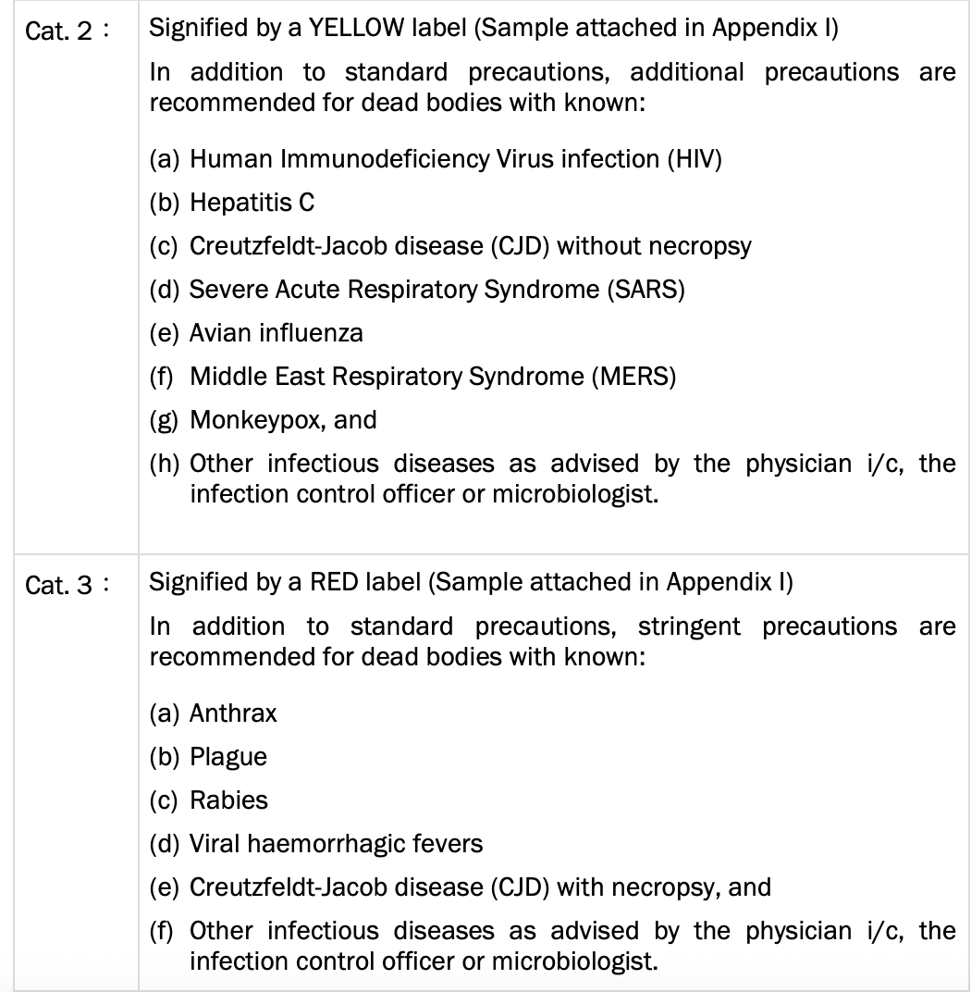
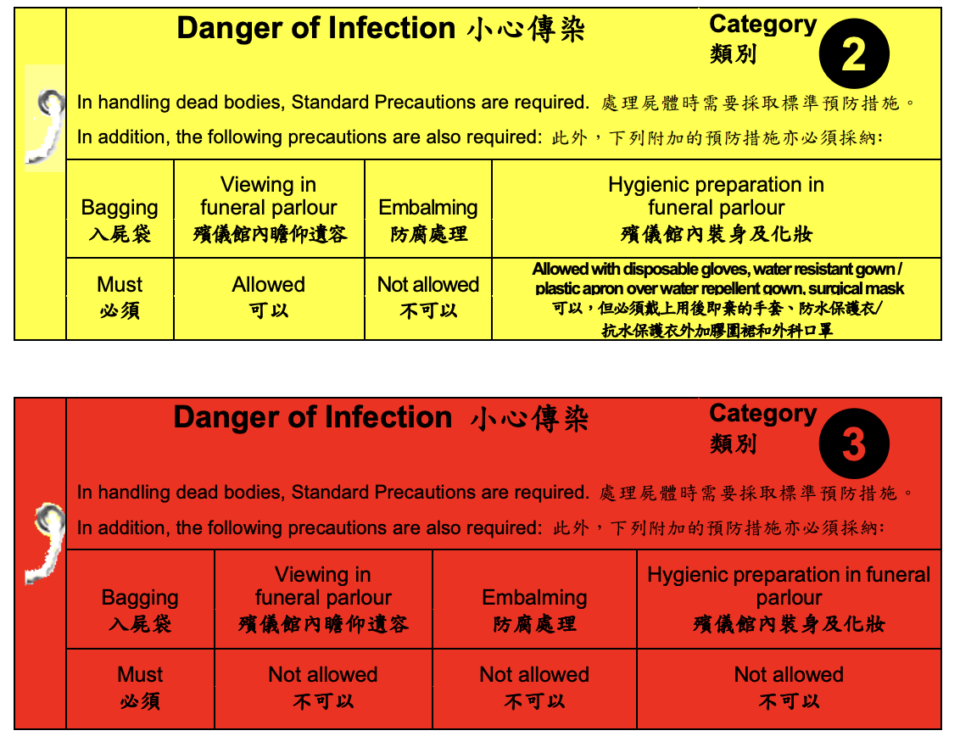

Slide 73
Unfortunately, the patient deteriorates rapidly and is certified dead in the AED. According to the guideline, how should the dead body be handled? What Category applies? Is autopsy recommended?
Body Handling: Handle as Category 3 precautions.
Disposition: Body should not be embalmed and must be cremated promptly.
Autopsy: Not recommended for confirmed VHF cases. If diagnosis unconfirmed, limited autopsy or percutaneous biopsy may be considered on a case-by-case basis with special arrangement with Department of Pathology.

Slide 74
During resuscitation, there is a large spillage of blood on the floor.
How should this be managed? What disinfectant concentration is required?

Slide 75
During resuscitation, there is a large spillage of blood on the floor.
How should this be managed? What disinfectant concentration is required?
Immediate action: Decontaminate immediately or as soon as possible.
Disinfectant: Use sodium hypochlorite 1:4 (10,000 ppm) for blood/body fluid spills.
General cleaning: For routine environmental decontamination, use sodium hypochlorite 1:49 (1000 ppm).

Slide 76
What is the mainstay of treatment for most VHFs? Is there any specific antiviral available for Ebola, and is it available in Hong Kong? What is the surveillance period for close contacts?

Slide 77
What is the mainstay of treatment for most VHFs? Is there any specific antiviral available for Ebola, and is it available in Hong Kong? What is the surveillance period for close contacts?
Mainstay treatment: Supportive care.
Ebola antiviral: Inmazeb (combination of monoclonal antibodies) is FDA-approved but not available in Hong Kong.
Ribavirin: May be effective for Lassa fever and CCHF, but not for Ebola or Marburg.
Contact surveillance: 21 days from last date of exposure.

Slide 78
Thank you!

