Slide 1
JCM OSCE
POH AED
5/2026
Dr Ricky Kam
Dr Susan Wong

Slide 2
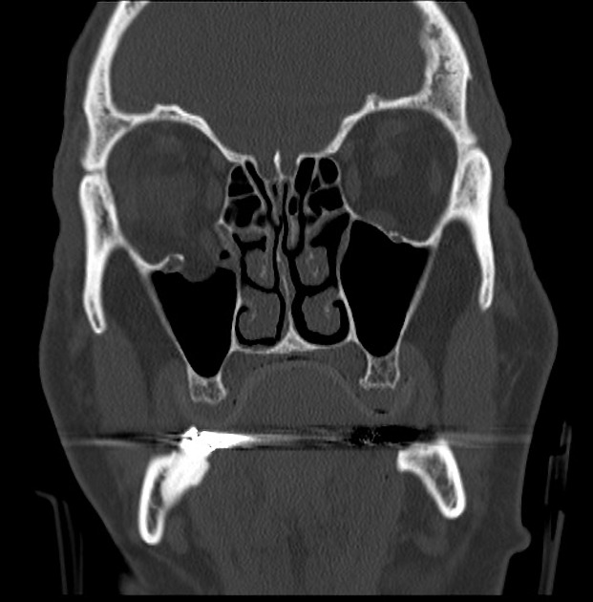
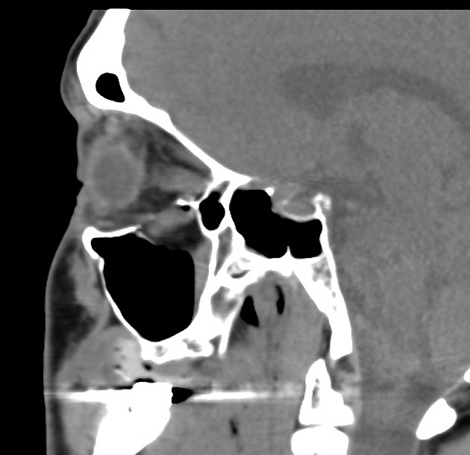
Case 1
A 50 year male had his face being hit by a metal rod while working. He complained of right eye pain after injury.
CT orbit was done:

Slide 3
Question 1
Give 2 CT findings. What is your diagnosis?

Slide 4
Question 1
Fracture right inferior orbital wall
Inferior rectus protrude from the fracture
Diagnosis: Right inferior blow out fracture with inferior rectus entrapment

Slide 5
Question 2
Give 3 examinations you will perform.

Slide 6
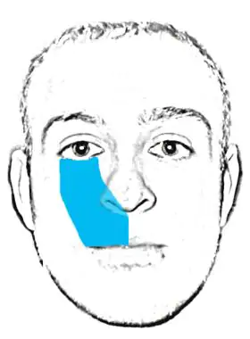
Question 2
Check for the extraocular movement
Check for the facial sensation
  Infraorbital anesthesia
  Due to injury to Maxillary Branch of Trigeminal Nerve (V2)
Check for visual acuity/ eye exam

Slide 7
Question 3
What is your management? And what advise will you give to patients?

Slide 8
Question 3
Urgent consult eye
Antibiotic
Analgesic
Avoid nose blowing

Slide 9
Question 4
The patient was noted to have bradycardia and hypotension. What is the possible cause?

Slide 10
Question 4
It can be due to the oculocardiac reflex: reduction of the heart rate resulting from direct pressure placed on the extraocular muscles (EOM), globe, or conjunctiva.
The reflex is mediated by the connection between the ophthalmic branch of the trigeminal nerve and the vagus nerve.
ddx vasovagal

Slide 11
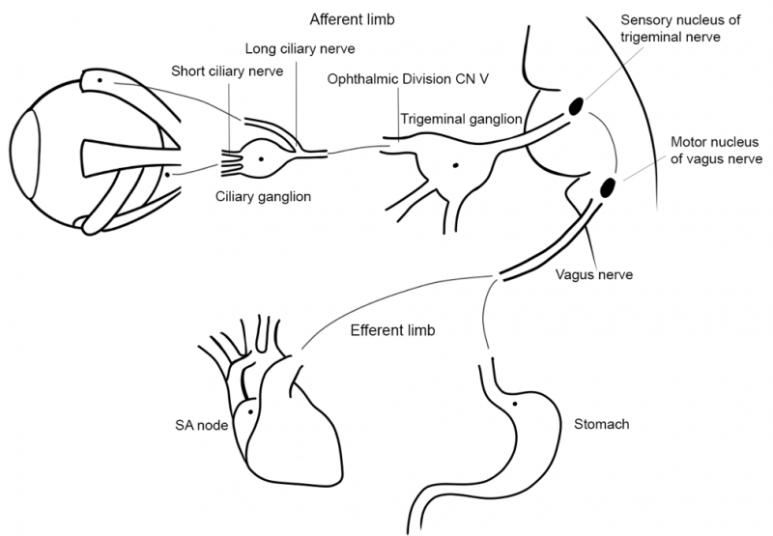

Slide 12
Question 5
What is trapdoor fracture?

Slide 13
Question 5
A trapdoor fracture is a fracture of the orbital floor where the inferiorly displaced blowout fracture recoils back to its original position and potentially entraps contents of the orbit.
It is seen in children and young adults due to the elasticity of the orbital floor. These fractures may be subtle and are associated with a high risk of tissue entrapment.

Slide 14
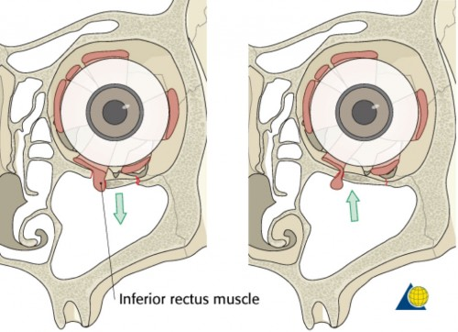

Slide 15
Question 6
What are the indications of surgical management in orbital fracture?

Slide 16
Question 6
Persistent Diplopia: Disabling double vision within 30 degrees of primary gaze that does not improve after 2–3 weeks.
Significant Enophthalmos: Eye displacement of 2mm (usually assessed after edema reduces, around 10–14 days).
Muscle Entrapment: Entrapment of the orbital contents (e.g., inferior rectus) evidenced by restricted eye movement, pain, and positive forced duction test.
Large Defect Size: Fractures involving >50% of the orbital floor or a volume increase greater than 10-15%.
Emergency/Urgent: Trapdoor fractures in children (often with minimal displacement) or oculocardiac reflex (bradycardia, nausea) due to muscle entrapment.

Slide 17
Case 2
A 30-year-old lady, presented to AED for on and off fever for 2 weeks with neck lymphadenopathy.
  Vitals are stable
  Temp 38.5
  SpO2 99% RA

Slide 18
Question 1
What are the differential diagnoses for prolonged fever and lymphadenopathy?

Slide 19
Question 1
Infectious causes:
  Viral:
    Infectious Mononucleosis: (EBV or CMV, Acute HIV Infection:Viral Hepatitis, Rubella, or Mumps.
  Bacterial:
    Tuberculosis, Secondary Syphilis, Cat-Scratch Disease: (Bartonella henselae)
  Parasitic/Fungal:
    Toxoplasmosis, Histoplasmosis or Coccidioidomycosis
Non‑infectious causes:
  Malignancies:
    Hematological Malignancies:
      Lymphoma, Leukemias.
    Metastatic Disease: Solid tumors (e.g., lung, breast, or head and neck cancers) spreading to regional nodes.
  Autoimmune & Inflammatory Causes
    Systemic Lupus Erythematosus (SLE), Rheumatoid Arthritis (RA), Sarcoidosis:
  Drugs: phenoytoin

Slide 20
Question 2
CXR was clear
Blood test was done in AED:
WCC: 100 x 10⁹/L, Hb: 8.0g/dL Platelet: 60 x 10⁹/L
What specific cells would you look for on the smear to differentiate between a leukemoid reaction and acute leukemia?

Slide 21
Question 2
A leukemoid reaction is a benign, extreme increase in white blood cell count (usually >50,000/µL) that mimics leukemia but is triggered by non-cancerous conditions like severe infection, inflammation, or massive tissue damage. It represents a reactive, temporary response where the bone marrow releases immature cells
"Left Shift“ in leukemoid reaction: A high percentage of immature neutrophils (band cells, metamyelocytes, myelocytes) are present in the blood, but rarely fully developed blast cells. It shows a full spectrum of myeloid maturation
Significant present of blast cells suggest leukemia. It exhibits Leukaemic Gap, which contain many blasts and some mature neutrophils instead of intermediate stages

Slide 22
Question 3
Which tool, pulse oximetry or arterial pO2, more accurate assessment of O2 saturation?

Slide 23
Question 3
Pulse oximetry provide a more accurate assessment of O2 saturation than arterial pO2.
Because arterial pO2 can be falsely decreased because of enhanced metabolic activities from the malignant cell.
This is called ‘Spurious Hypoxemia’

Slide 24
Question 4
What is your immediate management plan?

Slide 25
Question 4
IVF
Antibiotic
Admit to medical ward for cytoreduction/ treatment

Slide 26
Question 5
What are the possible complications?

Slide 27
Question 5
Leukostasis, including:
  Neurological: ischemic or haemorrhagic stroke
  Pulmonary: acute pulmonary failure, diffuse alveolar haemorrhage
  Cardiovascular: myocardial ischemia
  Renal: renal failure
  Priapism
  Bowel ischemia
Tumor lysis syndrome
DIC

Slide 28
Question 6
If the patient complain of blurring of vision, what would be the physical finding?

Slide 29
Question 6
Retinal vein tortuosity (sausage-like): due to the sluggish, high-viscosity blood flow.
Retinal haemorrhage/ flame shaped haemorrhage
Roth spot
Infiltrates: Cotton wool spots and white leukemic infiltrates.
Visual symptoms are a strong predictor of impending CNS disaster

Slide 30
Case 3
You are working in AED without Obstetric/paediatrics support.
A 28-year-old primiparous woman, singleton pregnancy, delivered vaginally just before AED arrival. She was noted to have a sudden, heavy vaginal bleeding (~1500 mL) upon arrival.
  BP 80/60
  Pulse 120
  RR 24
  SpO2 95% on RA
The new-born baby is stable (Apgar 10).

Slide 31
Question 1
What is the maternal diagnosis? What is the classic definition of this diagnosis?

Slide 32
Question 1
Primary postpartum haemorrhage (PPH)
  Traditionally defined as blood loss ≥500 mL after vaginal delivery or ≥1000 mL after Cesarean section within 24 hours after delivery.
  WHO: Blood loss ≥500ml; severe PPH if ≥1000mL
  ACOG: Cumulative blood loss ≥1000mL / any volume accompanied by s/s of hypovolaemia
  RCOG: minor 500-1000mL; major >1000mL (moderate 1001-2000mL; severe >2000mL)

Slide 33
Question 2
Name a bedside tool that can help detect coagulopathy.
What can be concluded in this test?

Slide 34
Question 2
ROTEM (rotational thromboelastometry)/ TEG (Thromboelastography)
Diagnosis of coagulopathy induced by low fibrinogen or hyperfibrinolysis, guiding the use of blood products +/- tranexamic acid

Slide 35
Question 3
List the emergency pharmacological treatments in AED.

Slide 36
Question 3
Oxytocin IV (First-Line) 5-10 units slow IV over 1-2 minutes+/-additional dose & maintenance at a rate ≤40unites/hour
  Binds oxytocin receptors on uterine smooth muscle, trigger release of intracellular calcium to stimulate upper segment contractions.
Ergometrine IM 0.2mg
  An ergot alkaloid that stimulates alpha-adrenergic, dopaminergic, and serotonergic receptors, producing sustained tetanic uterine contractions.
  Causes peripheral vasoconstriction. Contraindicated in hypertension/pre-eclampsia.
Carboprost IM (Hemabate) 0.25mg every 15-90mins up to 2mg
  A synthetic prostaglandin F2α​ analogue that increases intracellular calcium to provoke strong myometrial contractions.
  Causes bronchoconstriction. Contraindicated in severe asthma.
Tranexamic Acid (TXA) IV 1g over 10 mins +/- repeat
  A competitive inhibitor of plasminogen activation to preserve fibrin clots.
Misoprostol SL/PO/PR 400-800mcg
  A synthetic prostaglandin E1​ analogue. Binds to myometrial EP2/EP3 receptors to stimulate contractions.

Slide 37
Question 4
Besides pharmacological management, what other measures can be done?

Slide 38
Question 4
Resuscitation: Secure two large-bore IVs. Transfuse packed cells to stabilize vitals. Permissive hypotension using blood products rather than excessive crystalloids to avoid dilutional coagulopathy.
Tamponade: Insert intrauterine balloon or maintain bimanual compression during the transport.
Warming: Aggressive use of warm blankets and fluids to avoid the triad of death (hypothermia, coagulopathy, acidosis).

Slide 39
Question 5
Since there is no Obstetric/Neonatal support, can the mother and baby travel together in one ambulance? Why or why not?

Slide 40
Question 5
No.
They are two separate patients requiring close monitoring +/- resuscitation, which requiring separate monitoring/personnel.

Slide 41
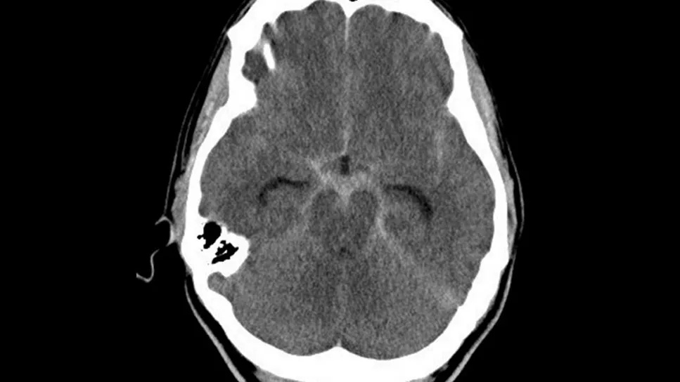
Case 4
You are working in AED without Neurosurgical support.
A 55-year-old male with a "thunderclap" headache.
BP 190/110, Pulse 110
GCS declining
CT was done:

Slide 42
Question 1
Describe the CT imaging. What is your provisional diagnosis?

Slide 43
Question 1
Hyperdensity of basal cisterns with dilatation of temporal horn of lateral ventricles, suggestive of acute subarachnoid haemorrhage

Slide 44
Question 2
Describe the typical diagnostic algorithm for your answer when the initial non-contrast CT brain is negative (besides repeating CT/MRI)

Slide 45
Question 2
Traditional "gold standard" remains a Lumbar Puncture to look for xanthochromia or non-clearing RBCs.
If CT is negative within 6 hours (high sensitivity) since onset, some protocols allow for discharge (Rule of sixes)

Slide 46
Question 3
You decided to intubate the patient due to deteriorating GCS and transfer to tertiary hospital.
During the Rapid Sequence Intubation (RSI) for this patient, describe the preferred pre-treatments and induction agents with their physiological rationales.

Slide 47
Question 3
Pre-treatments 1: Fentanyl
  blunts sympathetic surge and catecholamine release caused by airway manipulation
Pre-treatments 2: Lignocaine
  blunts the cough and gag reflex which mitigates the risk of ICP spikes.
Use of induction agents: Propofol / Thiopental
  reduce cerebral blood flow (CBF) and the cerebral metabolic rate for oxygen, actively lowering ICP and providing a potent neuroprotective effect.

Slide 48
Question 4
What can be done in AED to reduce ICP and provide neuro-protection while awaiting transfer?

Slide 49
Question 4
Positioning
  Head of bed to 30° (venous drainage); neck midline (neutral).
Ventilation
  Slight hyperventilation (etCO2​ 30–35 mmHg) to induce cerebral vasoconstriction.
Hyperosmolar Therapy
  Mannitol (osmotic diuresis) or
  Hypertonic Saline (pulls water from parenchyma while maintaining MAP).
Deep Sedation
  Reduces cerebral metabolic rate and prevents "bucking" the vent.
Temperature Control
  Aggressively treat fevers with antipyretics and cooling measures, as hyperthermia increases cerebral metabolism and worsens ICP.

Slide 50
Question 5
The patient is now intubated and requires escort to NS unit in another hospital. What medications should you prepare for transfer, and briefly explain the rationale?

Slide 51
Question 5
IV Antihypertensives (e.g. Nicardipine/ Labetalol)
  To maintain SBP < 160 mmHg to prevent re-bleeding.
Sedatives/Paralytics (e.g. Midazolam/ Propofol/ Rocuronium)
  To maintain neuro-protection and patient-ventilator synchrony over rough roads.
Analgesia
  Fentanyl / Morphine infusion to reduce pain and anxiety

Slide 52
Question 6
You need to escort the patient to NS unit. During the 20-minute ambulance journey, the ventilator high-pressure alarm sounds. The patient’s SpO2 drops from 98% to 84%.
What are the possible causes and what can be done while you are on ambulance?

Slide 53
Question 6
Causes: DOPES
  Dislodgement
  Obstruction
  Pneumothorax
  Equipment
  Stacked Breaths
Management: DOTTS
  Disconnect
  Oxygen with BMV
  Tube check
  Tweak the ventilator
  Sonography, suction

Slide 54
Question 7
Bibasal crepitations were noted with SpO2 at 85%. The remainder of the examination was unremarkable.
What would be the possible diagnosis? How would you do?

Slide 55
Question 7
Neurogenic pulmonary edema.
Add PEEP to the ventilator if have
To the nearest AED if still have desaturation

Slide 56
Case 5
A 45-year-old man was rescued from a house fire. He was unconscious.
  BP 100/60
  Pulse 110
  SpO2 92% high flow O2

Slide 57
Question 1
What possible conditions you should consider in this patient? Name 4.

Slide 58
Question 1
CO poisoning
Cyanide (CN) Poisoning
Inhalation Injury
Blast injury / trauma
Direct Thermal Burns
Hyperthermia

Slide 59
Question 2
What blood tests would you do and what you would like to look for?

Slide 60
Question 2
Blood gas: any type of acidosis, abnormally high SvO2, narrowed AV oxygen gap
CO-Hb: CO poisoning
Lactate: very high lactate to look for cyanide poisoning
Troponin: myocardial injury
Creatine kinase: rhabdomyolysis by crush injury
Random glucose: hypoglycaemia
Hb level: Internal bleeding
Other baseline blood: CBC/LRFT

Slide 61
Question 3
There was no burn or external injury.
He remained unconscious and intubation was done.
Blood gas: metabolic acidosis
Lactate: 5
CO-Hb: 50
He was suspected to have CO poisoning.

Slide 62
Question 3
Describe the pathophysiology of Carbon Monoxide (CO) poisoning.

Slide 63
Question 3
Pathophysiology of CO poisoning:
CO binds to hemoglobin with 250x affinity compared to oxygen, displacing O2​ and shifting the dissociation curve to the left (preventing O2​ release to tissues), decrease the O2 delivery to tissue
CO binds to mitochondrial cytochrome oxidase, impair mitochondrial utilization of oxygen
CO binds of myoglobin which impairs tissue oxygen delivery, causing myocardial and skeletal muscle hypoxia
CO induces inflammation through lipid peroxidation, which lead to delayed neurological sequelae even after the gas is cleared.

Slide 64
Question 4
List the specific clinical and laboratory indications for Hyperbaric Oxygen Therapy (HBOT).

Slide 65
Question 4
COHb level >25% (>15% in pregnancy).
Any history of loss of consciousness.
Neurological deficits (coma, confusion, or seizures).
Evidence of myocardial ischemia.

Slide 66
Question 5
What essential physical and medical pre-treatments must be completed before this patient enters the hyperbaric chamber?

Slide 67
Question 5
Bilateral Myringotomies: To prevent middle ear barotrauma in patients unable to equalize pressure.
CXR to rule out undrained pneumothorax (which would expand fatally during decompression).
ET Tube Cuff: Replace air with saline (liquid is non-compressible).
Sedation: To prevent seizures (HBOT lowers seizure threshold).

Slide 68
Question 6
After intubation, the blood pressure dropped to 80/40mmHg.
What are the possible differential diagnosis for his hypotension?

Slide 69
Question 6
Anaphylaxis: Reaction to RSI drugs (e.g., Rocuronium)
Sympatholysis: Loss of catecholamine drive due to sedatives
Tension Pneumothorax: PPV converting an occult lung injury
Decreased venous return: PPV increasing intrathoracic pressure reducing preload
Cyanide/CO Cardiotoxicity: Severe poisoning causes direct myocardial depression that is unmasked by sedation.
Hypovolemia: Hidden fluid loss from burns or trauma.

Slide 70
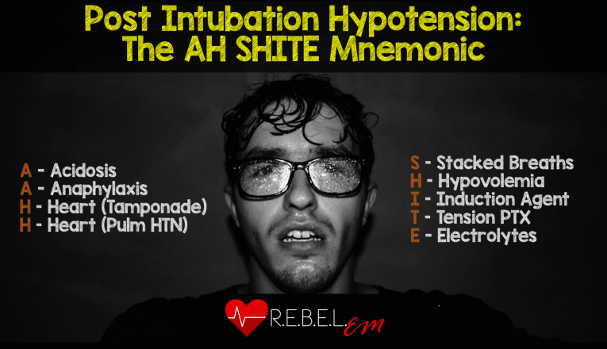

Slide 71
Question 7
Another patient rescued from same fire scene, noted to have circumferential full thickness burn over the chest wall. He was also successfully intubated. However, the SpO2 remains ~90% on FiO2 1.0 and high-pressure alarm ringed up all along.
What action should be taken to improve patient’s ventilation?

Slide 72
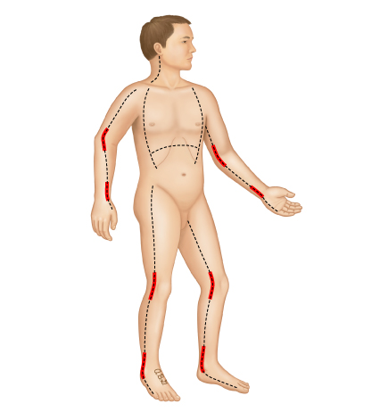
Question 7
chest wall escharotomy

Slide 73
Thank you!

